Slide 1

Presentation on Linked List By Mehedi Hasan ID : 18CSE062
Department of Computer Science & Engineering
Bangabandhu Sheikh Mujibur Rahman Science & Technology University , Gopalgonj – 8100.

Slide 2
Introduction to Data Structure

Slide 3
Basic Terminologies
Data Structure:
-> Data means “A set of information “and structure means ”A way of organizing data” So data structure means A way of organizing
data in such a way so that it can be easier to use .
-> A Data structure is a particular way of Organizing data in computer
so that it can be used efficiently .
-> A Data structure is the concept of set of algorithms
use to structure the information .

Slide 4
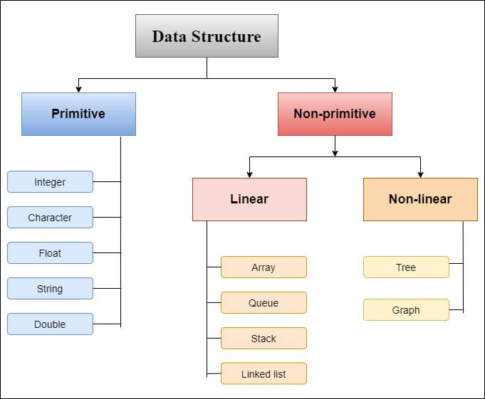
Classification of Data Structure

Slide 5

Linked List
A linked list is a linear data structure
Linked list is a collection of elements called nodes.
Each node contains two parts. they are data part and link part.
Node:
The data contains elements
Link contains address of another node.

Slide 6
Types of Linked List
Linked List
Single Linked List
Circular Linked List
Double Linked List
Circular Linked List

Slide 7
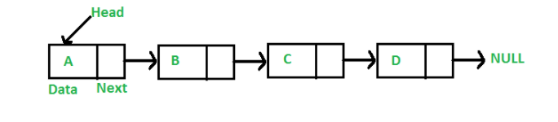
Single Linked List
A single linked list is one in which all nodes are linked together in some sequential manner .
Graphical Representation of Single Linked List

Slide 8
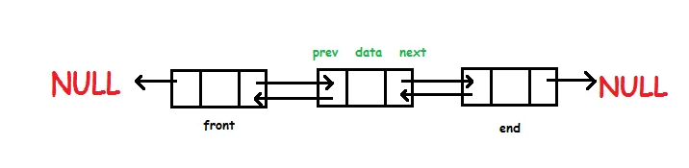
Double Linked List
Doubly linked list is a type of linked list in which each node has two links. The first link points to the previous node in the list and the second link points to the next node in the list. The first node of the list has its previous link pointing to NULL similarly the last node of the list has its next node pointing to NULL.
Graphical Representation of Single Linked List

Slide 9
Linked List Operations
Linked List Operations
Insertion
Deletion
Search
Sort
Traversal

Slide 10

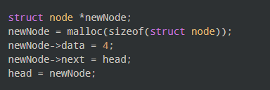
Insertion of a Linked List
We can add elements to either the beginning, middle or end of the linked list.
1. Insert at the beginning
Allocate memory for new node
Store data
Change next of new node to point to head
Change head to point to recently created node

Slide 11
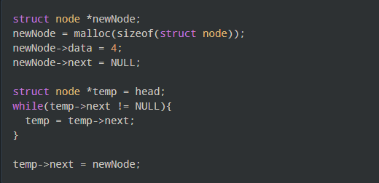
Insertion of a Linked List
2. Insert at the end
Allocate memory for new node
Store data
Traverse to last node
Change next of last node to recently created node

Slide 12
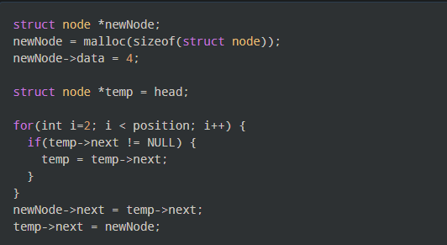
Insertion of a Linked List
3. Insert at the middle
Allocate memory and store data for new node
Traverse to node just before the required position of new node
Change next pointers to include new node in between

Slide 13
Deletion of a Linked List
We can delete either from the the beginning, middle or end of the linked list.
1. Delete from beginning
Point head to the second node

Slide 14
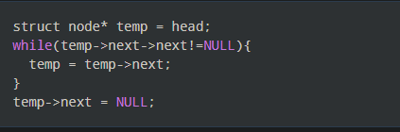
Insertion of a Linked List
2. Delete from end
Traverse to second last element
Change its next pointer to null

Slide 15
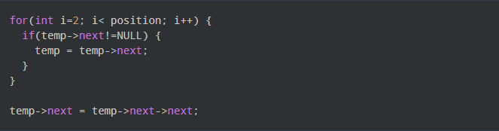
Insertion of a Linked List
3. Delete from middle
Traverse to element before the element to be deleted
Change next pointers to exclude the node from the chain

Slide 16
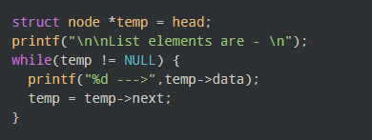
Traverse on a Linked List
Displaying the contents of a linked list is
very simple. We keep moving the temp
node to the next one and display
its contents.
When temp is NULL, we know
that we have reached the end
of the linked
list so we get out of the while loop. Traverse Code

Slide 17

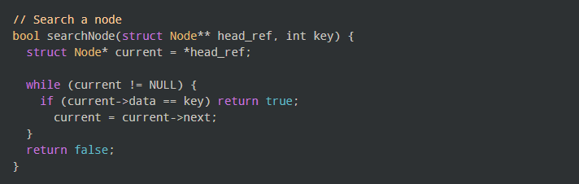
Search on a Linked List
We can search an element on a linked list using a loop using the following steps. We are finding item on a linked list.
Make head as the current node.
Run a loop until the current node is NULL because the last element points to NULL.
In each iteration, check if the key of the node is equal to item. If it the key matches the item, return true otherwise return false.

Slide 18
Time and Space Complexity
=> Time And Space :
Insertion - O(1).
Search - O(n).
Deletion - O(1).
Space-O(n).

Slide 19


Thank You Everyone

