Slide 1


Roth Peranson Algorithm SEMINAR PRESENTATION
MOJAMMIL
157238
COMPUTER SCIENCE ENGINEERING DEPARTMENT
NIT WARANGAL

Slide 2
Topics to be covered
Introduction to the Algorithm
Working of the Algorithm
It’s application in day to day life
It’s importance in the medical field

Slide 3
Introduction
The problem of matching residency programs with applicants is basically a generalization of the stable marriage problem in computer science, which is the problem of trying to find stable pairings between two sets of people (i.e., men and women who want to get married). A set of pairings is considered stable if there is no pair that prefers each other to their assigned matches. In other words, we don’t want any two people to have the incentive to elope. Each person creates a preference list, ranking the members of the other set from most preferred to least preferred, and these lists are used to calculate stable matches.
In 1962, David Gale and Lloyd Shapley published an algorithm to solve the stable marriage problem.

Slide 4
Algorithm Working
The algorithm works by a number of “rounds”. The process begins with each member of one group—say, the women— “proposing” to the member of the other group—in this case, the man—that she likes best. Each man then reviews the proposals he received, tentatively holds on to the best proposal and rejects the rest. In the next round, the rejected women propose to their next best choice, and the men again retain the best proposal and reject the rest. This process continues until there are no more women left to propose, at which point the men accept the best proposals among those they’ve held onto. Assuming an equal number of men and women in the problem, everyone will have been paired up. Gale and Shapley proved mathematically that the matches created by this method would always be stable. This method is called “deferred acceptance”.

Slide 5
In our example, it might seem that the men are at an advantage, but actually, it’s the group that does the proposing that is preferred by the algorithm. While the algorithm always finds matches that are stable, there is a tradeoff between whether the men always get their optimal woman, or the women always get their optimal man. This is why the algorithm takes either a male-optimal or female-optimal form. We can also show mathematically that the male-optimal form is also the female-pessimal form, and vice versa. In practical application, the difference between the two is found to be small, though it does exist.

Slide 6
Alvin Roth and others did further work on this problem, leading to Shapley and Roth receiving a Nobel Prize in 2012. Among the things they worked on was the issue of couples in the match wanting to be placed in the same location. Their solution involved running the match first with only single applicants involved, then adding in the couples one by one, using a similar “proposal” mechanism which works down their list until they find a pair of hospitals willing to accept them. The couples might displace applicants in the process, and these displaced applicants are brought back into the match again in another round. There are a number of sophisticated techniques used to combat the instabilities that may result.

Slide 7
Determining the running time of the Algorithm
The time it takes for an algorithm to run — in this case, the “wall-clock time” — depends on many factors including the number of steps or calculations the algorithm must perform to solve the problem, the speed at which the CPU can perform those steps, the speed at which data can be transferred to and from memory, the amount of data that must be transferred, and delays caused by other processes running concurrently.

Slide 8
The Experiment
User created 34,270 applicants, each having a rank list with an average of 10 programs. It also generated 4,735 residency programs having a total number of 29,671 positions, and ranking an average of 60 applicants each. At this point, user had a database representing the entire US residency match, and was ready to run the algorithm.
During the experiment testing environment was set up on an Amazon EC2 cloud server with the following specs: Intel Xeon E5–2670 v2 processor with a clock speed of 2.5 Ghz, 2 vCPUs, 15 GiB of RAM and a 32 GB SSD running Ubuntu Server 14.04 LTS. After running the algorithm 100 times, It is found that it took an average of 17 seconds to process all 34,270 applicants, including loading the dataset, calculating the stable matches, and saving the results to a database.

Slide 9
It’s Application
It is used in National Resident Matching Program in US
Most of the online dating sites uses this algorithm to optimize user experience
At college level, it can be used to select the Project and Project guide.
This algorithm can be used to develop an Application which can be helpful for both job seeker as well as job provider

Slide 10
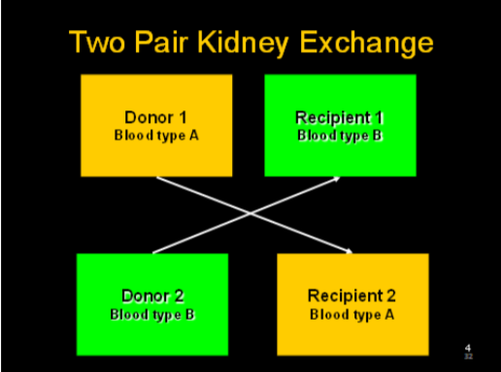
Application in Medical Field
Kidney exchange program: This algorithm helped donor and acceptor to find the right match in a very short span period of time of thus saving a large number of life. The algorithm takes just few second to find the donor and acceptor. Without which it would take many days to find the proper match.
A 2-way exchange involves 4 simultaneous surgeries.

Slide 11
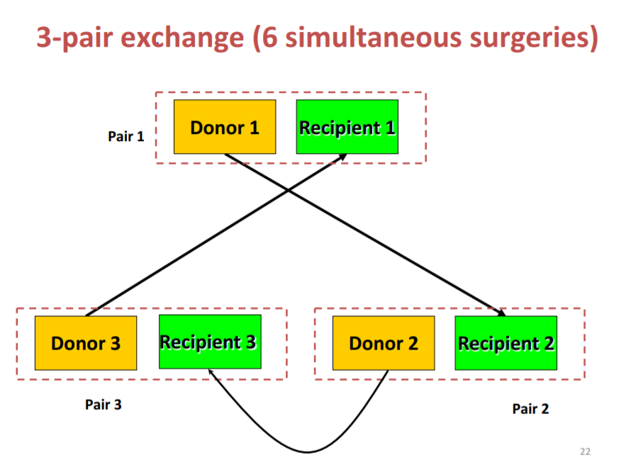

Slide 12
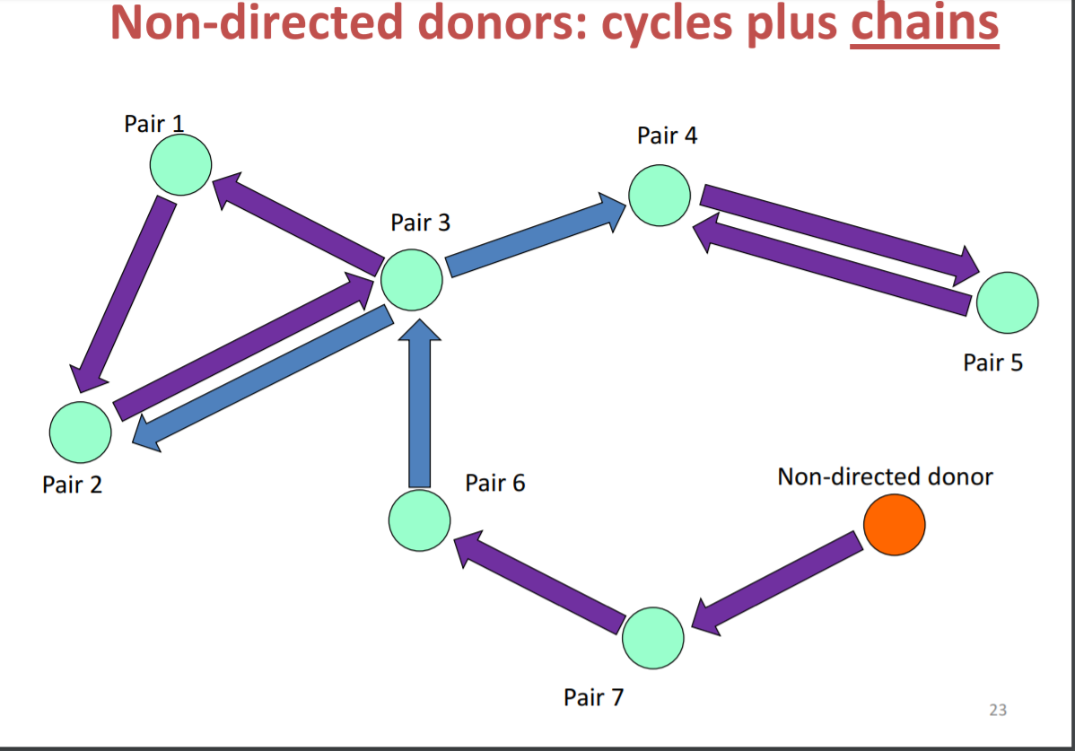

Slide 13
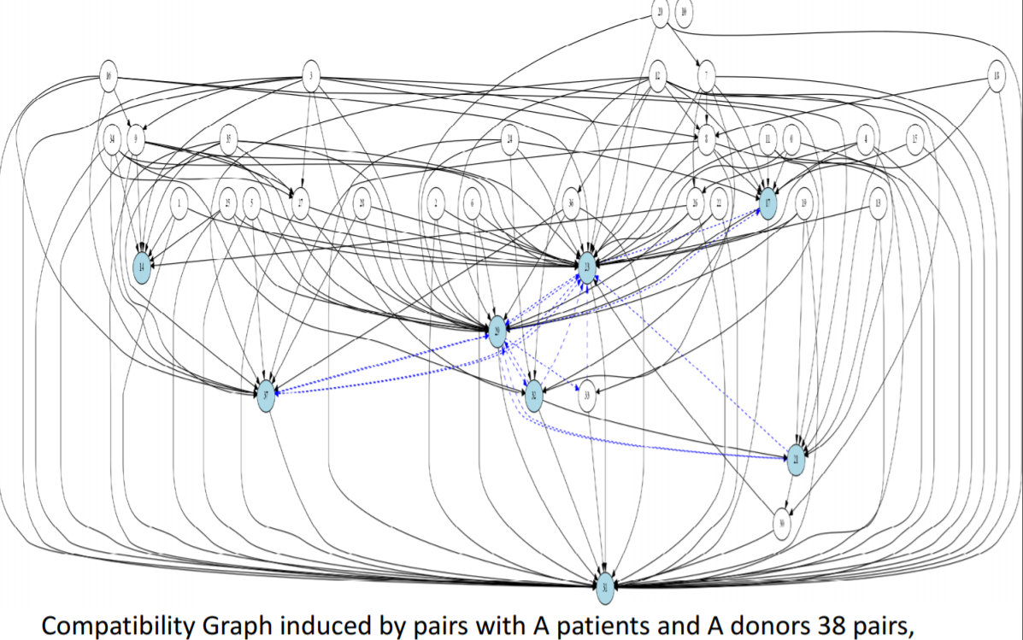

Slide 14
