Slide 1
MAC Protocols
Saurabh Ganeriwal
University of California Los Angeles
CS113, March 1, 2006.

Slide 2

Multiple Access or Medium Access Control (MAC) protocols
Single shared broadcast channel; collision
Multiple access protocol
  Distributed algorithm that determines how nodes share channel, i.e., determine when a node can transmit
Two broad classes:
  Channel partitioning and Random access

Slide 3
Channel Partitioning MAC protocols
TDMA: time division multiple access
Example:
Frequency
4 users
time
FDMA: frequency division multiple access
Frequency
time
CDMA: code division multiple access
  Same frequency and time but different codes.

Slide 4
Channel Partition: Control
How do nodes decide on time, frequency or code?
Assigned by a central coordinator
  IEEE 802.11 infrastructure mode
  Cellular networks
  Cable Modem
Distributed consensus protocols
  Nodes broadcast the time/frequency/code they are going to use and for how much duration.
  Done over a separate control channel
  Typically used in ad-hoc networks/MANET.

Slide 5
Random Access Protocols
Listen before transmit
When node has packet to send
  Sense the channel.
  If it is busy, wait for random amount of time and then retry.
  no a priori coordination among nodes.
  All nodes use the same time, frequency and code.
Two or more transmitting nodes ➜ “collision”
  Random access MAC protocol specifies how to recover from collisions -> Exponential backoff.
Examples of random access MAC protocols:
  CSMA, CSMA/CA, CSMA/CD

Slide 6

CSMA collisions
spatial layout of nodes
Why do collisions take place?
  Non-zero propagation delay.
Nodes continue to transmit even though a collision has taken place, resulting in a complete wastage of the channel capacity
Used in 802.11 ad-hoc mode.
Greater the propagation delay -> Greater is the probability of collisions.

Slide 7

CSMA/CD collision detection
If a collision is detected during transmission, cease transmission.
Advantage: Collisions detected within short time; colliding transmissions aborted, reducing channel wastage.
Used in Ethernet.
Why does 802.11 ad-hoc mode uses CSMA and not CSMA/CD?

Slide 8
Hidden and Exposed Terminals
Hidden terminals
  A sends to B, C cannot receive A
  C wants to send to B, C senses a “free” medium (CS fails)
  collision at B, A cannot receive the collision (CD fails)
  A is “hidden” for C
Exposed terminals
  B sends to A, C wants to send to another terminal (not A or B)
  C senses carrier, finds medium in use and has to wait
  A is outside the radio range of C, therefore waiting is not necessary
  C is “exposed” to B
A
B
C

Slide 9
802.11 DCF Operation
Use special signaling packets
B
RTS
CTS
Data
RTS
RTS
A
S
CTS
R
CTS
C
Data
Data
ACK
Receive RTS: Defer until CTS should have been sent
Receive CTS: Defer until Data should have been sent
If you don’t receive CTS or ACK, back off and try it all over again
Notes:
We can see this in other way like this.
RTS
CTS
Data
ACK

Slide 10
Comparison
Channel partitioning MAC protocols:
  share channel efficiently and fairly at high load
  inefficient at low load: delay in channel access, 1/N bandwidth allocated even if only 1 active node
Random access MAC protocols
  efficient at low load: single node can fully utilize channel
  high load: collision overhead
Both these types of protocols have been used in sensor networks depending on the application needs.

Slide 11
MAC Requirements in Sensor Networks
Important requirements of MAC protocols
  Energy efficiency
  Collision avoidance
  Scalability & Adaptivity
  Latency
  Fairness
  Throughput
  Bandwidth utilization
^{Primary}
^{Secondary}

Slide 12

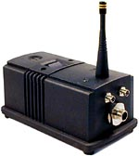
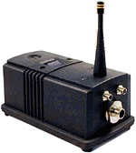

Energy Efficient Operation
End user
Event
Typical sense response application
But…….
  Event rate is very low
  Radio idle mode energy ≈ Radio Tx/Rx mode energy
Something important happened. Need to receive a packet. Keep the radio on for long duration
Listening
Radio
Duty-Cycling
Radio off
Notes:
The low power radios used in sensor nodes have a very high idle mode energy consumption.
In the idle mode, the radio receiver is continuously on and is sampling the channel for any incoming transmission.
The receive energy in the radios is higher than the transmit energy for low-range data transmission.
Therefore, periodically turning off the radio leads to significant energy savings.
During network operation, the nodes are mostly in the sleep mode and they wake up only in response to an event.
This mode of operation is referred to as On-demand Wakeup

Slide 13
Time Uncertainty Problem
Scenario: A and B need to communicate
Possible packet losses, if sleep-listen schedule of nodes do not intersect!
Packet ready
@ Tx
Rx ready
B
A
Three broad approaches
  Synchronous: SMAC, TMAC
  Asynchronous: BMAC, STEM, Wakeup
  Hybrid: UBMAC

Slide 14
S-MAC Design Overview
Tradeoffs
^{Latency}
^{Fairness}
^{Energy}
Major components in S-MAC
  Periodic listen and sleep
  Collision avoidance
  Overhearing avoidance
  Massage passing

Slide 15
Coordinated Sleeping
Nodes coordinate on sleep schedules
  Nodes periodically broadcast schedules
  New node tries to follow an existing schedule
^{Schedule 1}
^{Schedule 2}
1
2
Nodes on border of two schedules follow both
Time synchronized duty-cycling
  Not network-wide, just within the neighborhood!

Slide 16
Collision / Overhearing Avoidance
Adopt IEEE 802.11
Use the RTS/CTS exchange
  Broadcast packets (SYNC) are sent without RTS/CTS
  Unicast packets (DATA) are sent with RTS/CTS
Overhearing avoidance
  Sleep, while some node in neighborhood is transmitting
  Use the information in the network allocation vector (NAV) to decide the duration of sleep.

Slide 17
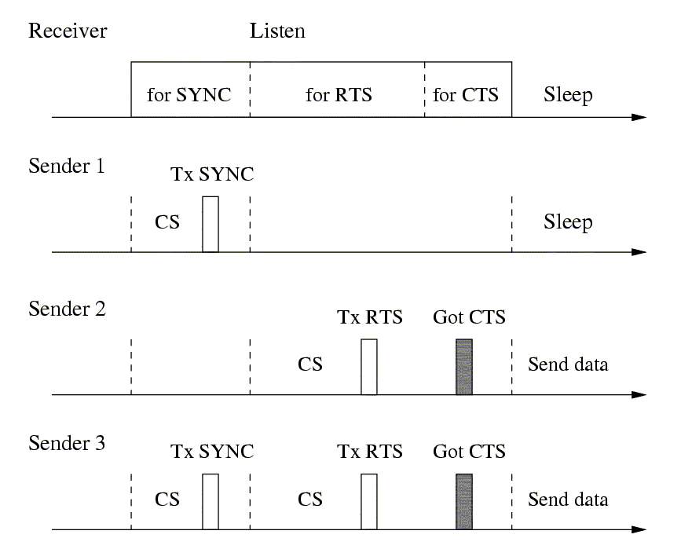
Example

Slide 18
Message Passing
How to efficiently transmit a long message?
Single packet vs. fragmentations
  Single packet: high cost of retransmission if only a few bits have been corrupted
  Fragmentations: large control overhead (RTS & CTS for each fragment), longer delay
Solution: Don’t interleave different messages
  Long message is fragmented & sent in burst
  RTS/CTS reserve medium for entire message
^{Fairness}
^{Energy}

Slide 19
Evaluation
Wins:
Periodically sleep reduced energy consumption in idle listening
Sleep during transmissions of other nodes
Message passing reduces control packet overhead
Losses:
Huge overhead of keeping the nodes in sync continuously.
  1 sync packet every 15 seconds.
  Sleep periods cannot be large, as nodes will drift apart and will be out of sync, completely messing the protocol.
Neutral:
Fairness, as long packets hog the channel.
Message latency.

Slide 20
Timeout-MAC (T-MAC)
Enhances S-MAC by allowing the nodes to have adaptive duty cycles rather than fixed duty-cycles.
Every node decides its own duty-cycle based on its activation period.
  Activation event -> firing of periodic timer, reception of any data on radio, sending data packets etc.
Has more latency than S-MAC but gives a much better energy performance for low data rate applications.
  Still periodic time synchronization consumes a lot of energy and there exists a cut-off point (in terms of data rate), beyond which asynchronous approaches start giving much better performance.

Slide 21
B-MAC Design Overview
Develop a very simple MAC protocol that can be configured by the applications at runtime.
  Emphasis is on keeping the code size small and provide complete flexibility.
Major components in B-MAC
  CSMA via CCA (Clear Channel Assessment) & Backoff
  Low power listening vis Preamble
  Link layer acks.

Slide 22
Clear Channel Assessment
Find out whether the channel is idle
  If too pessimistic: waste bandwidth
  If too optimistic: more collisions
Key observation
  Ambient noise may change significantly depending on the environment
  Packet reception has fairly constant channel energy
Software approach to estimating the noise floor
  Take moving average of the median signal strength
    Median works as a low pass filter
    A_t = a * S_t + (1 - a) * S_t-1
  Contrasts to common threshold-based methods in which only a single sample is taken

Slide 23
Low Power Listening: Preamble Sampling
Packet ready
@ Tx
Rx ready
B
Preamble
Payload
A
Choose a preamble such that receiver is guaranteed to wake up during the preamble transmission time.
  Size of preamble > Two * wakeup_time + Sleep_time
  Wakeup_time > Minimum preamble required to judge a valid pkt transmission
Some representative numbers for the TinyOS implementation for Mica2 motes.
  11.5% duty cycle ⇒ 250 bytes of preamble, 2.2% duty cycle ⇒ 1212 bytes of preamble.

Slide 24
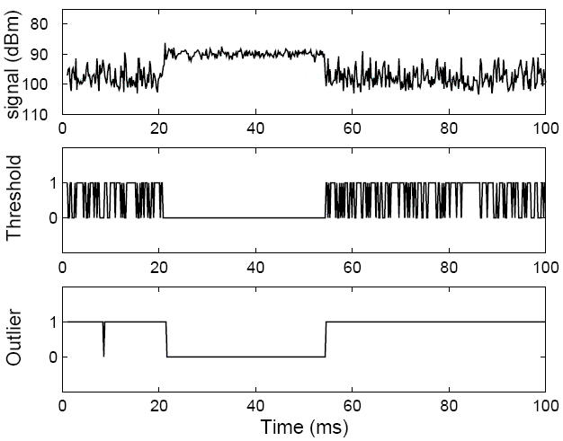
  Clear Channel Assessment
Before transmission – take a sample of the channel
If the sample is below the current noise floor, channel is clear, send immediately.
If five samples are taken, and no outlier found => channel busy, take a random backoff
Noise floor updated when channel is known to be clear e.g. just after packet transmission
A packet arrives between 22 and 54ms.
The middle graph shows the output of a thresholding CCA algorithm.
( 1: channel clear, 0: channel busy)

Slide 25
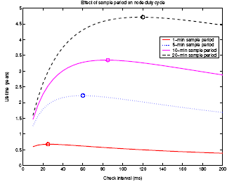
  LPL – Check Interval
    Too small
      Energy wasted on Idle Listening
    Too large
      Energy wasted on packet transmission (large preamble)
    In general, longer check interval is better

Slide 26
Evaluation
Wins:
No control packets overhead.
  No RTS/CTS, sync packets etc.
Can have arbitrarily long sleep periods.
Losses:
Worst case preamble size has to be used for every packet.
Huge overhead because of overhearing.
  Receiver nodes have to keep themselves on for receiving a long preamble even though they might not be the intended destination.
Neutral:
Fairness, as long preambles hog the channel.
Message latency.

Slide 27
Wakeup Frames: STEM
Packet ready
@ Tx
Rx ready
B
Duplicate
packets
A
C
Instead of sending a long preamble, send multiple wakeup frames, containing destination information.
  Need not be complete packets, but can be small frames.
  Need not be done on the same channel -> Wakeup frames can be sent on a separate control channel (Multiple radio systems).
  Need not be done continuously -> Send wakeup frame, wait for ack from recv and retransmit only if a valid ack is not rcvd.

Slide 28
Hybrid MAC: Predictive Duty-cycle Framework
Packet ready
@ Tx
B
A
{
Clock offset between A and B
Predict the clock offset, while transmitting the packet at runtime, to use the right amount of preamble size or number of wakeup frames, instead of the worst case.
Maintain just the right amount of time sync.
  Control overhead of using preamble/wakeup frames + sync packets is minimized.

Slide 29
Uncertainty-driven Duty Cycling MAC
RATS + BMAC → UBMAC
Rate Adaptive Time Synchronization
(achieves desired user-level precision while optimizing energy)
UBMAC
(fixed-mode)
UBMAC
(variable-mode)
BMAC
Irrespective of Duty Cycle
⇓
Use a preamble size of x bytes
⇓
Imposes the maximum allowed time uncertainty to be (x-4) * byte time
⇓
Use RATS to bound the time uncertainty between the two nodes within the limits derived above
Higher Duty Cycle
⇓
Higher Time Uncertainty
⇓
Longer Preamble
Irrespective of Duty Cycle
⇓
Use RATS to predict the time uncertainty
⇓
Use preamble size of time uncertainty / byte time
Notes:
Now that we have a very low overhead synchronization protocol, we can use it for efficiently duty-cycling of the radio.
Recollect that extra bytes were added into the preamble to take care of the time uncertainty between the transmitter and the receiver.
We created a new MAC protocol that integrates the rate adaptive time synchronization.
The MAC protocol can be operated in two modes.
In the fixed preamble mode, the MAC protocol uses a preamble of x bytes irrespective of the duty cycle of operation.
A preamble of X bytes translates into a bound on the maximum time uncertainty that can be allowed.
The objective of the RATS protocol is to achieve this bound.
In the variable preamble mode, the MAC protocol requests RATS to estimate the time uncertainty between the nodes
Based on the estimate, the length of the preamble is chosen on the fly.

Slide 30
Experiment in TinyOS
Set-up
  Multiple motes, 1 parent and rest are designated as child nodes.
  Each mote is doing 11.5% duty-cycle.
  Duration: 24 hrs, 1 packet every 30 s.
Energy consumption
  BMAC
    2880 data packets, each with 250 bytes of preamble.
    No extra control packet.
  SMAC
    2880 data packets, each with minimum 4 bytes of preamble. (Disabled RTS/CTS)
    1440 time synchronization packets, at the rate of 1 per minute.
  UBMAC
    2880 data packets, each with 6 bytes of preamble.
    28 time synchronization packets.
Notes:
Here we show the performance of the low power MAC
The application has a 35.5% duty cycle with a packet transmitted every 30 seconds.
A completely asynchronous MAC uses a 94 Byte preamble
UBMAC is operated in a fixed preamble mode with a preamble of length 6 bytes only
The preamble length automatically translates into a synchronization requirement of 832 uS.
In a 24 hours experiment, 2800 packets were transmitted with a 94 B preamble by the BMAC
UBMAC transmitted 2800 packets with 6 B preamble and exchanged only 28 additional packets for synchronization
Therefore there is a 3X energy improvement at the transmitter
The oscilloscope traces at the bottom show the long preamble for BMAC on the left and the shorter preamble for UBMAC on the right.

Slide 31
Evaluation
Wins:
Flexibility is the key!
  Can achieve best of both the worlds.
Can achieve best of both the worlds.
  Reduces to TDMA-ish protocol for high data rate.
  And to asynchronous MAC for low data rate.
Spends just the right amount of control overhead everytime and hence, optimizes overhearing overhead as well.
Losses:
Flexibility can be the curse.
  Applications have to choose fixed/variable mode and specify the precision.
  Can this be done in an automated manner?
Neutral:
Message latency.

Slide 32






IEEE 802.15.4
Wireless MAC and PHY layer specifications for Low-rate Wireless Personal Area Networks (LR-WPANs)
INDUSTRIAL & COMMERCIAL
CONSUMER ELECTRONICS
monitors
sensors
automation
control
TV
VCR
DVD/CD
remote
PERSONAL HEALTH CARE
PC & PERIPHERALS
monitors
diagnostics
sensors
ZigBee
LOW DATA-RATE
RADIO DEVICES
mouse
keyboard
joystick
TOYS &
GAMES
HOME AUTOMATION
PETs
gameboys
educational
security
HVAC
lighting
closures

Slide 33
802.15.4 MAC
Desired features
  Extremely low power consumption
  Ease of implementation
  Reliable data transfer
Traffic types
  Periodic data transfer such as temperature monitoring.
  Intermittent such as intruder detection.
Traffic pattern
  Pan coordinator to slaves -> Use slotted/unslotted CSMA/CA
  Slaves to pan coordinator -> Use slotted/unslotted CSMA/CA
  Peer-to-peer -> Full freedom (No specs)

Slide 34
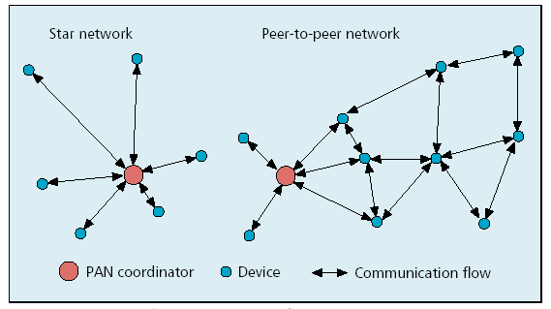
Combined topologies

Slide 35
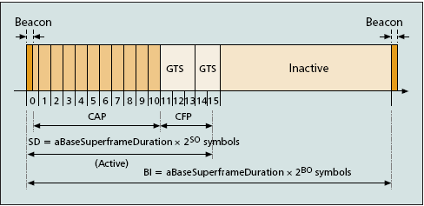
IEEE 802.15.4 superframe structure

Slide 36
Conclusion
One-fit-all solution for MAC protocols does not exist.
Different MAC protocols try to tradeoff different performance metrics such as throughput, latency, energy consumption etc.
Broadly two classes of protocols.
  Channel allotment and random access.
Time uncertainty becomes a critical bottleneck in the design of MAC protocols for duty-cycled sensor networking systems.
  Asynchronous approaches work best for low data rate applications, whereas synchronous approaches work best for high data rate applications.
  Hybrid approaches promises to achieve the best of both the worlds, but are in the need for thorough empirical evaluation.
  IEEE 802.15.4 has adopted very similar protocol as IEEE 802.11 for beacon mode, but has left full freedom with the developers for non-beacon mode.

Slide 37

Questions and Comments

