Slide 1
Algorithmic Aspect of Frequent Pattern Mining and Its Extensions
Takeaki Uno
National Institute of Informatics, JAPAN
The Graduate University for Advanced Studies (Sokendai)
joint work with
Hiroki Arimura, Shin-ichi Nakano
July/9/2007 Max Planc Institute

Slide 2
Introduction for Itemset Mining

Slide 3
Motivation: Analyzing Huge Data
• Recent information technology gave us many huge database
- Web, genome, POS, log, …
• "Construction" and "keyword search" can be done efficiently
• The next step is analysis; capture features of the data
- （size, #rows, density, attributes, distribution…)
Can we get more?
➔ look at (simple) local structures
but keep simple and basic
Database
実験1 | 実験2 | 実験3 | 実験4
● | ▲ | ▲
 | ● |  | ▲
● | ● | ▲ | ●
● | ● | ▲ | ●
▲ | ● |  | ●
 | ● | ▲ | ●
● | ▲ | ▲
 | ▲ | ▲
ATGCGCCGTA
TAGCGGGTGG
TTCGCGTTAG
GGATATAAAT
GCGCCAAATA
ATAATGTATTA
TTGAAGGGCG
ACAGTCTCTCA
ATAAGCGGCT
Results of
experiments
genome

Slide 4
Frequent Pattern Discovery
• The task of frequent pattern mining is to enumerate all pattern appearing in the database many times (or many places)
databases: item(transaction), tree, graph, string, vectors,…
patterns: itemset, tree, paths,cycles, graphs, geographs,…
database
Extract frequently
appearing patterns
・ 1● ,3 ▲
・ 2● ,4●
・ 2●, 3 ▲, 4●
・ 2▲ ,3 ▲
．
．
．
1 | 2 | 3 | 4
● | ▲ | ▲
 | ● |  | ▲
● | ● | ▲ | ●
● | ● | ▲ | ●
▲ | ● |  | ●
 | ● | ▲ | ●
● | ▲ | ▲
 | ▲ | ▲
ATGCGCCGTA
TAGCGGGTGG
TTCGCGTTAG
GGATATAAAT
GCGCCAAATA
ATAATGTATTA
TTGAAGGGCG
ACAGTCTCTCA
ATAAGCGGCT
・ ATGCAT
・ CCCGGGTAA
・ GGCGTTA
・ ATAAGGG
．
．
．
results of exp.
genomes

Slide 5
Application: Comparison of Databases
• Compare two database
⬅ ignore the difference on size, and noise
• statistic does not give information about combinations
• large noise by looking at detailed combinations
Compare the features on local
combinations of attributes
by comparing frequent patters
data
base
database
- dictionaries of languages
- genome data
- word data of documents
- customer data

Slide 6
Application: Rule Mining
• Find feature or rule to divide the database into true group and false group. (ex. include ABC if true, but not if false)
• frequent patterns in true group are candidates for such patterns
(actually, weighted frequency is useful)
database
data
base
true
false

Slide 7
Output Sensitivity
• To find interesting/valuable patterns, we enumerate many patterns
• Then, the computation time is desired to be output sensitive
- short if few patterns, long for many, but scalable for #outputs
• One criteria is output polynomiality; computational time order in the term of both input size and output size
➔ But, square time of output size is too large
➔ Linear time in output size is important (polynomial time for one)
Goal of the research here is to develop output linear time algorihtms

Slide 8
Definition of "Frequency"
多く現れるものを見つけるために、多く現れるとは何か、を決める
・ データベースが項目の集まりだとする
・ パターンに対して、そのパターンを含む項目を出現という
・ 出現の数（頻出度）が閾値より大きければ、良く現れるとする
（含む、の定義は、集合で行ったり、文字列の
包含、グラフの埋め込みなどで定義する）
パターン
XYZ
{A,C,D}
項目
AXccYddZf
{A,B,C,D,E}

Slide 9
History
• Frequent pattern mining is fundamental in data mining
➔ So many studies （5,000 hits by Google Scholar）
• The goal is "how to compute on huge data efficiently"
• The beginning is at 1990, frequent itemset in itemset database
• Then, maximal pattern, closed pattern, constrained patterns
• Also, extended to sequences, strings, itemset sequences, graphs…
• Recent studies are combination of heterogeneous database, more sophisticated patterns, matching with errors,…

Slide 10
History of Algorithms
• From algorithmic point of view, history of frequent itemset mining
- 1994, apriori by Agrawal et al. (BFS, compute patterns of each sizes by one scan of database)
- pruning for maximal pattern mining
- 1998, DFS type algorithm by Bayardo
- 1998, Closed pattern by Pasquir et al.
- 2001, MAFIA by Burdick et al. (speedup by bit operations)
- 2002, CHARM by Zaki (closed itemset mining with pruning)
- 2002, hardness proof for maximal frequent itemset mining by Makino et al.
- 2003, output polynomial time algorithm LCM for closed itemset mining by Arimura and I

Slide 11
Transaction Database
• Here we focus on itemset mining
Transaction database:
Each record T is a transaction, which is a
subset of an itemset E, i.e., D, ∀T ∈D, T ⊆ E
- POS data (items purchased by one customer)
- web log (pages viewed by one user)
- options of PC, cars, etc. (options chosen by one customer)
1,2,5,6,7
2,3,4,5
1,2,7,8,9
1,7,9
2,7,9
2
D ＝
Real world data usually is sparse, and satisfies distribution
Discovery of the combination "beer and nappy" is famous

Slide 12
Application: Basket Analysis
• Find combinations of items sold together, in stores
• items purchased by ➔ トランザクション
・ 品目の組で、多くの客が購入したもの
➔ 多くのトランザクションに含まれるアイテム集合
➔ （あるθに対する）頻出集合
● coffee, bread , apple
● bread, juice
● bread, magazine
● paper, pen
● sandwich, juice
● cups, plates
● coffee bread, books
．．．
Discovery of the combination
"beer and nappy" is famous

Slide 13
Occurrence and Frequency
For itemset K:
Occurrence of K: a transaction of D including K
Occurrence set Occ(K) of K ：all transactions of D including K
frequency frq(K) of K: the cardinality of Occ(K)
1,2,5,6,7,9
2,3,4,5
1,2,7,8,9
1,7,9
2,7,9
2
Occ( {1,2} )
＝ { {1,2,5,6,7,9},
{1,2,7,8,9} }
D ＝
Occ( {2,7,9} )
＝ { {1,2,5,6,7,9},
{1,2,7,8,9},
{2,7,9} }

Slide 14
Frequent Itemset
• Frequent itemset： itemset with frequency at least σ
(the threshold σis called minimum support )
Ex.) all frequent itemsets for minimum support 3
1,2,5,6,7,9
2,3,4,5
1,2,7,8,9
1,7,9
2,7,9
2
included in at least 3
transactions
{1} {2} {7} {9}
{1,7} {1,9}
{2,7} {2,9} {7,9}
{1,7,9} {2,7,9}
D＝
For given a transaction database and minimum support, the frequent itemset mining problem is to enumerate all frequent itemsets

Slide 15
Frequent Itemset Mining
Algorithm

Slide 16
Monotonicity of Frequent Itemsets
• Any subset of frequent itemset is frequent
➔ monotone property
➔ backtracking is available
• Frequency computation is O(||D||) time
• Each iteration ascends
at most n directions
➔ O(||D||n) time per one
111…1
frequent
000…0
1,2,3,4
1,2,3
1,2,4
1,3,4
2,3,4
1,2
1,3
1,4
2,3
2,4
3,4
Polynomial time for each, but
||D|| and n are too large
1
2
3
4
φ

Slide 17
Squeeze the occurrences
• For itemset P and item e, Occ(P+e) ⊆ Occ(P)
⬅ any transaction including P+e also includes P
• A transaction in Occ(P) is in Occ(P+e)
if it includes e
➔ Occ(P+e) = Occ(P) ∩ Occ({e})
➔ no need to scan the whole database
• By computing Occ(P+e) ∩ Occ({e}) for all e
at once we can compute all in O(||Occ(P)||) time
• In deeper levels of the recursion, computation time is shorter
A | 1
B |  | 2
C | 1 |  | 3 | 4
D |  | 2 | 3 | 4

Slide 18
Occurrence Deliver
・ Compute the denotations of P ∪{e} for all e’s at once,
by scanning each occurrence
A | 1 | 2 |  |  | 5 | 6 | 7 |  | 9
B |  | 2 | 3 | 4 | 5
C | 1 | 2 |  |  |  |  | 7 | 8 | 9
D | 1 |  |  |  |  |  | 7 |  | 9
E |  | 2 |  |  |  |  | 7 |  | 9
F |  | 2
A
A
A
A
1,2,5,6,7,9
2,3,4,5
1,2,7,8,9
1,7,9
2,7,9
2
D＝
C
C
C
D
P = {1,7}
Check the frequency for all
items to be added in linear
time of the database size
frequency of item = reliability of rule
Computed in short time

Slide 19
Bottom-wideness
• Backtrack algorithm generates some recursive calls in an iteration
➔ Computation tree expands exponentially
➔ Computation time is dominated by the bottom levels
long
・・・
short
Amortized computation time for one iteration is so short
This can be applicable to enumeration algorithms generally

Slide 20
For Large Minimum Supports
• For largeσ, the time in the bottom levels is still long
➔ Bottom-wideness does not work well
• Reduce the database of occurrencees to fasten the computation
(1) remove items smaller than the last added item
(2) remove infrequent items (never added in deeper levels)
(3) unify the same transactions into one
• In practice, the size is usually constant
in the bottom levels
１ |  | ３ | ４ | ５
１ | ２ |  | ４ |  | ６
 |  | ３ | ４ |  |  | ７
１ | ２ |  | ４ |  | ６ | ７
 |  | ３ | ４ | ５ | ６ | ７
 | ２ |  | ４ |  | ６ | ７
No big difference from when σ is small

Slide 21
Difficulties on Frequent Itemset
• If we want to look at the data deeper, we have to set σ to small
➔ many frequent itemsets appear
• We want to decrease #solutions without losing the information
(1) maximal frequent itemset:
included in no other frequent itemset
(2) closed itemset:
included in no other itemset with the
same frequency (same occurrence set)
111…1
000…0

Slide 22
Ex. Closed/Maximal Frequent Itemsets
• Classify frequnet itemsets by their occurrence sets
Frquency no less than 3 {1} {2} {7} {9}
{1,7} {1,9}
{2,7} {2,9} {7,9}
{1,7,9} {2,7,9}
1,2,5,6,7,9
2,3,4,5
1,2,7,8,9
1,7,9
2,7,9
2
D ＝
frequent closed itemset
maximal frequent itemset

Slide 23
Advantages & Disadvantages
maximal frequent itemset
• Existence of output polynomial time algorithms is open
• Simple pruning works well
• The solution set is small but changes drastically by change of σ
closed itemset
• Polynomial time enumeratable by reverse search
• Fast computation by the technique of discrete algorithms
• No loss of information in the term of occurrence set
• If data includes noises, few itemsets have the same occurrence sets, thus almost equivalent to frequnet itemsets
Both can be computed, up to 100,000 solutions per minute

Slide 24
Enumerating Closed Itemsets
Frequent itemset mining based approach
- find frequent itemsets and outputs only closed ones
- no advantage on computation time
Keep the solutions in memory and use for pruning
- computation time is pretty short
- keeping the solution needs much memory and computation
Reverse search with database reduction (LCM)
- DFS type algorithm thus no memory for solutions
- fast computation of checking the closedness

Slide 25
Adjacency on Closed Itemsets
• Remove items one-by-one from the tail
• At some points occurrence set expands
• The parent is defined by the closed itemset of the occurrence set
(obtained by taking intersection, thus defined uniquely)
• The frequency of the parent is always larger than any its child
➔ parent-child relation is acyclic

Slide 26
Reverse Search
• The parent child relation induces a directed spanning tree
DFS for visiting all the closed itemsets
• DFS needs to go to child, in each iteration
➔ algorithm to find the children of the parent
General technique to construct enumeration algorithms:
needs only polynomial time enumeration of children

Slide 27
Parent-Child Relation
• All closed itemsets and parent-child relation
φ
2
1,2,5,6,7,9
2,3,4,5
1,2,7,8,9
1,7,9
2,7,9
2
7,9
1,7,9
D ＝
2,5
2,7,9
1,2,7,9
2,3,4,5
Adjacency by
adding one item
Parent-child
1,2,7,8,9
1,2,5,6,7,9

Slide 28
Computing Children
• Let Q be the child of P, and e be the item removed last
• Then, Occ(Q) = Occ(P+e) holds
• We have to examine all e, but at most n cases
• If the closed itemset Q' for Occ(P+e) has an item e' not in P
and less than e, then the parent of Q' is not P
• Converse also holds, i.e., the closed itemset Q' for Occ(P+e) is a child of P iff their prefix less than e are the same
( and e has to be larger than the item used to obtain P)
➔ All children are computed in Occ(||Occ(P)||n) time

Slide 29
Experiments
• Benchmark problems taken from real world data
- 10,000 - 1,000,000 transactions
- 1000 - 10,000 items
Pen. M 1GHz
256 MB memory
data | POS | click | Webview | retail | word
#transactions | 510k | 990k | 77k | 88k | 60k
Database size | 3,300kb | 8,000kb | 310kb | 900kb | 230kb
#solutions | 4,600k | 1,100k | 530k | 370k | 1,000k
CPU time | 80 sec | 34 sec | 3 sec | 3 sec | 6 sec

Slide 30
Implementation Competition: FIMI04
・ FIMI: Frequent Itemset Mining Implementations
- A satellite workshop of ICDM (International Conference on Data Mining)
- Competition of the implementations of mining algorithms for frequent/frequent closed/maximal frequent itemsets
- FIMI 04 is the second FIMI, and the last
- over 25 implementations
Rule:
- read the problem file and write the itemsets to a file
- use time command to measure the computation time
- architecture level commands are forbidden, such as parallel, pipeline control, …

Slide 31
Environments in FIMI04
CPU: Pentium4 3.2GHz
memory: 1GB
OS and language: Linux, C compiled by gcc
• datasets
- sparse real data: many items, sparse
- machine learning benchmarks: dense, few items, have patterns
- artificial data: sparse, many items, random
- dense real data: dense, few items

Slide 32
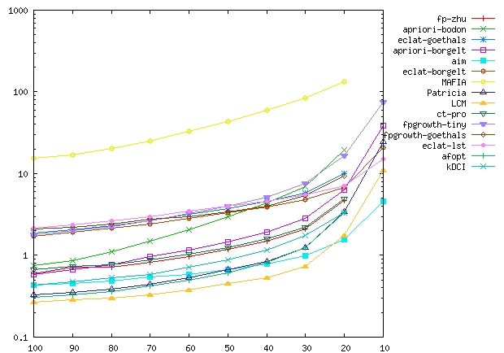
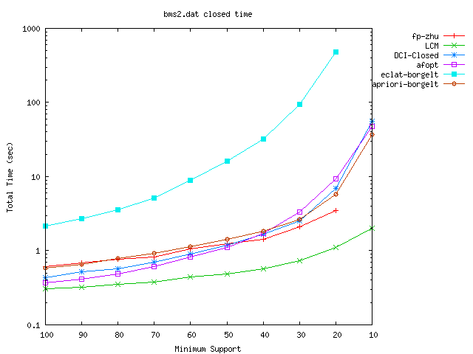
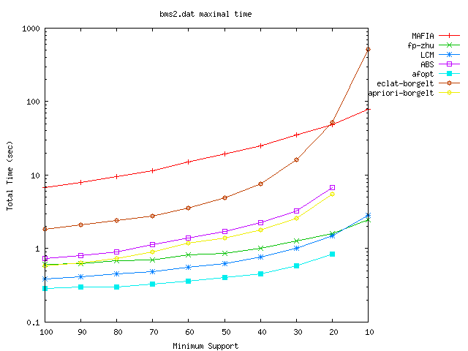
real data
(very sparse)
"BMS-WebView2"
Frq.：LCM
Clo.：LCM
Max.：afopt

Slide 33
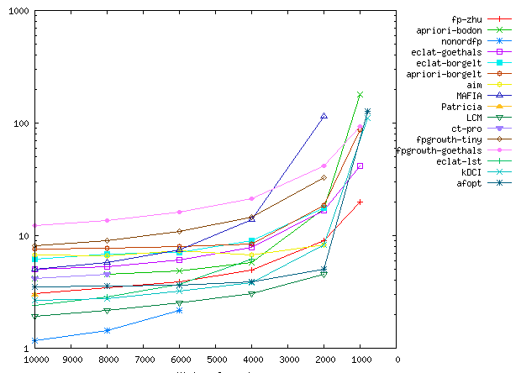
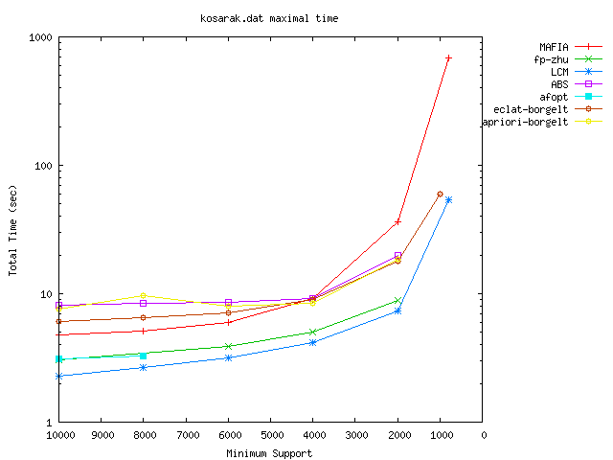
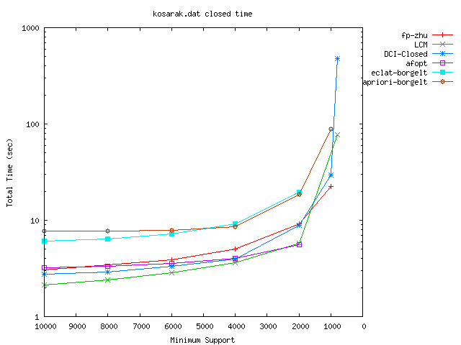
real data
(sparse)
"kosarak"
頻出：nonodrfp＆LCM
飽和：LCM
極大： LCM

Slide 34
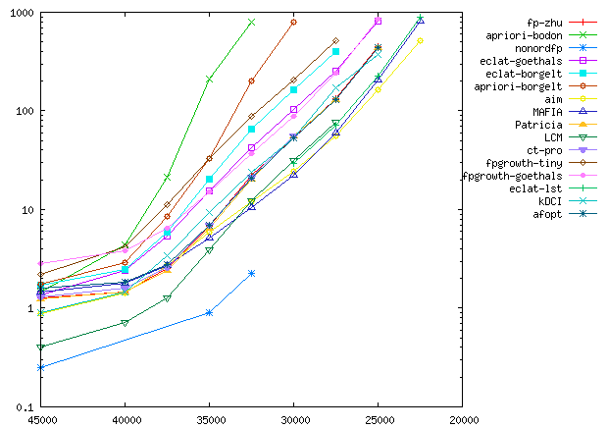
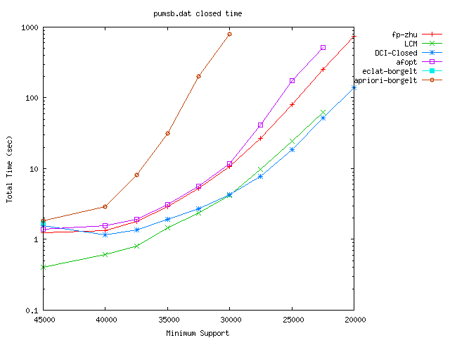
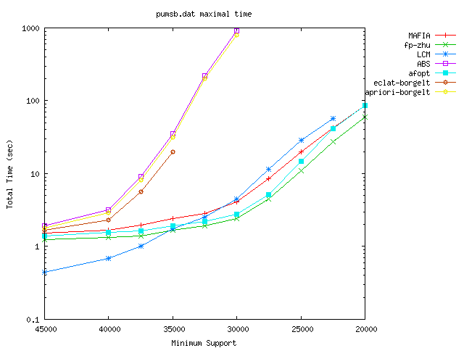
benchmark for machine learning
"pumsb"
frq.：many
Clo.：LCM＆DCI-closed
Max.： LCM＆
FP-growth

Slide 35
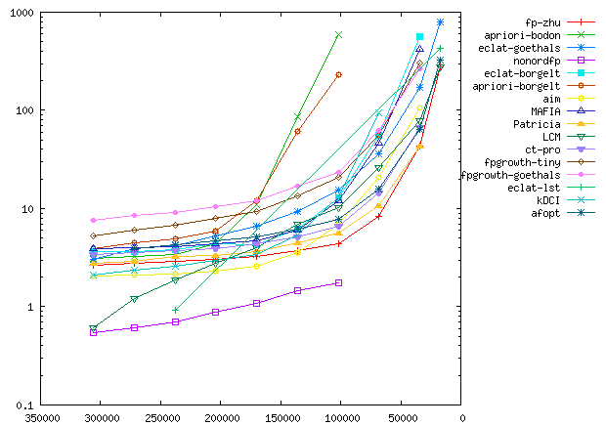
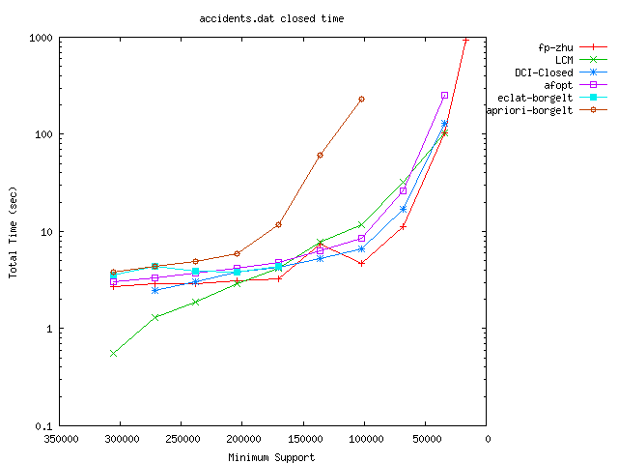
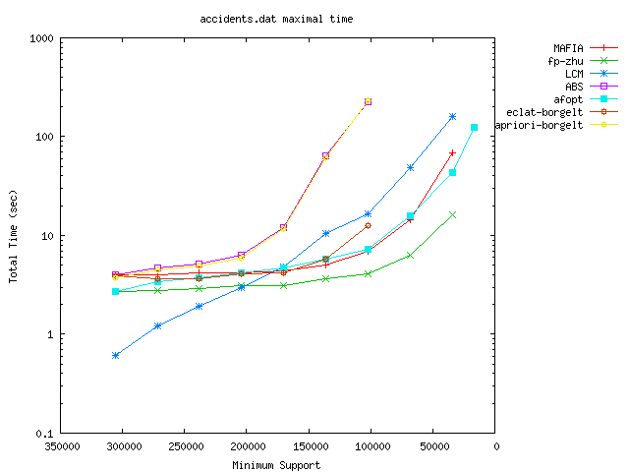
dense real data
"accidents"
頻出：nonodrfp
＆FP-growth
飽和：LCM＆FP-growth
極大： LCM
＆FP-growth

Slide 36
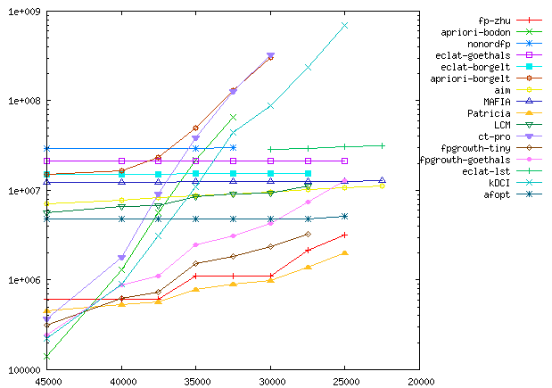
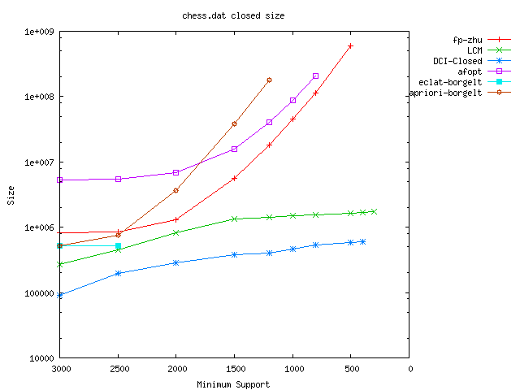
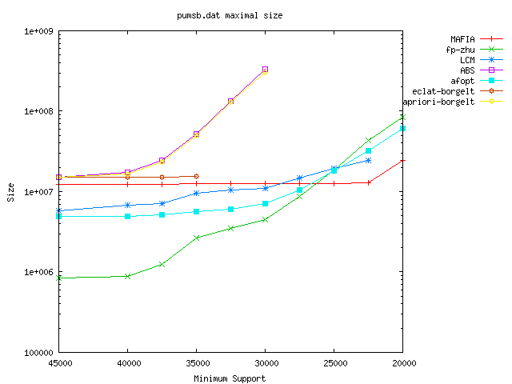
memory usage
"pumsb"
frq.
clo.
max.

Slide 37
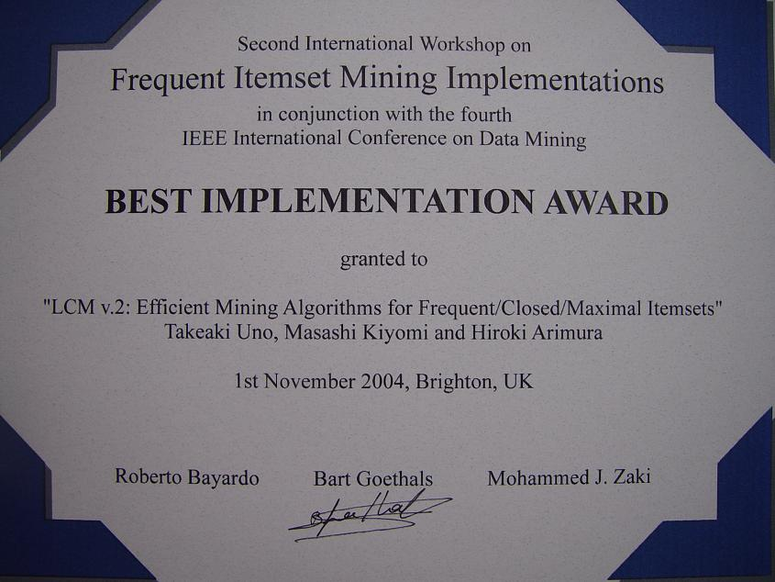
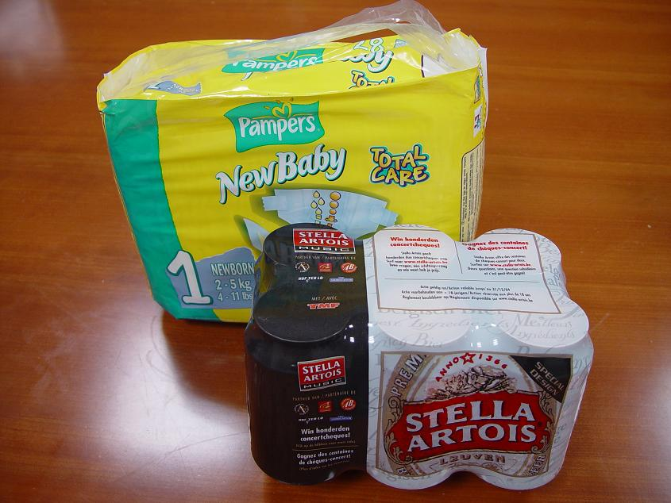
Prize for the Award
Prize is {beer, nappy}
“Most Frequent Itemset”

Slide 38
Mining Other Patterns

Slide 39
What can We Mine?
• I am often asked "what can we mine (find)?"
➔ usually I answer, "everything, as you like"
• "but, #solutions and computation time depend on the model"
- if there is difficulty on computation, we need long time
- if there are so many trivial patterns,
we may get many solutions
{ACD}, {BC}, {AB}
AXccYddZf

Slide 40
Pattern Mining Problems
• Again, there are many kinds of pattern mining problems, according to the classes of patterns and databases
- string, tree, path, cycle, graph, vectors, sequence of itemsets, graphs with itemsets on each vertex/edge,…
• Definition of "inclusion", "occurrence" also makes variants
{A},{BC},{A}
XYZ
{ACD}, {BC}, {AB}
AXccYddZf

Slide 41
Variants on Pattern Mining
• patterns/datasets string, tree, path, cycle, graph, vectors, sequence of itemsets, graphs with itemsets on each vertex/edge,…
• Definition of "inclusion"
- substring / subsequence
- subgraph / induced subgraph / embedding with stretching edges
• Definition of "occurrence"
- count all the possible embeddings (input is one big graph)
- count the records
• But, "what we can have to see" is simple
{A},{BC},{A}
XYZ
{ACD}, {BC}, {AB}
AXccYddZf

Slide 42
What We Have To See?
• Enumeration
- isomorphism check is easy?
- canonical form exists?
- canonical form enumeration accepts bottom up?
• Frequency
- inclusion check is easy?
- embedding or representative few?
• Computation
- data can be reduced in deeper levels?
- algorithms for each task is efficient?
• Model
- many (trivial) solutions?
- One occurrence set admits many maximals?

Slide 43
Enumeration Task: Frequent Graph Mining
• labeled graph is a graph is labels on either vertices or edges
- chemical compounds
- networks of maps
- graphs of organization, relationship
- XML
Frequent graph mining: find labeled graphs which are subgraphs of many graphs in the data
• Checking the inclusion is NP-complete, checking the duplication is graph isomorphism
How do we do?

Slide 44
Straightforward Approach
• Start from the empty graph (it's frequent)
• Generate graphs by adding one vertex or one edge to the previously obtained graphs (generation)
• Check whether we already get it or not (isomorphism)
• Compute their frequencies (inclusion)
• Discard those not frequent
Too slow, if all are done in straightforward ways

Slide 45
Encoding Graphs [Washio et al., etc.]
(inclusion)
• for small pattern graph, inclusion check is easy (#labels helps)
• Straightforward approach for inclusion
(isomorphism)
• Use canonical form to fast isomorphic tests
⬅ Canonical form is given by the
lexicographically minimum adjacency matrix
 | １ |  |  | １
１ |  | １ | １
 | １ |  |  | １
 | １ |  |  | １
１ |  | １ | １
Bit slow, but works

Slide 46
Restrict the Class of Pattern
• Another approach focuses the class with fast isomorphism
- paths, cycles, trees
• We can perform DFS enumeration
➔ We can memory the occurrence set of the current pattern, thus computation is very fast

Slide 47
Fast Isomorphism: Tree Mining
• Another approach focuses the class with fast isomorphism, - paths, cycles, trees
• Find frequent tree patterns from database whose records are labeled trees (included if a subgraph)
Ordered tree: a rooted tree with specified orders of children on each vertex
≠
≠
They are isomorphic, but the orderes of children, and the roots are different

Slide 48
Family Tree of Ordered Trees
Parent is removal of
the rightmost leaf
➔ child is an attachment of a rightmost leaf

Slide 49
Ordered Trees → Un-ordered Trees
• There are many ordered trees isomorphic to an ordinary un-ordered tree
• If we enumerate un-ordered trees in the same way, many duplications occur
Use canonical form

Slide 50
Canonical Form
depth sequence: the sequence of depths of vertices in the pre-order of DFS from left to right
• Ordered trees are isomorphic ⬄ depth sequences are the same
• left heavy embedding has the maximum depth sequence
(obtained by sorting children by depth sequences of the subtrees)
• Rooted trees are isomorphic ⬄ left heavy embeddings are the same
0,1,2,3,3,2,2,1,2,3 0,1,2,2,3,3,2,1,2,3 0,1,2,3,1,2,3,3,2,2

Slide 51
Parent-Child Relation for Canonical Forms
• The parent of left-heavy embedding T is the removal of the rightmost leaf
➔ the parent is also a left-heavy embedding
T
parent
grandparent
0,1,2,3,3,2,1,2,3,2,1 0,1,2,3,3,2,1,2,3,2 0,1,2,3,3,2,1,2,3
• A child is obtained by adding a rightmost leaf no deeper than the copy depth
➔ No change of the order on any vertex
➔ Copy depth can be update in constant time

Slide 52
Family Tree of Un-ordered Trees
• Pruning branches of ordered trees

Slide 53
Inclusion for Unordered Tree
• Pattern enumeration can be done efficiently
• Inclusion check is polynomial time if data graph is a (rooted) tree
• For ordered trees, it is sufficient to memorize the rightmost leaves of the embeddings
➔ rightmost path is determined,
we can put rightmost leaf on its right
• The size of (reduced) occurrence set is
less than #vertices in the data

Slide 54
Other Family Tree: Floor Plan
Parent: shrink the most left-upper room by sliding

Slide 55
Closedness: Sequential Data
• Closed pattern is useful for representative of equivalent patterns
⬅ Equivalent means the occurrence sets are the same
• "Maximal pattern" in the equivalence class is not always unique
Ex) sequence mining (appear with keeping its order)
ACE is a subsequence of ABCDE, but BAC is not
ABCD • ABD, ACD, both are maximal
ACBD
If intersection (greatest common subpattern) is uniquely defined, closed pattern is defined well

Slide 56
In What Cases …
- graph mining: all labels are distinct (equivalent to itemset mining)
- un-ordered tree mining: if no siblings have the same label
- string with wildcards
- geometric graphs (geographs) (coodinates, instead of labels)
- leftmost positions of subseuqence in (many) strings
abcdebdbbee
d?b
abcdebdabcbee

Slide 57
Handling Ambiguity

Slide 58
Inclusion is Strict
• In practice, datasets may have errors
• Or, we often want to use "similarity", instead of "inclusion"
- many records "almost" include this pattern
- many records have substructures "similar to" this pattern
• For these cases, ordinary inclusion is bit strong
➔ Ambiguous inclusion is necessary
1,2,5,7,9
2,3,4,5
1,2,7,8,9
1,7,9
2,7,9
2
1,2,7
1,2,7,9
D ＝

Slide 59
Models for Ambiguous Frequency
Ambiguity on inclusion
• Choose an "inclusion", which allows ambiguity
➔ frequency is #records including a pattern in this definition
• In some cases, we can say, σ records miss at most d of a pattern
Ambiguity on pattern
• For a pattern and a set of records,
define a criteria, how good the inclusion is
- #total missing cells, some functions on
the ambiguous inclusion
• More rich, but the occurrence set
may not be defined uniquely
 | v | w | x | y | z
A | ■ | ■ | ■ | ■ | ■
B |  | ■ | ■ | ■ | ■
C |  | ■ | ■ | ■
D | ■ |  | ■ |  | ■

Slide 60
Use Simple Ambiguous Inclusion
• For given k ,here we define simple ambiguous inclusion for sets;
P is included in Q ⬄ |P＼Q|≦k
➔ Satisfies monotone property
• Let Occ_{h}(P) = { P | |P＼Q| = h } then
Occ(P) = Occ₁(P) ∪… ∪ Occ_{k}(P)
Occ_{h}(P∪{i}) = Occ_{h}(P) ∩ Occ({i})
Occ(P∪{i}) = Occ₁(P∪{i}) ∪… ∪ Occ_{k}(P∪{i})
We can use the same technique as ordinary itemset mining
The time complexity is the same

Slide 61
A Problem on Ambiguity
• When we use ambiguous inclusion, too many small patterns become frequent
⬅ For example, if k = 3, all patterns of sizes of at most 3 are included in all transactions
• In these cases, we want to find larger patterns only
# patterns
size of pattern

Slide 62
Directly Finding Larger Patterns
• To find larger patterns directly, we use another monotonicity
• Consider a pattern P of size h of frequency frq_{k}(P)
- For a partition P₁,…,P_{k+1} of P into k+1 subsets,
at least one P_{i} has frequency ≧frq(P), in the the ordinary inclusion
- For k+2 subsets P₁,…,P_{k+2}, at least two have frequency ≧frq(P)
- For a partition P₁,P₂ of P, at least one has frq_{k/2}(P_{i})≧frq(P)
# patterns
size of pattern

Slide 63
Our Problem
Problem:
For given a database composed of n strings of the fixed same length l, and a threshold d,
find all the pairs of strings such that the Hamming distance of the two strings is at most d
ATGCCGCG
GCGTGTAC
GCCTCTAT
TGCGTTTC
TGTAATGA
．．．
・ ATGCCGCG , AAGCCGCC
・ GCCTCTAT , GCTTCTAA
・ TGTAATGA , GGTAATGG
．．．

Slide 64
Basic Idea: Fixed Position Subproblem
• Consider the following subproblem:
• For given l-d positions of letters, find all pairs of strings with Hamming distance at most d such that
"the letters on the l-d positions are the same"
Ex) 2nd, 4th, 5th positions of strings with length 5
• We can solve by "radix sort" by letters on the positions, in O(l n) time.

Slide 65
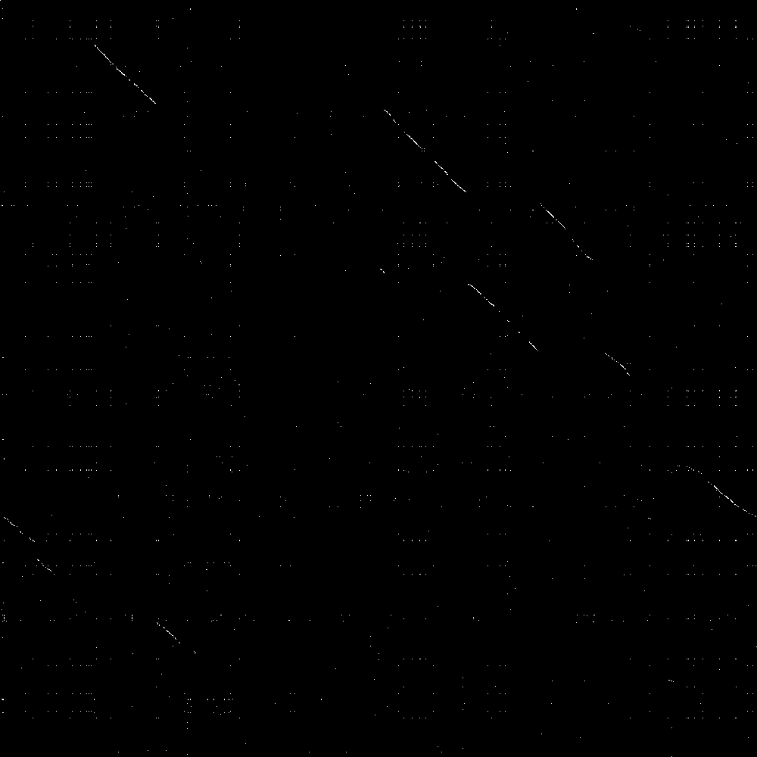
Homology Search on Chromosomes
Human X and mouse X chromosomes (150M strings for each)
• take strings of 30
letters beginning at
every position
・ For human X,
Without overlaps
・ d=2, k=7
・ dots if 3 points are
in area of width 300
and length 3000
human X chr.
mouse X chr.
1 hour by PC

Slide 66
References (?)
・ Frequent itemset and applications ('90 -) so many
web search by "frequent pattern", "frequent itemset"
・ 極大頻出集合およびその応用 (’90～) やはり多い
“maximal frequent itemset” などで検索すると出てくる
・ pasquerらのアルゴリズム (‘99) 飽和集合の導入
・ 宇野らのアルゴリズムLCM (‘04) 現在最速のアルゴリズム
・ 実装 LCM: (Linear time Closed itemset Miner) 宇野のHP
http:research.nii.ac.jp/~uno/
・ レポジトリ （実装、論文、比較実験の数々）
http://fimi.cs.helsinki.fi/

Slide 67
References 2
・ 鷲尾らのアルゴリズム （’01 ） グラフマイニングの先駆け
・ 中野先生（群馬大）の列挙アルゴリズム
順序木・極大三角形分割・フロアプランなど
・ 中野・宇野・有村 （’03～ ） 順序木・無順序木の多項式時間頻出列挙

Slide 68
Conclusion
• Frequent pattern mining motivated by database analysis
• Efficient algorithms for itemset mining
• Enumeration of labeled trees
• Important points for general pattern mining problems
Future works
• Model closed patterns for various data
• Algorithms for directly finding large frequent patterns
• Algorithms for directly finding large frequent patterns

