Slide 1
What Is Sequential Pattern Mining?
Given a set of sequences, find the complete set of frequent subsequences
A sequence : < (ef) (ab) (df) c b >
A sequence database
SID | sequence
10 | <a(abc)(ac)d(cf)>
20 | <(ad)c(bc)(ae)>
30 | <(ef)(ab)(df)cb>
40 | <eg(af)cbc>
An element may contain a set of items.
Items within an element are unordered
and we list them alphabetically.
<a(bc)dc> is a subsequence of <a(abc)(ac)d(cf)>
Given support threshold min_sup =2, <(ab)c> is a sequential pattern

Slide 2
Challenges on Sequential Pattern Mining
A huge number of possible sequential patterns are hidden in databases
A mining algorithm should
  find the complete set of patterns, when possible, satisfying the minimum support (frequency) threshold
  be highly efficient, scalable, involving only a small number of database scans
  be able to incorporate various kinds of user-specific constraints

Slide 3
Sequential Pattern Mining Algorithms
Concept introduction and an initial Apriori-like algorithm
  Agrawal & Srikant. Mining sequential patterns, ICDE’95
Apriori-based method: GSP (Generalized Sequential Patterns: Srikant & Agrawal @ EDBT’96)
Pattern-growth methods: FreeSpan & PrefixSpan (Han et al.@KDD’00; Pei, et al.@ICDE’01)
Vertical format-based mining: SPADE (Zaki@Machine Leanining’00)
Constraint-based sequential pattern mining (SPIRIT: Garofalakis, Rastogi, Shim@VLDB’99; Pei, Han, Wang @ CIKM’02)
Mining closed sequential patterns: CloSpan (Yan, Han & Afshar @SDM’03)

Slide 4
The Apriori Property of Sequential Patterns
A basic property: Apriori (Agrawal & Sirkant’94)
  If a sequence S is not frequent
  Then none of the super-sequences of S is frequent
  E.g, <hb> is infrequent → so do <hab> and <(ah)b>
Seq. ID
Sequence
Given support threshold min_sup =2
10
<(bd)cb(ac)>
20
<(bf)(ce)b(fg)>
30
<(ah)(bf)abf>
40
<(be)(ce)d>
50
<a(bd)bcb(ade)>

Slide 5
GSP—Generalized Sequential Pattern Mining
GSP (Generalized Sequential Pattern) mining algorithm
  proposed by Agrawal and Srikant, EDBT’96
Outline of the method
  Initially, every item in DB is a candidate of length-1
  for each level (i.e., sequences of length-k) do
    scan database to collect support count for each candidate sequence
    generate candidate length-(k+1) sequences from length-k frequent sequences using Apriori
  repeat until no frequent sequence or no candidate can be found
Major strength: Candidate pruning by Apriori

Slide 6
Finding Length-1 Sequential Patterns
Examine GSP using an example
Initial candidates: all singleton sequences
  <a>, <b>, <c>, <d>, <e>, <f>, <g>, <h>
Scan database once, count support for candidates
Cand | Sup
<a> | 3
<b> | 5
<c> | 4
<d> | 3
<e> | 3
<f> | 2
<g> | 1
<h> | 1
min_sup =2
Seq. ID
Sequence
10
<(bd)cb(ac)>
20
<(bf)(ce)b(fg)>
30
<(ah)(bf)abf>
40
<(be)(ce)d>
50
<a(bd)bcb(ade)>

Slide 7
GSP: Generating Length-2 Candidates
 | <a> | <b> | <c> | <d> | <e> | <f>
<a> | <aa> | <ab> | <ac> | <ad> | <ae> | <af>
<b> | <ba> | <bb> | <bc> | <bd> | <be> | <bf>
<c> | <ca> | <cb> | <cc> | <cd> | <ce> | <cf>
<d> | <da> | <db> | <dc> | <dd> | <de> | <df>
<e> | <ea> | <eb> | <ec> | <ed> | <ee> | <ef>
<f> | <fa> | <fb> | <fc> | <fd> | <fe> | <ff>
51 length-2
Candidates
 | <a> | <b> | <c> | <d> | <e> | <f>
<a> |  | <(ab)> | <(ac)> | <(ad)> | <(ae)> | <(af)>
<b> |  |  | <(bc)> | <(bd)> | <(be)> | <(bf)>
<c> |  |  |  | <(cd)> | <(ce)> | <(cf)>
<d> |  |  |  |  | <(de)> | <(df)>
<e> |  |  |  |  |  | <(ef)>
<f>
Without Apriori property,
8*8+8*7/2=92 candidates
Apriori prunes
44.57% candidates

Slide 8
The GSP Mining Process
5th scan: 1 cand. 1 length-5 seq. pat.
<(bd)cba>
Cand. cannot pass sup. threshold
4th scan: 8 cand. 6 length-4 seq. pat.
<abba> <(bd)bc> …
Cand. not in DB at all
3rd scan: 46 cand. 19 length-3 seq. pat. 20 cand. not in DB at all
<abb> <aab> <aba> <baa> <bab> …
2nd scan: 51 cand. 19 length-2 seq. pat. 10 cand. not in DB at all
<aa> <ab> … <af> <ba> <bb> … <ff> <(ab)> … <(ef)>
1st scan: 8 cand. 6 length-1 seq. pat.
<a> <b> <c> <d> <e> <f> <g> <h>
Seq. ID
Sequence
min_sup =2
10
<(bd)cb(ac)>
20
<(bf)(ce)b(fg)>
30
<(ah)(bf)abf>
40
<(be)(ce)d>
50
<a(bd)bcb(ade)>

Slide 9
Candidate Generate-and-test: Drawbacks
A huge set of candidate sequences generated.
  Especially 2-item candidate sequence.
Multiple Scans of database needed.
  The length of each candidate grows by one at each database scan.
Inefficient for mining long sequential patterns.
  A long pattern grow up from short patterns
  The number of short patterns is exponential to the length of mined patterns.

Slide 10
The SPADE Algorithm
SPADE (Sequential PAttern Discovery using Equivalent Class) developed by Zaki 2001
A vertical format sequential pattern mining method
A sequence database is mapped to a large set of
  Item: <SID, EID>
Sequential pattern mining is performed by
  growing the subsequences (patterns) one item at a time by Apriori candidate generation

Slide 11
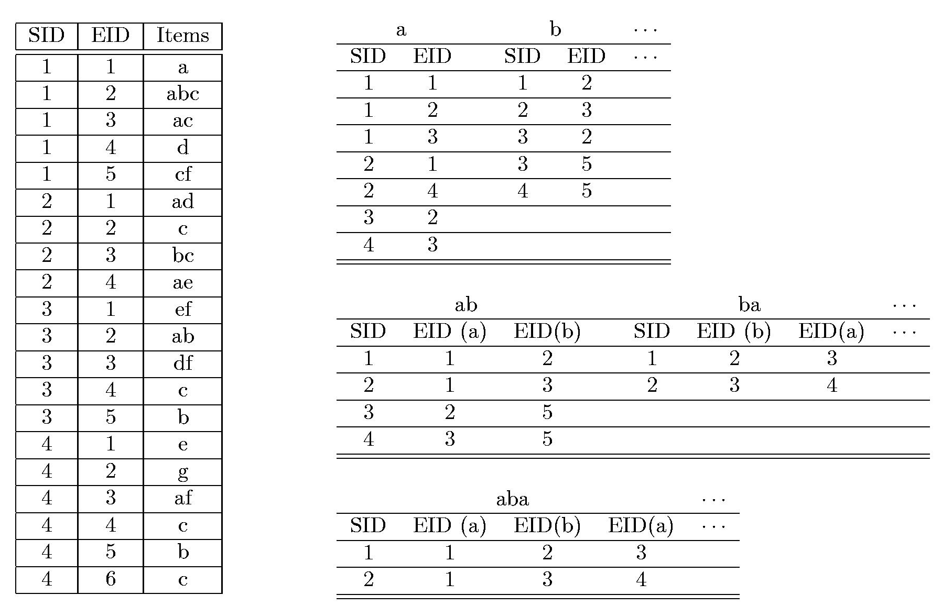
The SPADE Algorithm

Slide 12
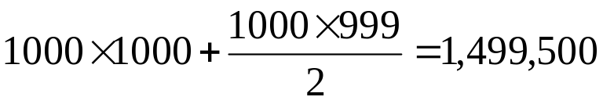
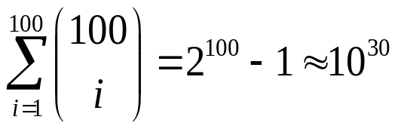
Bottlenecks of GSP and SPADE
A huge set of candidates could be generated
  1,000 frequent length-1 sequences generate s huge number of length-2 candidates!
Multiple scans of database in mining
Breadth-first search
Mining long sequential patterns
  Needs an exponential number of short candidates
  A length-100 sequential pattern needs 10³⁰ candidate sequences!

Slide 13
Prefix and Suffix (Projection)
<a>, <aa>, <a(ab)> and <a(abc)> are prefixes of sequence <a(abc)(ac)d(cf)>
Given sequence <a(abc)(ac)d(cf)>
Prefix | Suffix (Prefix-Based Projection)
<a> | <(abc)(ac)d(cf)>
<aa> | <(_bc)(ac)d(cf)>
<ab> | <(_c)(ac)d(cf)>

Slide 14
Mining Sequential Patterns by Prefix Projections
Step 1: find length-1 sequential patterns
  <a>, <b>, <c>, <d>, <e>, <f>
Step 2: divide search space. The complete set of seq. pat. can be partitioned into 6 subsets:
  The ones having prefix <a>;
  The ones having prefix <b>;
  …
  The ones having prefix <f>
SID | sequence
10 | <a(abc)(ac)d(cf)>
20 | <(ad)c(bc)(ae)>
30 | <(ef)(ab)(df)cb>
40 | <eg(af)cbc>

Slide 15
Finding Seq. Patterns with Prefix <a>
Only need to consider projections w.r.t. <a>
  <a>-projected database: <(abc)(ac)d(cf)>, <(_d)c(bc)(ae)>, <(_b)(df)cb>, <(_f)cbc>
Find all the length-2 seq. pat. Having prefix <a>: <aa>, <ab>, <(ab)>, <ac>, <ad>, <af>
  Further partition into 6 subsets
    Having prefix <aa>;
    …
    Having prefix <af>
SID | sequence
10 | <a(abc)(ac)d(cf)>
20 | <(ad)c(bc)(ae)>
30 | <(ef)(ab)(df)cb>
40 | <eg(af)cbc>

Slide 16
Completeness of PrefixSpan
SDB
SID | sequence
10 | <a(abc)(ac)d(cf)>
20 | <(ad)c(bc)(ae)>
30 | <(ef)(ab)(df)cb>
40 | <eg(af)cbc>
Length-1 sequential patterns
<a>, <b>, <c>, <d>, <e>, <f>
Having prefix <a>
Having prefix <c>, …, <f>
Having prefix <b>
<a>-projected database
<(abc)(ac)d(cf)>
<(_d)c(bc)(ae)>
<(_b)(df)cb>
<(_f)cbc>
<b>-projected database
…
Length-2 sequential
patterns
<aa>, <ab>, <(ab)>,
<ac>, <ad>, <af>
… …
Having prefix <aa>
Having prefix <af>
<aa>-proj. db
…
<af>-proj. db

Slide 17
Efficiency of PrefixSpan
No candidate sequence needs to be generated
Projected databases keep shrinking
Major cost of PrefixSpan: constructing projected databases
  Can be improved by pseudo-projections

Slide 18
Constraint-Based Seq.-Pattern Mining
Constraint-based sequential pattern mining
  Constraints: User-specified, for focused mining of desired patterns
  How to explore efficient mining with constraints? — Optimization
Classification of constraints
  Anti-monotone: E.g., value_sum(S) < 150, min(S) > 10
  Monotone: E.g., count (S) > 5, S ⊇ {PC, digital_camera}
  Succinct: E.g., length(S) ≥ 10, S ∈ {Pentium, MS/Office, MS/Money}
  Convertible: E.g., value_avg(S) < 25, profit_sum (S) > 160, max(S)/avg(S) < 2, median(S) – min(S) > 5
  Inconvertible: E.g., avg(S) – median(S) = 0

Slide 19
From Sequential Patterns to Structured Patterns
Sets, sequences, trees, graphs, and other structures
  Transaction DB: Sets of items
    {{i₁, i₂, …, i_{m}}, …}
  Seq. DB: Sequences of sets:
    {<{i₁, i₂}, …, {i_{m}, i_{n}, i_{k}}>, …}
  Sets of Sequences:
    {{<i₁, i₂>, …, <i_{m}, i_{n}, i_{k}>}, …}
  Sets of trees: {t₁, t₂, …, t_{n}}
  Sets of graphs (mining for frequent subgraphs):
    {g₁, g₂, …, g_{n}}
Mining structured patterns in XML documents, bio-chemical structures, etc.

Slide 20
Episodes and Episode Pattern Mining
Other methods for specifying the kinds of patterns
  Serial episodes: A → B
  Parallel episodes: A & B
  Regular expressions: (A | B)C*(D → E)
Methods for episode pattern mining
  Variations of Apriori-like algorithms, e.g., GSP
  Database projection-based pattern growth
    Similar to the frequent pattern growth without candidate generation

Slide 21
Ref: Mining Sequential Patterns
R. Srikant and R. Agrawal. Mining sequential patterns: Generalizations and performance improvements. EDBT’96.
H. Mannila, H Toivonen, and A. I. Verkamo. Discovery of frequent episodes in event sequences. DAMI:97.
M. Zaki. SPADE: An Efficient Algorithm for Mining Frequent Sequences. Machine Learning, 2001.
J. Pei, J. Han, H. Pinto, Q. Chen, U. Dayal, and M.-C. Hsu. PrefixSpan: Mining Sequential Patterns Efficiently by Prefix-Projected Pattern Growth. ICDE'01 (TKDE’04).
J. Pei, J. Han and W. Wang, Constraint-Based Sequential Pattern Mining in Large Databases, CIKM'02.
X. Yan, J. Han, and R. Afshar. CloSpan: Mining Closed Sequential Patterns in Large Datasets. SDM'03.
J. Wang and J. Han, BIDE: Efficient Mining of Frequent Closed Sequences, ICDE'04.
H. Cheng, X. Yan, and J. Han, IncSpan: Incremental Mining of Sequential Patterns in Large Database, KDD'04.
J. Han, G. Dong and Y. Yin, Efficient Mining of Partial Periodic Patterns in Time Series Database, ICDE'99.
J. Yang, W. Wang, and P. S. Yu, Mining asynchronous periodic patterns in time series data, KDD'00.

