Slide 1
Association Rule Mining
Part 2
(under construction!)
Introduction to Data Mining with Case Studies
Author: G. K. Gupta
Prentice Hall India, 2006.

Slide 2
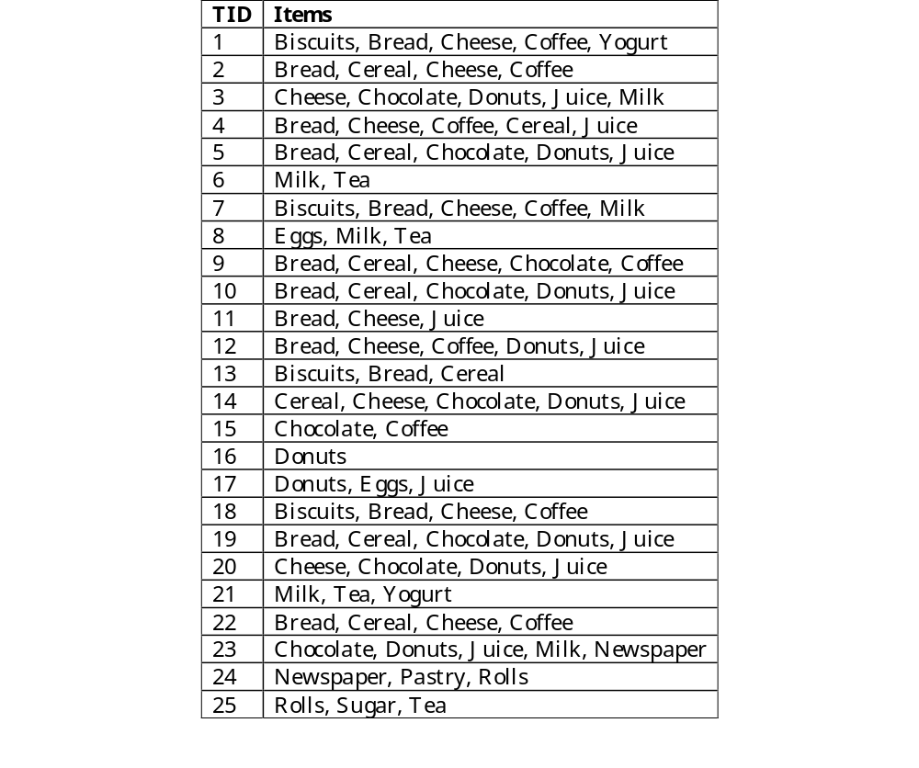
Bigger Example

Slide 3
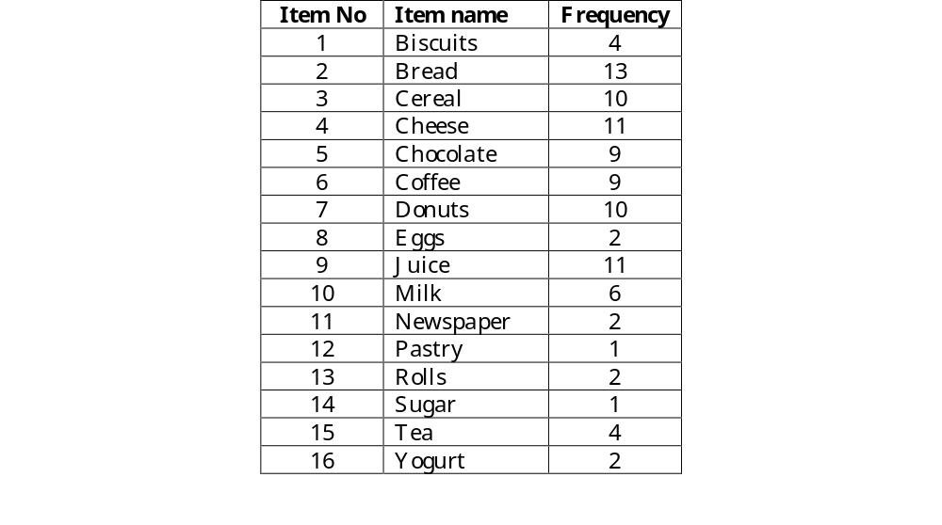
Frequency of Items

Slide 4

Frequent Items
Assume 25% support. In 25 transactions, a frequent item must occur in at least 7 transactions. The frequent 1-itemset or L₁ is now given below. How many candidates in C₂? List them.

Slide 5
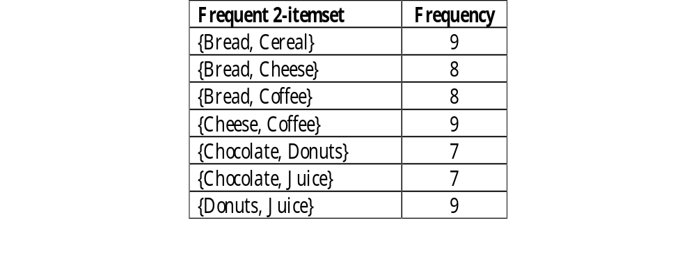
L₂
The following pairs are frequent. Now find C₃ and then L₃ and the rules.

Slide 6
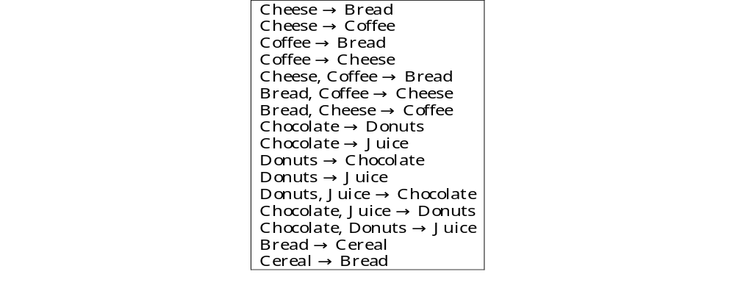
Rules
The full set of rules are given below. Could some rules be removed?
Comment: Study the above rules carefully.

Slide 7
Improving the Apriori Algorithm
Many techniques for improving the efficiency have been proposed:
  Pruning (already mentioned)
  Hashing based technique
  Transaction reduction
  Partitioning
  Sampling
  Dynamic itemset counting

Slide 8
Pruning
Pruning can reduce the size of the candidate set C_{k}. We want to transform C_{k} into a set of frequent items L_{k}. To reduce the work of checking, we may use the rule that all subsets of C_{k} must also be frequent.

Slide 9
Example
Suppose the items are A, B, C, D, E, F, .., X, Y, Z
Suppose L₁ is A, C, E, P, Q, S, T, V, W, X
Suppose L₂ is {A, C}, {A, F}, {A, P}, {C, P}, {E, P},
{E, G}, {E, V}, {H, J}, {K, M}, {Q, S}, {Q, X}
Are you able to identify errors in the L₂ list?
What is C₃?
How to prune C₃?
C₃ is {A, C, P}, {E, P, V}, {Q, S, X}

Slide 10
Hashing
The direct hashing and pruning (DHP) algorithm attempts to generate large itemsets efficiently and reduces the transaction database size.
When generating L₁, the algorithm also generates all the 2-itemsets for each transaction, hashes them to a hash table and keeps a count.

Slide 11

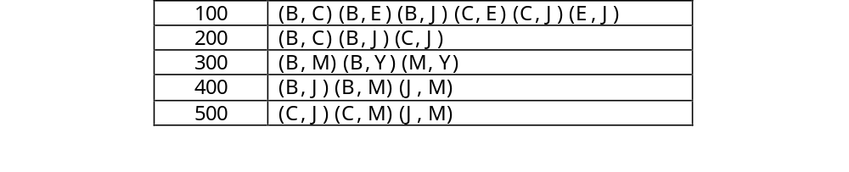
Example
Consider the transaction database in the first table below used in an earlier example. The second table below shows all possible 2-itemsets for each transaction.

Slide 12
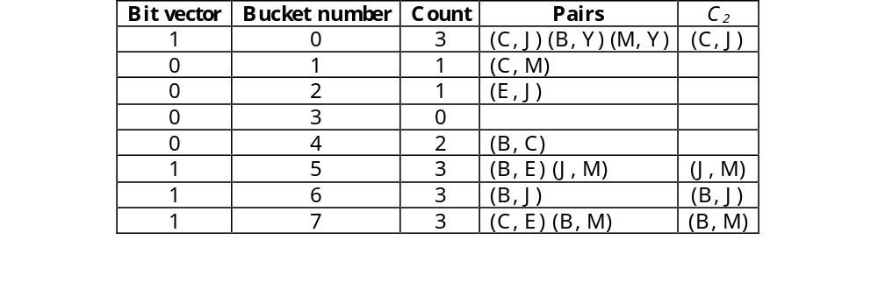
Hashing Example
The possible 2-itemsets in the last table are now hashed to a hash table below. The last column shown in the table below is not required in the hash table but we have included it for explaining the technique.

Slide 13
Hash Function Used
For each pair, a numeric value is obtained by first representing B by 1, C by 2, E 3, J 4, M 5 and Y 6. Now each pair can be represented by a two digit number, for example (B, E) by 13 and (C, M) by 26.
The two digits are then coded as modulo 8 number (dividing by 8 and using the remainder). This is the bucket address.
A count of the number of pairs hashed is kept. Those addresses that have a count above the support value have the bit vector set to 1 otherwise 0.
All pairs in rows that have zero bit are removed.

Slide 14
Find C₂
The major aim of the algorithm is to reduce the size of C₂. It is therefore essential that the hash table is large enough so that collisions are low. Collisions result in loss of effectiveness of the hash table. This is what happened in the example in which we had collisions in three of the eight rows of the hash table which required us finding which pair was frequent.

Slide 15
Transaction Reduction
As discussed earlier, any transaction that does not contain any frequent k-itemsets cannot contain any frequent (k+1)-itemsets and such a transaction may be marked or removed.

Slide 16
Example
Frequent items (L₁) are A, B, D, M, T. We are not able to use these to eliminate any transactions since all transactions have at least one of the items in L₁. The frequent pairs (C₂) are {A,B} and {B,M}. How can we reduce transactions using these?
TID | Items bought
001 | B, M, T, Y
002 | B, M
003 | T, S, P
004 | A, B, C, D
005 | A, B
006 | T, Y, E
007 | A, B, M
008 | B, C, D, T, P
009 | D, T, S
010 | A, B, M

Slide 17
Partitioning
The set of transactions may be divided into a number of disjoint subsets. Then each partition is searched for frequent itemsets. These frequent itemsets are called local frequent itemsets.
How can information about local itemsets be used in finding frequent itemsets of the global set of transactions?
In the example on the next slide, we have divided a set of transactions into two partitions. Find the frequent items sets for each partition. Are these local frequent itemsets useful?

Slide 18
Example
1 | 2 | 5 | 7
2 | 3 | 4 | 5
5 | 6 | 11
2 | 5 | 7 | 4 | 13
6 | 11 | 13 | 2 | 4
14 | 19
1 | 2 | 5 | 7 | 14
12 | 14 | 19
2 | 4 | 5 | 6 | 7
2 | 4 | 6 | 11 | 13
2 | 4 | 6 | 11 | 13
2 | 13
2 | 5 | 7 | 11 | 13
1 | 2 | 3
4 | 5 | 6
1 | 2 | 5 | 7
2 | 4 | 6 | 11 | 13
5 | 6 | 11 | 13

Slide 19
Partitioning
Phase 1
  Divide n transactions into m partitions
  Find the frequent itemsets in each partition
  Combine all local frequent itemsets to form candidate itemsets
Phase 2
Find global frequent itemsets

Slide 20
Sampling
A random sample (usually large enough to fit in the main memory) may be obtained from the overall set of transactions and the sample is searched for frequent itemsets. These frequent itemsets are called sample frequent itemsets.
How can information about sample itemsets be used in finding frequent itemsets of the global set of transactions?

Slide 21
Sampling
Not guaranteed to be accurate but we sacrifice accuracy for efficiency. A lower support threshold may be used for the sample to ensure not missing any frequent datasets.
The actual frequencies of the sample frequent itemsets are then obtained.
More than one sample could be used to improve accuracy.

Slide 22
Problems with Association Rules Algorithms
Users are overwhelmed by the number of rules identified ─ how can the number of rules be reduced to those that are relevant to the user needs?
Apriori algorithm assumes sparsity since number of items on each record is quite small.
Some applications produce dense data which may also have
  many frequently occurring items
  strong correlations
  many items on each record

Slide 23
Problems with Association Rules
Also consider:
AB → C (90% confidence)
and A → C (92% confidence)
Clearly the first rule is of no use. We should look for more complex rules only if they are better than simple rules.

Slide 24
Top Down Approach
Algorithms considered so far were bottom up i.e. they started from looking at each frequent item, then each pair and so on.
Is it possible to design top down algorithms that consider the largest group of items first and then finds the smaller groups. Let us first look at the itemset ABCD which can be frequent only if all subsets are frequent.

Slide 25
Subsets of ABCD
ABCD
ABC
ABD
ACD
BCD
AB
AC
AD
BC
BD
CD
A
B
C
D

Slide 26
Closed and Maximal Itemsets
A frequent closed itemset is a frequent itemset X such that there exists no superset of X with the same support count as X.
A frequent itemset Y is maximal if it is not a proper subset of any other frequent itemset.
Therefore a maximal itemset is a closed itemset but a closed itemset is not necessarily a maximal itemset.

Slide 27
Closed and Maximal Itemsets
Frequent maximal itemsets – the frequent maximal itemsets uniquely determine all frequent itemsets. Therefore the aim of any association rule algorithm is to find all maximal frequent itemsets.

Slide 28
Closed and Maximal Itemsets
In Example, we found {B, D} and {B, C, D} had the same support of 8 while {C, D} had a support of 9. {C, D} is therefore a closed itemset but not maximal. On the other hand, {B, C} was frequent but no superset of the two items is frequent. This pair therefore is maximal as well as closed.

Slide 29
Closed and maximal itemsets
Frequent
Itemsets
Closed
Frequent
Itemsets
Maximal
Frequent
Itemsets

Slide 30
Performance Evaluation of Algorithms
The FP-growth method was usually better than the best implementation of the Apriori algorithm.
CHARM was also usually better than Apriori. In some cases, Charm was better than the FP-growth method.
Apriori was generally better than other algorithms if the support required was high since high support leads to a smaller number of frequent items which suits the Apriori algorithm.
At very low support, the number of frequent items became large and none of the algorithms were able to handle large frequent sets gracefully.

Slide 31
Bibliography
R. Agarwal, T. Imielinski, and A. Swami, Mining Association Rules Between sets of Items in Large Databases, In Proc of the ACM SIGMOD, 1993, pp. 207-216.
R. Ramakrishnan and J. Gehrke, Database management systems,, 2nd ed. McGraw-Hill, 2000.
M. J. A. Berry and G. Linoff, Mastering data mining : the art and science of customer relationship management, Wiley, 2000.
I. H. Witten and E. Frank, Data mining: practical machine learning tools and techniques with Java implementations,. Morgan Kaufmann, 2000.

Slide 32
Bibliography
M. J. A. Berry and G. Linoff, Data mining techniques: for marketing, sales, and customer support, New York : Wiley, 1997.
U. M. Fayyad, G. Piatetsky-Shapiro, P. Smyth, and R. Uthurusamy (eds.), Advances in Knowledge Discovery and Data Mining, AAAI/MIT Press, 1996.
R. Agarwal, M. Mehta, J. Shafer, A. Arning, and T. Bollinger, The Quest Data Mining System, Proc 1996 Int. Conf on Data Mining and Knowledge Discovery (KDD’96), Portland, Oregon, pp. 244-249, Aug 1996.

