Slide 1
The Concept of Maximal Frequent Itemsets
NCU CSIE Database Laboratory
Kuo-Yu Huang
2002-04-15

Slide 2
Outline
Introduction
Max-Miner
MAFIA
GenMax
Conclusion

Slide 3
Introduction(1/2)
Interesting datasets with long patterns
  Questionnaire results
  Transactions database
    Contain many frequently occurring items
    A wide average record length
Apriori-like algorithms are inadequate
  Enumerates every single frequent itemsets

Slide 4
Introduction(2/2)
Maximal Frequent Itemsets
  If it has no superset that is frequent.
  eq
    Items: a, b, c, d, e
    Frequent Itemset: {a, b, c}
    {a, b, c, d}, {a, b, c, e}, {a, b, c, d, e} are not Frequent Itemset.
    Maximal Frequent Itemsets: {a, b, c}

Slide 5
Max-Miner(1/4)
Efficiently mining long patterns from databases
  R. J. Bayardo
  ACM SIGMOD’98
Max-Miner
  Abandons a bottom-up traversal
  Attempts to “look-ahead”
  Identify a long frequent itemset, prune all its subsets.

Slide 6
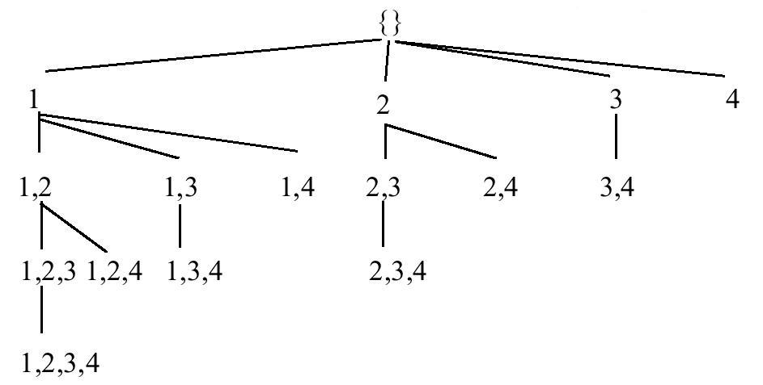
Max-Miner(2/4)
Set-enumeration tree
Breadth-first search

Slide 7
Max-Miner(3/4)
Candidate group
  Head: h(g)
    Itemset enumerated by the node.
  Tail: t(g)
    An ordered set and contains all items not in h(g)
  eg:Node {1}
    h{g}: {1}
    t{g}: {2, 3, 4}

Slide 8
Max-Miner(4/4)
Support counting
  h(g), h(g)∪t{g}, h(g) ∪{i} for all
  If h(g)∪t{g} is frequent, then any itemset enumerated by a sub-node will also be frequent but no maximal.
  If h(g)∪{i} is infrequent, then any head of a sub-node that contains item I will also be infrequent.

Slide 9
MAFIA(1/4)
MAFIA: A Maximal Frequent Itemset Algorithm for Transactional Databases.
  D. Burdick, M. Calimlim, and J. Gehrke.
  ICDE’01
MAFIA
  Integrates a depth-first traversal of the itmset lattice with eiffective pruning mechanisms

Slide 10
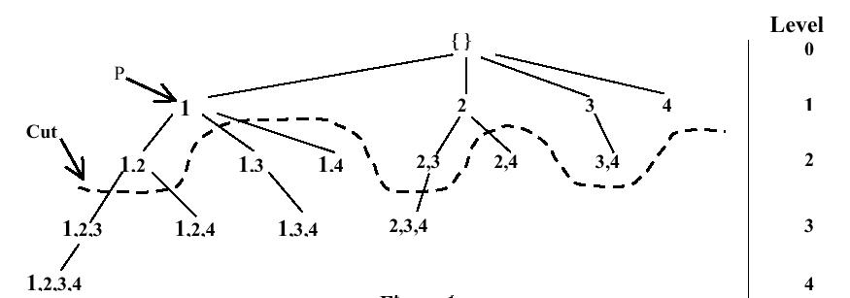
MAFIA(2/4)

Slide 11
MAFIA(3/4)
HUTMFI
  Check Head Union Tail is in MFI
    Stop searching and return
PEP
  newNode = C ∪ i
  Check newNode.support == C.support
    Move I from C.tail to C.head
FHUT
  newNode = C ∪ I
  Whether I is the leftmost child in the tail

Slide 12
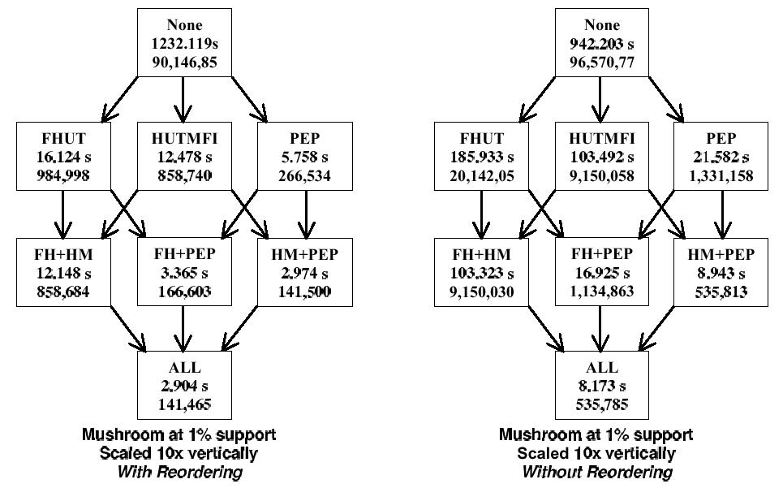
MAFIA(4/4)

Slide 13
GenMax(1/2)
Efficiently Mining Maximal Frequent Itemsets
  Karam Gouda and Mohammed J. Zaki.
  ICDM’01
GenMax
  A backtrack search based algorithm for mining maximal frequent itemsets.

Slide 14
GenMax(2/2)
Superset checking techniques
  Do superset check only for I_{l+1}∪P_{l+1}
  Using check_status flag
  Local maximal frequent itemsets
Reordering the combine set
Diffsets propagation

Slide 15
Conclusion(1/4)
Type I:
  normal MFI distribution with not too long maximal patterns.
Type II:
  Left-skewed distribution with longer pattern
Type III:
  Exponential decay distribution with short maximal pattern
database | # of Items | Average length | # of records | Maximal pattern length
Chess Pumsb | 76 7117 | 37 74 | 3196 49046 | 23(20%) 27(40%)
Connect Pumsb* | 130 7117 | 43 50 | 67557 49046 | 31(2.5%) 43(2.5%)
T10I4D100K T40I10D100K | 1000 1000 | 10 40 | 100,000 100,000 | 13(0.01%) 25(0.1%)
Type I
Type II
Type III

Slide 16
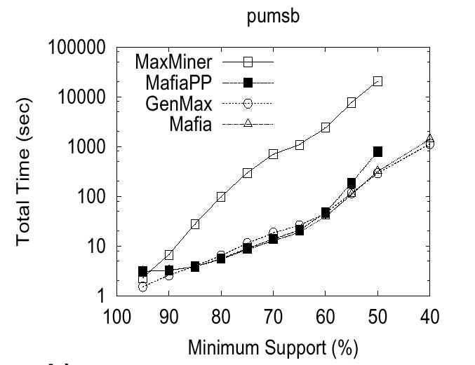
Conclusion(2/4)

Slide 17
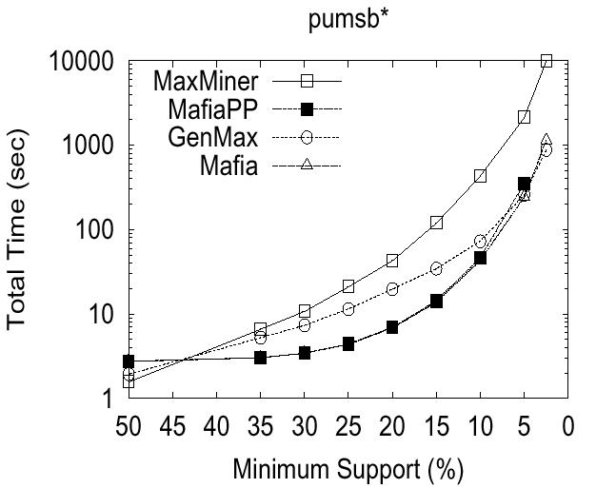
Conclusion(3/4)

Slide 18
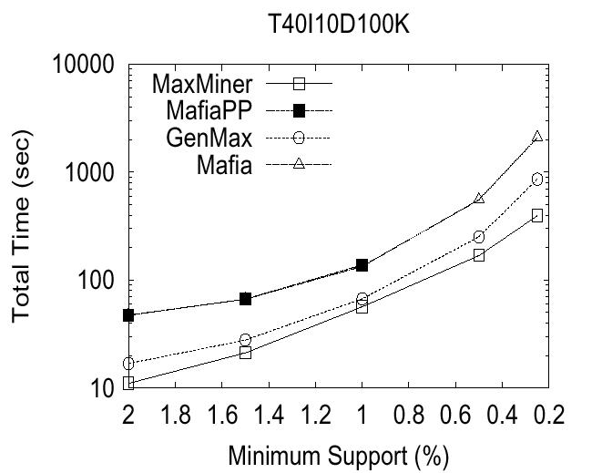
Conclusion(4/4)

