Slide 1
Flocking
Artificial intelligence for Games

Slide 2
Flocking
In the natural world, organisms exhibit certain behaviours when traveling in groups
This phenomenon, also known as flocking, occurs at both microscopic scales (bacteria) and macroscopic scales (insects, fish & birds)
Another example is a crowd full of people, making their way from one part of town to another, or going to/from a sporting venue

Slide 3
Flocking
Using computers, these patterns can be simulated by creating simple rules and combining them.
Craig Reynolds was the first person to simulate flocking behaviour using his program called “Boids” in 1986.
This is known as emergent behaviour, and can be used in games to simulate chaotic or life-like group movement.
Flocking AI has acted as a valuable tool for scientists and nature lovers alike because it has helped one gain a greater understanding of the way creatures interact with each other.

Slide 4
Flocking
A specialised version of steering behaviours
Basic models of flocking behaviour are controlled by three simple rules:
Separation - avoid crowding neighbours (short range repulsion)
Alignment - steer towards average heading of neighbours
Cohesion - steer towards average position of neighbours (long range attraction)
With these three simple rules, the flock moves in an extremely realistic way, creating complex motion and interaction that would be extremely hard to create otherwise.

Slide 5

Alignment
Alignment is a behaviour that causes a particular agent to line up with agents close by.
We need a function that computes a vector based on the velocity vectors associated with the nearest neighbours (either the n closest or those within a given distance of the agent).

Slide 6
We average the velocities of the other boids. We calculate an average velocity from nearby boids, averageVelocity_{i}, then add a small portion (about an eighth but can vary) to the boid's current velocity.
PROCEDURE alignment(boid currentBoid_{i})
Vector averageVelocity_{i} = 0
Count = 0
FOR EACH NEARBY BOID nearbyBoid
IF nearbyBoid != currentBoid_{J} THEN
averageVelocity_{i} += nearbyBoid.velocity
END IF
Count++
END FOR
averageVelocity_{i} = averageVelocity_{J} / Count - 1
RETURN (averageVelocity_{i} + currentBoid_{i}.velocity) / 8
END PROCEDURE

Slide 7

Cohesion
Cohesion is a behaviour that causes agents to steer towards the "center of mass" - that is, the average position of the agents within a certain radius.
The implementation is almost identical to that of the alignment behavior, but there is a key difference.
Instead of adding the velocity to the steering vector, the position is added instead.

Slide 8
The 'centre of mass' is simply the average position of all the boids. However, it makes sense to consider moving towards the average position of all percieved boids except itself i.e. the perceived centre of mass.
PROCEDURE cohesion(boid currentBoid_{i})
Vector averagePosition_{i} = 0
Count = 0
FOR EACH BOID nearbyBoid
IF nearbyBoid != currentBoid_{i} THEN
averagePosition_{i} += nearbyBoid.position
END IF
Count++
END FOR
averagePosition_{i} = averagePosition_{i} / Count - 1
RETURN (averagePosition_{i} - currentBoid_{i}.position) / 100
END PROCEDURE

Slide 9

Separation
Separation is the behaviour that causes an agent to steer away from all of its neighbours.
The purpose of this rule is to make sure that the agents do not collide with each other.

Slide 10
Simply look at each boid, and if it's within a defined small distance (say 100 units) of another boid move it as far away again as it already is. This is done by subtracting from a vector c the displacement of each boid which is near by. Initialise c to zero as we want this rule to give a vector which when added to the current position moves a boid away from those near it.
PROCEDURE separation(boid currentBoid_{i})
Vector seperation = 0;
FOR EACH BOID nearbyBoid
IF nearbyBoid != currentBoid_{i} THEN
IF |nearbyBoid.position - currentBoid_{i}.position| < 100 THEN
seperation -= (nearbyBoid.position - currentBoid_{i}.position)
END IF
END IF
END FOR
RETURN seperation
END PROCEDURE

Slide 11
Combine With Steering
As flocking uses a modification of the steering algorithms
Other behaviours can be added e.g.
Obstacle avoidance
Fleeing
Chasing
These can lead to interesting behaviours for predator or prey like creatures
The weights of the various steering forces may need to be tweaked to get good results

Slide 12
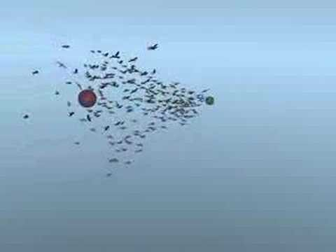
How It Looks

