Slide 1
Consumer Trust in Online Reviews
A Statistical Analysis of Pakistani Online Shoppers
Presented By:
• Adeeha Shahzad (241125) • Khansa Aslam (242887)
Notes:
Welcome to our presentation on Consumer Trust in Online Reviews. This study was conducted as part of the Applied Statistics course under Dr. Faridoon Khan at Air University, Islamabad. Our group analyzed data from 81 Pakistani online shoppers to understand how reviews influence purchasing behavior. The analysis applies five non-parametric statistical tests due to non-normally distributed data.

Slide 2
Introduction & Problem Statement
Background
Key Research Areas
E-commerce in Pakistan is growing rapidly, with millions of consumers turning to platforms like Daraz, Instagram Shops, and Amazon.
Online reviews have become a primary source of product information, yet the extent to which Pakistani shoppers trust and act on these reviews is understudied.
Trust in Reviews How much do shoppers trust online reviews?
Negative Review Impact Do negative reviews deter purchases more than positive ones build confidence?
Willingness to Pay More Are shoppers willing to pay a premium for highly reviewed products?
Demographic Differences Do trust levels vary by age or return behavior?
Review-Checking Behavior Does frequency of checking reviews predict trust?
Notes:
Pakistan's e-commerce landscape is expanding rapidly, making consumer trust in digital reviews a pressing research topic. This study investigates five key research areas: how much Pakistani shoppers trust reviews, the disproportionate influence of negative reviews, willingness to pay premium prices, differences across demographic groups, and whether habitual review-checking correlates with higher trust. The findings have practical implications for both consumers and e-commerce businesses.

Slide 3
Methodology
Data Collection
Variables Measured
Recoding Process
Statistical Tests
Google Forms survey
Sample size: 81 respondents
Collection: May 18–30, 2026
Convenience sampling
Trust in Online Reviews (TrustLevel)
Negative Review Impact (NegImpact)
Willingness to Pay More (PayMore)
Age, platform used, return behavior
Raw text responses recoded to numeric values in SPSS
Value labels assigned for interpretation
Age grouped: 18–27 vs 28+ years
Review behavior: Sometimes or Less vs Usually or Always
Shapiro-Wilk (normality)
Wilcoxon Signed-Rank
Mann-Whitney U
Kruskal-Wallis H
Chi-Square + Cramér's V
Spearman Correlation
Notes:
The study used a Google Forms survey distributed to 81 respondents between May 18–30, 2026. Variables were measured using Likert-scale items and recoded numerically in SPSS for analysis. Notably, age was grouped into two categories for the Chi-Square test, and review-checking behavior was dichotomized. Because the Shapiro-Wilk test revealed non-normal distributions across all key variables, five non-parametric tests were selected to ensure valid inference.

Slide 4
Demographics
Age Distribution of Respondents
Most Used Shopping Platform
Notes:
The sample skews young, with over 55% of respondents aged 18–22 years. This demographic profile is consistent with the primary user base of Pakistani e-commerce platforms. Daraz dominates platform usage at 40.7%, followed by Instagram and Facebook Shops at 33.3%. The heavy representation of younger respondents should be kept in mind when interpreting findings, as it may limit generalizability to older consumer segments.

Slide 5
Descriptive Statistics
3.42
3.90
3.12
Trust in Reviews
(Mean)
Negative Review Impact
(Mean)
Willingness to Pay More
(Mean)
SD = 0.998
SD = 1.147
SD = 1.144
Variable | N | Minimum | Maximum | Mean | Std. Deviation
Trust in Reviews | 81 | 1 | 5 | 3.42 | 0.998
Negative Review Impact | 81 | 1 | 5 | 3.90 | 1.147
Willingness to Pay More | 81 | 1 | 5 | 3.12 | 1.144
All three variables measured on a 5-point Likert scale (1 = Strongly Disagree, 5 = Strongly Agree).
Notes:
Descriptive statistics reveal that Negative Review Impact has the highest mean (3.90), suggesting respondents feel negative reviews affect their decisions more than their general trust level (3.42). Willingness to Pay More scored lowest (3.12), indicating moderate price sensitivity among respondents. All variables are measured on a 5-point Likert scale. The relatively similar standard deviations across variables indicate comparable variability in responses.

Slide 6
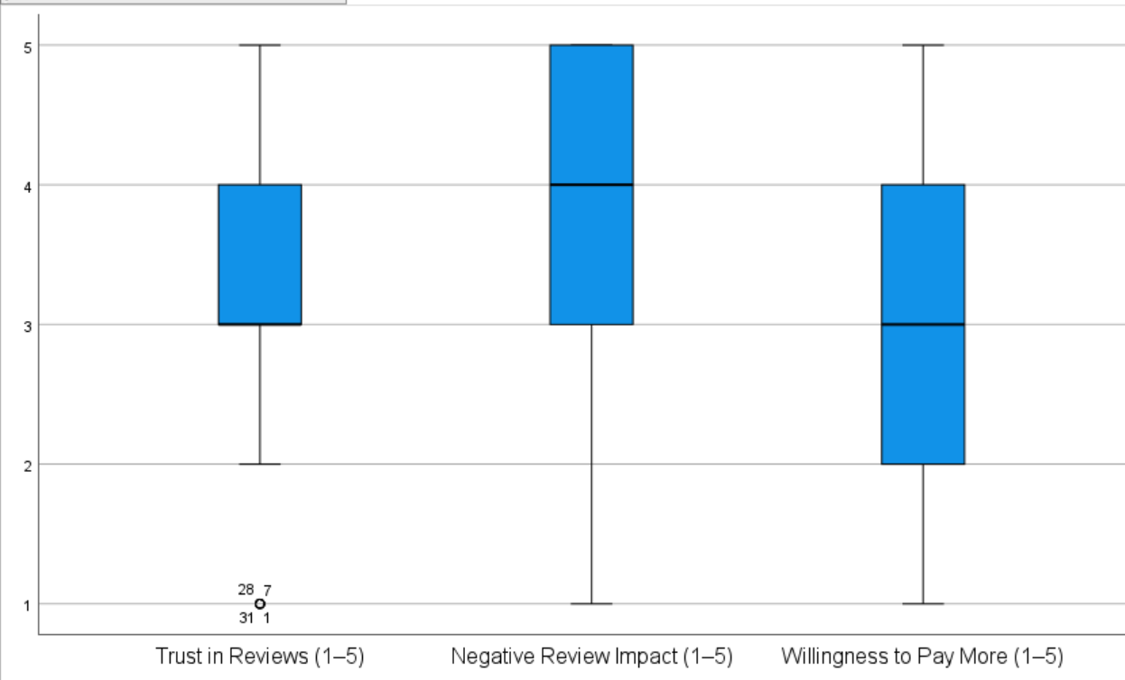
Normality Assessment — Shapiro-Wilk Test
Variable | Statistic (W) | df | p-value | Normal?
Trust in Reviews | — | 81 | < .001 | No ✗
Negative Review Impact | — | 81 | < .001 | No ✗
Willingness to Pay More | — | 81 | < .001 | No ✗
⚠ All three variables are non-normally distributed (p < .001). → Non-parametric tests selected for all inferential analyses.
Notes:
The Shapiro-Wilk test was chosen because our sample size is under 2000 respondents. Results show that all three key variables — Trust in Reviews, Negative Review Impact, and Willingness to Pay More — significantly deviate from normality, with p < .001 in all cases. This violation of the normality assumption means that parametric tests such as the t-test or ANOVA would be inappropriate. Therefore, we proceed with non-parametric alternatives throughout the analysis.

Slide 7
Data Transformation
Step 1 — Recoded Text Variables to Numbers
Step 2 — Value Labels (Example: Age)
Variable | Original Text Values | Numeric Codes
Age | 18-22, 23-27, 28-35, 35+ | 1, 2, 3, 4
Education | Matric, Intermediate, Undergraduate, Postgraduate | 1, 2, 3, 4
Shopping Frequency | Rarely, 1-2x, 3-5x, 5+ times | 1, 2, 3, 4
Review Checking | Never, Rarely, Sometimes, Usually, Always | 1, 2, 3, 4, 5
Review Count Importance | Not important → Extremely important | 1, 2, 3, 4, 5
Verified Badge Trust | Trust less → Trust completely | 1, 2, 3, 4, 5
Photos/Videos Trust | Yes, No, Doesn't matter | 1, 0, 2
Cross-platform Check | Never, Rarely, Sometimes, Usually, Always | 1, 2, 3, 4, 5
Ignore Reviews | Never, Rarely, Sometimes, Usually, Always | 1, 2, 3, 4, 5
Returned Product | Yes, No, Never returned | 1, 0, 2
Value | Label Shown in SPSS
1 | 18–22
2 | 23–27
3 | 28–35
4 | 35+
Step 3 — Further Recoding for Chi-Square Test
Original | Recoded To
Age 1 (18-22), 2 (23-27) | Group 1: 18–27 years
Age 3 (28-35), 4 (35+) | Group 2: 28+ years
Review: 1-3 (Never–Sometimes) | Group 1: Sometimes or Less
Review: 4-5 (Usually–Always) | Group 2: Usually or Always
Key Takeaway: All categorical text responses from Google Forms were recoded into numeric values for SPSS compatibility. Value labels were added to preserve readability in output. For Chi-Square analysis, Age and Review Checking were further dichotomized into two groups each, enabling a clean 2×2 contingency table.
Notes:
This slide explains the three-step data transformation process. First, all Google Forms text responses were recoded into numeric values so SPSS could run statistical tests. Second, value labels were added so SPSS output shows meaningful text rather than raw numbers. Third, for the Chi-Square test, age was grouped into 18–27 and 28+ years, and review-checking frequency was dichotomized into 'Sometimes or Less' and 'Usually or Always' to create a valid 2×2 contingency table.

Slide 8
Research Questions & Hypotheses
Statistical Test | H₀ (Null Hypothesis) | H₁ (Alternative)
Wilcoxon Signed-Rank | No difference between Trust in Reviews and Negative Review Impact | Significant difference exists
Mann–Whitney U | No trust difference between return groups | Trust differs between return groups
Kruskal–Wallis H | No trust difference across age groups | At least one age group differs
Chi-Square Test | Age and review-checking behavior are independent | Age and review-checking are associated
Spearman Correlation | No relationship between review-checking frequency and trust | Significant relationship exists
Notes:
This table summarizes the five research questions and their corresponding null and alternative hypotheses. All hypotheses were tested at a significance level of α = 0.05. If the p-value for any test falls below 0.05, we reject the null hypothesis and conclude there is a statistically significant result. The five non-parametric tests were selected based on the normality assessment conducted using the Shapiro-Wilk test.

Slide 9
Wilcoxon Signed-Rank Test
Research Question: Do negative reviews influence consumers more strongly than their general trust in reviews?
H₀: No significant difference between Trust in Reviews and Negative Review Impact. H₁: A significant difference exists between the two variables.
Z-Statistic
p-value
-2.997
0.003
Rank Group | N
Negative Ranks (NegImpact < TrustLevel) | 19
Positive Ranks (NegImpact > TrustLevel) | 45
Ties | 17
Total | 81
α level
Decision
0.05
Reject H₀
Conclusion: Negative reviews have a significantly stronger influence on Pakistani consumers than their general trust in reviews (Z = −2.997, p = .003 < .05).
Notes:
The Wilcoxon Signed-Rank Test compares two related samples from the same respondents — their trust level versus the impact of negative reviews. With 45 positive ranks versus 19 negative ranks, negative review impact scores are generally higher than trust scores. The Z-statistic of −2.997 and p-value of 0.003, well below α = 0.05, provide strong evidence to reject the null hypothesis. Pakistani consumers are disproportionately swayed by negative reviews.

Slide 10
Chi-Square Test of Independence
Research Question: Is there a statistically significant association between age group and review-checking behavior?
H₀: Age group and review-checking behavior are independent. H₁: Age group and review-checking behavior are associated.
Pearson χ²
df
6.809
1
Age Group | Usually/Always Check | Sometimes or Less
18–27 years | 88% | 12%
28+ years | 62% | 38%
p-value
Cramér's V
0.009
0.366
Conclusion: Significant association found (χ² = 6.809, p = .009). Younger consumers (18–27) are more likely to check reviews. Effect size is moderate (Cramér's V = 0.366). Reject H₀.
Notes:
The Chi-Square test examines whether age group and review-checking frequency are statistically related. Age was recoded into two groups: 18–27 years and 28+ years. Review-checking behavior was dichotomized into 'Usually or Always' versus 'Sometimes or Less.' With χ² = 6.809 and p = .009, the association is significant at α = 0.05. Cramér's V of 0.366 indicates a moderate effect size, suggesting a practically meaningful difference in review habits across age groups.

Slide 11
Spearman Correlation
Research Question: Is review-checking behavior related to trust in online reviews?
H₀: No significant correlation between review-checking frequency and trust in online reviews. H₁: There is a significant correlation between review-checking frequency and trust.
Spearman's ρ
0.247
Direction: Positive — more checking → higher trust
p = 0.026 • n = 81
Strength: Weak (ρ = 0.247)
Significance: p = 0.026 < α = 0.05
Decision: Reject H₀
Conclusion: Weak but statistically significant positive relationship (ρ = 0.247, p = .026). Consumers who check reviews more frequently tend to trust them slightly more.
Notes:
Spearman's Correlation is appropriate here because both variables — review-checking frequency and trust in reviews — are ordinal, and the data violates normality assumptions. The coefficient of 0.247 indicates a weak but statistically significant positive association. While the relationship is not strong, it is consistent: people who habitually consult reviews develop a slightly higher baseline trust in them. The p-value of 0.026 confirms this is not a chance finding at α = 0.05.

Slide 12
Summary of Findings
Statistical Test | p-value | Decision | Conclusion
Wilcoxon Signed-Rank | 0.003 | Reject H₀ | Negative reviews have stronger influence than general trust
Mann–Whitney U | 0.937 | Fail to Reject H₀ | No trust difference between return groups
Kruskal–Wallis H | 0.443 | Fail to Reject H₀ | No trust difference across age groups
Chi-Square Test | 0.009 | Reject H₀ | Age is associated with review-checking behavior
Spearman Correlation | 0.026 | Reject H₀ | Weak positive relationship: review-checking & trust
Bold p-values indicate statistical significance at α = 0.05
Notes:
This slide consolidates all five test results. Three tests yielded significant results — the Wilcoxon Signed-Rank Test, Chi-Square Test, and Spearman Correlation — each with p-values below 0.05. Two tests, Mann-Whitney U and Kruskal-Wallis H, were non-significant. Together, these findings paint a nuanced picture: while negative reviews and age-related review habits matter, trust levels themselves are fairly consistent across demographic groups.

Slide 13
Conclusion, Limitations & Future Work
Key Conclusions
Limitations
Future Directions
Online reviews significantly influence purchasing decisions among Pakistani shoppers.
Negative reviews have a disproportionately stronger impact than general trust levels.
Age is associated with review-checking behavior — younger consumers check more frequently.
Trust levels do not differ significantly across age groups or by return behavior.
Small sample size (n = 81).
Predominantly young respondents (55.6% aged 18–22).
Self-reported data subject to response bias.
Geographically limited to accessible respondents.
Expand to a larger, more diverse sample.
Include additional demographics (gender, income, education).
Compare trust patterns across multiple e-commerce platforms.
Conduct longitudinal studies to track trust over time.
Thank You
Notes:
To conclude: this study found that online reviews significantly shape consumer behavior in Pakistan, with negative reviews having an outsized influence. Age predicts how frequently consumers consult reviews, and frequent checkers tend to trust reviews slightly more. However, trust levels themselves are remarkably uniform across age groups and return experience. Key limitations include the small, youth-heavy sample and self-reported data. Future research should address these by widening scope, adding demographics, and exploring longitudinal patterns.

