Slide 1


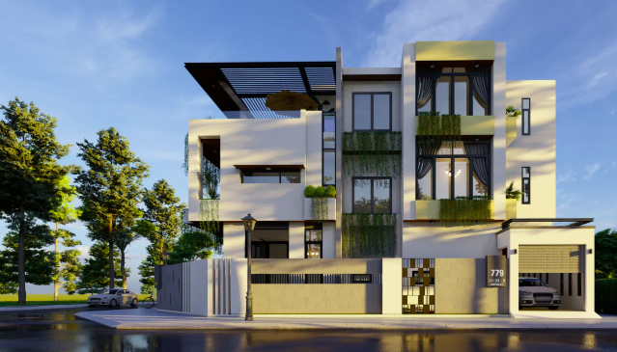

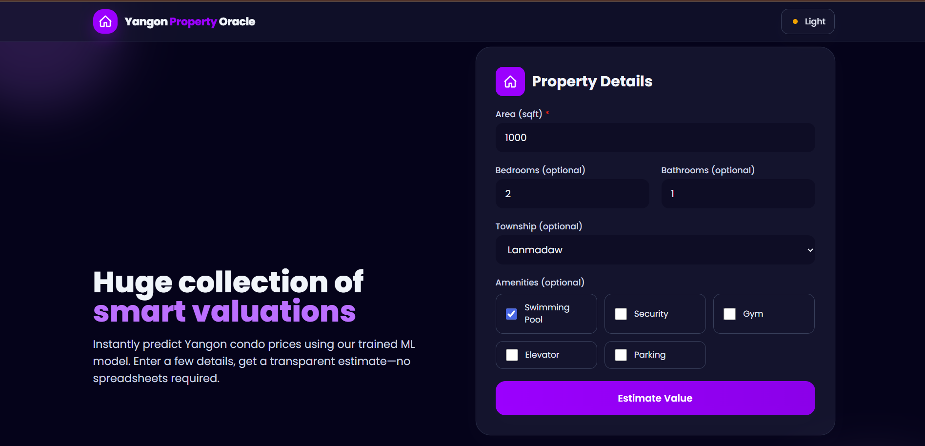
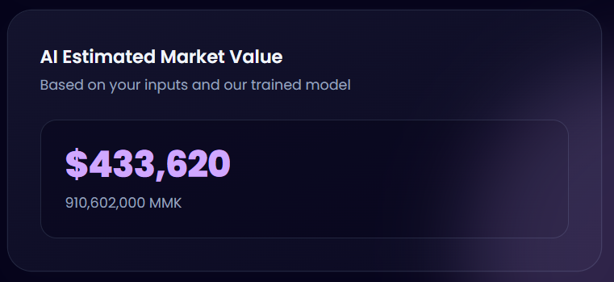
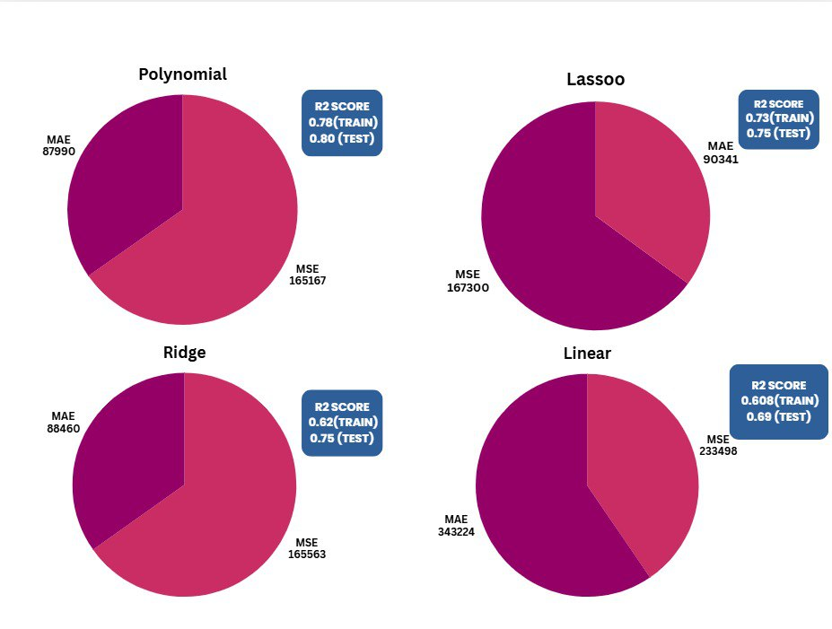
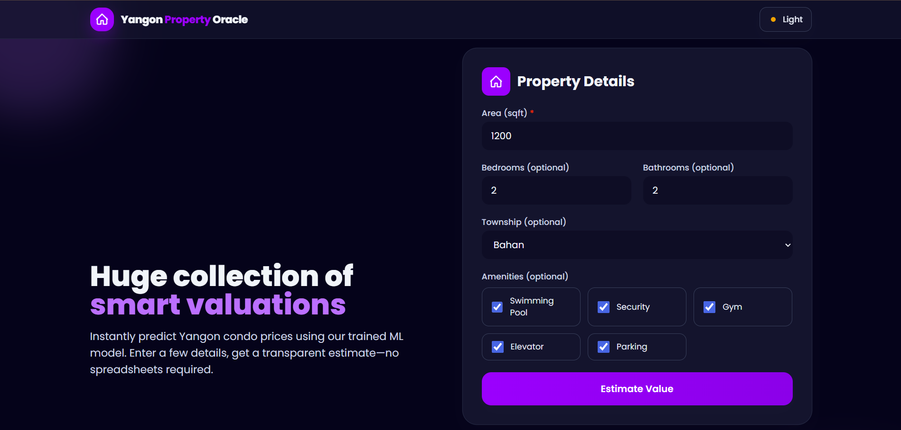
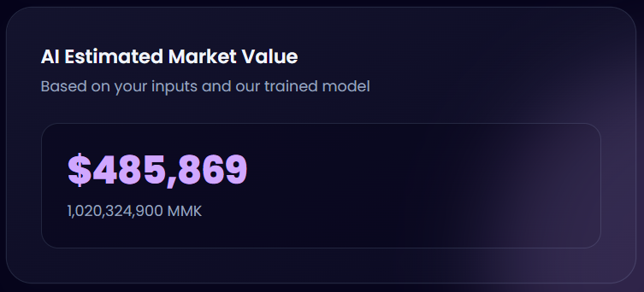
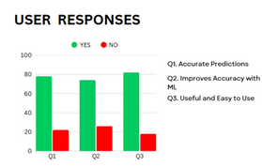
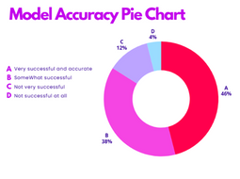
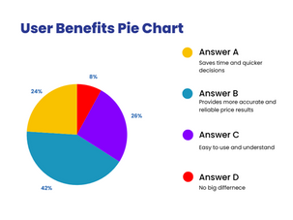
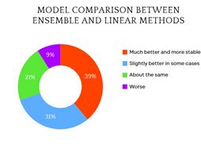
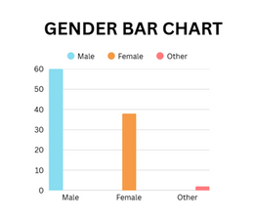
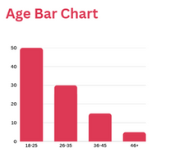
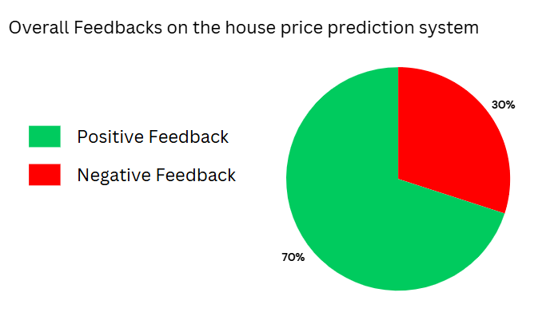
House Price Predicition,yic,gROUP-1
Introduction
Objective
  Developed a Machine Learning web app to predict condo prices in Yangon.
  Trained multiple regression models (Polynomial, Ridge, Lasso, Linear) using real housing data.
  Integrated the best-performing model into a Flask-based web interface for instant price prediction in USD and MMK.
  Ensure users can rely on accurate price predictions and make quicker, confident decisions.
  Develop a machine learning model to predict house prices effectively.
  Evaluate the model’s performance through statistical analysis and user feedback.
Methodology
Case study
observation
Data analyst
Action Research
QUESTIONARIES
Use of Personal record
Implementation Result
Implementation Result
Result Analysis
Reference
https://online-journals.org/index.php/i-jim/article/download/38073/14301/140519
https://docs.google.com/viewerng/viewer?url=http://www.jetir.org/papers/JETIR2110302.pdf
https://www.ijraset.com/best-journal/house-price-prediction-using-linear-regression

