Slide 1
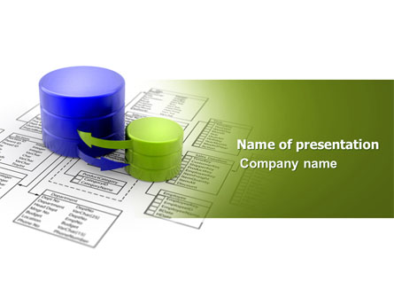
RDBMS

Slide 2
What a Relational Database Management System ?
A relational database is a set of tables (datasets with rows and columns) that contain information relating to other tables in the database.
A Relational Database Management System (RDBMS) is a collection of programs and capabilities that enable IT teams and others to create, update, administer and otherwise interact with a relational database.

Slide 3
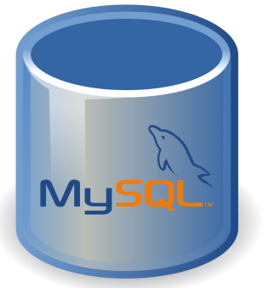
MySQL
MySQL is the most popular amongst the relational databases and is a widely used one too. Offers a fully-managed database service for Google Cloud platform and is a scalable database with high availability and security at no extra cost.
Advantages of MySQL:
Data security.
On-demand scalability.
High performance.
Round-the-clock uptime.
Comprehensive transactional support.
Complete workflow control.
The reduced total cost of ownership.
The flexibility of open source.

Slide 4
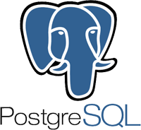
PostgreSQL
PostgreSQL is a fully managed and scalable relational database with high availability and security built in at no additional charge.
It is a fully managed database service for the Google Cloud Platform.
Is better in query optimization and query execution as compared to MySQL.
Postgres has a storage engine which is suitable for INSERT and complex search applications such as data mining.
Advantages of Postgresql:
Supports the locking mechanism.
Free and open-source software.
Supports image, video, audio storage and also supports graphical data.
Has the capacity for fault tolerance.
Requires low maintenance.
Supports Multi-version concurrency control (MVCC).
Has user-defined data-types.
Table inheritance.
Runs on all operating systems.

Slide 5
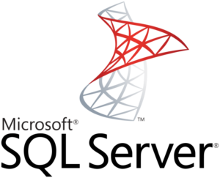
Microsoft SQL Server
Microsoft SQL Server developed by Microsoft has multiple editions with different feature sets and user profiles.
It has some fantastic features like SQL server on Linux, resumable online index build, machine learning services, query processing improvements, and much more.
Advantages of SQL Server:
Streamlined Installation.
Great Security Features.
Enhanced Performance.
Low Cost Of Ownership.

Slide 6
Comparaison between Microsoft SQL Server, MySQL and PostgreSQL
Feature | Microsoft SQL Server | MySQL | PostgreSQL
Operating System | Windows XP, Windows 2000+ | Windows (even down to 98?), Linux, Unix, Mac | Windows 2000+, Linux, Unix, Mac
Licensing | Commercial - Closed Source, Various levels of features based on version, Free Crippleware | GPL Open Source, Commercial. | BSD Open Source
Install/Maintenance Process | Hardest most time-consuming and biggest hog of resources of the 3 even when its not doing anything | Easiest | Medium
Can add columns and change names, data types of views without dropping | Yes | Yes | No - and extremely annoying if you have views that depend on other views.
Can drop tables, (drop, change size, data type of columns), and views used in views | Yes -(but if you schema bind your tables and views, you can not drop dependent objects) | Yes | No
Graphical View Designer | Yes via SQL Management Studio and Express? | No | No
Dynamic and action SQL in functions | No - but you can in Stored procedures but you can't call stored procs from SELECT statements so much more limiting than PostgreSQL | No, but can in Stored procedures which aren't callable from SELECT statements so more limiting than PostgreSQL | Yes! - you can do really cool things with action functions in SELECT statements
Schemas | Yes | No | Yes

