Slide 1
OUTLAND ADVENTURES
Milestone #5

Slide 2
Khaoula Azdoud
Tanner Agnew
I am a Software Development student living in Orlando, Florida, and working at Disney's Magic Kingdom Park. I chose to work on the Outland Adventures case study because it is close to my job. It was great working with Tanner during this project, as we shared ideas, insights, and experiences while tackling the challenges presented by the case study. This presentation will provide an overview of our collaborative efforts, the lessons learned, and our proposed solutions. I’m looking forward to seeing the choices and solutions of other groups.
This is my second semester pursuing Software Development. I live in Southern California and work at Disneyland and hope to eventually use my degree for a remote job or something in the entertainment industry. I liked the Outland Adventure Case Study because I love the outdoors and thought the supply and demand business aspects of the case were very interesting. I’m lucky to have been partnered with such a dedicated and intelligent partner like Khaoula for this project and I am excited to see what everyone else has come up with In Module 12!
Group Introduction
GROUP 1

Slide 3
Outland Adventures
Description: Outland Adventures is a venture started by Blythe Timmerson and Jim Ford, outdoor enthusiasts, to cater to people who enjoy hiking and camping in remote locations. They offer guided trips, equipment rentals, and sales, and have recently expanded their services with an e-commerce site developed by Mei Wong. The organization has seen promising growth, prompting Blythe and Jim to consider optimizing their operations. They have identified three key questions to address:
Equipment Sales: Do enough customers buy equipment to sustain equipment sales as a revenue source?
Booking Trends: Are there any downward trends in bookings for the locations they have operated in, Africa, Asia, and Southern Europe?
Inventory Aging: Are there any inventory items that are over five years old, raising concerns about their condition and relevance?

Slide 4
Assumptions
Customers provide their personal information when booking a trip.
Only one guide will be organizing the trip.
Each guide can organize and plan multiple trips.
The e-commerce site will store customer information, trip schedules, and equipment details.
The inventory age is determined based on the purchase date of each item.
Regular audits are being done to identify items that should be removed from shelves due to aging.
Each customer needs to rent or buy his equipment for the trip.
Each trip can have multiple customers.
Each customer can book one or multiple trips.
Each location can have multiple trips.
Only the supply manager is responsible for ordering supplies for the trips and keeping the equipment inventory up to date.

Slide 5
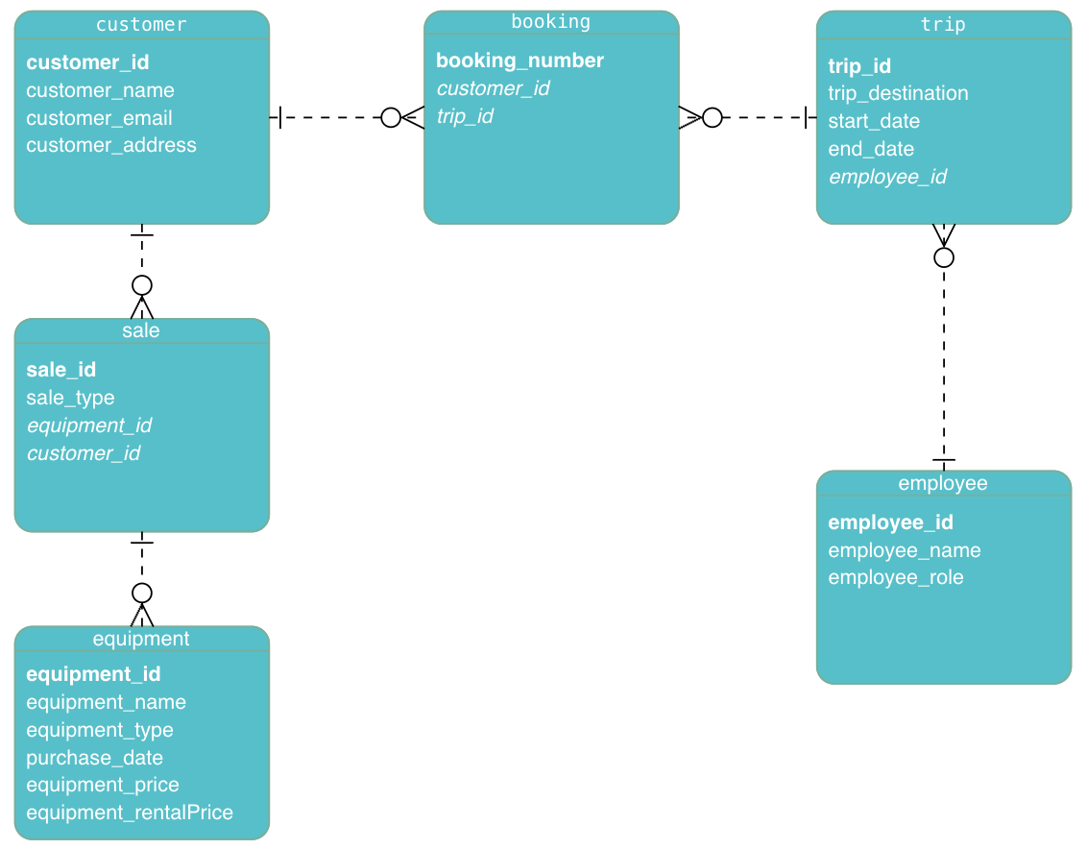
The Final ERD

Slide 6
Reports
The equipment sales report is a summary of sales related to the purchasing of equipment. It would include customer names, addresses, and the equipment that was specifically purchased by those customers.
The report aims to determine if customers are buying enough equipment to keep equipment sales as a source of revenue for Outland Adventures. Blythe and Jim would be able to use an equipment sales report to observe what items are popular, determine how profitable the sales are, and analyze other relevant sales patterns.
Equipment Sales Report:
The booking trend report is responsible for observing the current locations, in Africa, Asia, and Southern Europe, and recording the number of bookings. This kind of report serves to prevent downward trends by identifying noticeable changes in booking trends in those locations and sending a notification.
A report like this aims to identify locations that may be struggling or fluctuating in consistency so that Blythe and Jim are made aware that booking numbers are decreasing and that those locations may require additional help or alternative strategies to assist those situations.
Booking Trend Report:
The purpose of an inventory aging report is to examine the timeline of all items in the inventory. This report provides an overview of the inventory and highlights items that are five years past their purchase dates. Relevant details that are included in the report are Purchase Dates, equipment ID, type, and name. The report observes the quality of the items within the inventory as they age on the shelf.
Blythe and Jim must utilize the inventory aging report as it is crucial in updating them about products that require replacement and inventory orders that need to be refilled. This is vital for ensuring that the equipment is compliant with safety standards and ready for sale or rent by customers.
Inventory Aging Report:

Slide 7
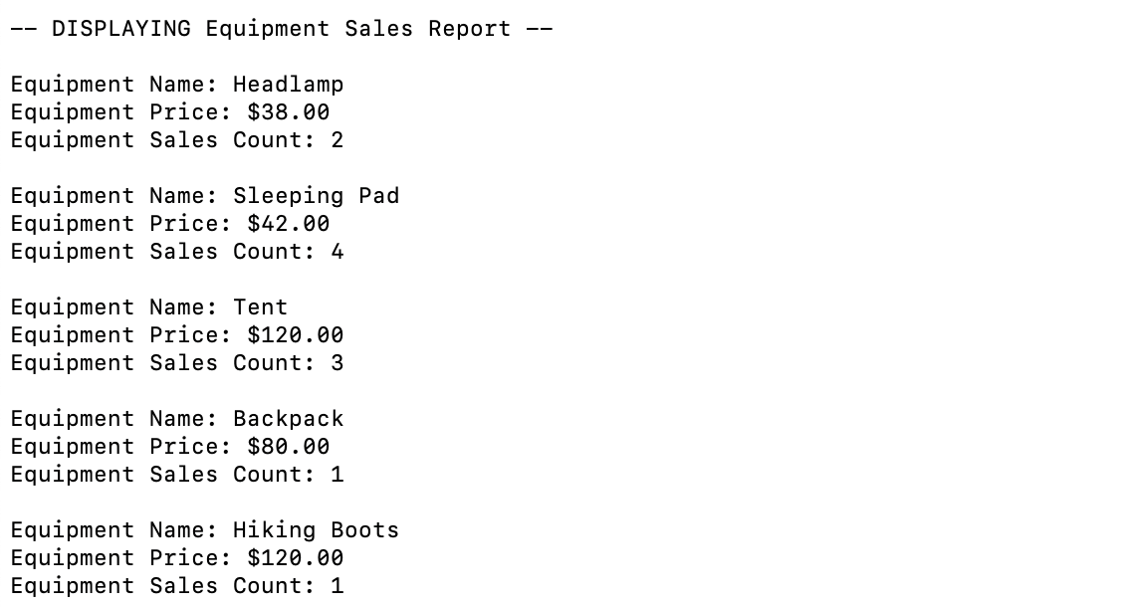
Equipment Sales Report Example

Slide 8
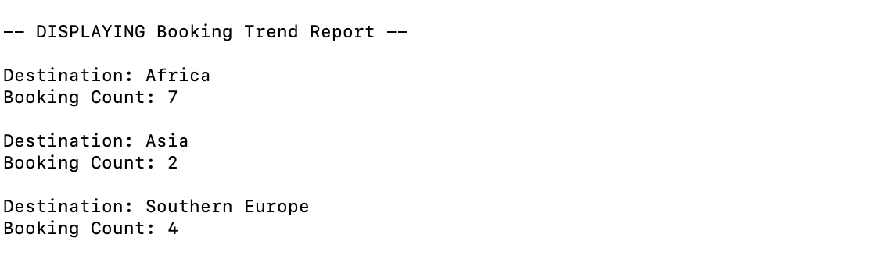
Booking Trend Report Example

Slide 9
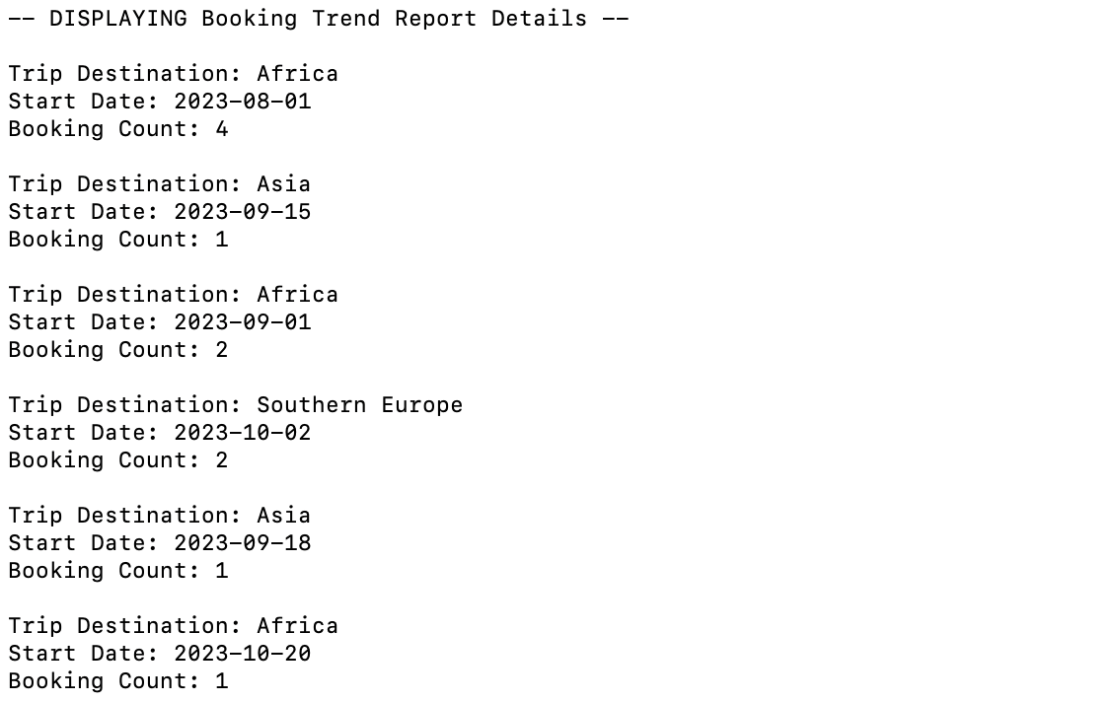
Booking Trend Report Details
10%
40%
20%
30%

Slide 10
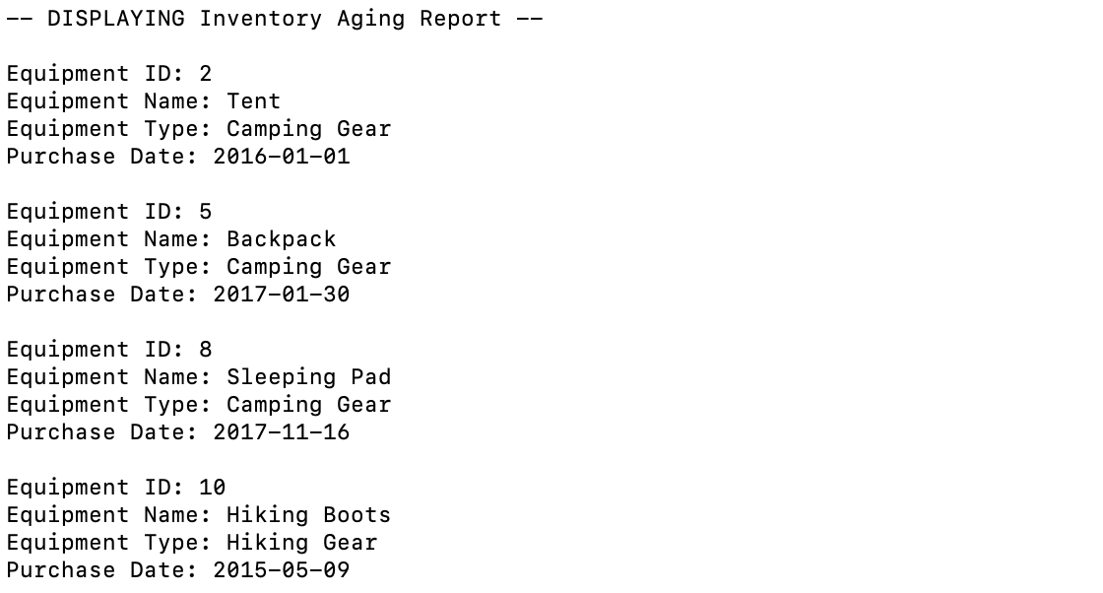

Inventory Aging Report Example

Slide 11
Conclusion
In conclusion, the Outland Adventures case study highlights the journey of Blythe Timmerson and Jim Ford as they established and grew their outdoor adventure business. To optimize their operations, they focused on three key areas: equipment sales, booking trends, and inventory aging.
By generating reports, Blythe and Jim will gain valuable insights to inform their decision-making. The Equipment Sales Report provided an overview of sales, customer preferences, and profitability.
The Booking Trend Report will help them monitor booking patterns in Africa, Asia, and Southern Europe, enabling them to identify potential issues and adjust marketing strategies. The Inventory Aging Report will allow them to assess the age and relevance of inventory items, ensuring customer safety and satisfaction.

Slide 12
THANK YOU

