Slide 1
Musa Khan |BCS163006
Tasks Performed:
Feasibility Report
Decision Trees
Deployment Design

Slide 2
Feasibility Report
A feasibility study decides whether or not the proposed system is worthwhile based on information collection, information assessment and report writing. Different questions may appear which would be answered according to the requirements gathered and the resources which are given by the organization.
The Features it includes are: Student Sign Up, Admin Sign Up, Online Booking, Canceling Ride, GPS location, Transaction, etc.
By considering time, money, resources for these requirements and many more factors, surely we can make such software which would help users to order at any place and enjoy it.

Slide 3
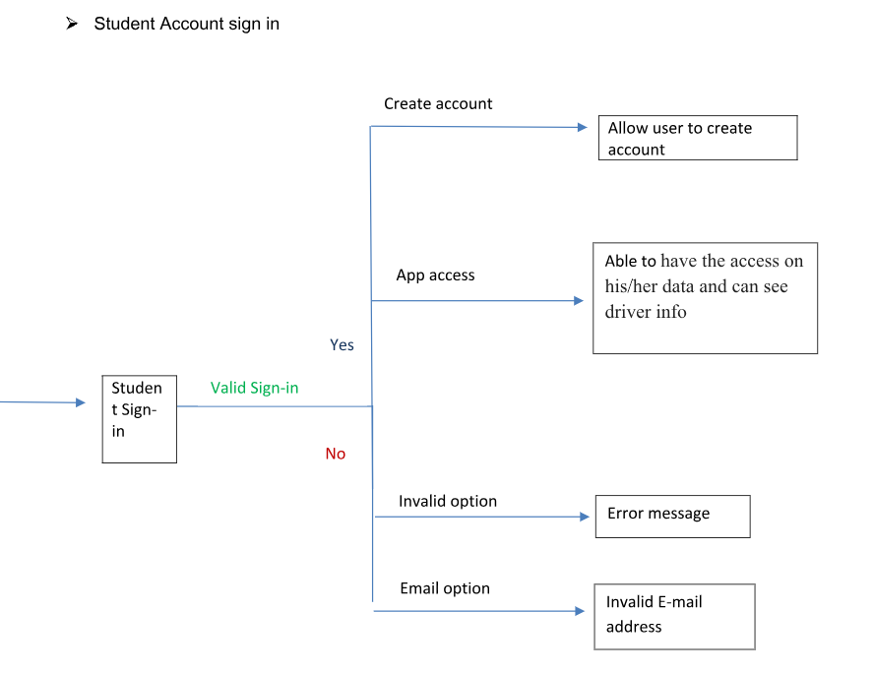
Decision Trees
A decision tree gives a graphic view of the processing logic involved in decision making and the corresponding actions taken.
Example shows us a decision trees constructed for login page in the App Online Ride Share.

Slide 4
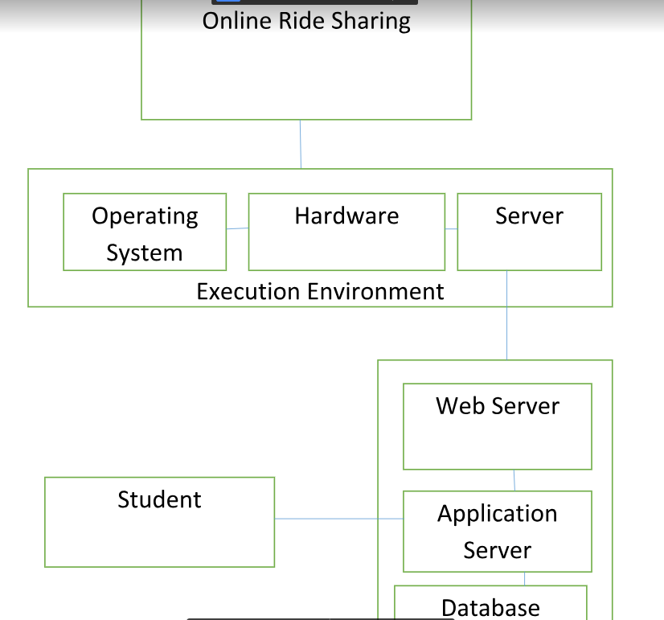
Deployment Design
Deployment design is a kind of structure diagram used in modeling the physical aspects of the system. It includes hardware required for the system, operating system requirements, plugins/libraries/servers/databases required for the system to operate, technologies required to develop the system.

