Slide 1

Welcome to The Sparks Foundation Orientation for Graduate Rotational Internship Program
Presented By
Suraj Kharade

Slide 2
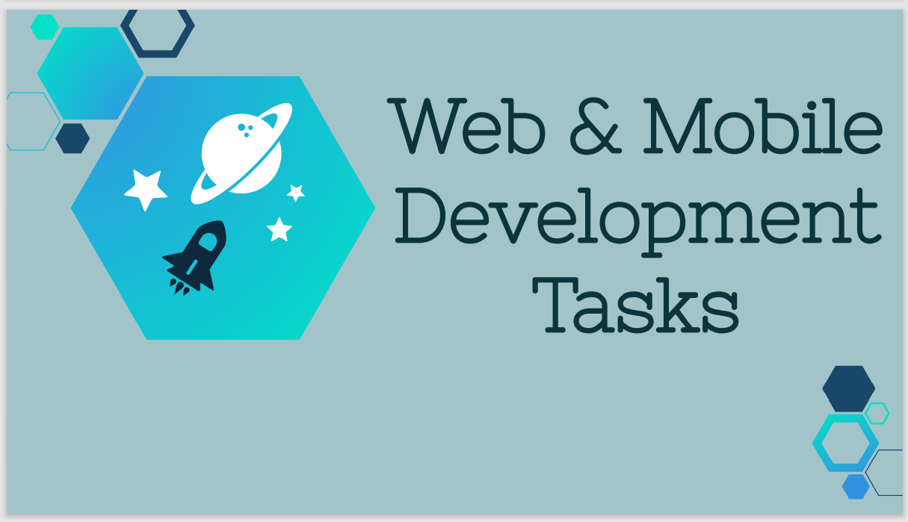

Slide 3
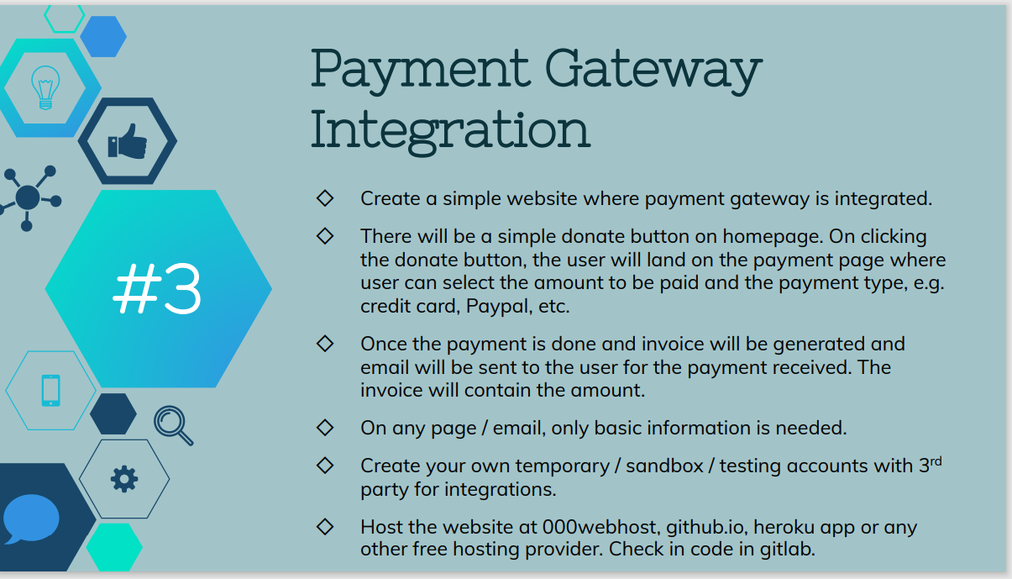

Slide 4
Web View

Slide 5
Coding Part

