Slide 1
PixelHaven Interactive Gaming Website
Name – Kalpak Khare (2330041)
Madhura Kulkarni (2330044)

Slide 2
Overview
Chapter 1 – Introduction
Chapter 2 – Proposed System
Chapter 3 – User Interface
Chapter 4 – Conclusion

Slide 3
Chapter 1 - Introduction
1.1 Objective of the Project - The primary objective of PixelHaven is to revive the charm of retro gaming by offering a fun and engaging platform where users can enjoy classic flash games, compete with friends, and earn exciting rewards. The website aims to create a community-centric space that combines nostalgia with modern features like leaderboards and exclusive merchandise.
1.2 Introduction - PixelHaven is a retro-themed online gaming platform designed to bring back the nostalgia of classic flash games like Mario, Snake, and Hangman. This website goes beyond just gaming by creating a vibrant, interactive community. Users can play games and compete on leaderboards. The platform also offers comprehensive help and support to ensure a seamless user experience. With its perfect blend of classic fun and modern rewards, PixelHaven is the ultimate destination for casual gamers and retro enthusiasts.

Slide 4
Chapter 1 - Introduction
1.3 Problem Statement –
Many online gaming platforms lack an intuitive interface and engaging features, leading to low user retention and participation.
Players often seek a diverse range of games in one location. The absence of a centralized platform for various games, especially classics like Hangman and exclusive Nintendo games, limits user experience.
There is a need for platforms that foster competition through leader boards and achievements, driving player motivation and enhancing gaming experience.
As more users engage in casual gaming, it’s essential to provide a seamless, browser-based gaming experience without needing extensive downloads.
Existing platforms might not encourage community interaction, limiting social engagement among players who share a passion for gaming.

Slide 5
Chapter 1 - Introduction
1.4 Scope of the Project –
Game Variety: Existing platforms typically offer a limited selection of games. Your platform aims to expand this by including both classic games (like Hangman and Snake) and exclusive Nintendo games.
User Engagement: Current platforms often lack community-driven features. Your platform's focus on leaderboards, achievements, and user support fosters community interaction.
Accessibility: Many gaming platforms require downloads and installations. Your project provides a browser-based solution, enabling instant play without significant barriers.
Cross-Device Compatibility: Existing systems may not fully support cross-device gaming. Your platform targets compatibility across desktops, laptops, tablets, and smartphones.
User Interface: The platform will provide a more intuitive and engaging user interface compared to some existing solutions that can be cluttered or complicated.

Slide 6
Chapter 1 - Introduction
1.5 Limitations of existing system –
Game Complexity: While aiming for an interactive platform, more complex games may be beyond the scope, as this project primarily targets simpler, more nostalgic games.
Single-Page Application Optionality: While Angular is listed as an optional technology, not implementing it may limit the platform's responsiveness and performance compared to other modern gaming websites.
Limited Community Features: While social engagement is a goal, the extent of community features (such as chat or multiplayer functionalities) may be constrained by time and resource limitations during development.
Content Licensing: Including exclusive Nintendo games may encounter licensing and legal limitations, impacting the availability of certain titles on the platform.

Slide 7
Chapter 1 - Introduction
1.6 Project Perspective –The project aims to position itself as an engaging and approachable online gaming platform specifically designed for casual gamers. By focusing on classic games and community interaction, the platform seeks to bridge the gap between nostalgia and modern gaming experiences. It emphasizes a user-friendly interface, performance, and accessibility, allowing users to easily discover and play games while fostering an online community.
1.7 Technology Used – HTML, CSS, JavaScript for UI/UX & AngularJS for interactive elements.

Slide 8
Chapter 1 - Introduction
1.8 Software/Hardware Specifications –
1.8.1 Technologies Used:
- HTML for structuring the website's content.
- CSS for styling and enhancing the platform's visual appeal.
- JavaScript for implementing game logic and facilitating user interactions.
- Angular (optional) for creating a dynamic single-page application experience, enhancing responsiveness and performance.

Slide 9
Chapter 1 - Introduction
1.8 Software/Hardware Specifications –
1.8.2 Client Devices:
Compatible with a range of devices, including desktops, laptops and tablets.
Minimum recommended specifications:
Processor: Dual-core CPU with a clock speed of at least 2.0 GHz.
RAM: At least 4 GB of RAM.
Storage: Sufficient storage space for cached data and game assets.
Network: Stable internet connection with at least 5 Mbps download speed for smooth gameplay.

Slide 10
Chapter 2 – Proposed System
2.1 Objectives –
- To create an engaging and interactive frontend static website that features popular games such as Tic Tac Toe, Flappy Bird, and Snake Game.
- To develop a seamless gaming environment that provides users with exclusive access to Nintendo games.
- To offer a diverse selection of gaming options that appeals to a wide audience.

Slide 11
Chapter 2 – Proposed System
2.2 Features –
Game Listing:
Categories for different types of games (e.g., classic, exclusive).
Search and filter options for easy navigation.
Leaderboard
Display top players and their scores.
Options to filter by game or time frame (daily, weekly).
Merchandise:
Section for selling or promoting game-related merchandise (e.g., physical collectibles, in-game items).
Help and Support:
User guides and contact options for user assistance.

Slide 12
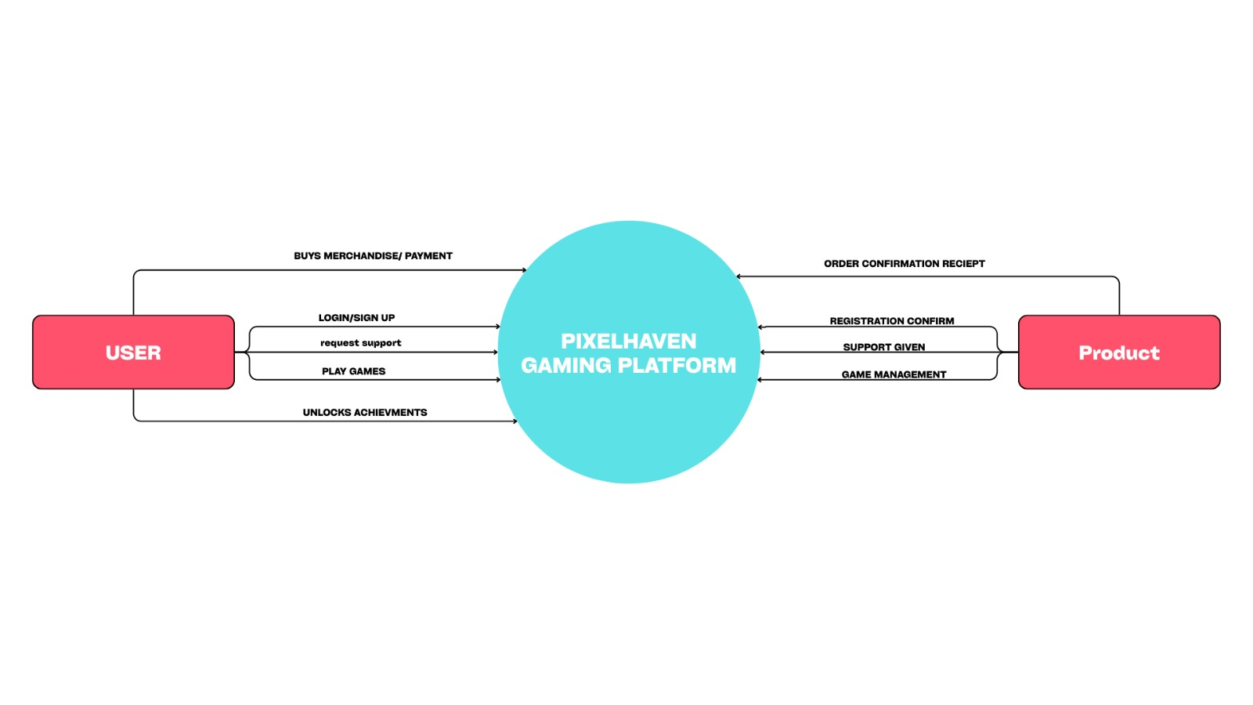
Chapter 2 – Proposed System
2.3 DFD ( Data Flow Diagram) –

Slide 13
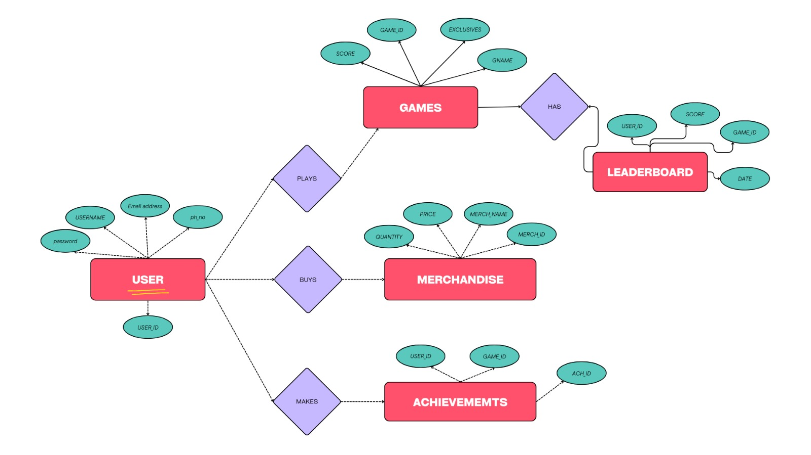
Chapter 2 – Proposed System
2.4 ERD ( Entity Relationship Diagram) –

Slide 14
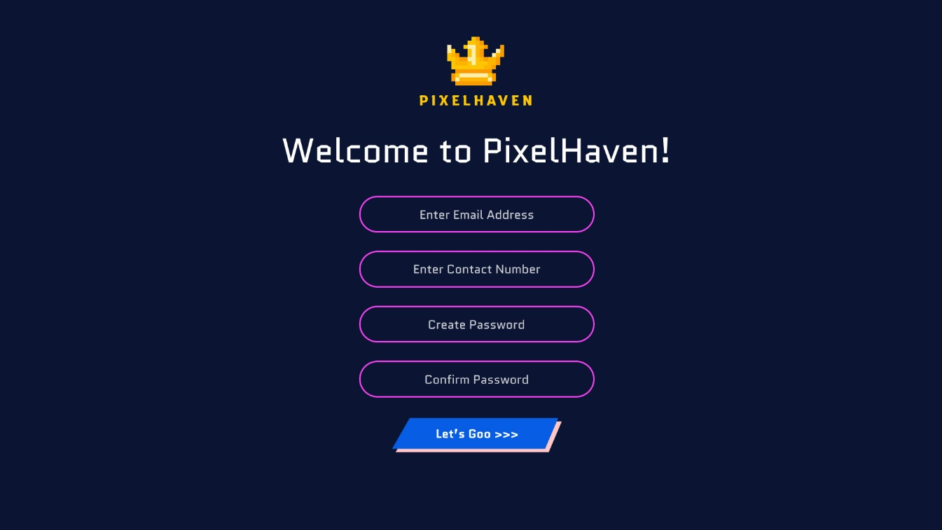
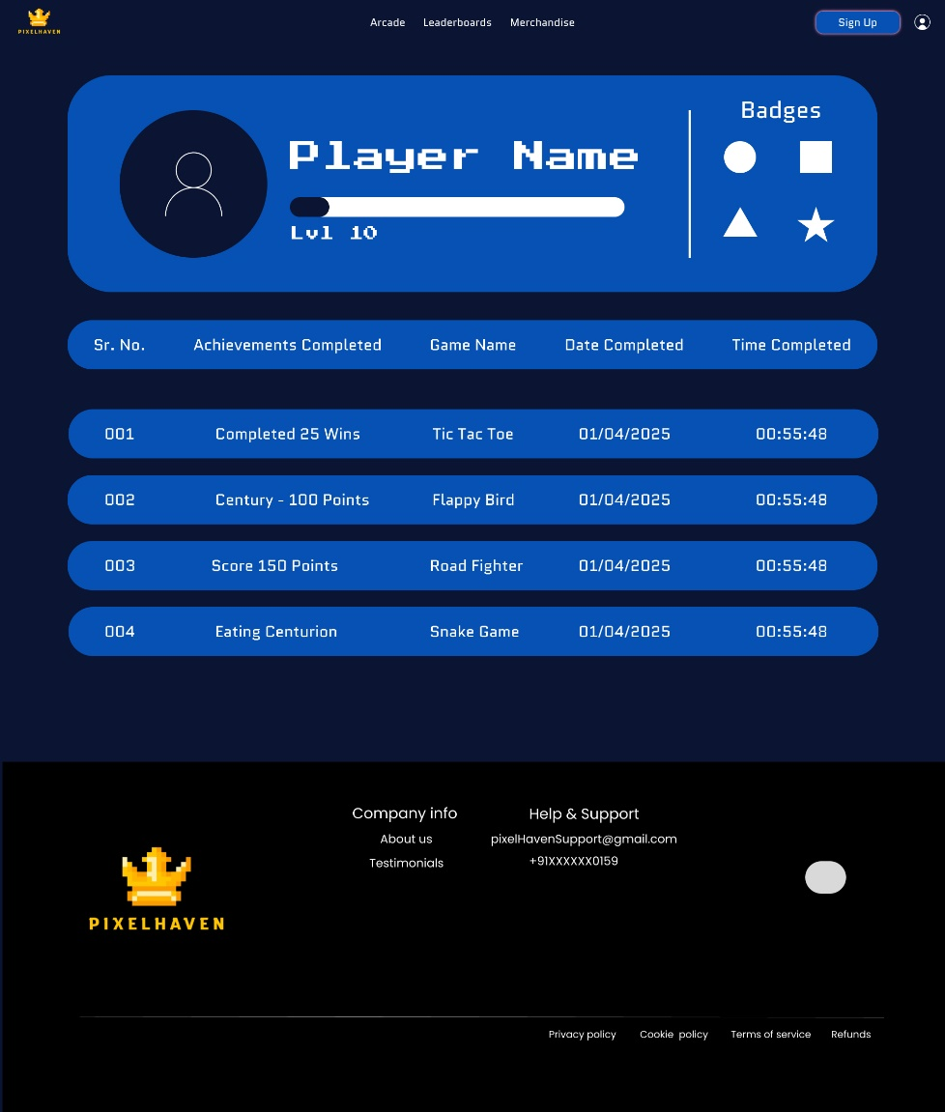
Chapter 3 – UI (User Interface)
3.1 UI Designs –

Slide 15
Chapter 4 – Conclusion
PixelHaven successfully bridges the gap between nostalgia and modern gaming by offering a seamless, browser-based retro gaming platform. With engaging features like leaderboards, exclusive merchandise, and a strong community focus, it enhances user experience beyond just gameplay. The project leverages intuitive UI/UX design and cutting-edge technologies to provide an accessible and interactive space for gamers. Moving forward, potential expansions could include multiplayer modes and enhanced social engagement features, making PixelHaven a go-to destination for retro gaming enthusiasts.

