Slide 1



Slide 2




Always there to always care – Your moral Support
Target Market
Families with All Sizes.
Workplaces can use this application to plan on a department level.
Roommates and close group of friends can use this app.
Soccer/football teams can use this app.
Who we are: Team Ninja
Vamsi Krishna Tummala
BE,
Pursuing MS in CS
Cassandra Mae C. Patel
MBA,
Pursuing PhD in Computer Science & Eng.
Khaled Saleh
MSCS,
Pursuing PhD in Computer Science & Eng.
Sai Teja Alladi
BE,
Pursuing MS in CS
Snigdha Kalipindi
BE,
Pursuing MS in CS
Notes:
Khaled – Into,2 , slide 5
Sai – Value Proposition and Target Market
Snig- Call, use case, Chat
Vamsi- Around me, finish
Cassa- conclusion plan ,

Slide 3
Application & The Three Most Unique Features
Application Name | Calendar (individual as well as compare other’s calendar – hide /visible) | Chat (with Tags like “reminder”, “meeting” or “event”) | Around me (can share location with family, provide list of restaurants nearby and can also allow to make reservation.)
Fazeal.com | ✓ | ✓ | ✓
Cozi | × | × | ×
Timetree | × | × | ×
Flayk | ✓ | × | ×
Our home | × | × | ×
Family matters | × | × | ×

Slide 4

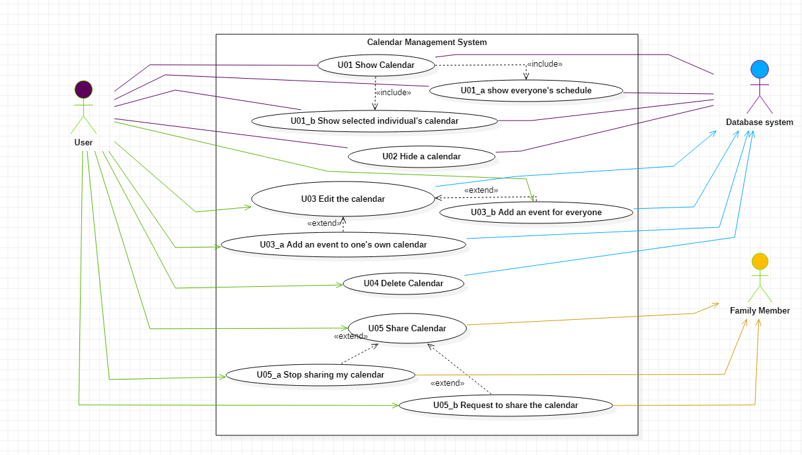
Calendar:
One can compare all the members' calendar/schedule to figure out a perfect time for the family.
The user can either make visible/hide all the calendars shared of the family members shared with him.
This functionality is not available in any of the family app out there, which makes it a unique one.
The family app that creates just one do the to-do-task/schedule for the family - Cozi, Busy Kids
Notes:
Unique because, one can manage individual calendar at a time and also, if required, one can compare all the members' calendar/schedule to figure out a perfect time for the family. Also, the functionality which comes with it is that either make visible all the calendars, or hide those. This whole functionality is not available in any of the family app out there, which makes it a unique one. [The family app that creates just one do the to-do-task/schedule for the family - Cozi, Busy Kids]

Slide 5
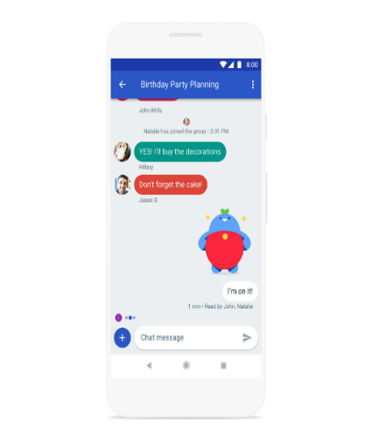


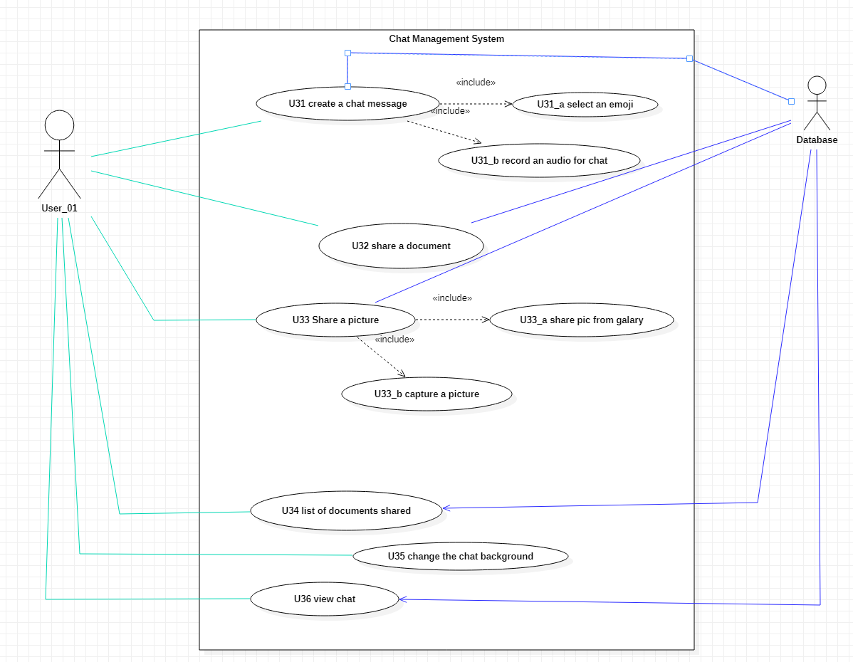
Chat:
This is another unique that is not available in any of the family app out there. There is one [Chatbooks] which allows you to share pics like any other social media, but not won't give you options of sharing the documents and texts via chat.
Pin a reminder on the family dashboard or person dashboard with certain notifications controlled by sender add meeting to calendar and add events such as Dinner/game time which could also include voting.

Slide 6
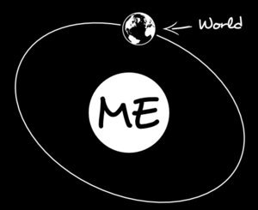
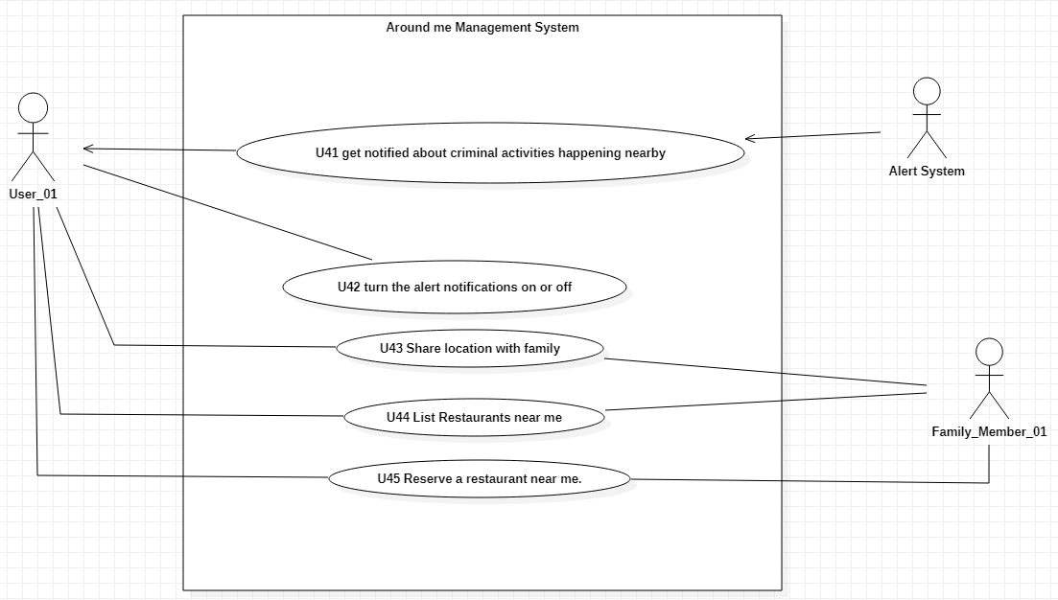
Around me:
This app will help the user to share their location with other family members and also stop sharing but, this app provides the users with the list of all restaurants available near them and makes a reservation for one or more.

Slide 7
Plan for Implementation
Conclusion
The family always stays together no matter what the situation is or the circumstances. One will always have their loved ones to back them up.
We will be providing the platform where the kid(s) can virtually meet their parent who they are longing for to see and talk to. In case the family/couple are separated - Children will have full access to both- father’s family and mother’s family, but the parents will be having access only to their respective family and not to their ex spouse’s family. Children will be able to add event in both the family’s calendar and so on.
In this way, though the parents of the child are separated but, the child would be getting full love and care of both the parents. This would help the child’s good up-bringing and development. Also, this solution can lead to the healthy mindset of the children. By implementing this solution, both the issues mentioned earlier are addressed and there will not be any kind of hard feelings among the separated family.
We need to fund this app to investigate those legal obligations as part of the laws. That will acquire specific licensing and legal consent.
Use the Use Cases defined in this presentation to develop the features.
Keep a 14 days sprint for the better pace of the development
Keep track of features in Jira
Keep git repository updated while implementing features.
Keep attending the Daily Sync meeting for better understanding the requirements and solving any queries.
Follow a quality assurance pattern to test the implemented features by defining the expected behavior that matches the acceptance criteria of the feature and log any discrepancies between them and resolve it as a part of the development.
Having a dedicated environment where the code will be deployed and built by pipelines to this environment.

Slide 8

Thank You!

