Slide 1

EasyFund
We believe we can save more lives with you
Student Name | Student ID
Farsheed Rahman | 1830360
S.M. Arif Mahmud | 1830398
Md Tuhin Al Jobayer | 1831124
Shahria Sultana | 1920280
Md. Abrarul Karim | 2022521
Md Abdullah | 1731558

Slide 2
Problem Statement
Civic and charitable organizations, along with individuals, face difficulties in efficiently collecting and managing donations.
Existing donation platforms may lack user-friendly interfaces, leading to challenges for donors to contribute seamlessly.
Organizations struggle to effectively process and track donations, resulting in potential inefficiencies in fund utilization.
A dedicated donation website is needed to provide an intuitive platform for donors to easily contribute to a variety of causes.
The website should offer streamlined donation processing, ensuring a seamless and convenient experience for donors.
Transparent tracking of contributions is essential to enhance donor trust and confidence in the donation process.
Security measures must be implemented to protect donor information and maintain a secure environment.
The donation website aims to bridge the gap between contributors and impactful causes, fostering a culture of giving and positive change.

Slide 3
Key Challenges
Diverse Funding Opportunities: The Crowd Funding App can cater to various domains such as tech startups, social causes, art and creative projects, charitable initiatives, educational campaigns, and more.
Global Reach: The digital nature of the platform allows it to reach a vast and diverse audience worldwide, increasing the chances of projects getting funded.
Niche-specific Crowd funding: The app can offer specialized categories or filters, enabling users to support causes and projects that align with their interests and values.
Data Insights: The platform can gather valuable data on user preferences, funding trends, and popular causes, which can be used for market research and targeted marketing.
Collaboration and Networking: The app can facilitate connections between creators, backers, and other stakeholders, fostering collaboration and potential partnerships.
Low Entry Barrier: The app can empower small-scale projects and individuals who might otherwise struggle to access funding through traditional channels.
Community Building: Building a community around the app can lead to increased engagement, user retention, and potential repeat backers.

Slide 4
Proposed Solution
The app would facilitate the entire crowdfunding process, from project submission to payment processing. It would incorporate features like:
Project Presentation: Allow creators to showcase their projects with clear descriptions, images, and videos to attract potential backers.
Payment Processing: Secure reliable payment methods to ensure smooth transactions between donors and campaign creators.
Social Integration: Integration with social media platforms to enable easy sharing of projects, thereby increasing their visibility and reach.
Transparency: Implement mechanisms to ensure transparency and accountability of the projects. This could include regular project updates, financial reporting, and progress tracking.
User Verification: Establish a verification process for project creators to enhance trust and credibility among potential backers.

Slide 5
Unique Features
Project Showcase: The app allows campaign creators to present their ideas, ventures, or charitable causes with compelling descriptions, images, and videos to attract potential backers.
Easy Contribution: Backers can securely and conveniently contribute funds to projects of their choice through a seamless and user-friendly payment processing system.
Social Integration: To maximize project visibility, the app integrates with popular social media platforms, enabling easy sharing and engagement within the user's networks.
Transparency and Accountability: Project creators are encouraged to provide regular updates, progress reports, and financial accountability, instilling trust and confidence among backers.
Project Categories: The app supports diverse project categories, including technology, arts, social causes, environmental initiatives, healthcare, education, and more, catering to a wide range of interests.
Verification System: To enhance credibility, the app incorporates a thorough verification process for project creators, reducing the risk of fraudulent or illegitimate projects.

Slide 6
Functional Requirements
Users can register accounts with their email or social media profiles.
Users can create and manage profiles with personal information.
Fundraisers can provide additional details like project descriptions, goals, and campaign videos.
Donors can view their donation history and manage their preferences.
Fundraisers can create and submit campaigns with project details, images, and videos.
Campaign creators can set funding goals, deadlines, and choose funding models.
Fundraisers can edit and update campaign information during the fundraising period.
Users can filter campaigns based on location, type, or funding progress.
Campaign pages display compelling project descriptions, visuals, and funding progress.
Users can contribute to campaigns using multiple payment methods (credit card, Bkash, etc.).
Donation process should be user-friendly with options to enter custom donation amounts.
Users can view a confirmation of their donation and receive email receipts.
Admin panel for website administrators to manage campaigns, users, and content.
Moderation tools to review and approve campaigns to ensure legitimacy and adherence to guidelines.
Clear communication about how funds will be used and potential risks.
Transparency in displaying the funding progress and where the money will go.
The website should be responsive and usable on various devices including smartphones and tablets.

Slide 7
Non-Functional Requirements
Performance:
The website should load quickly and respond promptly to user interactions.
It should be able to handle a large number of concurrent users without significant slowdowns.
Scalability:
The architecture should be designed to accommodate increasing traffic and user activity over time.
The platform should be scalable to support a growing number of campaigns and users.
Reliability and Availability:
The website should have high availability, with minimal downtime for maintenance or updates.
Backup systems and data recovery processes should be in place to ensure data integrity.
Compatibility:
The website should be compatible with popular web browsers and devices, ensuring a consistent experience for all users.
Security:
The platform must use secure authentication methods for user registration and login.
All user data, especially financial information, should be securely encrypted and stored.
Usability and User Experience:
The user interface should be intuitive and user-friendly, catering to users of varying technical backgrounds.
Navigation should be clear, and actions (creating campaigns, donating, etc.) should be easy to perform.

Slide 8
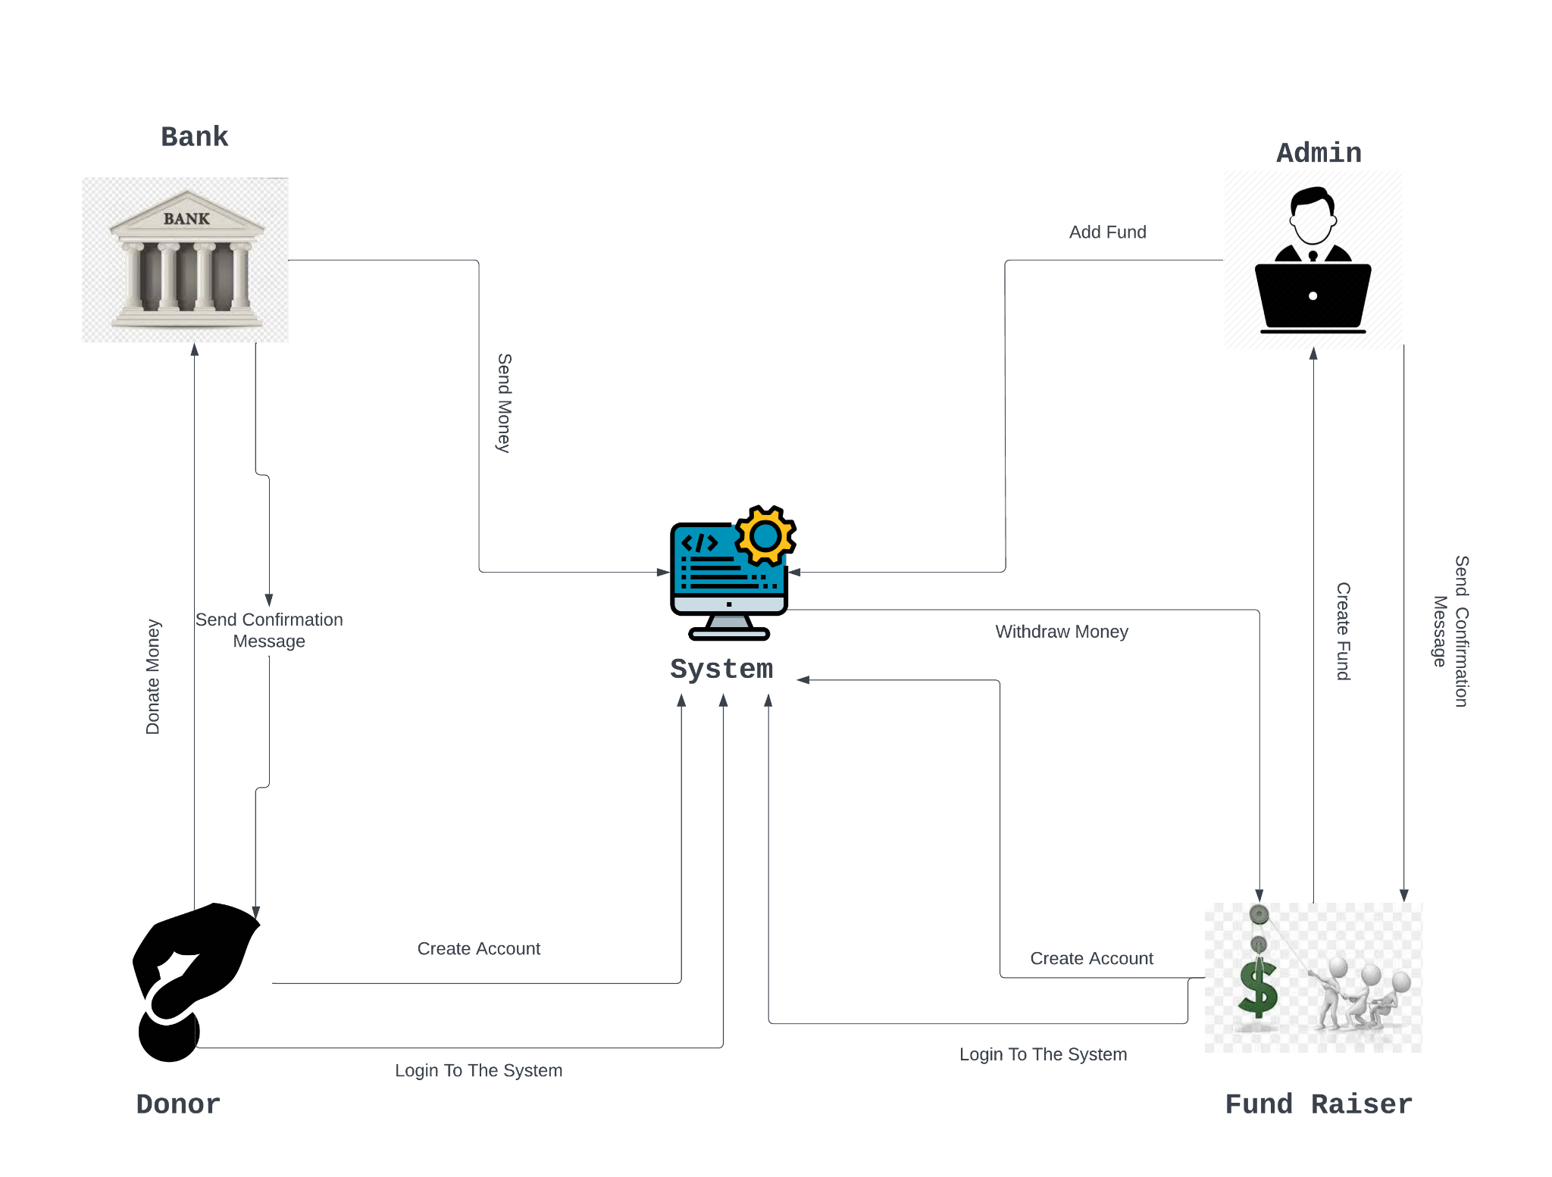
Rich Picture

Slide 9
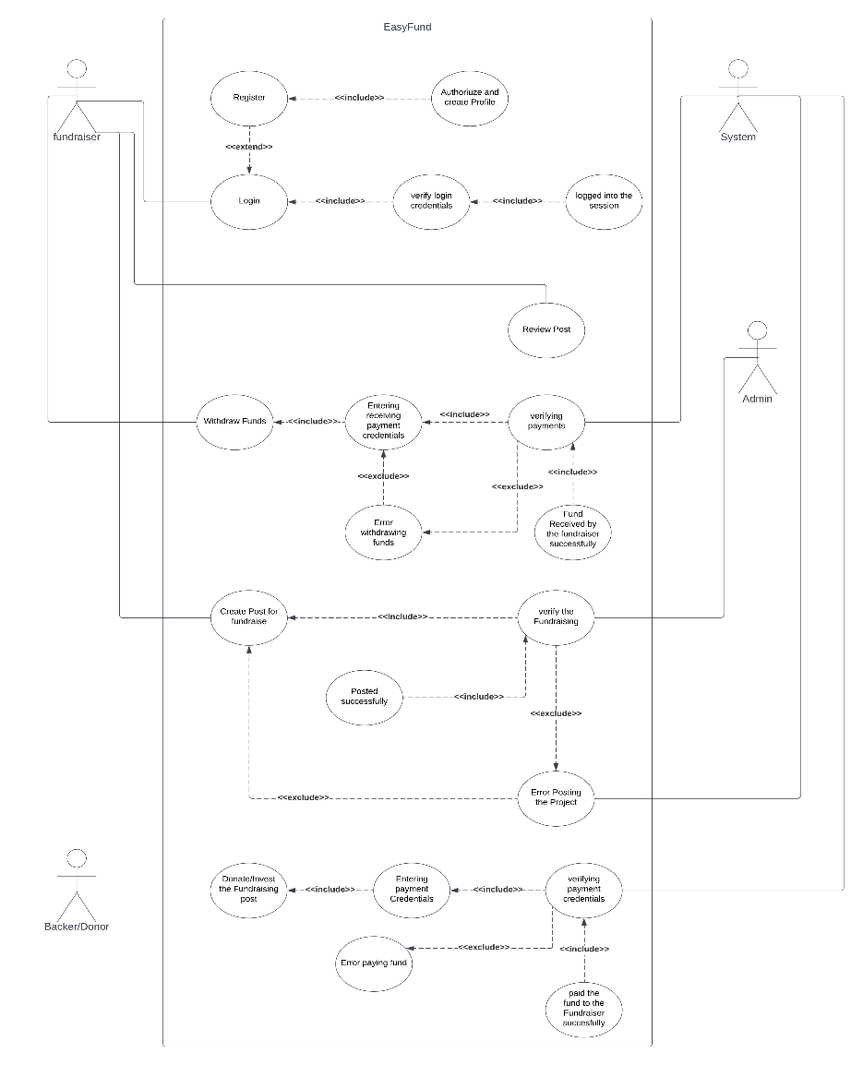
Use case Diagram

Slide 10
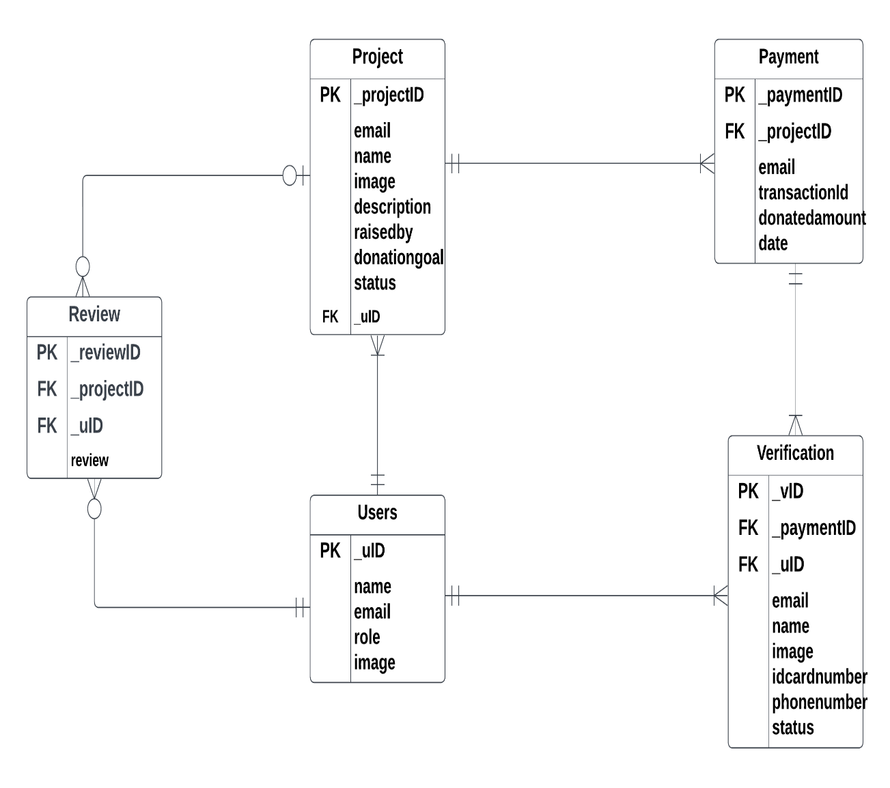
ERD

Slide 11
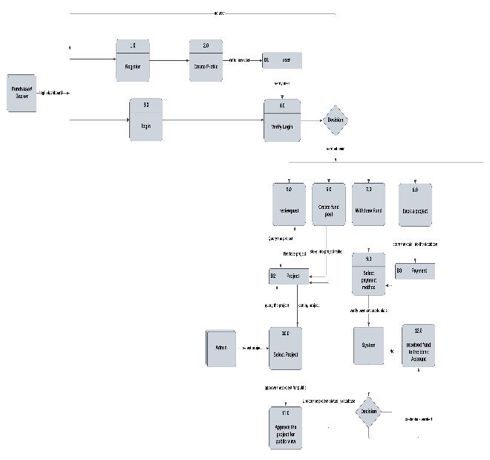
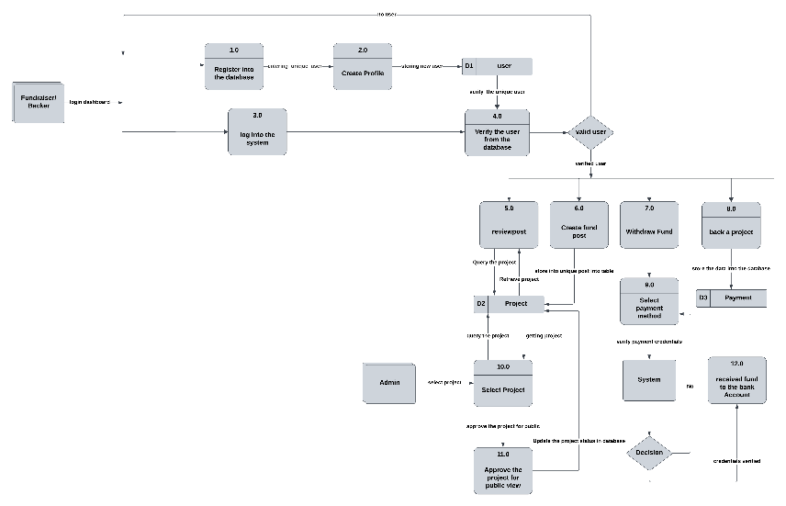
Logical and Physical DFD
Logical DFD
Physical DFD

Slide 12
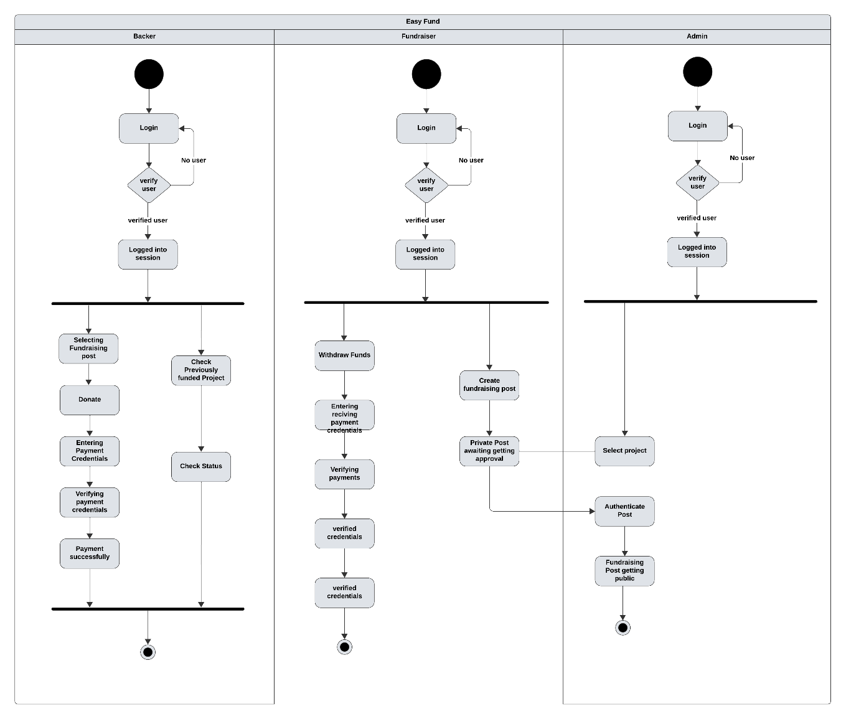
Activity Diagram

Slide 13
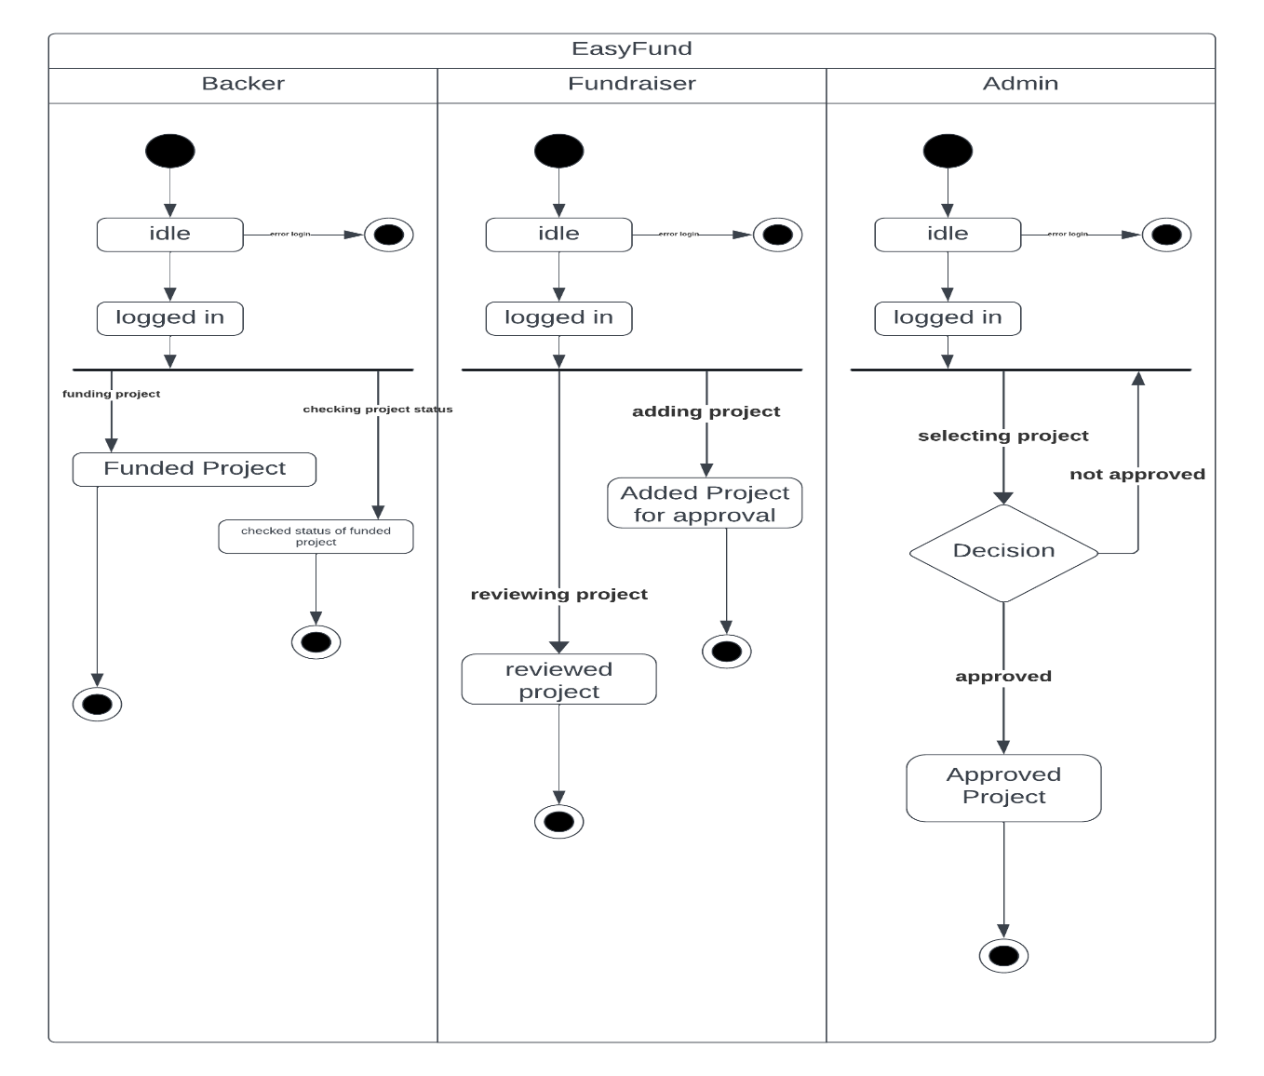
State Chart Diagram

Slide 14
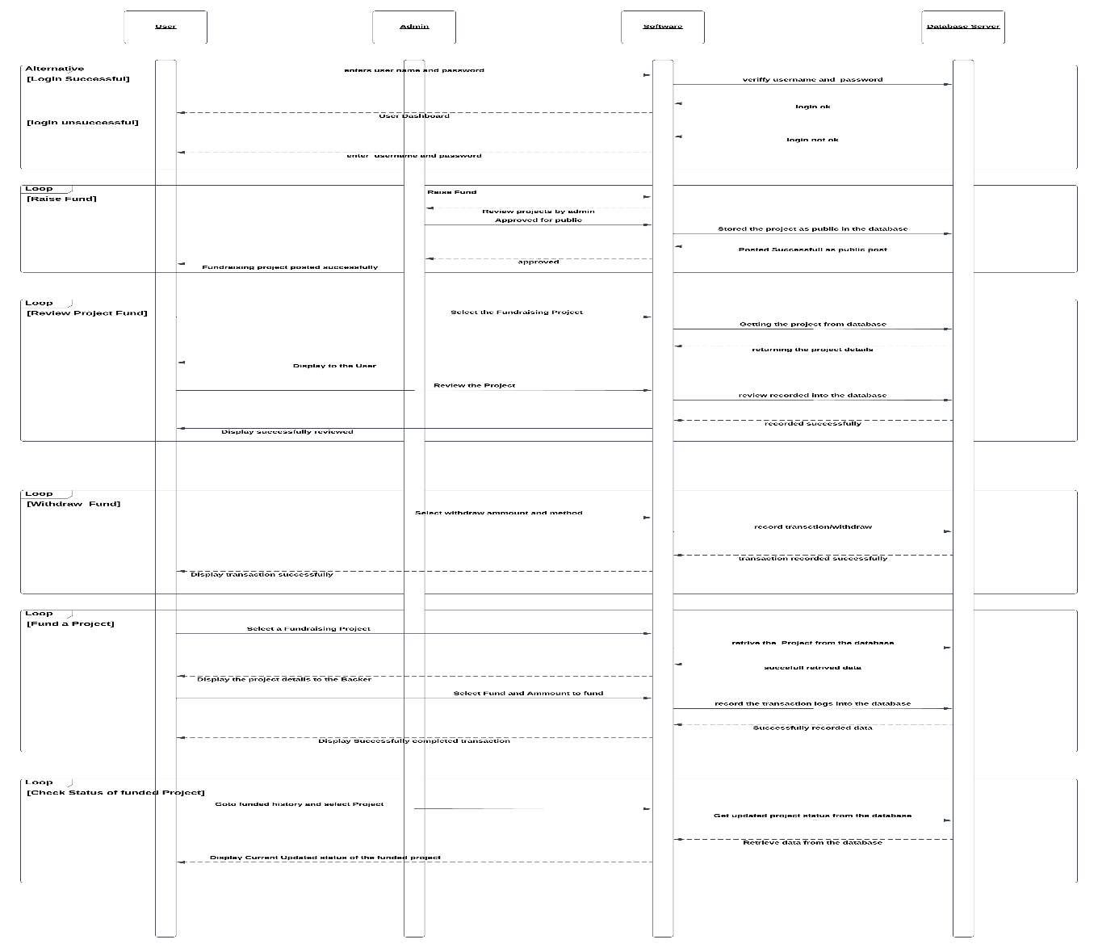
Sequence Diagram

Slide 15
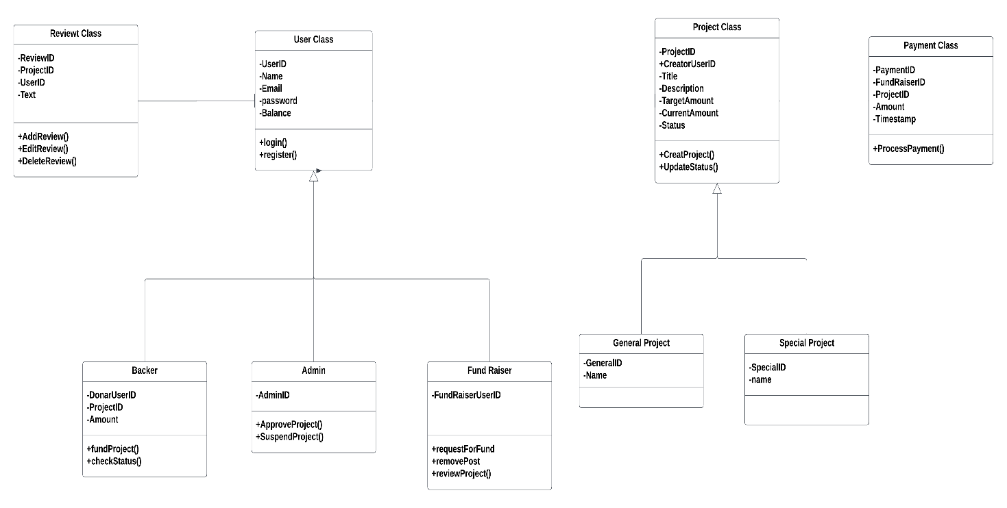
Class Diagram

Slide 16
CRUD Matrix
PROGRAM |  | TABLES
 |  | Users | Project | Payment | Reviews | Verification
Users.register | Procedure | C
Users.login | Procedure | R
fundRaiser.CreateProject | Procedure | R | C
Users.addReview () | Procedure | R | R |  | C
Users.editReview() | Procedure | R | R |  | RU
Users.deleteReview() | Procedure | R | R |  | RD
fundRaiser.deleteproject() | Procedure | R | RD
Backer.fundProject() | Procedure | R | R | C |  | C
Backer.checkStatus() | View |  | R |  | R
Admin.approveProject() | Procedure | R | U
Admin.suspendproject() | Procedure | R | U

Slide 17
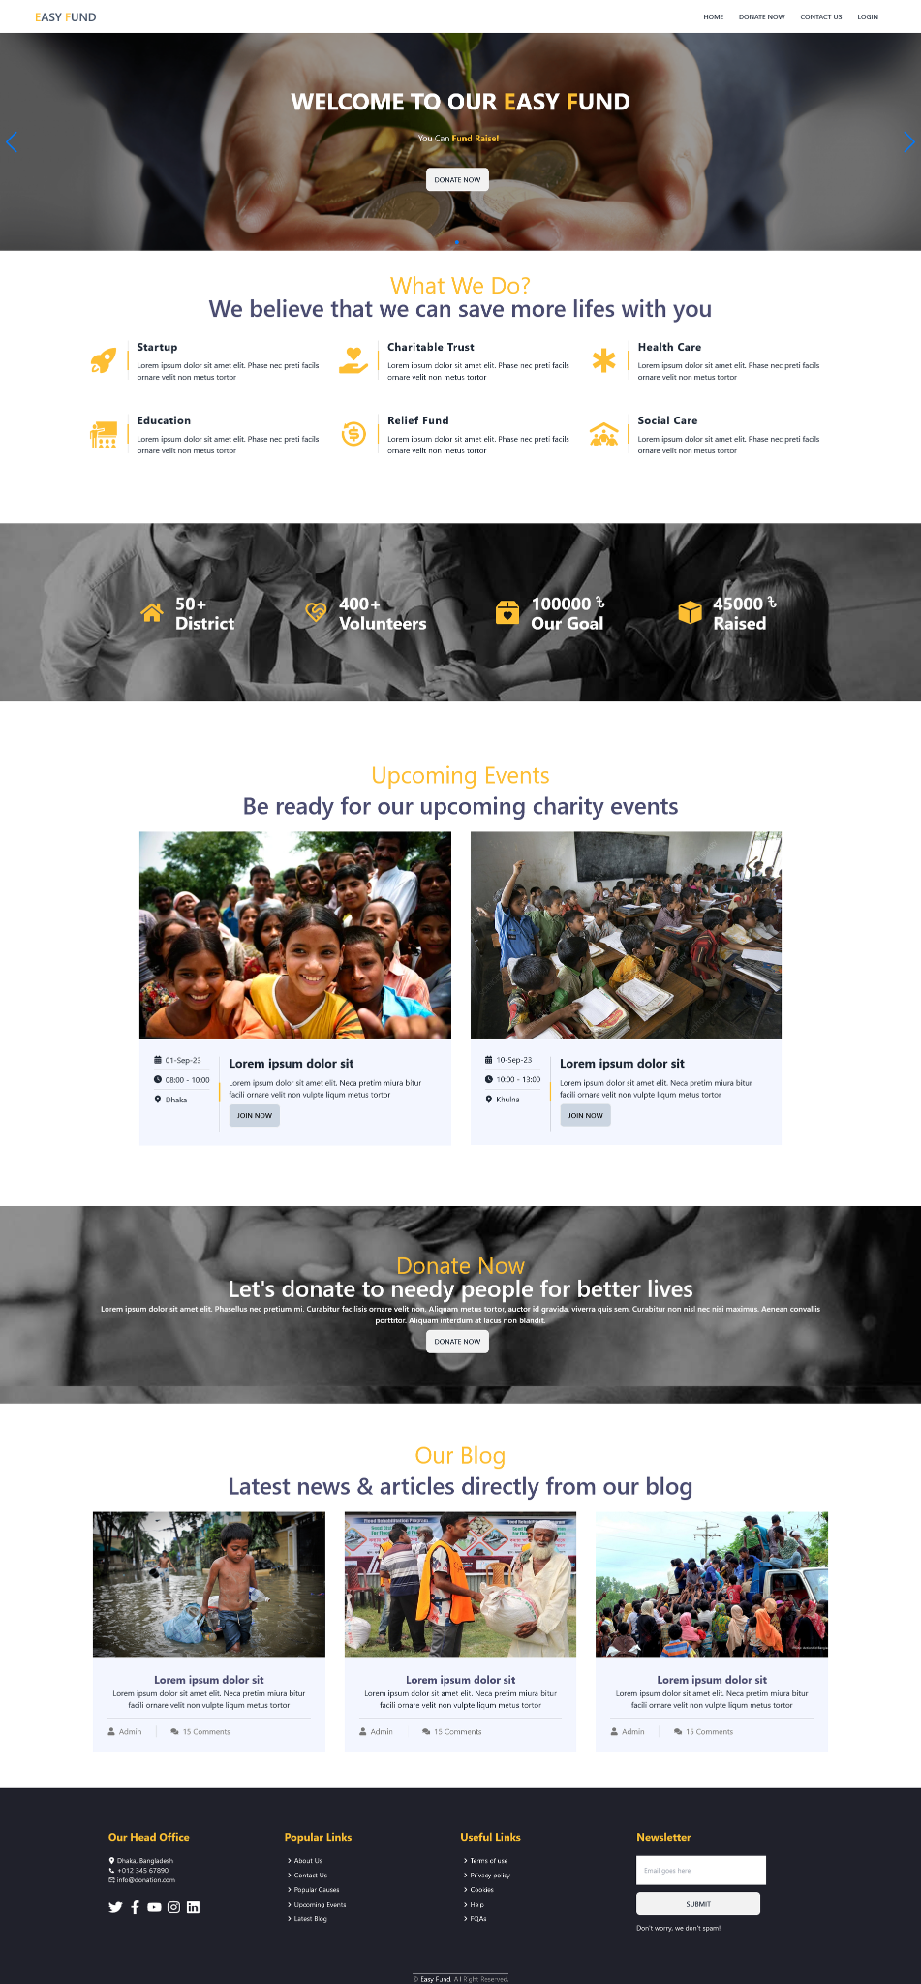
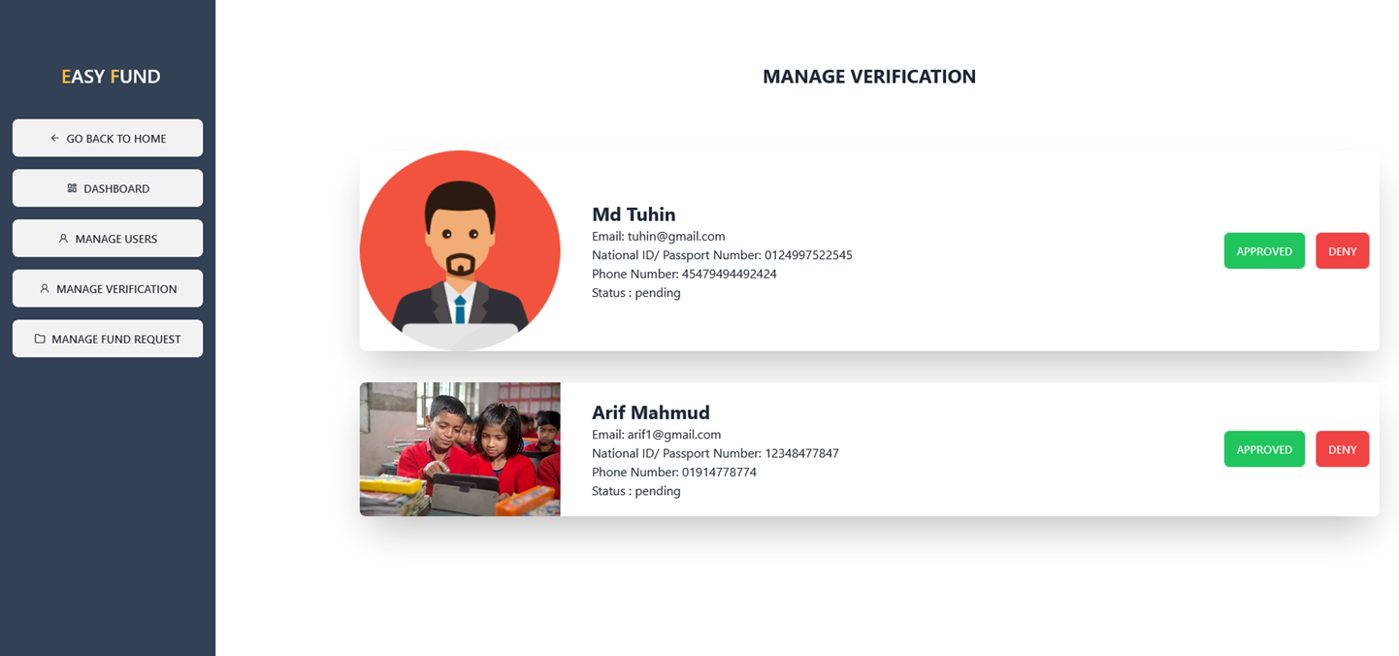
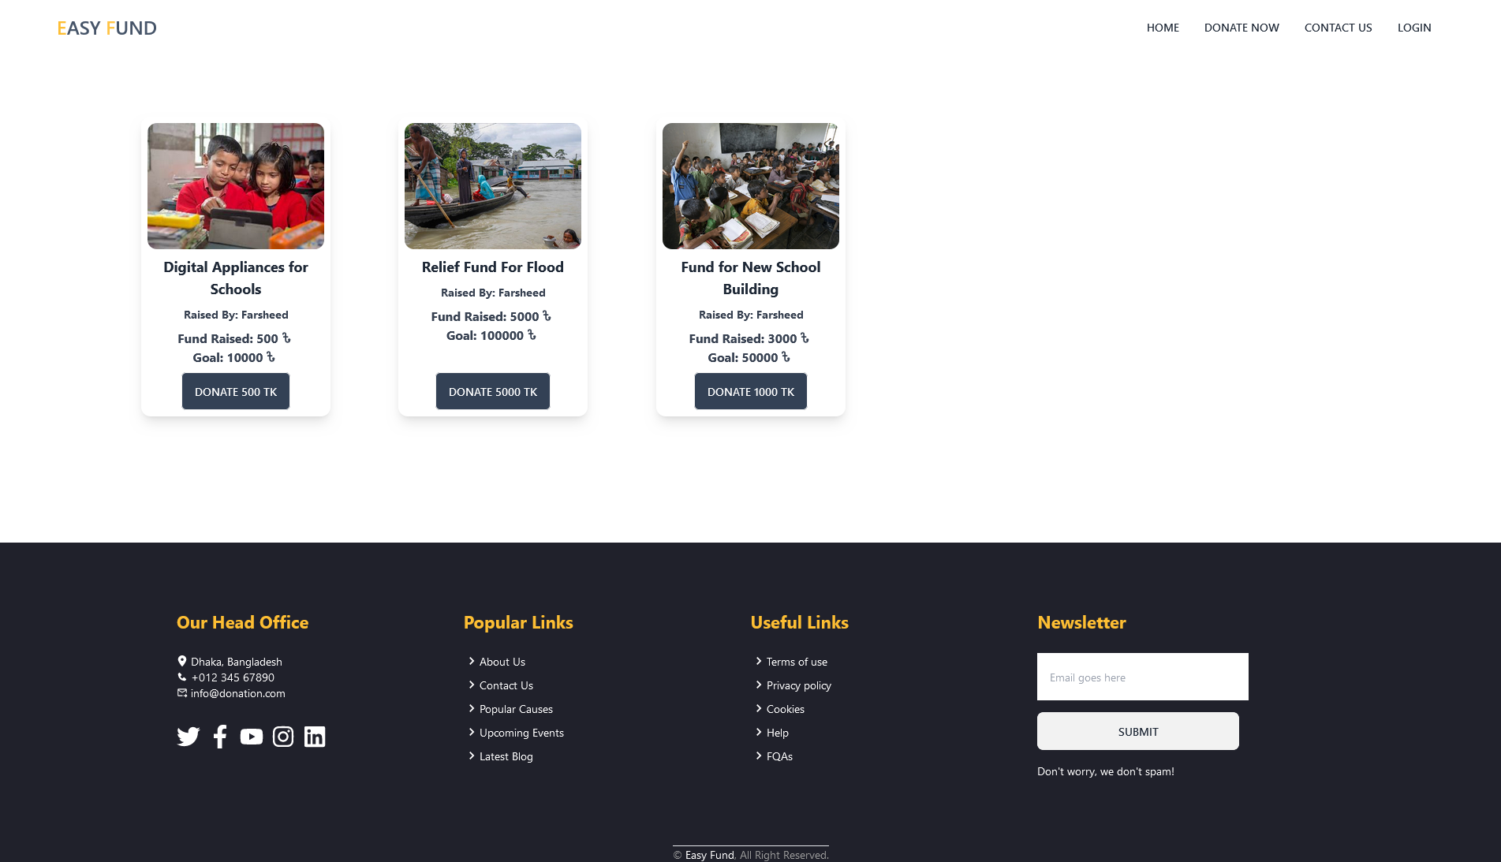
Screenshots Of The Prototype

Slide 18
Thank You

