Slide 1


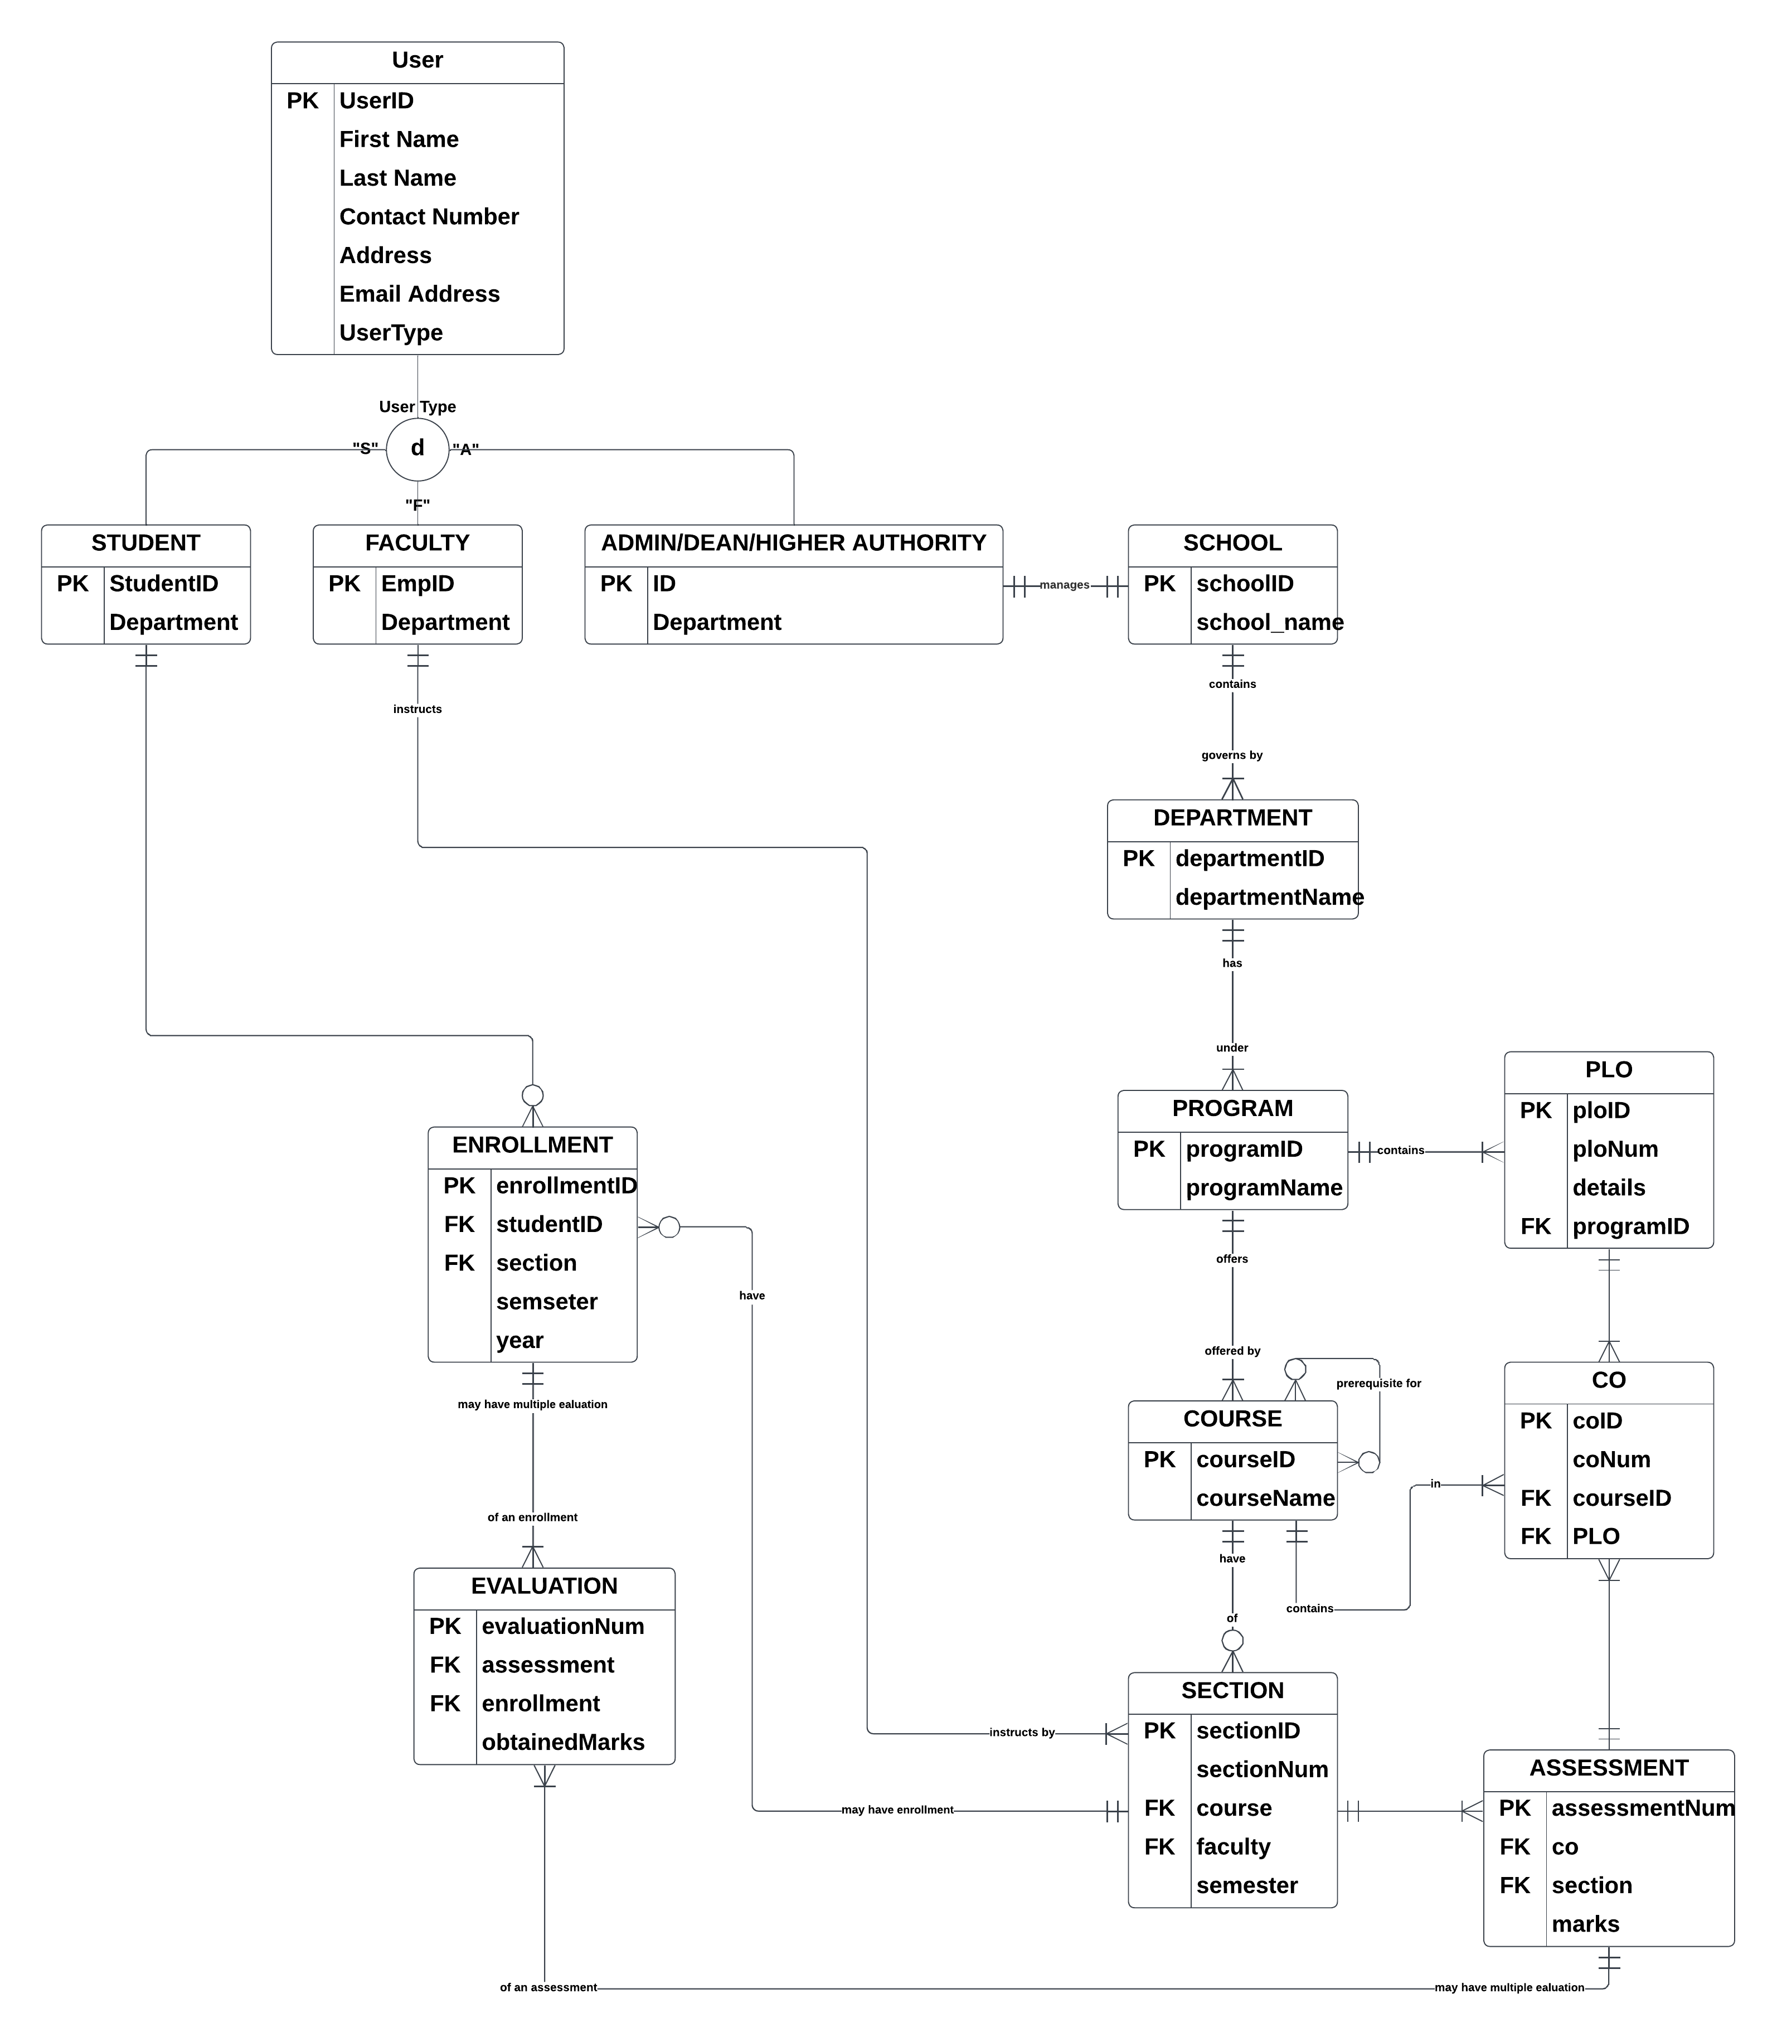
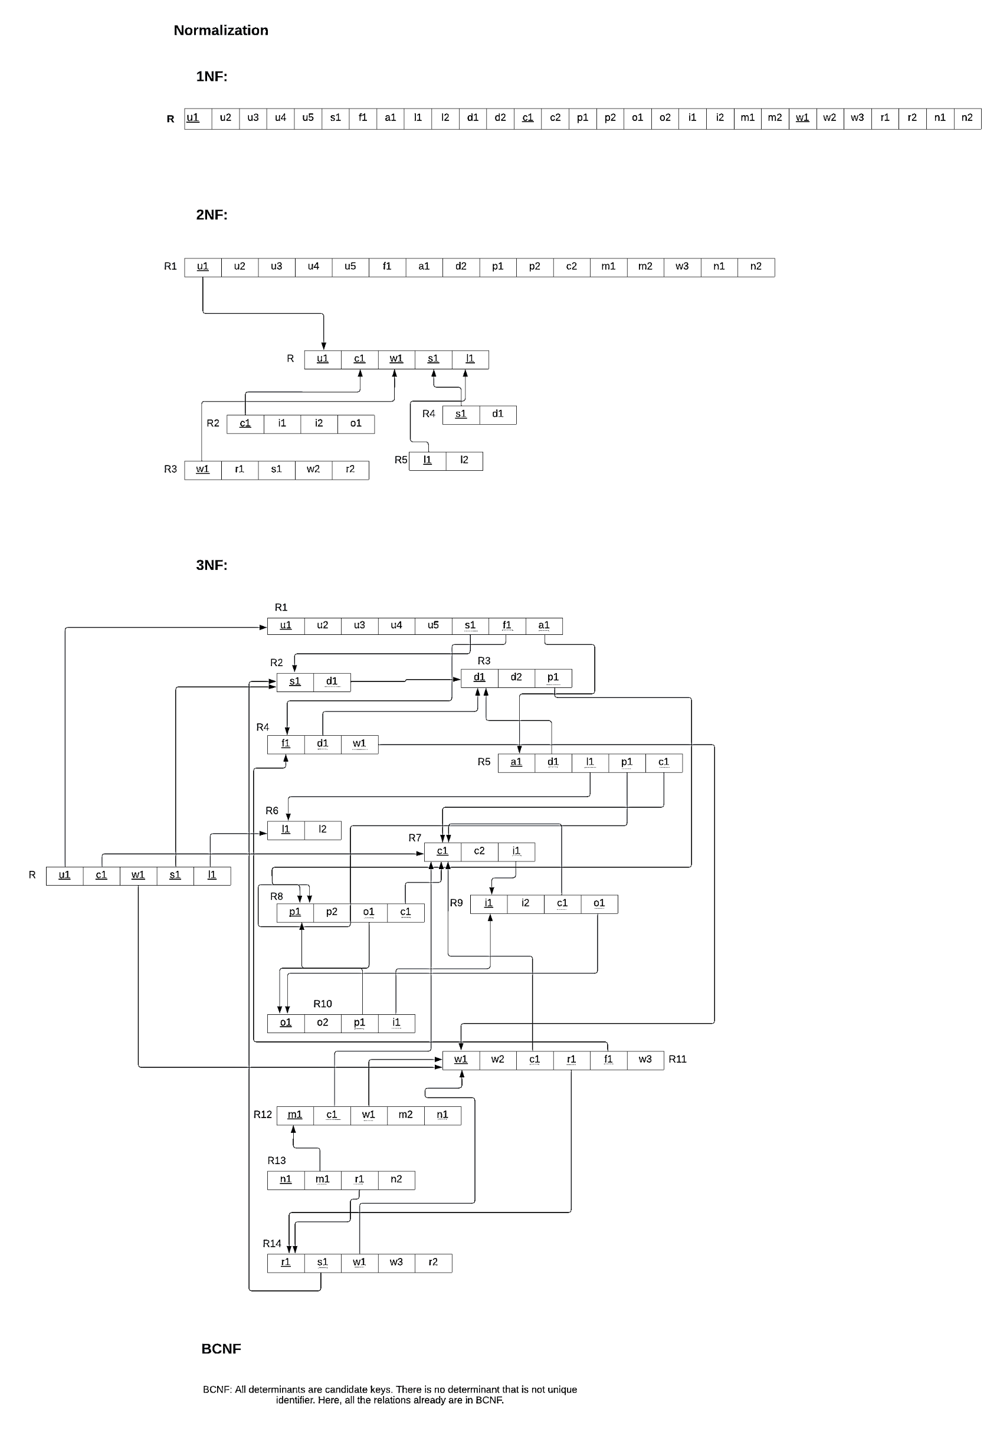
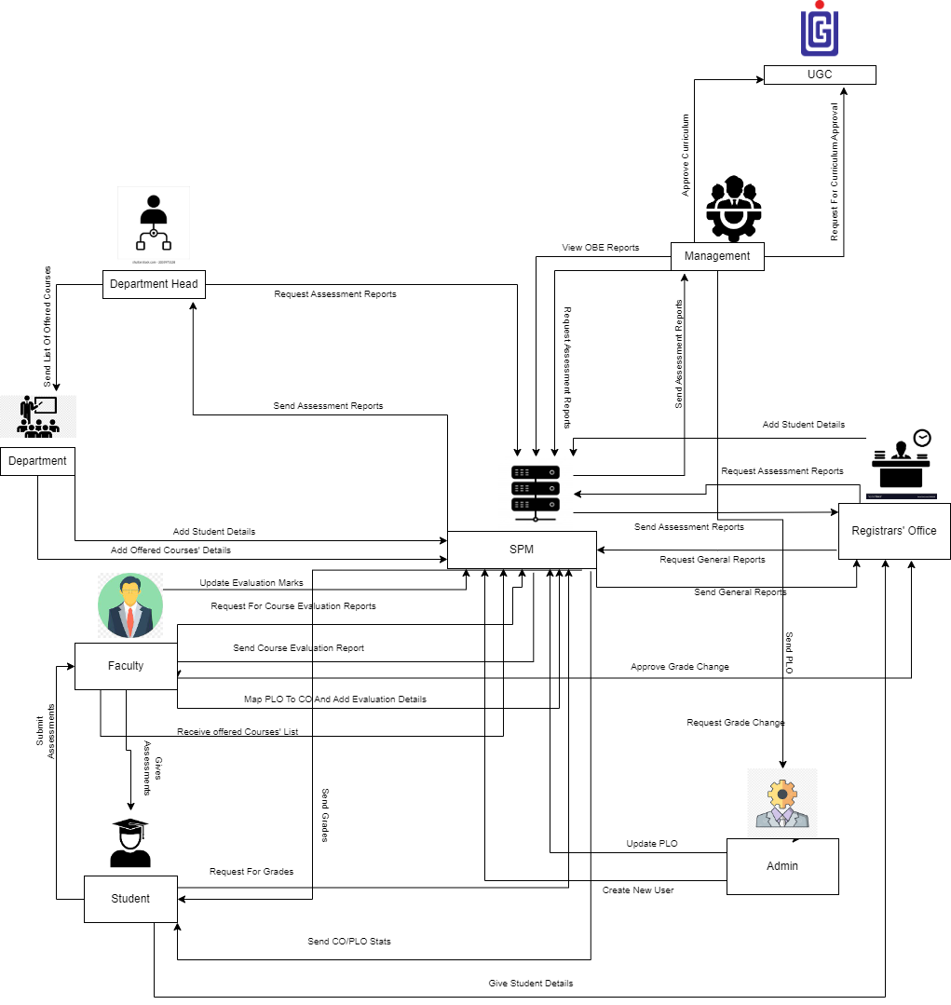
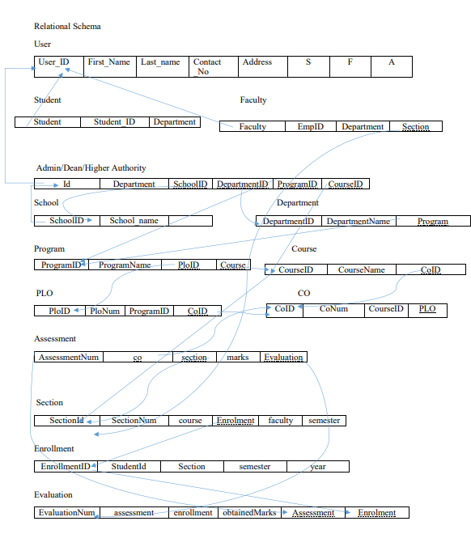
Student Performance and Monitoring System
^{Group 27}
^{Data Leakers}
Md Tuhin Al Jobayer, Farsheed Rahman, S.M. Arif Mahmud, Safayet Khan, Sheikh Raiyan Hossain, Md Samiur Rahman Department of Computer Science and Engineering, Independent University, Bangladesh (IUB)
Introduction
Entity Relation Diagram
Normalization
Our project's goal is to create, develop, and distribute software that, in our opinion, will assist universities worldwide in promoting a more fruitful and efficient method of student evaluation. As the central concept of our project, we've introduced the notion of Course Outcomes (COs) and Program Learning Outcomes (PLOs), where each CO is mapped to a PLO, and each PLO represents a particular valuable skill that students are expected to acquire or improve at the conclusion of that course, such as problem analysis, design, implementation of a skill and spider chart.
The details will all be present in the course outline for the students to have easy access and have all the necessary details regarding a course. The project will determine whether each student has successfully completed the PLOs that are linked to the COs requirements in order to evaluate them effectively through tools such as spider charts. IEB input is accepted by the system when establishing PLO criteria. For the system to map the COs to PLO appropriately, the faculties then input the COs for each of their students. It was discovered via the execution of this project that the efficiency not only reduced time but also increased quality. The PLOs are carefully and deliberately selected to guarantee that each student gets the most skills out of a course.
Methodology
Framework used in this Project is Django following MVT design pattern. HTML5, Java-script, Bootstrap 5.3 for User Interface. For charts and graph we used chart.js. csrf_token used For submitting form using POST method. SQLite for database, with Standard Query Language
Figure 2. ERD of SPMS
Rich Picture
Relation Schema
Figure 4. Normalization of SPMS
Future Planning
1.The number of users will be increased to include advisers, who will receive pertinent data on the students they are advising for better and more advantageous interactions between students and advisors.
2.Project goals include adding a component that predicts a candidate's grade based on prior grades and performances.
3. Faculties will insert multiple student’s grade at a time by uploading a formatted spreadsheet
3.Other stakeholders will have limited Access
Conclusions
We think the idea we had for our SPM System has been created, built, and implemented in the greatest way possible. With the appropriate application of this system, we intend to significantly raise the standard of education offered by institutions. This program can be used by students who want to become better and more capable scholars, by faculties to keep better track of their students and adjust their teaching strategies accordingly, and by institution members to more effectively manage their resources. With the limited time provided to us designed decent system possible.
Figure 1. Rich Picture of SPMS
Figure 3. Relation Schema of SPMS

