Slide 1
Designing Drone-Assisted Radio Access Networks
Student Name: Abdur Razaqh khatib
Student ID: 001331395
Supervisor Name: Mohammed Majid Al-Rifaie

Slide 2
Aim
To develop and evaluate an adaptive optimization framework using the Dispersive Flies Optimization (DFO) algorithm for enhancing drone-assisted Radio Access Networks (RAN), with a focus on maximizing user coverage and optimizing resource allocation.

Slide 3
Objective of Study
Investigate the current challenges and opportunities in drone-assisted Radio Access Networks (RAN).
Analyse the applicability of the Dispersive Flies Optimization (DFO) algorithm in dynamic wireless network environments.
Design a DFO-based optimization framework for adaptive drone deployment in RAN.
Implement the proposed optimization framework in a simulation environment.
Evaluate the performance of the DFO framework against existing methods in drone-assisted RANs.

Slide 4
Literature Review
Author(s) and Year | Algorithm Used | Details
Hossain, Hasan, & Alam (2021) | Linear Programming (LP) | Focuses on resource allocation in 5G RAN; highlights LP’s precision but notes its scalability challenges.
Chen, Zhang, & Zhang (2019) | Simulated Annealing (SA) and Tabu Search (TS) | Applied for drone placement optimization; evaluated for real-time application in dynamic environments.
Wang & Liu (2020) | Genetic Algorithms (GA) and Particle Swarm Optimization (PSO) | Compared for optimizing drone placement, power allocation, and spectrum management in RAN.
Hossain, Hasan, & Alam (2021) | Dispersive Flies Optimization (DFO) | Explored DFO for resource allocation and drone placement in 5G RAN; found effective for real-time optimization.
Ali & Ahmed (2021) | Centralized vs. Distributed Optimization | Examined performance differences between centralized and distributed approaches in drone-assisted RAN.
Nguyen & Hanzo (2020) | Comparative Analysis of Multiple Algorithms | Analysed trade-offs between computational efficiency and optimization accuracy across various methods in RAN.

Slide 5
Algorithms
Algorithm Name | Description
Random Placement Algorithm | A baseline method where drones are positioned randomly within the area without considering user distribution or environmental factors. It is computationally inexpensive but results in suboptimal coverage and resource utilization. Useful as a benchmark for evaluating more advanced algorithms.
Greedy Algorithm | A simple and efficient method that incrementally places drones to maximize immediate coverage gains. It is useful in scenarios prioritizing computational efficiency but tends to get stuck in local optima, limiting its effectiveness in complex environments.
Grid Placement Algorithm | A structured method where drones are positioned on a predefined grid across the area of interest. This approach ensures uniform coverage but may not be efficient in adapting to dynamic user distributions or environmental changes. It is useful in scenarios with predictable and static network demands.
Particle Swarm Optimization (PSO) | An evolutionary algorithm inspired by the social behavior of birds or fish. It balances local exploration and global search, making it well-suited for complex search spaces. However, PSO is sensitive to parameter choices and may require careful tuning for optimal performance.
Dispersive Flies Optimization (DFO) algorithm | A modified version of the Dispersive Flies Optimization (DFO) algorithm designed for dynamic environments. It includes a repulsion mechanism to prevent drone overcrowding and adaptive parameter adjustment for better exploration and exploitation. Suitable for evolving user distributions and network topologies. DFO is known for its simplicity, adaptability, and effectiveness in solving complex optimization problems.

Slide 6
Modified DFO
Inspired by Nature: The Dispersive Flies Optimization (DFO) algorithm is a nature-inspired metaheuristic that mimics the swarming behavior of flies in a search space. It uses random dispersal and attraction to guide particles towards optimal solutions.
Repulsion Mechanism: Integrates a repulsion force between drones to prevent overcrowding and ensure a uniform distribution across the coverage area.
Adaptive Parameter Adjustment: Dynamically tunes algorithm parameters based on the current state of the network, enhancing exploration and preventing premature convergence.
Enhanced Coverage: Addresses limitations of the original algorithm by ensuring drones do not cluster together, optimizing coverage across the area.
Balancing Exploration and Exploitation: Effectively balances the need to explore new areas and exploit known good solutions, making it ideal for complex, evolving networks.
Suited for Dynamic Environments: Particularly well-suited for scenarios where user distribution and network topology are constantly changing, ensuring reliable and efficient resource management.

Slide 7
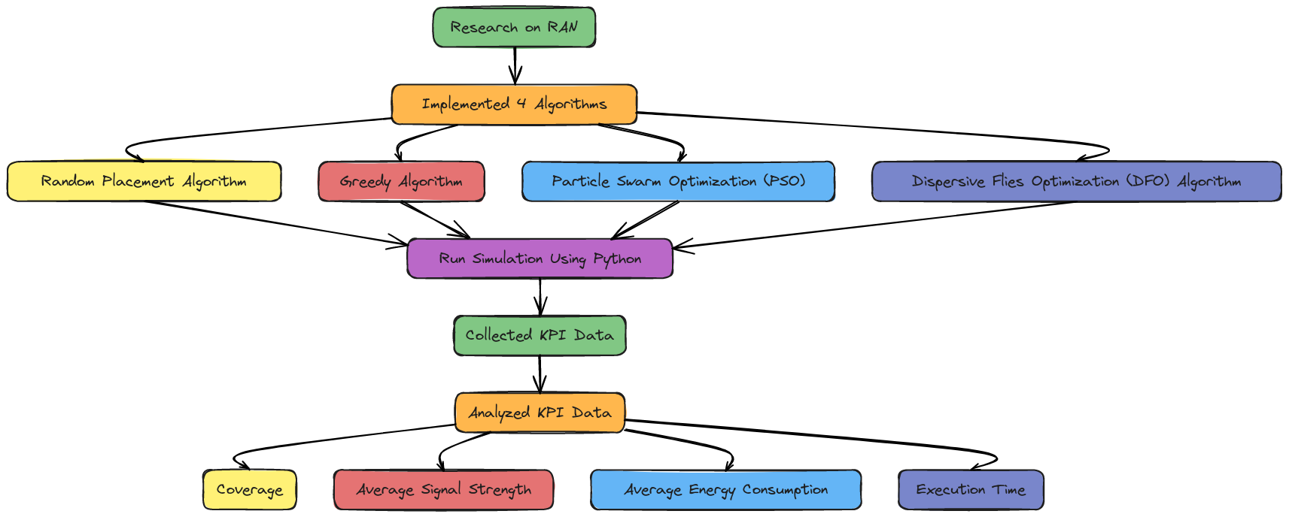
Methodology

Slide 8
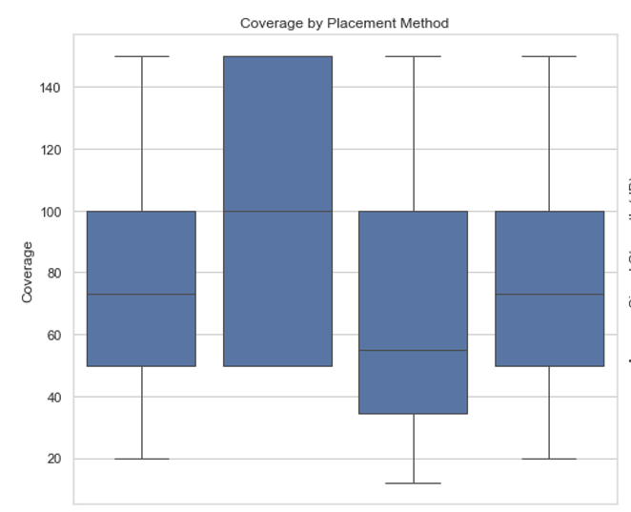
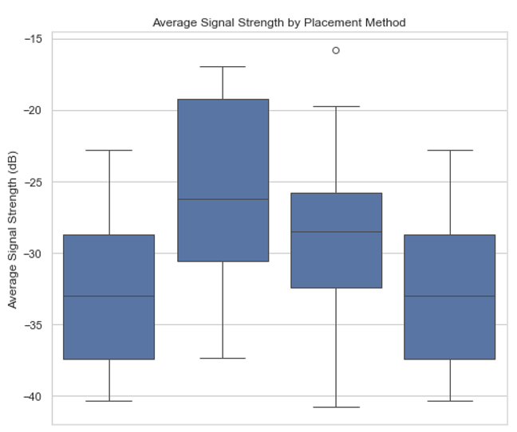
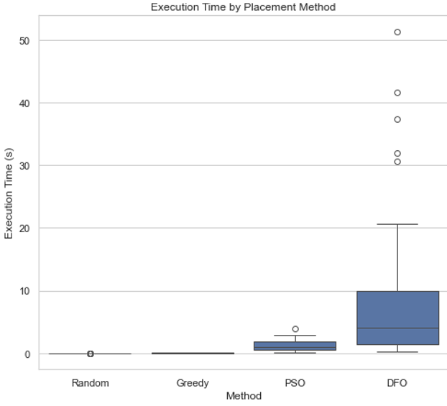
Algorithm Comparison

Slide 9
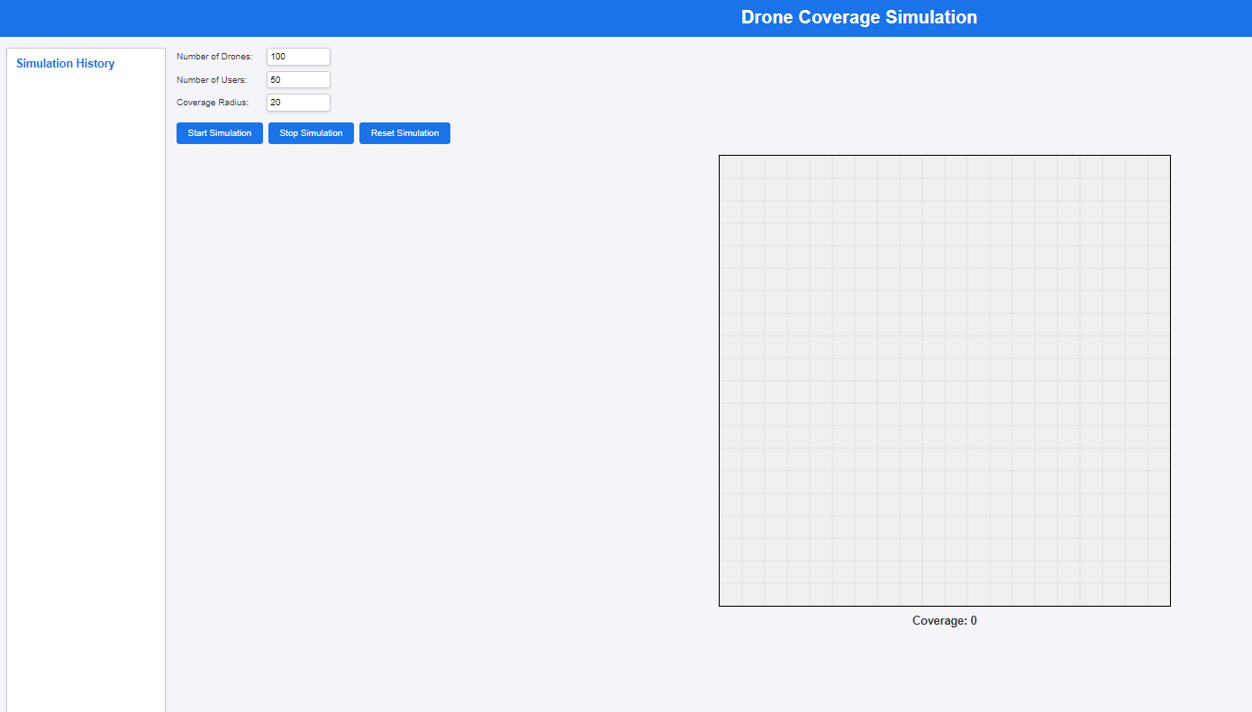
Website Design
User Input Interface: Set up simulation parameters.
Start Simulation Button: Begins real-time drone coverage.
Real-Time Coverage Display: Shows drones and users' positions.
Stop Simulation Button: Halts the ongoing simulation.
Reset Simulation Button: Clears data for a new run.
Simulation History Section: Records and compares previous outcomes.

Slide 10
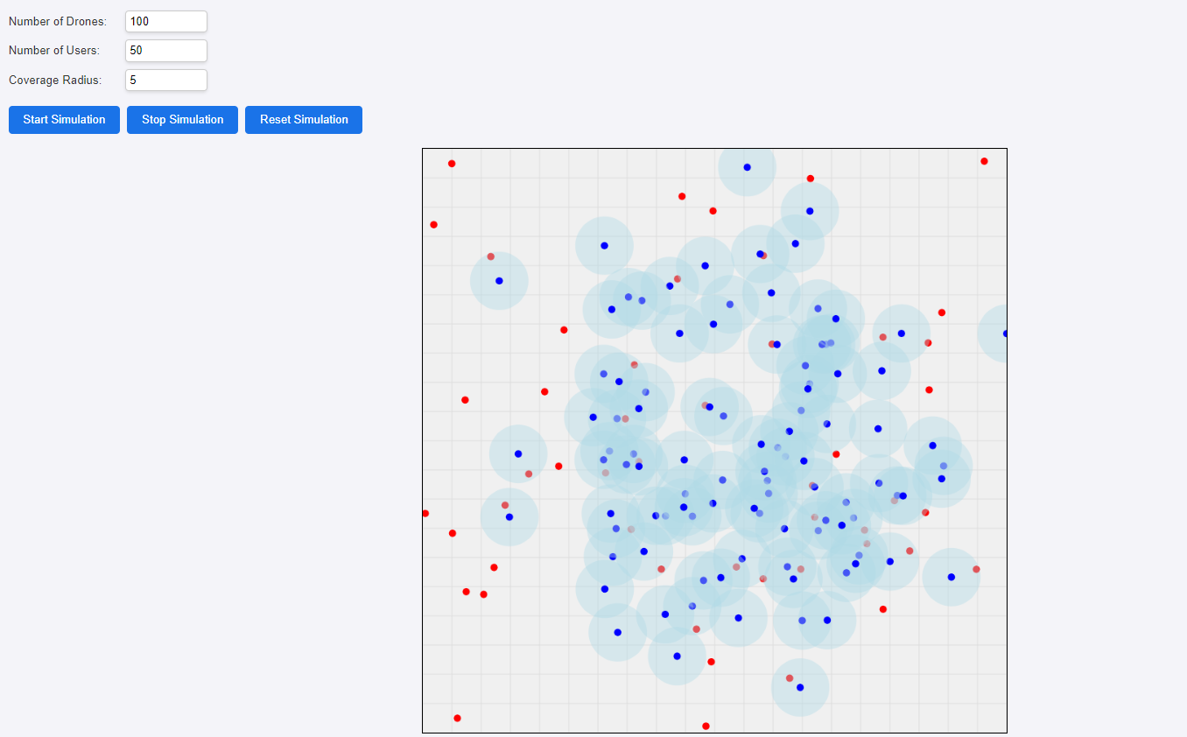
Simulation in Website for DFO

Slide 11
Conclusion
Adaptive Optimization Framework: Successfully implemented DFO-based optimization for improving drone-assisted RANs.
Enhanced Coverage and Resource Management: Modified DFO algorithm effectively maximized coverage and managed resources in dynamic wireless networks.
Repulsion Technique Effectiveness: The inclusion of repulsion techniques in DFO prevented drone clustering, ensuring better network performance.
Superior Performance: Modified DFO outperformed Random, Greedy, and PSO algorithms in coverage and signal strength metrics.
Trade-off with Execution Time: Higher execution time with DFO was justified by improved coverage and signal strength, making it suitable for real-time applications.
Positive Correlation Analysis: Statistical analysis confirmed DFO's efficiency, especially in larger areas, maintaining good coverage and signal strength.
Future Research Potential: Opportunities exist to integrate machine learning, simulate more complex environments, and apply the framework to other wireless systems like IoT and disaster relief networks.

Slide 12
Thank YOU

Slide 13
Any questions!

