Slide 1
Grep
Like File Search Tool in .NET
Ehsan Khatiban
Parallel and Ansynchronous Programming with .NET

Slide 2
How It Works
01
02
03
04
Recursive File Search
-r flag for subdirectory scanning
Result Limit
-t:N to limit results (e.g., -t:100).
Cancellation Support
Press c to stop the search
Async Processing
Uses Task.Run for non-blocking operations

Slide 3
Code Structure
Main() → Parse args → Search → Display → Retry loop

Slide 4
Technical Implementation
Argument Parsing
Async Search Logic
User Interaction
ParseArguments(args, ref searchTerm, ...);
Supports -d:path, -r, and -t:N
await ParallelSearchAsync(...);
Uses Directory.GetFiles + File.ReadLines with cancellation checks.
GetUserInput(...);

Slide 5
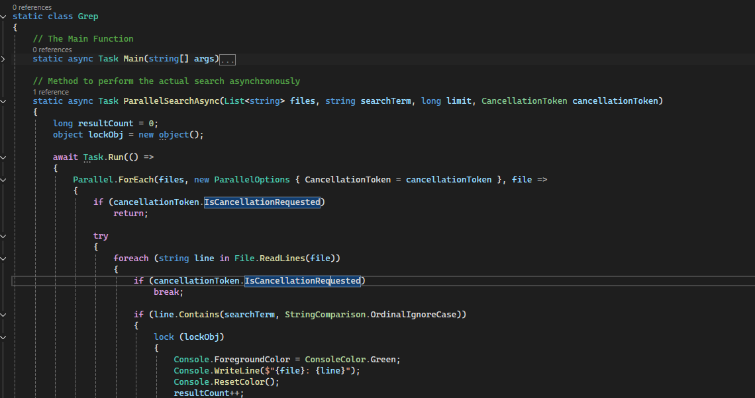
How to Use the Tool
Command-Line Arguments: GREP.exe "hello world" -r -d:C:\Projects -t:50 *.txt Interactive Mode (no args): Enter search term: "error"
File pattern: *.log
Search recursively? (y/n): y

Slide 6
Thanks!
Do you have any questions?
Ehsankhatiban@gmail.com

