Slide 1
Trapped in a Low Dimension
Decoding Visual Stimulus Identity from Neuron Activity
Does a low-dimensional representation allow for decoding of the coarse category of visual stimulus from full-time-averages or narrow-bin averages of V1 excitatory neuron responses?
Does the L4 layer carry a stronger stimulus-category signal than other layers, and does any individual layer outperform the full-population decoder?
Omar Jallouq, Filip Janczak, Mohammed Aaaqib Khatibi, Dhruv Singh

Slide 2
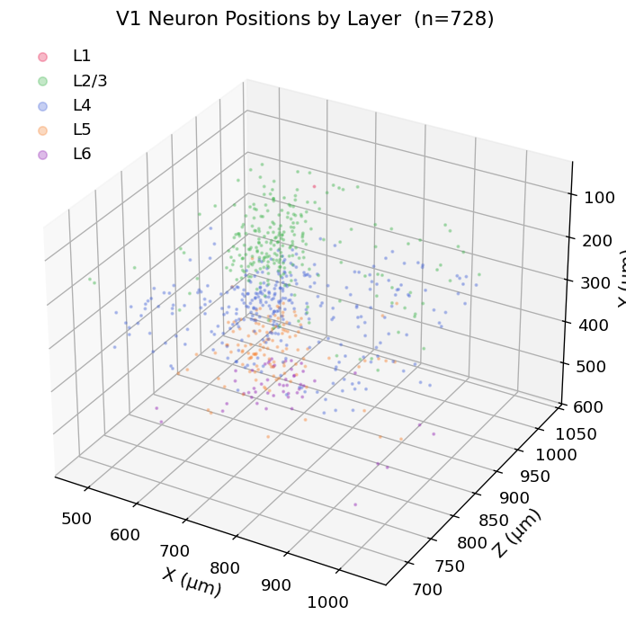
Introduction
Decoding from V1
Decoding from V1
Primary visual cortex (V1) is the first stage of visual processing, transforming retinal input into neural population
Nature of encoding of stimulus identity is a central question
MICrONS offers structured database allowing investigation of information encoding
Dimensionality reduction, including general (PCA, t-SNE, UMAP) and specialized tools (CEBRA) allow structural analysis, visualization, and facilitated prediction/decoding
Neural Layers
L4 is the primary thalamo-cortical input layer and may be expected to encode a more coherent signal
Other layers’ involvement may contribute to or detract from the informativity of a full-layer representation
3D anatomical positions of 728 proofreaded V1 excitatory neurons
coloured by cortical layer (L1–L6) — MICrONS v1718.

Slide 3
Methodology — Dataset & Preprocessing
Dataset: MICrONS v1718
Neuron Selection / Filtering
Layer 2/3-6 of V1
Proofread axons with matched functional tuning
Result:
579 trusted neurons
All excitatory
280 unique stimuli across 464 trials
Preprocessing
Removed neurons with >10% NaN
Remaining NaNs imputed with column means
Constant response stimuli dropped
StandardScaler applied for zero mean and unit variance
Class-balanced subsample derived
Neuron Layer Distribution
464
Stimulus Category Distribution (Initial)
total
trials
579
280
neurons
(V1 excit.)
unique
stimuli

Slide 4
Methodology — Analysis Pipeline
PART I — Trial-Averaged
First Attempt – Trial-Averaged Dara
Improved Approach – Temporal Bins
①
Average trial repetitions & frames per unique stimulus hash -> 280 × 579 response matrix
①
Segment each trial into 5-frame bins -> 7 520 samples (bin × neuron matrix)
②
Apply PCA, t-SNE (perp 15/30/50), UMAP (nn 5/15/50), CEBRA
②
Apply PCA-2D, UMAP, CEBRA; t-SNE for visualization only
->
③
StratifiedKFold (n=5) logistic regression on 2D coordinates -> balanced accuracy & macro F1
③
GroupKFold (n=5) -> impute an evaluate with logistic regression in each fold -> balanced accuracy & macro F1
④
Shuffle control: permute stimulus labels 100× at stimulus level -> empirical null
④
Shuffle control: permute labels at the trial level (all bins of a trial get same shuffled label)
⑤
Per-layer analysis: repeat pipeline for L4 (257 neurons) and L2/3 (220 neurons) separately
⑤
Per-layer analysis: repeat pipeline for L2/3 (220), L4 (257), L5 (89) with PCA and CEBRA

Slide 5
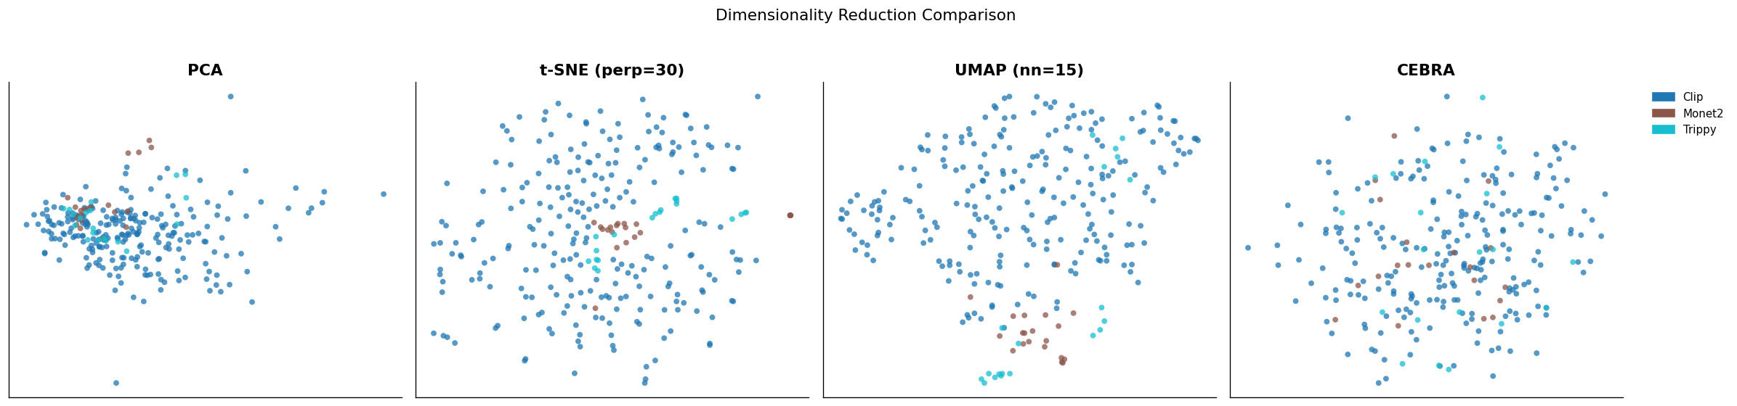
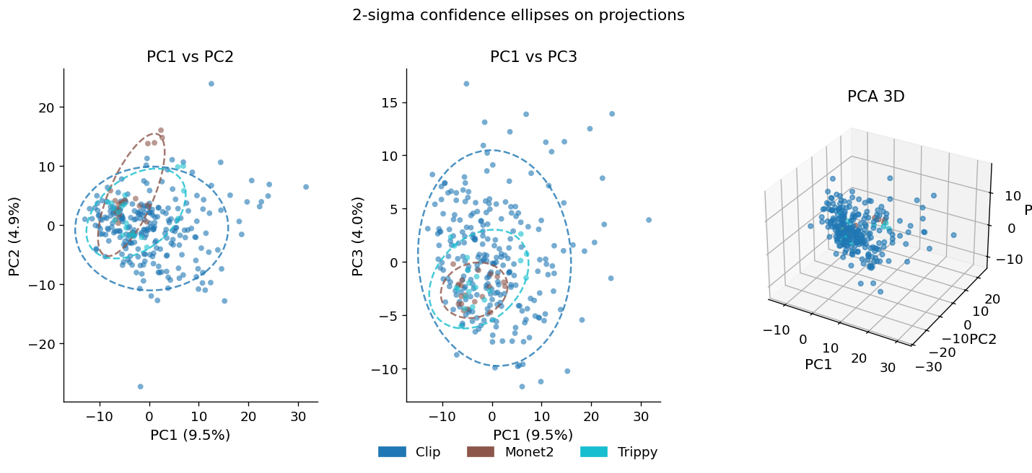
Results — Part I: Dimensionality Reduction
Classification Performance (Balanced Accuracy)
Method | Bal. Acc. | F1
PCA | 0.465 *** | 0.364 ***
t-SNE (p=30) | 0.401 *** | 0.339 ***
UMAP (nn=15) | 0.515 *** | 0.471 ***
CEBRA | 0.274 ns | 0.185 ns
PCA, t-SNE (perp=30), UMAP (nn=15), CEBRA 2D embeddings on 280 trial-averaged stimuli
UMAP leads
UMAP (nn=15) achieves the highest balanced accuracy of 0.515, significantly above the 0.333 chance level (p < 0.001)
CEBRA fails
Non-temporal data and small sample size prevents expected CEBRA high performance
PCA participation ratio
Effective dimensionality = 47.2 PCs. 82 PCs needed for 80% variance; V1 activity lies in a high-dimensional space

Slide 6
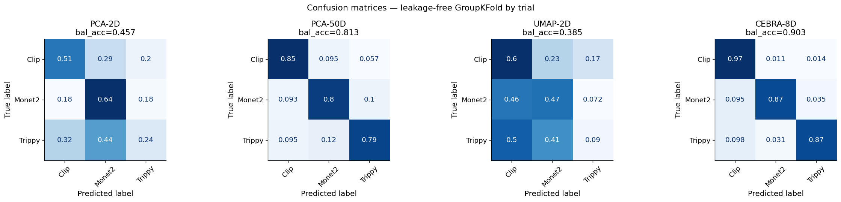
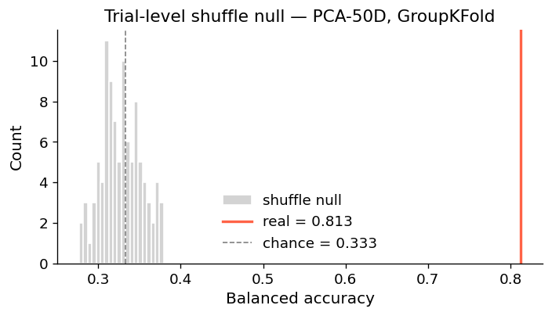
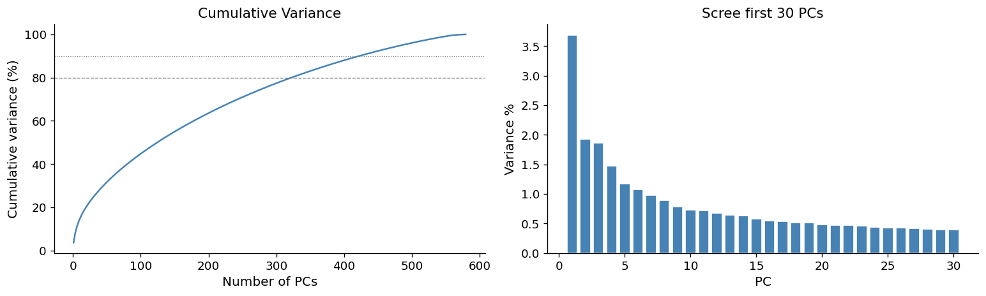
Results – Improved Approach: 5-Frame Bins
CEBRA-8D Achieves 90% Accuracy, PCA-50D Achieves 81%
Confusion matrices for PCA-2D, PCA-50D, UMAP-2D, CEBRA-8D — GroupKFold per trial
Part II — GroupKFold Results
Method | Bal. Acc. | F1
PCA-2D | 0.457 ± 0.04 | 0.378 ± 0.03
PCA-50D | 0.813 ± 0.02 | 0.740 ± 0.02
UMAP-2D | 0.385 ± 0.03 | 0.350 ± 0.03
CEBRA-8D | 0.903 ± 0.02 | 0.906 ± 0.01
Part II shuffle null
(trial-level permutation)
Part II PCA scree — effective dim 212

Slide 7
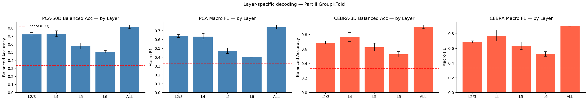
Layer Performance Analysis
PCA-50D, UMAP-2D, CEBRA-8D — GroupKFold balanced accuracy and F1 broken down by cortical layer
L4 leads among layers
L2/3 weaker despite similar sample size
L4 achieves highest balanced accuracy (~83%) in per-bin decoding, consistent with its role as gateway for visual signals into cortex
Associative layer L2/3 falls behind despite similar sample size – information may be encoded in a less linear structure
Other layers fail
Full-layer analysis gives best results
Small sample size of L5 and L6 sets back performance even further (L1, with only one neuron left after filtering, was not considered)
Both PCA-50D and CEBRA-8D achieve highest accuracy and macro F1 on full data, suggesting relevance of all layers to encoding of visual information

Slide 8
Discussion & Conclusions
Answered Research Questions
Limitations & Possible Future Expansions
Sample imbalance
Does a low-dimensional representation allow for decoding of the coarse category of visual stimulus from full-time-averages or narrow-bin averages of V1 excitatory neuron responses?
Clip trials dominate (240/280 stimuli). Even with class-balanced subsamples, natural distribution inflates majority-class accuracy. Future approaches could oversample or use stratified generation.
Yes, using temporal bins allowed dimensionality reduction through PCA and CEBRA to recover meaningful information from encoding in V1 neurons, and resulting predictions achieved up to 90% accuracy, a successful decoding of visual stimuli. With a larger dataset, even higher accuracies may be possible.
Using wider bins, i.e. full-time averages, was a failed approach, giving no meaningful results and preventing CEBRA from utilizing the advantages it has in the temporal setting.
Calcium imaging resolution
Truly effective neural analysis may require higher time-sensitivity and finer data than offered by the methodology that created the MICrONS dataset. Bin size may still be too large to detect all meaningful changes in our improved approach.
Linear classifier only
Logistic regression can only exploit linearly separable structure. Non-linear classifiers like SVM might reveal additional decodable information in the neural manifold.
Does the L4 layer carry a stronger stimulus-category signal than other layers, and does any individual layer outperform the full-population decoder?
Yes, model evaluation showed L4 outperforming other layers, including the similarly-sized L2/3, consistent with thalamo-cortical input being the sharpest driver of stimulus category. The higher success level of the full-layer data supports the notion that neural encoding integrates all layers, rather than being concentrated in the most involved layer entirely.
Within-category decoding
A more elaborate investigation might implement the pipeline for identification of specific clip Ids or grating orientations, rather than coarse category.
Fine temporal dynamics
Performing dimensionality reduction on data placed in different bin sizes could reveal hidden information. There may be a meaningfully optimal bin size.

Slide 9


Thank you for lisetning!

Slide 10
Trapped in a Low Dimension
Decoding Visual Stimulus Identity from V1 Population Activity
MICrONS Dataset — Session 9_4 | Two-Photon Calcium Imaging | Primary Visual Cortex
579
280
3
~7,500
V1 excitatory
neurons
unique
stimuli
stimulus
categories
temporal
bins (Part II)
Neuroscience Project · 2026

Slide 11
Introduction
Why decode stimulus identity from V1?
Visual Cortex as a Decoder
Primary visual cortex (V1) is the first cortical stage of visual processing — it transforms retinal input into a neural population code that downstream areas read out.
A central question in systems neuroscience is whether and how population activity encodes stimulus identity — not just orientation or contrast, but the coarse category of what the animal is seeing.
Two-photon calcium imaging (MICrONS dataset) lets us record hundreds of genetically identified neurons simultaneously with single-cell resolution, an approach directly connected to population coding frameworks covered in the course.
Dimensionality reduction (PCA, t-SNE, UMAP) and contrastive learning (CEBRA) are modern tools for visualising and decoding high-dimensional neural manifolds — core topics in computational neuroscience.
3D anatomical positions of 728 proofreaded V1 excitatory neurons
coloured by cortical layer (L1–L6) — MICrONS v1718.
Course links: population coding · neural manifolds · dimensionality reduction · decoding theory · calcium imaging

Slide 12
Research Questions
Three guiding hypotheses
Q1
Stimulus Category Decoding
Can the coarse category of a visual stimulus (natural movie clip, Monet noise, full-field grating) be reliably decoded from the mean population response of ~579 proofreaded V1 excitatory neurons — above and beyond a trial-level shuffle baseline?
Q2
Role of Temporal Structure
Does retaining the temporal structure within each trial — treating every 5-frame bin as an independent observation (~7,500 bins) rather than averaging across time — improve decoding performance and allow richer manifold visualisation?
Q3
Layer-Specific Coding
Does the primary thalamo-cortical input layer L4 carry a stronger stimulus-category signal than the associative layer L2/3, and does either layer outperform the full-population decoder under both trial-averaged and per-bin protocols?

Slide 13
Methodology — Dataset & Preprocessing
MICrONS Two-Photon Calcium Imaging
Data Source
Neuron Layer Distribution
MICrONS public dataset (v1718)
Session 9_4 · Layer 2/3–6 of primary visual cortex (V1)
Neuron selection:
V1-only · proofread axons (ax_clean) · matched functional tuning · excitatory only → 579 trusted neurons
Stimulus set:
280 unique stimuli across 464 trials — natural movie clips (240), Monet2 noise (20), Trippy gratings (20)
Preprocessing pipeline:
① Remove neurons with >10% NaN ② Impute remaining NaNs with column means ③ Drop constant-response stimuli ④ StandardScaler (zero mean, unit variance) ⑤ Class-balanced subsample (20 per class)
Layer L4 is the primary thalamo-cortical
input; L2/3 is the main downstream associative layer.
Stimulus Category Distribution
579
280
464
neurons
(V1 excit.)
unique
stimuli
total
trials

Slide 14
Methodology — Analysis Pipeline
Two-phase investigation: trial-averaged vs. per-bin temporal decoding
PART I — Trial-Averaged
PART I — Trial-Averaged
PART II — Per-Bin Temporal
①
Average all trial repetitions & all frames per unique stimulus hash → 280 × 579 response matrix
①
Segment each trial into 5-frame bins → ~7,520 samples (bin × neurons matrix)
②
Apply PCA, t-SNE (perp 15/30/50), UMAP (nn 5/15/50), CEBRA on 2D embeddings
②
GroupKFold(n=5, groups=trial_id) — test bins never share a trial with training bins (no leakage)
fixes →
③
StratifiedKFold(n=5) logistic regression on 2D coords — balanced accuracy & macro F1
③
Inside each fold: impute → scale → PCA then evaluate PCA-2D, PCA-50D, UMAP-2D, CEBRA-8D
④
Shuffle control: permute stimulus labels 100× at stimulus level → empirical null (p-value)
④
Shuffle control: permute labels at the trial level (all bins of a trial get same shuffled label)
⑤
Layer sub-analysis: repeat pipeline for L4 (257 neurons) and L2/3 (220 neurons) separately
⑤
Layer sub-analysis: repeat for L2/3 (220), L4 (257), L5 (89) separately with CEBRA
⚠ Leakage: UMAP/t-SNE fitted on all data before CV split
✓ Fully leakage-free: all DR fitted inside CV fold

Slide 15
Results — Part I: Dimensionality Reduction
Trial-averaged embeddings coloured by stimulus category
Classification Performance (Balanced Acc.)
Method | Bal. Acc. | F1
Chance (1/3) | 0.333 | —
PCA | 0.465 *** | 0.364 ***
t-SNE (p=30) | 0.401 *** | 0.339 ***
UMAP (nn=15) | 0.515 *** | 0.471 ***
CEBRA | 0.274 ns | 0.185 ns
PCA · t-SNE (perp=30) · UMAP (nn=15) · CEBRA — 2D embeddings on 280 trial-averaged stimuli
UMAP leads
UMAP (nn=15) achieves the highest balanced accuracy of 0.515 — significantly above the 0.333 chance level (p < 0.001).
CEBRA fails here
With only 100 samples, CEBRA finds no structure (0.274, ns). It needs temporal data — fixed in Part II.
PCA participation ratio
Effective dimensionality = 47.2 PCs. 82 PCs needed for 80% variance — V1 activity lives in a high-dimensional space.

Slide 16
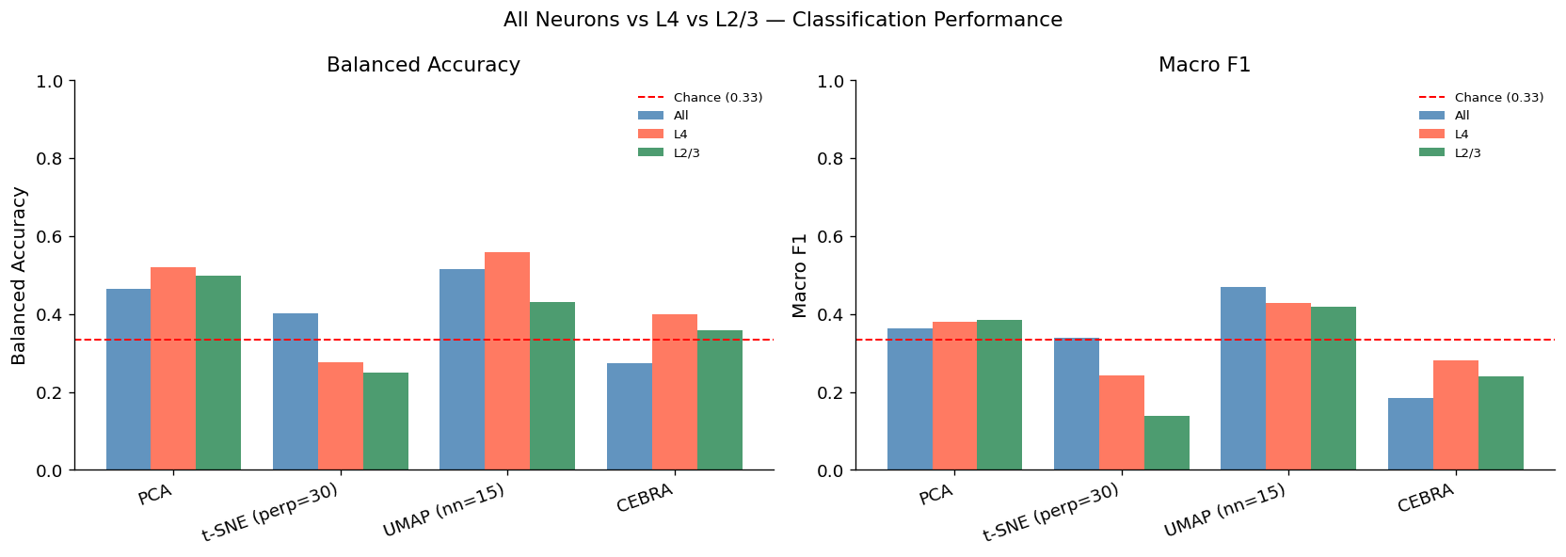
Results — Shuffle Controls & Layer Analysis
Significance testing and cortical layer breakdown
Part I — Shuffle Control Results (100 permutations)
Layer-Specific Findings
Method | Metric | Real | Null mean | Sig.
PCA | Bal. Acc. | 0.465 | 0.335 | ***
PCA | Macro F1 | 0.364 | 0.232 | ***
t-SNE (p=30) | Bal. Acc. | 0.401 | 0.345 | ***
UMAP (nn=15) | Bal. Acc. | 0.515 | 0.320 | ***
UMAP (nn=15) | Macro F1 | 0.471 | 0.215 | ***
CEBRA | Bal. Acc. | 0.274 | 0.330 | ns
CEBRA | Macro F1 | 0.185 | 0.225 | ns
*** p < 0.001 one-sided t-test vs shuffle null · ns = not significant
L4 > All neurons
L4 (primary thalamic input) outperforms full population on PCA (+5.4%) and UMAP (+4.3%), consistent with L4 carrying a sharper visual drive.
L2/3 mixed
L2/3 matches L4 on PCA F1 but falls behind on UMAP — higher recurrent connectivity may spread information across dimensions differently.
Three-way: All neurons vs L4 vs L2/3 — Part I balanced accuracy and F1 by method

Slide 17
Results — Part II: Temporal Binning
GroupKFold cross-validation on ~7,500 per-bin samples
PCA-50D achieves 81.3% balanced accuracy
Part I vs Part II: Balanced Accuracy
up from 46.5% in Part I — temporal binning provides ~7,500 samples and leakage-free GroupKFold evaluation
Confusion matrices for PCA-2D, PCA-50D, UMAP-2D, CEBRA-8D — GroupKFold per trial
Note: PCA-50D (main metric) achieves 0.813 in Part II;
PCA-2D shown for fair comparison vs Part I 2D results.
Part II — GroupKFold Results
Method | Bal. Acc. | F1
Chance | 0.333 | —
PCA-2D | 0.457 ± 0.038 | 0.378 ± 0.028
PCA-50D ✓ | 0.813 ± 0.021 | 0.740 ± 0.021
UMAP-2D | 0.385 ± 0.033 | 0.350 ± 0.030
Part II shuffle null
(trial-level permutation)
Part II PCA scree — effective dim 212

Slide 18
Results — Layer-Specific Analysis (Part II)
Per-bin GroupKFold decoding restricted to individual cortical layers
PCA-50D, UMAP-2D, CEBRA-8D — GroupKFold balanced accuracy and F1 broken down by cortical layer
Balanced Accuracy by Layer — PCA-50D (Part II)
L4 leads across layers
L4 (primary thalamic input, 257 neurons) achieves the highest balanced accuracy (~83%) in per-bin decoding — consistent with its role as the gateway for visual signals into cortex.
L5 punches above weight
L5 (only 89 neurons) performs surprisingly well (~79%), suggesting it carries a more concentrated or efficient stimulus-category representation.
L2/3 lower (~76%)
The associative layer L2/3 (220 neurons) falls behind despite more cells — its richer recurrent connectivity may distribute information in a way that makes simple linear decoding harder.
* Approximate values estimated from layer analysis results

Slide 19
Discussion & Conclusions
Research Questions — Answered
Limitations & Future Directions
Q1: Can V1 population decode stimulus category?
⚠ Sample imbalance
Yes — PCA and UMAP are significantly above chance (p < 0.001). However, the modest effect sizes (46-52% balanced acc in Part I; up to 81% in Part II with 50 PCs) suggest that coarse category is decodable but not trivially so from mean-rate V1.
Clips dominate (240/280 stimuli). Even with class-balanced subsamples, the natural distribution inflates majority-class accuracy — future work should oversample or use stratified generation.
⚠ Calcium imaging resolution
ΔF/F is a slow proxy for spiking. GCaMP6s has ~300 ms decay, blurring rapid neural dynamics. Fine temporal patterns within 5-frame bins are partially washed out.
Q2: Does temporal structure improve decoding?
Strongly yes. Temporal binning increased sample size from ~100 to ~7,500, enabling PCA-50D to reach 81.3% balanced accuracy — a +35% gain. It also enabled CEBRA to work at all, and eliminated leakage via GroupKFold.
⚠ Linear classifier only
Logistic regression can only exploit linearly separable structure. Non-linear classifiers (SVM-RBF, MLP) might reveal additional decodable information in the neural manifold.
Q3: Do cortical layers differ in stimulus coding?
→ Within-category decoding
Yes. L4 consistently outperforms L2/3 and all-neuron baselines, consistent with thalamo-cortical input being the sharpest driver of stimulus category. L5 shows unexpectedly strong performance with fewer neurons.
Next step: decode specific clip IDs or grating orientations rather than coarse category. This would test whether V1 carries fine identity information, not just category.
→ Fine temporal dynamics
Reduce bin size to 1-2 frames and use recurrent decoders to exploit rapid V1 temporal dynamics that 5-frame averaging discards.
Seed: 42 · MICrONS v1718 · Session 9_4 · Full reproducible analysis in NEW_OUTPUT2.ipynb

