Slide 1
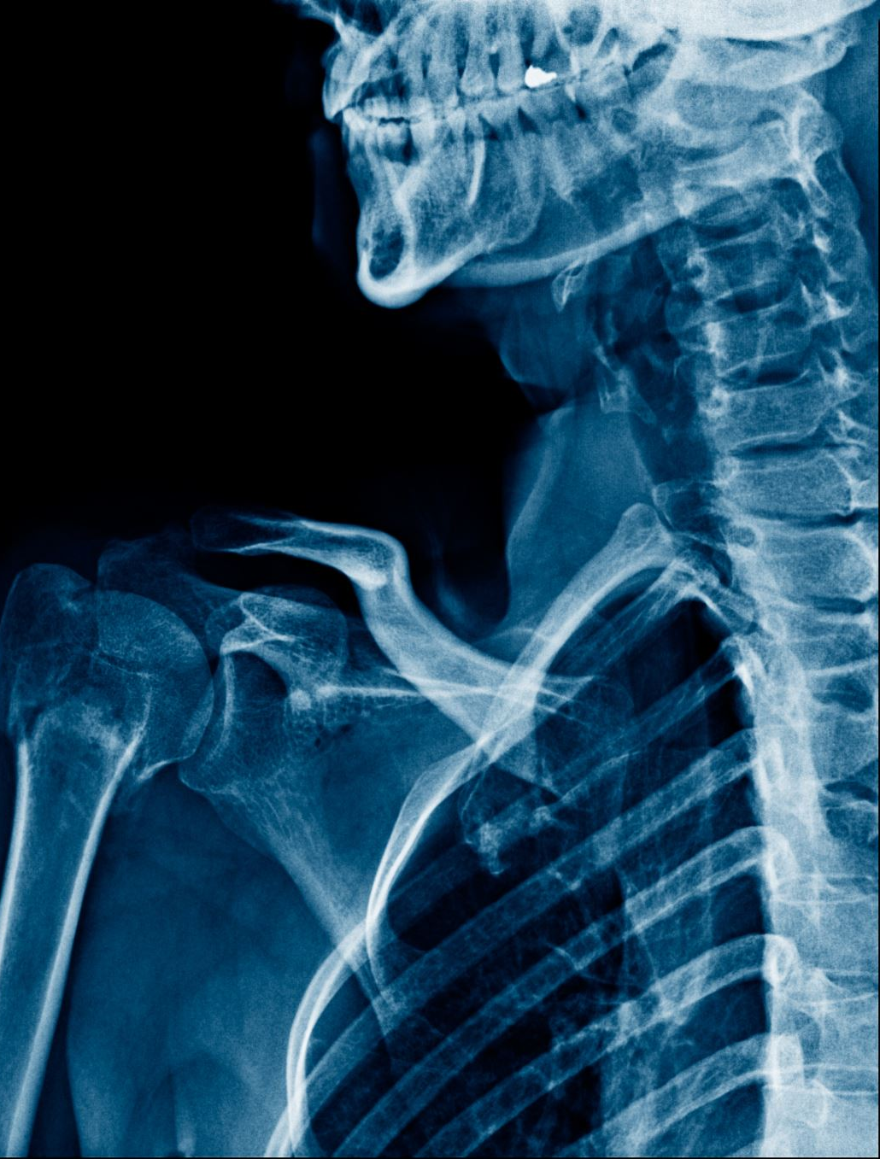
Detecting Abnormalities from Chest X-ray Images: Optimized Learning Approach

Slide 2
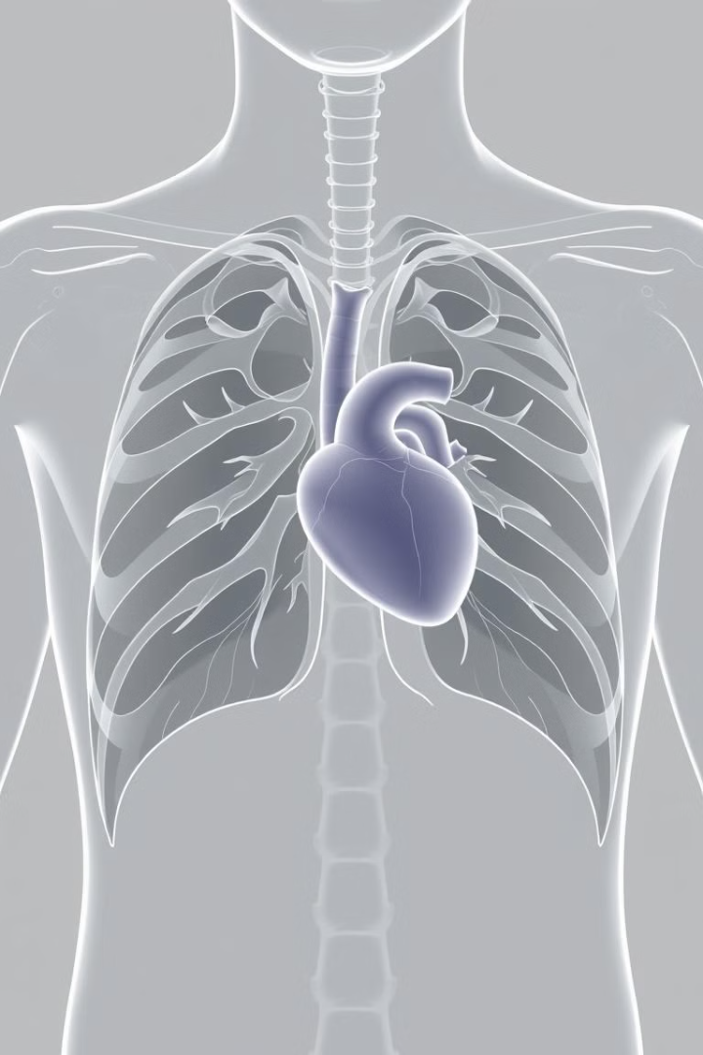
Overview
Lung diseases are a leading cause of mortality worldwide, and the lack of radiological services in low-resource regions exacerbates this issue. This research aims to leverage deep learning models to assist radiologists in detecting abnormalities more efficiently, providing a solution that can improve healthcare outcomes, especially in regions with limited medical resources.

Slide 3
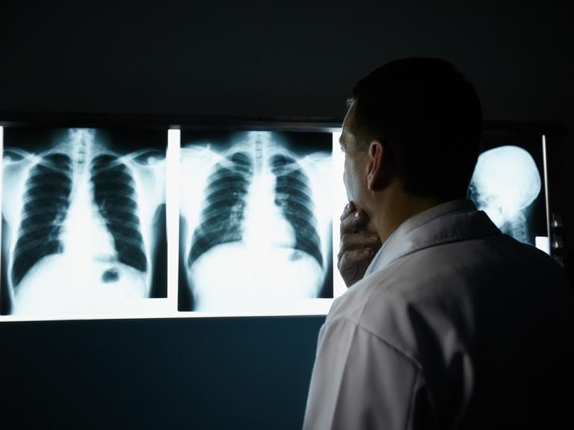
Introduction & Motivation
The motivation behind this research is the pressing need to address the challenges posed by lung diseases, which are a significant global health concern. The lack of radiological expertise and services, particularly in developing regions, creates a barrier to timely and accurate diagnosis. By leveraging the power of deep learning, this study aims to develop a system that can assist radiologists in analyzing chest X-rays more efficiently, ultimately improving the detection and management of various thoracic diseases.

Slide 4

Problem Statement
1
Diagnosing Complexity
2
Radiological Scarcity
3
Objective and Goal
Diagnosing lung diseases from chest X-rays is a complex and time-consuming task, requiring extensive expertise and experience from radiologists.
Radiological services are scarce, particularly in developing regions, limiting access to timely and accurate diagnoses.
The objective of this research is to develop a deep learning system that can classify 14 thoracic diseases using chest X-rays, with the goal of outperforming existing solutions in accuracy and efficiency.

Slide 5
Related Works
Benchmarking Datasets
Pioneering Models
Recent Advancements
The introduction of the ChestX-ray8 dataset by Wang et al. in 2017 has provided a benchmark for the research community to advance chest X-ray analysis using deep learning.
CheXNet, developed by Rajpurkar et al., has demonstrated the potential of deep learning to surpass radiologists in pneumonia detection. Studies by Guendel et al. and Yao et al. have explored spatial context and multi-resolution techniques to enhance model performance.
Recent research by Kim et al. and Kufel et al. has focused on addressing the challenges of multi-class classification and dataset imbalance, further advancing the field of chest X-ray analysis using deep learning.

Slide 6
Related Works
Research Paper | Dataset | Model Architecture | Key Focus | Evaluation Metric | Top Performance
Kufel et al. (2023) | NIH ChestX-ray14 (custom split) | EfficientNetB1 + custom layers | Multi-label classification of 14 thoracic diseases | AUC-ROC | Average AUC-ROC: 0.843
Wang et al. (2017) | ChestX-ray8 (subset of NIH ChestX-ray14) | Various pre-trained models (AlexNet, GoogLeNet, VGGNet, ResNet) | Weakly-supervised multi-label classification and disease localization | AUC | Average AUC: 0.745 (ResNet-50)
Rajpurkar et al. (2017) | ChestX-ray14 | 121-layer DenseNet (CheXNet) | Pneumonia detection (binary) and extension to multi-label classification | F1 score (pneumonia), AUC-ROC (multi-label) | F1: 0.435 (pneumonia), State-of-the-art on all 14 diseases (multi-label)
Kim et al. (2022) | NIH & SCH datasets | EfficientNet v2-M | Multi-class classification (3 classes for NIH, 4 classes for SCH) | Accuracy, Sensitivity, Specificity | NIH: Accuracy = 82.15%, Sensitivity = 81.40%, Specificity = 91.65% ,
Baltruschat et al. (2019) | ChestX-ray14 | ResNet-50 (with variations) | Multi-label classification, impact of transfer learning, architecture, and non-image features | AUC-ROC | Average AUC: 0.822 (ResNet-50-large-meta)

Slide 7
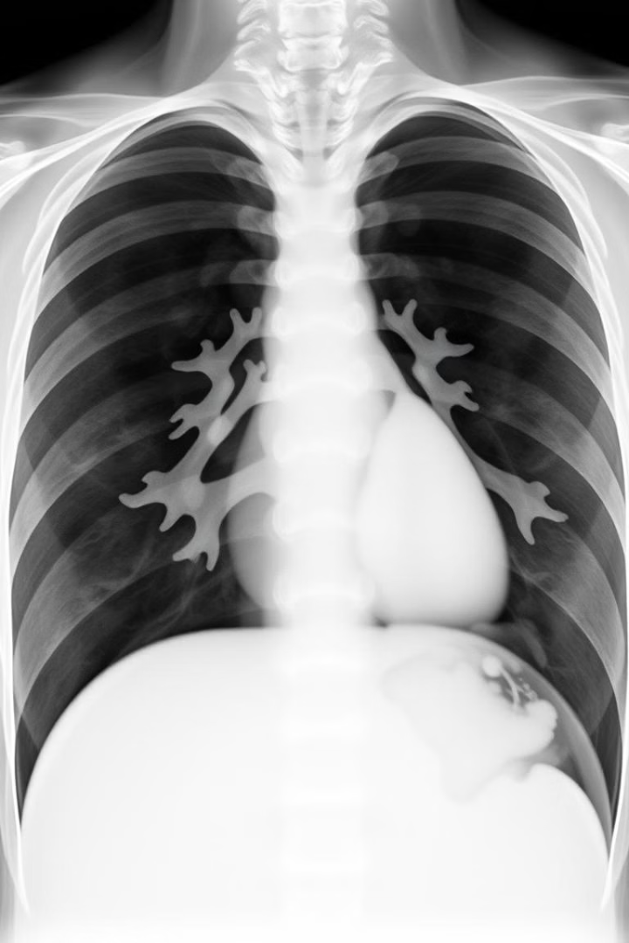
Dataset Overview
The research team utilized the NIH ChestX-ray14 dataset, which consists of 112,120 frontal-view chest X-ray images, each labeled with one or more of the 14 thoracic disease classifications, including Pneumonia, Fibrosis, and Hernia. The images have a resolution of 1024x1024 pixels, providing high-quality visual information for the deep learning models to analyze.

Slide 8
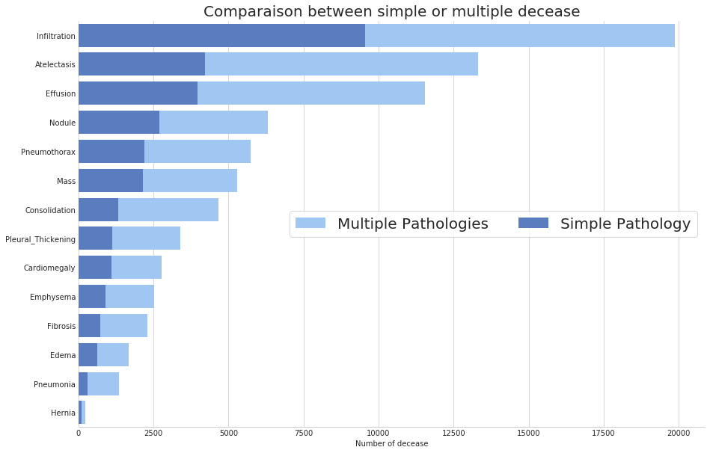
Comparison between simple
Or multiple decease

Slide 9
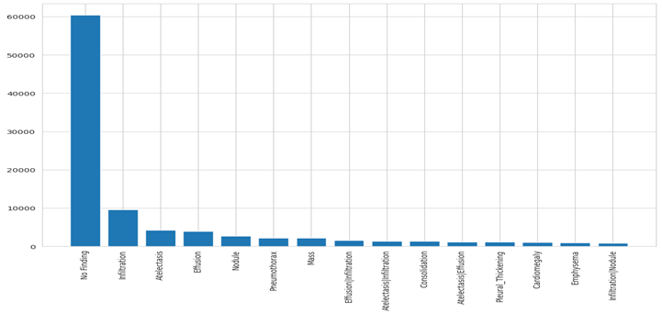
Imbalance of data set classes

Slide 10
Dataset Challenges
Class Imbalance
High Resolution
The dataset exhibits a significant class imbalance, with the Hernia class representing only 0.2% of the total samples, while classes like Effusion and Infiltration are more prevalent.
The high-resolution 1024x1024 pixel images provide a wealth of visual information, but also increase the computational complexity and memory requirements for the deep learning models.
Diverse Pathologies
Unique Characteristics
The 14 thoracic disease classifications included in the dataset cover a wide range of pathologies, requiring the deep learning models to learn intricate features and patterns to accurately identify each condition.
Each disease class has unique visual characteristics and spatial distributions within the chest X-ray images, necessitating specialized techniques to capture these nuances effectively.

Slide 11
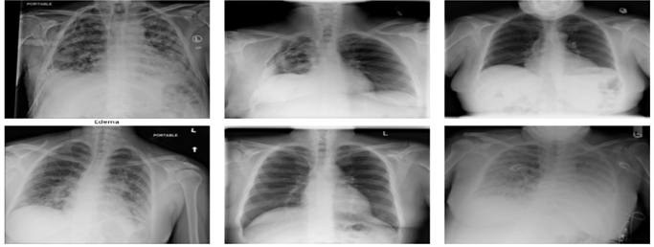
Data Preprocessing and Augmentation
1
Data Split
The dataset was split into three non-overlapping subsets: a 70% training set, a 20% testing set, and a 10% validation set, ensuring a robust evaluation of the deep learning model's performance.
2
Data Augmentation
The research team tested various data augmentation techniques individually and then combined the most effective ones, including horizontal flipping, height and width shifts, rotations, and zoom and shear transformations, to enhance the model's generalization capabilities and address the class imbalance.
3
Preprocessing
The high-resolution 1024x1024 pixel images were preprocessed to optimize the input for the deep learning model, including normalization, resizing, and other techniques to ensure efficient training and inference.

Slide 12
Methodology
Optimization Techniques
Evaluation Metric
Adamax optimizer was used, a variant of Adam that is more stable when dealing with varying gradient scales and imbalanced data.
The ROC AUC score, is a key measure that tells us how well the model distinguishes between positive and negative classes, by comparing the True Positive Rate (TPR) against the False Positive Rate (FPR).

Slide 13
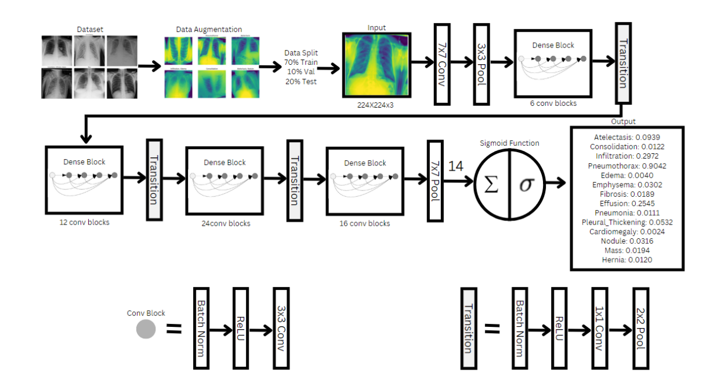
Methodology Flow Chart

Slide 14
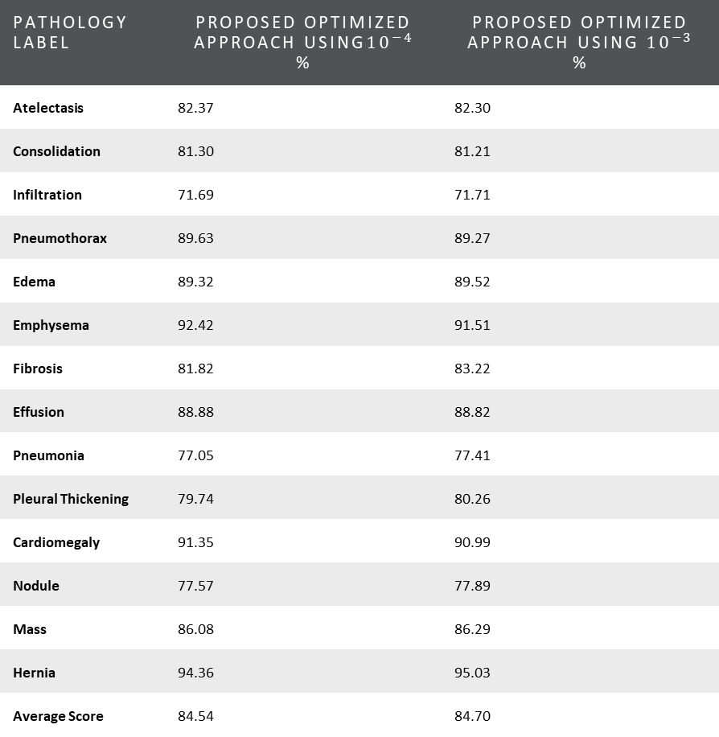
Results
Comparison between the two approaches.
Pathology Label | Proposed Optimized approach using${10}^{−4}$ % | Proposed Optimized approach using ${10}^{−3}$ %
Atelectasis | 82.37 | 82.30
Consolidation | 81.30 | 81.21
Infiltration | 71.69 | 71.71
Pneumothorax | 89.63 | 89.27
Edema | 89.32 | 89.52
Emphysema | 92.42 | 91.51
Fibrosis | 81.82 | 83.22
Effusion | 88.88 | 88.82
Pneumonia | 77.05 | 77.41
Pleural Thickening | 79.74 | 80.26
Cardiomegaly | 91.35 | 90.99
Nodule | 77.57 | 77.89
Mass | 86.08 | 86.29
Hernia | 94.36 | 95.03
Average Score | 84.54 | 84.70

Slide 15
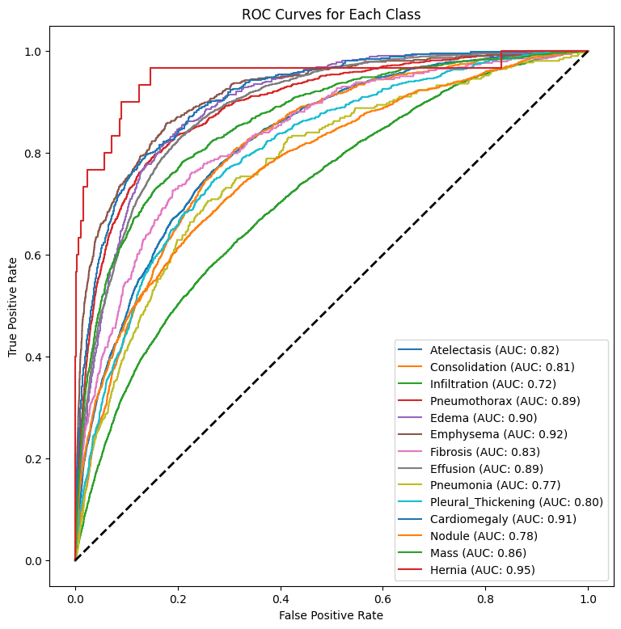
Results
ROC AUC Curves
Improved from 84.54% to 84.70%.

Slide 16
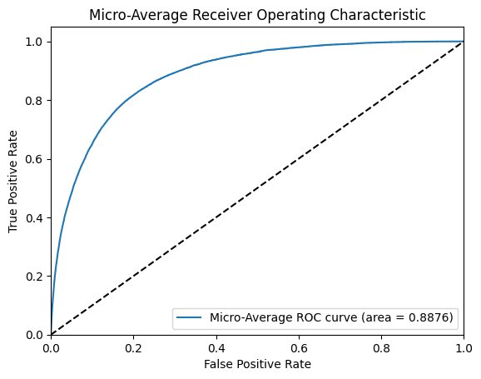
Results
Micro-average ROC AUC: 88.76%

Slide 17
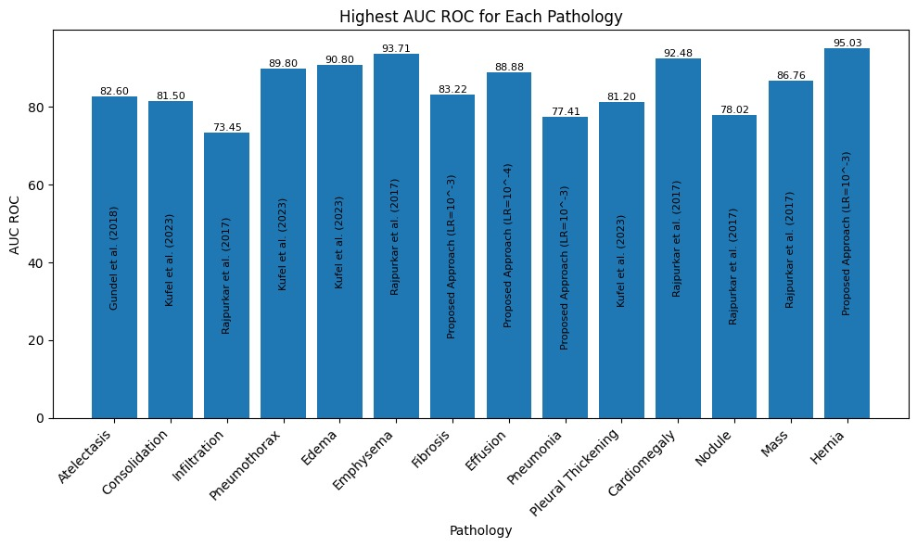
Results
Best Performance:
Fibrosis 83.22%
Effusion 88.82%
Pneumonia 77.41%
Hernia 95.03%

Slide 18
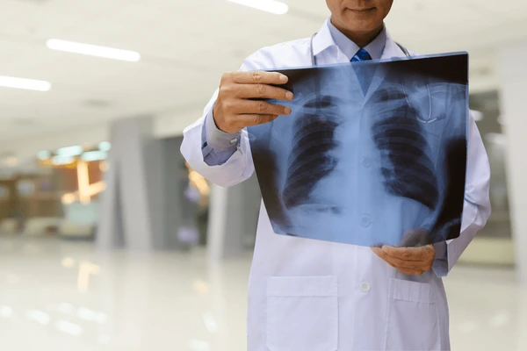
Conclusion & Future Work
DenseNet-121 with optimizations showed competitive results in multi-label classification.
Future work: Address label noise and dataset imbalance using NLP techniques.
Explore domain adaptation to improve generalizability across diverse populations.
Integration of multi-modal data (e.g., CT scans) to improve diagnostic accuracy.

Slide 19
Thank you!

