Slide 1
Welcome to My Presentation

Slide 2
"A Study on the Correlation Between Social Media Usage, Physical Activity, and Academic Performance in University Students"
Submitted By:
Khatun E Jannat Mimia
(Roll: 01-065-07,
Batch-65)
Instructor:
Dr. Tania Islam,
Assistant Professor,
CSE, University of Barishal

Slide 3
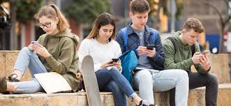
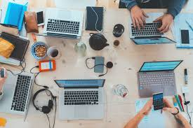
Introduction
Key Points:
Social media and physical activity impact academic performance.
Social media may distract from studies.
Physical activity enhances cognitive function.

Slide 4

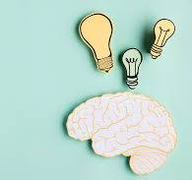
Background
Social Media:
3 hours/day linked to lower grade
Physical Activity:
Improves memory and problem-solving

Slide 5
Objectives
Examine social media’s impact on grades.
Analyze physical activity’s role in academic success.
Study combined effects of both factors.
Compare performance across departments (CSE, STAT, BBA, LAW).

Slide 6
Dataset Overview

