Slide 1
HTML
Language of webpage
Presented By: Khaula

Slide 2
INDEX
Hypertext and Hyperlinks
Introduction to HTML
HTML Syntax
Structure Of The Webpage
Create A Basic HTML File
Introduction to some Common Tags
Include A Picture

Slide 3
Introduction to HTML
HTML stands for Hyper Text Markup Language.
HTML describes the content and format of webpages using text tags.
FOR EXAMPLE:
Title tag: <title> Name </title>
It’s the job of the web browser to interpret tags and display the content accordingly.

Slide 4
Hypertext And Hyperlinks
Hyper Text markup language
Webpages are text files.
The Key to Hyper Text is the use of Hyperlinks, which allow you to jump from one topic to another topic.

Slide 5
HTML Syntax:
An HTML file contains both contents and tags.
Documents Content is what we see on the webpage.
Tags are the HTML codes that control the appearance of the document content.
Types of Tags:
An HTML document is created using different types of tags. HTML tags can be defined and divided based on a different basis. Let’s see them in the coming parts of this article. We have divided HTML tags based on the following classifications:
Paired and Unpaired Tags
Paired Tags:
An HTML tag is known as a paired tag when the tag consists of an opening tag and a closing tag as its companion tag.

Slide 6
Example #1:
<p> My Name is Duaa. </p>
Output:
My Name is Duaa.
NOTE:
Here the opening tag is <p> and the closing tag is </p>.
Example #2:
Another example of a paired tag is, italic and/or bold tags:
<i> <b> Aptech</b> </i>
Output:
Aptech
NOTE:
These pair tags are also called container tags.

Slide 7
Unpaired Tags:
An HTML tag is called an unpaired tag when the tag only has an opening tag and does not have a closing tag or a companion tag.
Example :
<p> My Name is Duaa. </p>
<hr>
<i> <b> Aptech</b> </i>
NOTE:
Here the <hr> is the unpaired tag used to create a horizontal line. In older versions, you might see hr tag written as <hr/> instead of <hr>. These tags are also called Empty Tag.
Self-Closing Tags:
Self-Closing Tags are those HTML tags that do not have a partner tag, where the first tag is the only necessary tag that is valid for the formatting. The main and important information is contained WITHIN the element as its attribute.

Slide 8
Example :
<img src="a.jpg" alt="This is an alternate text">
NOTE:
In the older versions, the self-closing tags use a ‘forward slash’ before the ending or closing ‘greater than’ sign/symbol, as written below:
<img src="a.jpg" alt="This is an alternate text“/>
Utility-Based Tags:
The HTML tags can be widely differentiated on the basis of their utility, that is, on the basis of the purpose they serve. We can divide them basically into three categories as discussed below:
Formatting Tags:
The HTML tags that help us in the formatting of the texts like the size of the text, font styles, making a text bold, etc. This is done using tags like <font>, <b>, <u>, etc. Tables, divisions, span tags are also those tags that help in formatting a web page or document and in setting layout of the page. Below is a small program using divisions for formatting the page along with some other formatting tags.

Slide 9
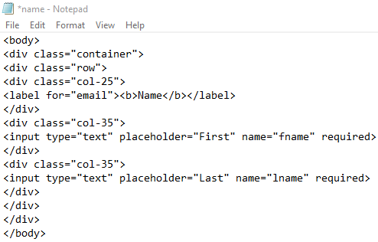
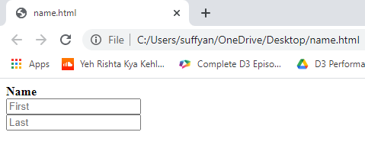
Example :
Output:

Slide 10
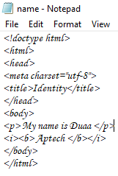
Formatting Tags:
The HTML tags that help in structuring the HTML document are called Structure Tags. Description, head, html, title, body, etc forms the group of the page structure tags. The structure tags only assist in creating or forming the basic html page from the root, that is, they do not affect or has any hand in the formatting of texts.
Example :

Slide 11
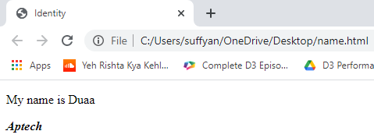
Output:
Control Tags:
Another category of tags that can be created is ‘Control Tags’. The Script tags, radio buttons or checkboxes, the Form tags, etc forms the control tags. These are the tags that are used in managing content or managing scripts or libraries that are external. All the form tags, drop-down lists, input text boxes, etc that are used in interacting with the visitor or the user.
The above distinction of the HTML tags is based on the type of tags and their utility. The HTML tags can also be simply divided based on basic categories like Basic HTML Root Tags, Formatting tags, Audio and Video Tags, Form and Input Tags, Frame Tags, Link Tags, List Tags, Table Tags, Style Tags, Meta Tags, etc.

Slide 12
Structure of the webpage
Starting with the tag <html>……</html>
<html>
Everything about the webpage should be enclosed here
</html>
Inside the <html> </html> tag
Each web page has a head part described in <head> </head> tag:
<html>
<head>
The title of the webpage should be put here <title> testing page </title>
</head>
</html>

Slide 13
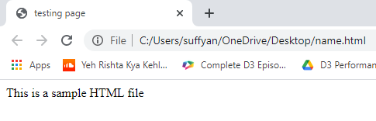
Each web page has a body part described in <body> </body> tag:
<html>
<head>
<title> testing page </title>
</head>
<body>
This is a sample HTML file
</body>
</html>
The Content of the whole web page should be put here
Title
Body

Slide 14
Create a Basic HTML File
Open your text editor (notepad).
Type the following lines of code into the document:
<html>
<head>
<title> testing page </title>
</head>
<body>
This is a sample HTML file
</body>
</html>

Slide 15
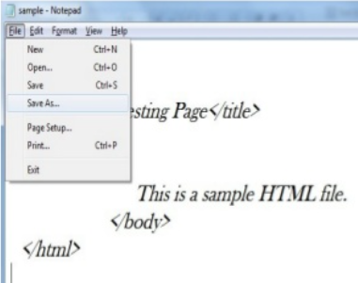
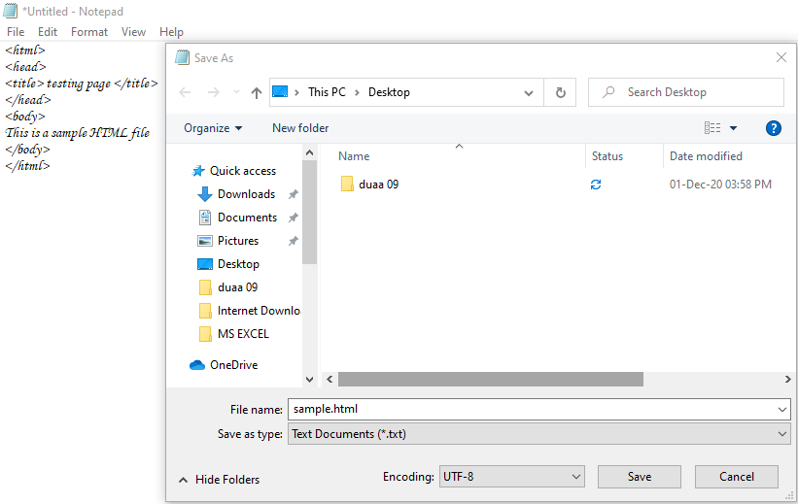

Slide 16
Introduction to Some Common Tags
Paragraph Tag
List Tag

Slide 17
Paragraph Tag <p> …… </p>
<html>
<head>
<title> Testing Web Page </title>
</head>
<body>
<p> Here is the first paragraph. </p>
<p> Here is the second paragraph. </p>
</body>
</html>

Slide 18
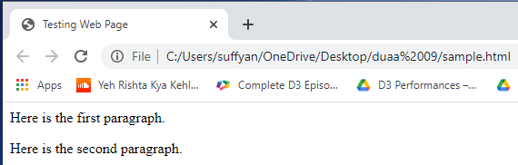
First Paragraph
Space Between Paragraph
Second Paragraph

Slide 19
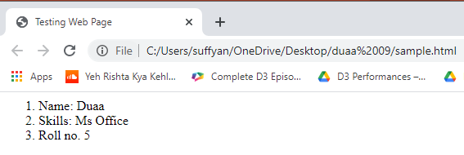
List Tags
Ordered List: used to display information in a numeric order . The syntax for creating an order list is
<ol >
<li> Name: Duaa </li>
<li> Skills: Ms Office </li>
<li> Roll no. 5 </li>
</ol>
Output:

Slide 20
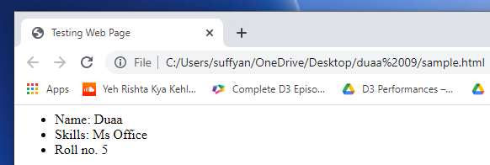
Unordered List: List item is not in a particular order . The syntax is
<ul >
<li> Name: Duaa </li>
<li> Skills: Ms Office </li>
<li> Roll no. 5 </li>
</ul>
Output:

Slide 21
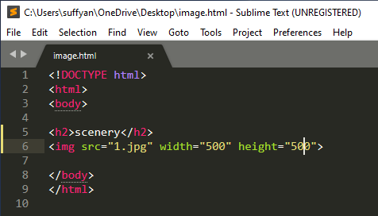

Include A Picture

