Slide 1
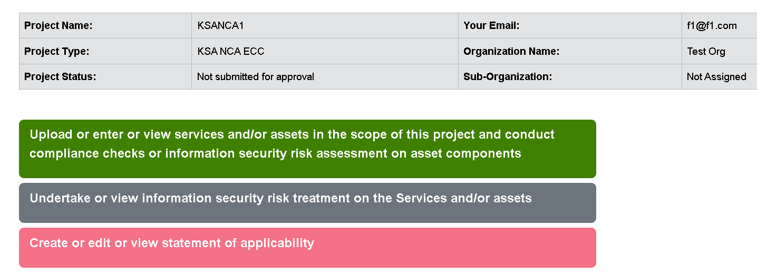
Compliance Framework | ISO 27001:2022 | Information Security Risk Management Methodology | ISO 27005:2022 Qualitative-Event based
Change button text to:
Enter, upload or view services and assets
Conduct compliance checks
Assess and treat information security risks

Slide 2

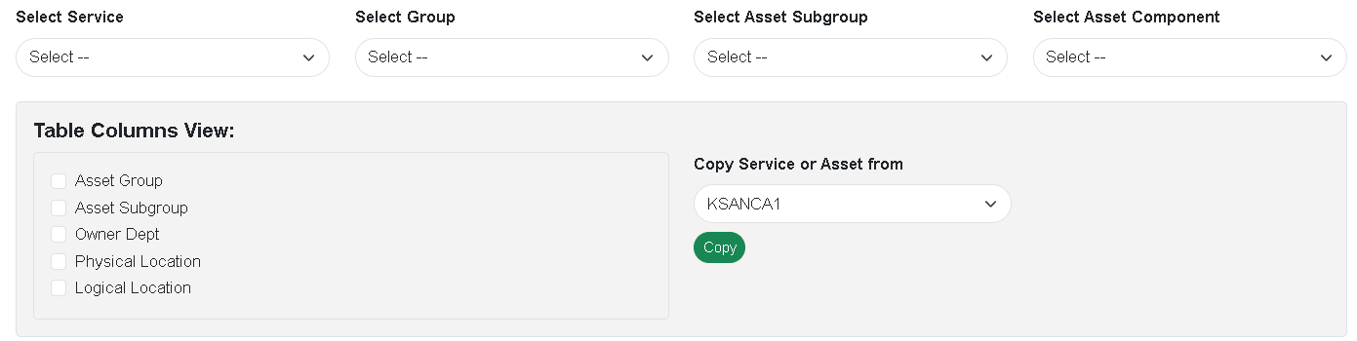
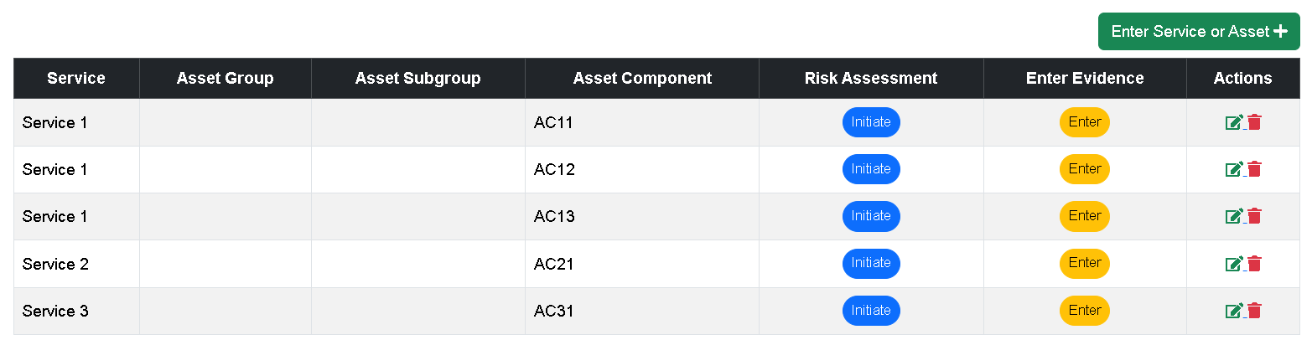
Compliance Framework | ISO 27001:2022 | Information Security Risk Management Methodology | ISO 27005:2022 Qualitative-Event based
Initiate Risk Assessment
go page 3

Slide 3

Compliance Framework | ISO 27001:2022 Annex A | Information Security Risk Management Methodology | ISO 27005:2022 Qualitative-Event based
Test Org
Identify parties and the adverse impacts they can have on the organization’s information assets
Strategic scenarios of adverse impacts
(Optional)
Party Name | Party Type | Party Category | Data Confidentiality | Data Integrity | Data Availability
External
Internal
Customer
Partner
Contractor
IT Service Provider
Business Service Provider
End User
Other
Open New Form
Party Name: xxxxxxxxxx
Party Type: xxxxxxxxxxx
Party Category: xxxxxxxxxx
Possible adverse impacts on data confidentiality/integrity/availability:
Strategic scenario 1:
Back
Save
Save & go to next step
Add Scenario
Save

Slide 4

Compliance Framework | ISO 27001:2022 Annex A | Information Security Risk Management Methodology | ISO 27005:2022 Qualitative-Event based
Test Org
Services: Service 1, Service 2, Service 3
Identify which risk sources could exploit vulnerabilities in the services
Select | Risk Source | Target Objective of Risk Source | Threat Posed by Risk Source
 | Cyber terrorists, cyber militias
 | Cyber-hacktivists, interest groups, sects
 | “Cyber-mercenary” profile with IT capacities that are generally high from a technical standpoint.
 | Script kiddies with the capacity of use the attack kits that are available online
 | Attacker with motivations of acute vengeance or a feeling of injustice (e.g. employee dismissed for serious fault, discontented service provider following a contract that was not renewed, etc.).
 | Pathological attacker e.g. unfair competitor, dishonest client, scammer, and fraudster.
Consolidated level of threats
Page 5
Page 6
Very High (default)
High
Medium
Low
Very Low
Go to Services & Assets Page
Back
Save
Save & go to next step
Page 7

Slide 5
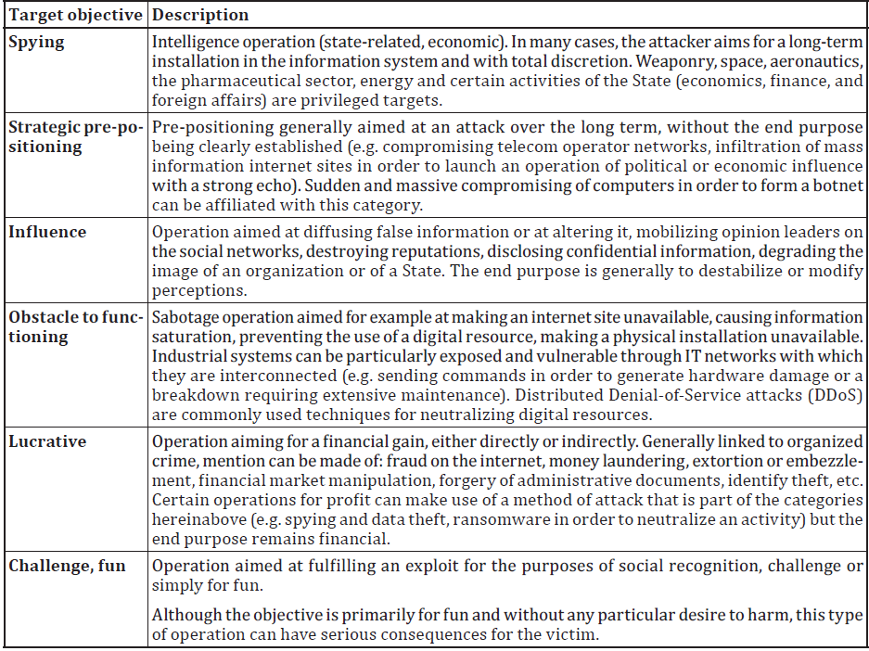

Compliance Framework | ISO 27001:2022 Annex A | Information Security Risk Management Methodology | ISO 27005:2022 Quantitative-Asset based
Services: Service 1, Service 2, Service 3
Risk Source
Attacker with motivations of acute vengeance or a feeling of injustice (e.g. employee dismissed for serious fault, discontented service provider following a contract that was not renewed, etc.).
Target Objective of the Risk Source
Back
Save
Press the Save button even if no checkbox is selected

Slide 6
Compliance Framework | ISO 27001:2022 Annex A | Information Security Risk Management Methodology | ISO 27005:2022 Quantitative-Event based
Services: Service 1, Service 2, Service 3
Risk Source
Attacker with motivations of acute vengeance or a feeling of injustice (e.g. employee dismissed for serious fault, discontented service provider following a contract that was not renewed, etc.).
Threats Posed by the Risk Source
Physical Threats | Natural Threats | Infrastructure Failures | Technical Failures | Human Actions | Service Compromise | Organizational Threats
Description 1 | Description 1 | Description 1 | Description 1 | Description 1 | Description 1 | Description 1
Description 2 | Description 2 | Description 2 | Description 2 | Description 2 | Description 2 | Description 2
Description 3 | Description 3 | Description 3 | Description 3 | Description 3 | Description 3 | Description 3
Will provide the list of values later
Back
Save
Press the Save button even if no checkbox is selected

Slide 7
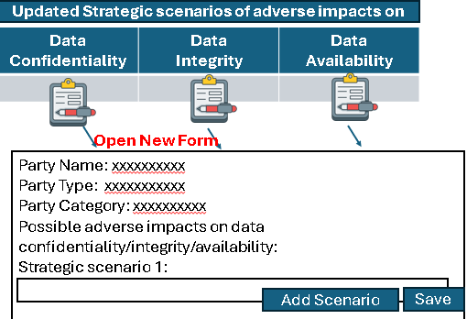
Compliance Framework | ISO 27001:2022 Annex A | Information Security Risk Management Methodology | ISO 27005:2022 Quantitative-Asset based
Test Org
By evaluating gaps in applicable controls, update the strategic scenarios of adverse impacts
Applicable | No. | Controls (as per ISO 27001:2022 Annex A) | Vulnerability level due to control gaps
 | 5.1 | Policies for information security
 | 5.7 | Threat intelligence
 | 5.8 | Information security in project management
 | 5.9 | Inventory of information and other associated assets
 | 5.12 | Classification of information
 | 5.13 | Labelling of information
 | 5.14 | Information transfer
 | 5.19 | Information security in supplier relationships
 | 5.20 | Addressing information security within supplier agreements
 | 5.21 | Managing information security in the information and communication technology (ICT) supply chain
Very High
High
Medium
Low
Very Low
Open a new form when icon is clicked
Service: Service1
Asset Component: AC1
Risk Sources
Xxxxxx
Xxxxxx
Xxxxxx
Target Objectives
Xxxxx
Xxxxx
Threats
Xxxxx
xxxxx
One drop down box per row
Very High
High
Medium
Low
Very Low
Consolidated vulnerability level
Go to Services & Assets Page
Back
Save
Next

Slide 8
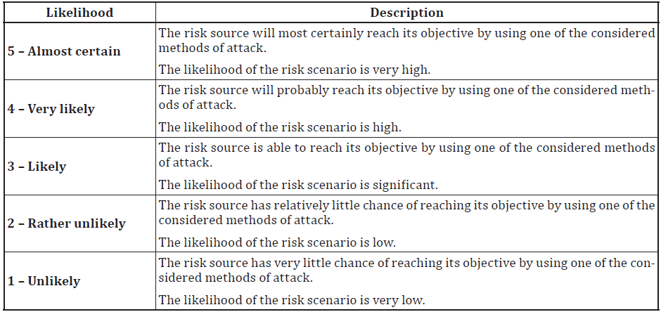
Compliance Framework | ISO 27001:2022 Annex A | Information Security Risk Management Methodology | ISO 27005:2022 Quantitative-Asset based
Test Org
Evaluate the likelihood of each DATA CONFIDENTIALITY scenario that could materialize in a finite timeframe
DATA CONFIDENTIALITY Adverse Strategic Scenario 1: xxxxxxxxxxxxxxxxxx
Consolidated level of risk sources (threats)
Display from previous selected value
Consolidated vulnerability level
Display from previous selected value
Likelihood that the DATA CONFIDENTIALITY adverse scenario will materialize in a finite timeframe
Time frame
Numeric input field
Days
Select Likelihood Value
Select
Go to Services & Assets Page
Back
Save
Next

Slide 9
Compliance Framework | ISO 27001:2022 Annex A | Information Security Risk Management Methodology | ISO 27005:2022 Quantitative-Asset based
Test Org
Evaluate the likelihood of each DATA CONFIDENTIALITY scenario that could materialize in a finite timeframe
DATA CONFIDENTIALITY Adverse Strategic Scenario 2: xxxxxxxxxxxxxxxxxx
Consolidated level of risk sources
Display from previous selected value
Consolidated vulnerability level
Display from previous selected value
Likelihood that the DATA CONFIDENTIALITY adverse scenario will materialize in a finite timeframe
Time frame
Numeric input field
Days
Select Likelihood Value
Select
Go to Services & Assets Page
Back
Save
Next

Slide 10
Compliance Framework | ISO 27001:2022 Annex A | Information Security Risk Management Methodology | ISO 27005:2022 Quantitative-Asset based
Test Org
Evaluate the likelihood of each DATA INTEGRITY scenario that could materialize in a finite timeframe
DATA INTEGRITY Adverse Strategic Scenario 1: xxxxxxxxxxxxxxxxxx
Consolidated level of risk sources (threats)
Display from previous selected value
Consolidated vulnerability level
Display from previous selected value
Likelihood that the DATA INTEGRITY adverse scenario will materialize in a finite timeframe
Time frame
Numeric input field
Days
Select Likelihood Value
Select
Go to Services & Assets Page
Back
Save
Next

Slide 11
Compliance Framework | ISO 27001:2022 Annex A | Information Security Risk Management Methodology | ISO 27005:2022 Quantitative-Asset based
Test Org
Evaluate the likelihood of each DATA INTEGRITY scenario that could materialize in a finite timeframe
DATA INTEGRITY Adverse Strategic Scenario 2: xxxxxxxxxxxxxxxxxx
Consolidated level of risk sources (threats)
Display from previous selected value
Consolidated vulnerability level
Display from previous selected value
Likelihood that the DATA INTEGRITY adverse scenario will materialize in a finite timeframe
Time frame
Numeric input field
Days
Select Likelihood Value
Select
Go to Services & Assets Page
Back
Save
Next

Slide 12
Compliance Framework | ISO 27001:2022 Annex A | Information Security Risk Management Methodology | ISO 27005:2022 Quantitative-Asset based
Test Org
Evaluate the likelihood of each DATA AVAILABILITY scenario that could materialize in a finite timeframe
DATA AVAILABILITY Adverse Strategic Scenario 1: xxxxxxxxxxxxxxxxxx
Consolidated level of risk sources (threats)
Display from previous selected value
Consolidated vulnerability level
Display from previous selected value
Likelihood that the DATA AVAILABILITY adverse scenario will materialize in a finite timeframe
Time frame
Numeric input field
Days
Select Likelihood Value
Select
Go to Services & Assets Page
Back
Save
Next

Slide 13
Compliance Framework | ISO 27001:2022 Annex A | Information Security Risk Management Methodology | ISO 27005:2022 Quantitative-Asset based
Test Org
Evaluate the likelihood of each DATA AVAILABILITY scenario that could materialize in a finite timeframe
DATA AVAILABILITY Adverse Strategic Scenario 2: xxxxxxxxxxxxxxxxxx
Consolidated level of risk sources (threats)
Display from previous selected value
Consolidated vulnerability level
Display from previous selected value
Likelihood that the DATA AVAILABILITY adverse scenario will materialize in a finite timeframe
Time frame
Numeric input field
Days
Select Likelihood Value
Select
Go to Services & Assets Page
Back
Save

