Slide 1
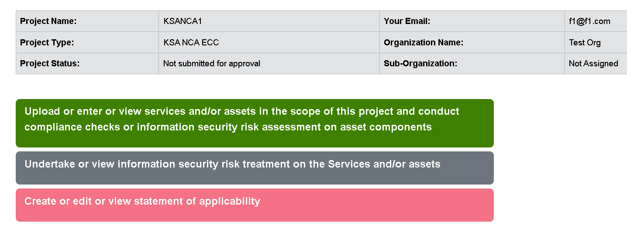
Change button text to:
Enter, upload or view services and assets
Conduct compliance checks
Assess and treat information security risks

Slide 2
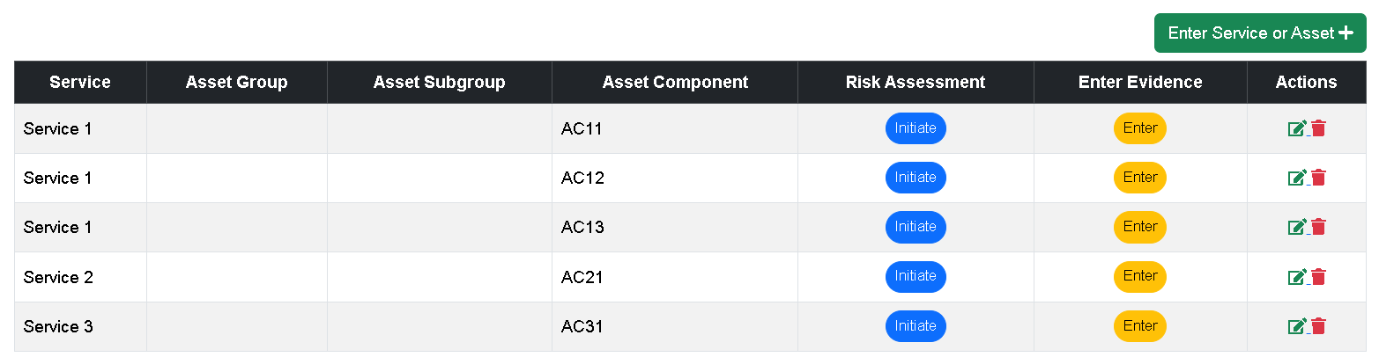
Display one of the 4 values (as was set by super-user) for the project type selected by end user)
Information Security Risk Management Framework: ISO 27005:2022 QUANTITATIVE – ASSET-based with operational risk scenarios
For all project types, change column title to “Asset Category” and make it mandatory with list of values as given below
PII
PCI Account Data
PCI CHD
PCI SAD
Other data
Technology
Organization
People
Physical
Service Provider
Clicking any button goes to page 3
p. 15
View Risk Assessment of all services
p. 14
View Risk Assessment of all asset components

Slide 3
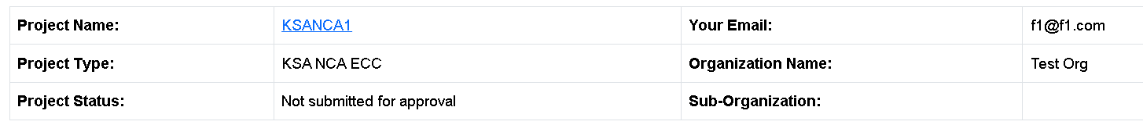
Table background color should be shaded gray - always
Service | S1 | Asset Group |  | Asset Category | PCI CHD | Asset Component | PCI CHD of Visa debit cards
Information Security Risk Management Framework: ISO 27005:2022 QUANTITATIVE– ASSET-based with operational risk scenarios
Initiate Risk Assessment
See page 4
p. 15
View Risk Assessment of all services
p. 14
View Risk Assessment of all asset components

Slide 4
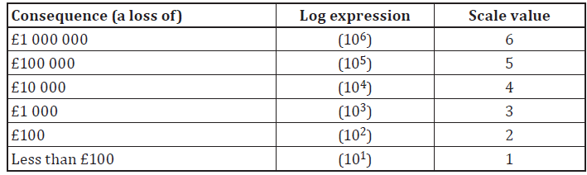
These values are the x-axis values of the tables on p. 8, 10 & 12
Service | S1 | Asset Group |  | Asset Category | PCI CHD | Asset Component | PCI CHD of Visa debit cards
Information Security Risk Management Framework: ISO 27005:2022 QUANTITATIVE – ASSET-based with operational risk scenarios
Select the consequence on this service in case of:
Loss of Data Confidentiality | Loss of Data Integrity | Loss of Data Availability
Currency
None
PKR
USD
SAR
AED
GBP
p. 15
View Risk Assessment of all services
Save & go to next step
p. 14
Go to Services & Assets Page
Back
Save
View Risk Assessment of all asset components

Slide 5

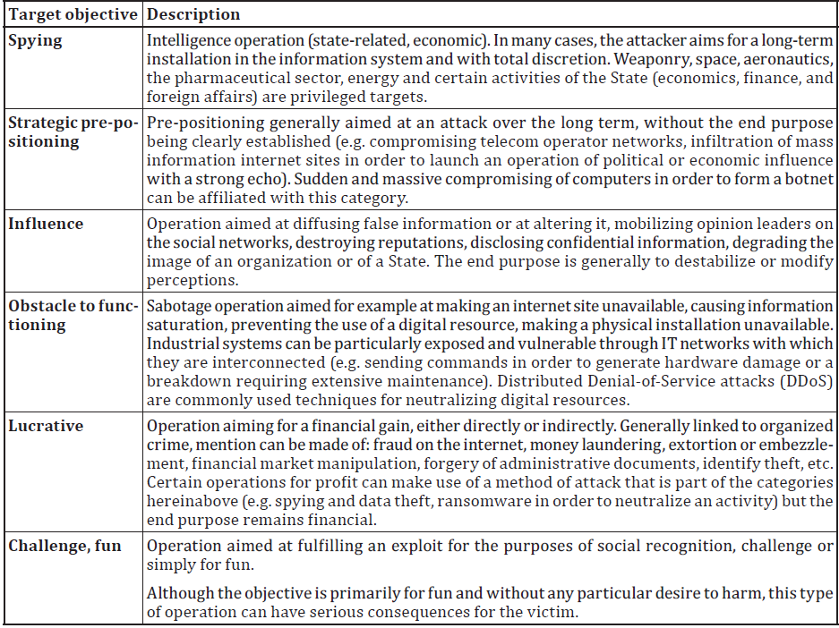
Service | S1 | Asset Group |  | Asset Category | PCI CHD | Asset Component | PCI CHD of Visa debit cards
Information Security Risk Management Framework: ISO 27005:2022 QUANTITATIVE – ASSET-based with operational risk scenarios
Identify which risk sources (threats) could exploit vulnerabilities in the asset component
Select | Risk Source (Threat) | Target Objectives of Risk Source
 | Cyber terrorists, cyber militias
 | Cyber-hacktivists, interest groups, sects
 | “Cyber-mercenary” profile with IT capacities that are generally high from a technical standpoint.
 | Script kiddies with the capacity of use the attack kits that are available online
 | Attacker with motivations of acute vengeance or a feeling of injustice (e.g. employee dismissed for serious fault, discontented service provider following a contract that was not renewed, etc.).
 | Pathological attacker e.g. unfair competitor, dishonest client, scammer, and fraudster.
p. 15
View Risk Assessment of all services
Consolidated level of risk sources (threats)
p. 14
To be calculated
View Risk Assessment of all asset components
For each row, allow user to select one or more of the 6 values (new page or pop-up)
Save & go to next step
Go to Services & Assets Page
Back
Save

Slide 6

Service | S1 | Asset Group |  | Asset Category | PCI CHD | Asset Component | PCI CHD of Visa debit cards
Information Security Risk Management Framework: ISO 27005:2022 QUANTITATIVE – ASSET-based with operational risk scenarios
By evaluating gaps in applicable controls, evaluate how vulnerable the asset component is to actions by risk sources (threats) in the environment
Applicable | No. | Controls (as per ISO 27001:2022 Annex A) | Vulnerability level due to control gaps | Operational risk scenarios
 | 5.1 | Policies for information security
 | 5.7 | Threat intelligence
 | 5.8 | Information security in project management
 | 5.9 | Inventory of information and other associated assets
 | 5.12 | Classification of information
 | 5.13 | Labelling of information
 | 5.14 | Information transfer
 | 5.19 | Information security in supplier relationships
 | 5.20 | Addressing information security within supplier agreements
 | 5.21 | Managing information security in the information and communication technology (ICT) supply chain
Service: S1
Asset Component: PCI CHD of Visa debit cards
Risk Sources (Threats)
Xxxxxx
Xxxxxx
Xxxxxx
Target Objectives
Xxxxx
Xxxxx
Operational Risk Scenario 1
Very High
High
Medium
Low
Very Low
Save
Add scenario
One drop down box per row
Consolidated vulnerability level to be calculated
Go to Services & Assets Page
Back
Save
Next

Slide 7
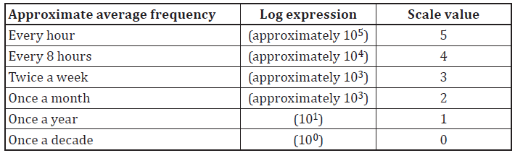
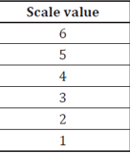
Service | S1 | Asset Group |  | Asset Category | PCI CHD | Asset Component | PCI CHD of Visa debit cards
Information Security Risk Management Framework: ISO 27005:2022 QUANTITATIVE – ASSET-based with operational risk scenarios
By considering both the risk sources (threats) in the environment of an asset component and the vulnerabilities of the asset component, evaluate the likelihood that a DATA CONFIDENTIALITY exploit will occur in a finite timeframe
Consolidated level of risk sources (threats)
Display from previous calculated value
Consolidated vulnerability level
Display from previous calculated value
Likelihood that a DATA CONFIDENTIALITY exploit will occur in a finite timeframe
Time frame
Numeric input field
Days
This value is the y-axis value of the table on p. 8
Select Likelihood Value
Calculate
p. 15
View Risk Assessment of all services
p. 14
View Risk Assessment of all asset components
Go to Services & Assets Page
Back
Save
Next

Slide 8
Service | S1 | Asset Group |  | Asset Category | PCI CHD | Asset Component | PCI CHD of Visa debit cards
Information Security Risk Management Framework: ISO 27005:2022 QUANTITATIVE – ASSET-based with operational risk scenarios
Assessment of risk to DATA CONFIDENTIALITY
 | Consequence
Likelihood | 6 | 5 | 4 | 3 | 2 | 1
6 | 36 | 30 | 24 | 18 | 12 | 6
5 | 30 | 25 | 20 | 15 | 10 | 5
4 | 24 | 20 | 16 | 12 | 8 | 4
3 | 18 | 15 | 12 | 9 | 6 | 3
2 | 12 | 10 | 8 | 6 | 4 | 2
1 | 6 | 5 | 4 | 3 | 2 | 1
p. 15
View Risk Assessment of all services
p. 14
View Risk Assessment of all asset components
Go to Services & Assets Page
Back
Save
Next

Slide 9
Service | S1 | Asset Group |  | Asset Category | PCI CHD | Asset Component | PCI CHD of Visa debit cards
Information Security Risk Management Framework: ISO 27005:2022 QUANTITATIVE – ASSET-based with operational risk scenarios
By considering both the risk sources (threats) in the environment of an asset component and the vulnerabilities of the asset component, evaluate the likelihood that a DATA INTEGRITY exploit will occur in a finite timeframe
Consolidated level of risk sources (threats)
Display from previous calculated value
Consolidated vulnerability level
Display from previous calculated value
Likelihood that a DATA INTEGRITY exploit will occur in a finite timeframe
Time frame
Numeric input field
Days
This value is the y-axis value of the table on p. 10
Select Likelihood Value
Calculate
p. 15
View Risk Assessment of all services
p. 14
View Risk Assessment of all asset components
Go to Services & Assets Page
Back
Save
Next

Slide 10
Service | S1 | Asset Group |  | Asset Category | PCI CHD | Asset Component | PCI CHD of Visa debit cards
Information Security Risk Management Framework: ISO 27005:2022 QUANTITATIVE – ASSET-based with operational risk scenarios
Assessment of risk to DATA INTEGRITY
 | Consequence
Likelihood | 6 | 5 | 4 | 3 | 2 | 1
6 | 36 | 30 | 24 | 18 | 12 | 6
5 | 30 | 25 | 20 | 15 | 10 | 5
4 | 24 | 20 | 16 | 12 | 8 | 4
3 | 18 | 15 | 12 | 9 | 6 | 3
2 | 12 | 10 | 8 | 6 | 4 | 2
1 | 6 | 5 | 4 | 3 | 2 | 1
p. 15
View Risk Assessment of all services
p. 14
View Risk Assessment of all asset components
Go to Services & Assets Page
Back
Save
Next

Slide 11
Service | S1 | Asset Group |  | Asset Category | PCI CHD | Asset Component | PCI CHD of Visa debit cards
Information Security Risk Management Framework: ISO 27005:2022 QUANTITATIVE – ASSET-based with operational risk scenarios
By considering both the risk sources (threats) in the environment of an asset component and the vulnerabilities of the asset component, evaluate the likelihood that a DATA AVAILABILITY exploit will occur in a finite timeframe
Consolidated level of risk sources (threats)
Display from previous calculated value
Consolidated vulnerability level
Display from previous calculated value
Likelihood that a DATA AVAILABILITY exploit will occur in a finite timeframe
Time frame
Numeric input field
Days
This value is the y-axis value of the table on p. 12
Select Likelihood Value
Calculate
p. 15
View Risk Assessment of all services
p. 14
View Risk Assessment of all asset components
Go to Services & Assets Page
Back
Save
Next

Slide 12
Service | S1 | Asset Group |  | Asset Category | PCI CHD | Asset Component | PCI CHD of Visa debit cards
Information Security Risk Management Framework: ISO 27005:2022 QUANTITATIVE – ASSET-based with operational risk scenarios
Assessment of risk to DATA AVAILABILITY
 | Consequence
Likelihood | 6 | 5 | 4 | 3 | 2 | 1
6 | 36 | 30 | 24 | 18 | 12 | 6
5 | 30 | 25 | 20 | 15 | 10 | 5
4 | 24 | 20 | 16 | 12 | 8 | 4
3 | 18 | 15 | 12 | 9 | 6 | 3
2 | 12 | 10 | 8 | 6 | 4 | 2
1 | 6 | 5 | 4 | 3 | 2 | 1
p. 15
View Risk Assessment of all services
p. 14
View Risk Assessment of all asset components
Go to Services & Assets Page
Back
Save
Next

Slide 13
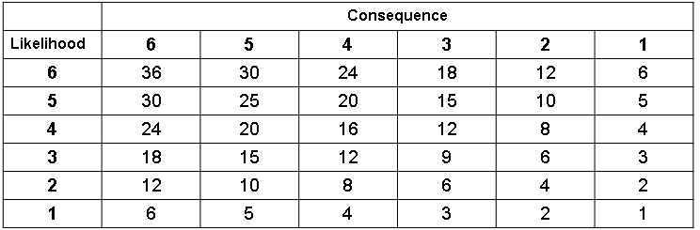
Service | S1 | Asset Group |  | Asset Category | PCI CHD | Asset Component | PCI CHD of Visa debit cards
Information Security Risk Management Framework: ISO 27005:2022 QUANTITATIVE – ASSET-based with operational risk scenarios
Assessment of risk to:
DATA CONFIDENTIALITY
DATA INTEGRITY
DATA AVAILABILITY
p. 15
View Risk Assessment of all services
p. 14
Go to Services & Assets Page
Back
Save
Next
View Risk Assessment of all asset components

Slide 14
Information Security Risk Management Framework: ISO 27005:2022 QUANTITATIVE – ASSET-based with operational risk scenarios
Information Security Risk Assessment
Data Confidentiality | Data Integrity | Data Availability
24 | 15 | 12
20 | 20 | 20
36 | 36 | 8
5 | 5 | 5
18 | 18 | 18
PII
PCI Account Data
PCI CHD
PCI SAD
Other data
Technology
Organization
People
Physical
Service Provider
p. 15
Go to Services & Assets Page
Back
View Risk Assessment of all services

Slide 15
Information Security Risk Management Framework: ISO 27005:2022 QUANTITATIVE – ASSET-based with operational risk scenarios
 | Information Security Risk Assessment
 | Data Confidentiality |  | Data Integrity |  | Data Availability
 | Max | Min | Max | Min | Max | Min
Service 1
Service 2
Service 3
p. 14
Go to Services & Assets Page
Back
View Risk Assessment of all asset components

