Slide 1
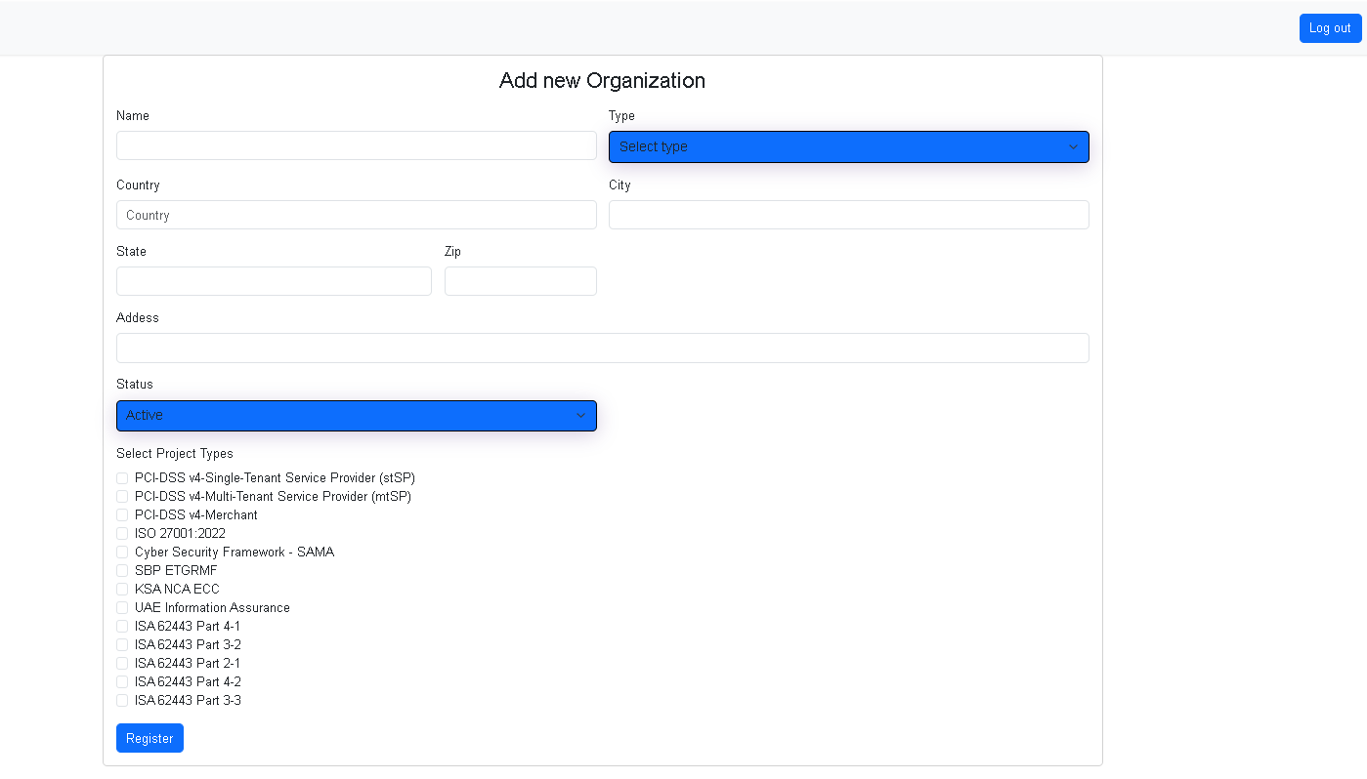
When logged in as Shahmeer
+DAMA DMBOK
+Audit Standard

Slide 2

When logged in as organization end user
Page 5

Slide 3
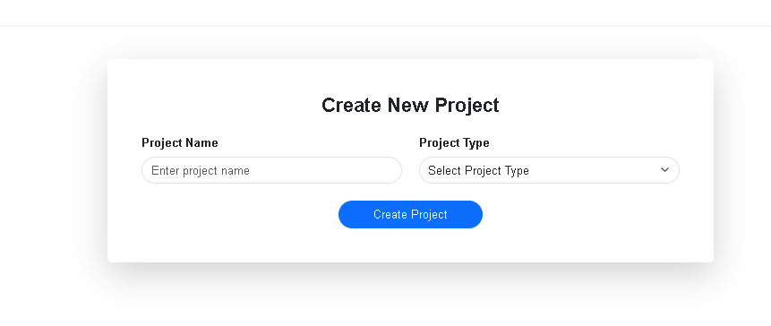
When logged in as organization end user
Data Governance 2025
+DAMA DMBOK
+Audit Standard
Page 6

Slide 4
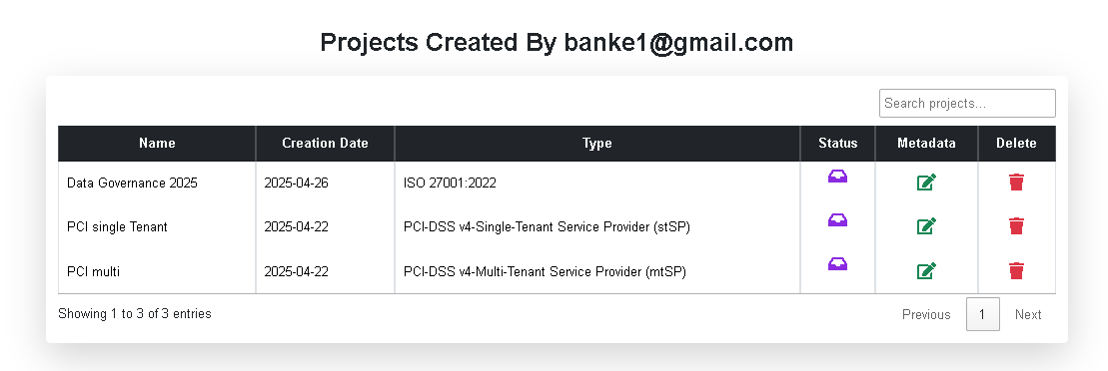
When logged in as organization end user
DAMA DMBOK
+DAMA DMBOK
+Audit Standard

Slide 5
When logged in as organization end user
Page 8

Slide 6
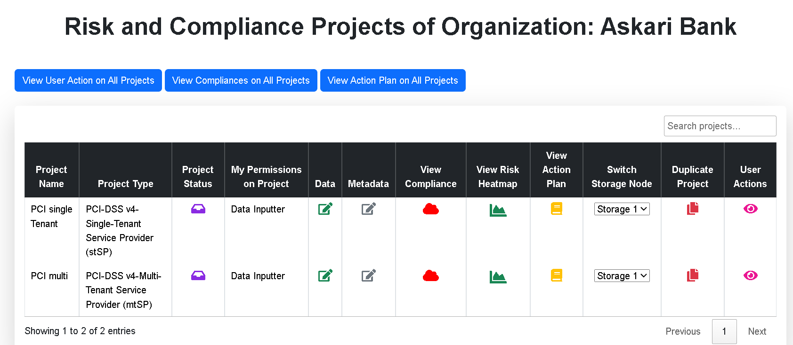

Data Catalog
Data Governance 2025
DAMA DMBOK
Add 2 new columns to the table:
Data Governance
Audit
Page 7
Page x
Baniazsun007.

Slide 7
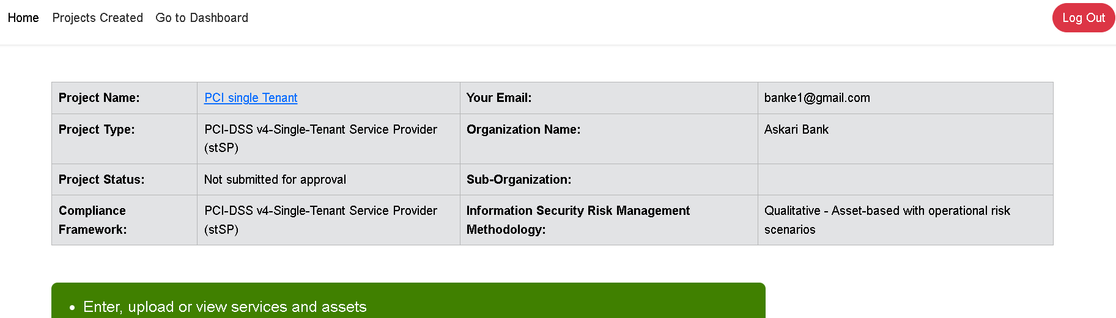
data catalog
Page 8

Slide 8
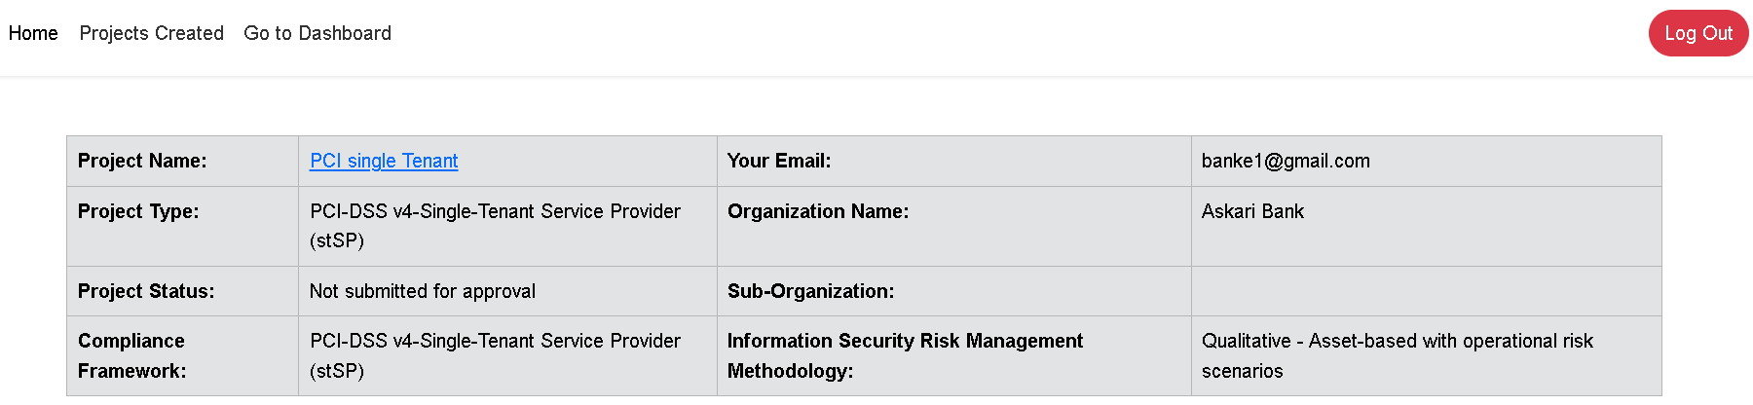

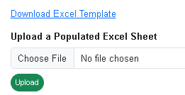
Filter by
Enter Data Catalog+
Note: Each column should be sortable alphabetically
Dataset ID/ Name | Data Source | Data Type | Data Definition | Data Owner Dept | Data User Dept | Data Quality Score | Data Lineage | Data Governance Policy | Confidentiality Classification Tag | Integrity Classification Tag | Availability Classification Tag
Enter, Import or Upload Dataset
PRA Record | xxxxxx | xxxxxx | xxxxxx | xxxxxx | xxxxxx
CNIC Record | xxxxxx | xxxxxx | xxxxxx | xxxxxx | xxxxxx |  |  |  | xxxxxx | xxxxxx | xxxxxx
Clicking on the number goes to Page 10
Go to page 11

Slide 9
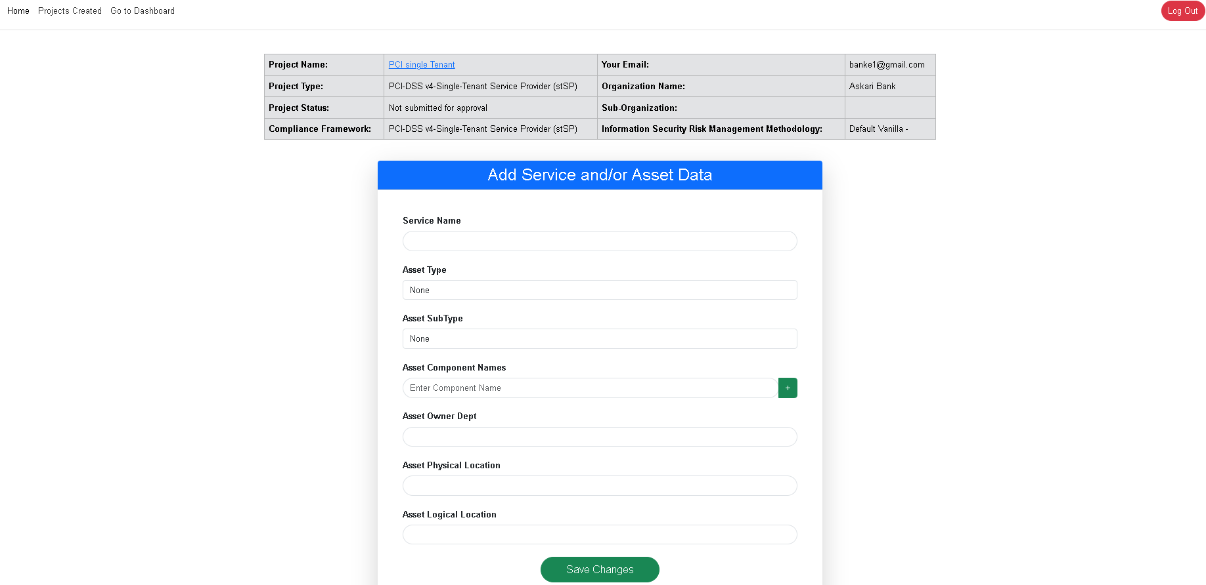
data and its metadata
Dataset ID/Name (free form text)
Data Source (select)
Data Type (select)
Data Definition (free form text)
Data Owner Dept (select)
Data User Dept (select)
Data Lineage (clickable icon)
Data Governance Policy (attachable)
Confidentiality Classification Tag (select)
Integrity Classification Tag (select)
Availability Classification Tag (select)
Dataset ID/Name (free form text)
CNIC Record

Slide 10
CNIC Record | Enter Display name
Column 1 | CNIC No. | 1-20 (text), 21-30 (calendar)
Column 2 | First name
Column 3
. .
Column 30
Enter, Import or Upload Dataset: CNIC Record
Enter Dataset
Import Dataset from API
CNIC No. | First name | Last Name | Home Address | Date of Birth | Father’s Name
Xxxxx1 | xxxxx | xxxxx | xxxxx |  | xxxxx
Xxxxx2 | xxxxx | xxxxx | xxxxx | xxxxx | xxxxx
Xxxxx3 | xxxxx | xxxxx | xxxxx | xxxxx | xxxxx
Xxxxx4 | xxxxx |  | xxxxx | xxxxx
xxxxx5 |  | xxxxx |  | xxxxx | xxxxx
Calculate Quality Score
Page 11

Slide 11
Data Quality Score for Dataset ID/Name: CNIC Record
Quality Attribute | Data Source: CNIC Record | Data Source: PRA Record | Consolidated Score
Completeness Score | 83.33%
Accuracy Score
Timeliness Score
Uniqueness Score
Validity Score
Consistency across systems Score
Aggregate Score

Slide 12
Ignore this page
A well-structured data catalog should capture **essential metadata** that helps users **discover, understand, and trust** the data. Here are some key types of information typically included:
1. **Data Source & Location** – Where the data comes from (databases, APIs, cloud storage).
2. **Schema & Structure** – Tables, fields, data types, and relationships.
3. **Data Ownership** – Who is responsible for maintaining the dataset.
4. **Business Definitions** – Clear descriptions to help non-technical users understand the data.
5. **Data Lineage** – A record of how data has moved and transformed over time.
6. **Data Quality & Profiling** – Completeness, accuracy, and freshness of the data.
7. **Access & Security** – Permissions, encryption, and governance policies.
8. **Tags & Classification** – Labels for organizing datasets (e.g., sensitive, confidential, public).
9. **Usage Statistics** – How often the data is used and by whom.
A good catalog makes it easy to **search, explore, and use** data effectively. Are you looking to implement one for your organization?

