Slide 1
CyberGuard
• A Suricata-Powered Network IDS and Monitor
• University Information Security Project
• Student: Khayal
• Suricata detects. Python only shows.
Notes:
Hello. My project is CyberGuard. It is a network security monitor. The big idea is simple: Suricata finds the attacks, and my Python code only shows them.

Slide 2
The problem
• Networks face many attacks.
• Teams need to see suspicious traffic fast.
• Many demos mix detection and display.
• Then it is hard to trust the result.
• We want clear, honest detection.
Notes:
Many small demos make their own alerts in the display code. So you cannot tell what really found the attack. I wanted a clean design that is easy to trust.

Slide 3
The main idea
• Suricata is the only detection engine.
• Python never detects anything.
• Python reads, stores, and shows alerts.
• If Suricata stops, new alerts stop.
• This is the correctness test.
Notes:
This is the heart of my project. One engine does detection. Everything else just presents the results. If I stop Suricata, new alerts must stop. I will prove that later.

Slide 4
What is an IDS?
• IDS = Intrusion Detection System.
• It watches traffic and warns.
• It detects but does not block.
• IPS can block; we are IDS only.
• Suricata is a free, open-source IDS.
Notes:
An IDS watches and warns. It does not block. A tool that blocks is an IPS. I chose IDS so I never drop good traffic by mistake.

Slide 5
Architecture
Network traffic
Suricata IDS
EVE JSON
Python reader
Dashboard
Flask API
SQLite
Telegram alert (optional)
Notes:
Here is the data flow. Suricata writes alerts to a file called EVE JSON. Python reads the new lines, stores them in SQLite, and serves an API. The dashboard shows them.

Slide 6
Technology stack
• Suricata 8.0.7 on Kali Linux.
• Python 3 and Flask.
• SQLite for storage.
• HTML, CSS, vanilla JavaScript.
• Telegram Bot API (optional).
Notes:
I kept the stack small. No React, no Docker, no cloud. Just a real IDS, Python, SQLite, and plain web code. It is easy to read and maintain.

Slide 7
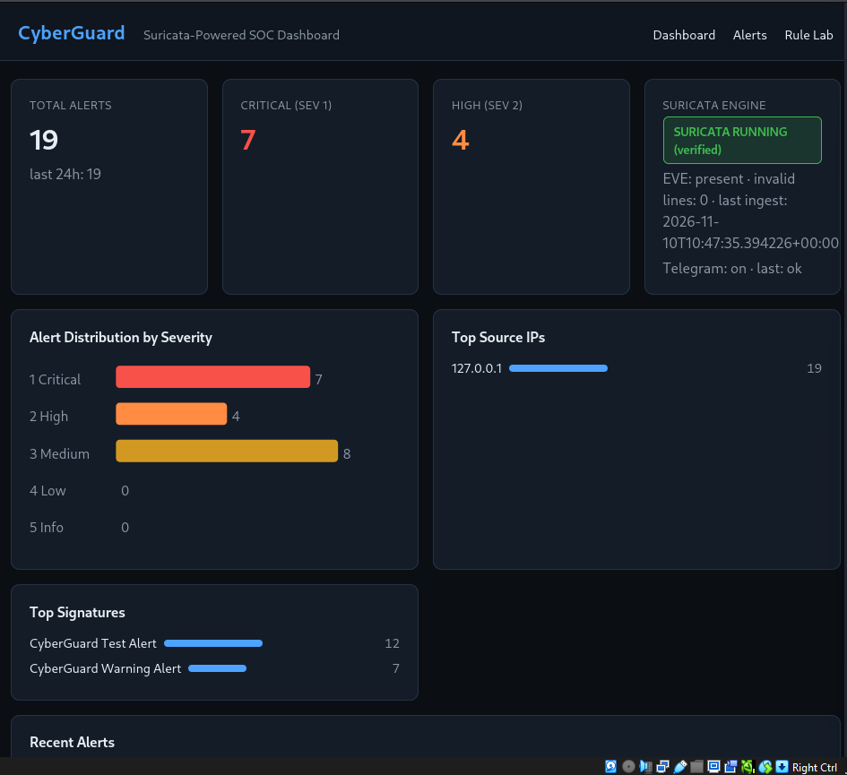
The dashboard
• Honest engine status card.
• Cards: total, critical, high.
• Severity chart and top lists.
• Alert table with filters and paging.
• Click a row for full details.
Notes:
This is the dashboard. The status card is honest: it checked the Suricata process. The cards and chart give a quick view. The table lists the alerts.

Slide 8
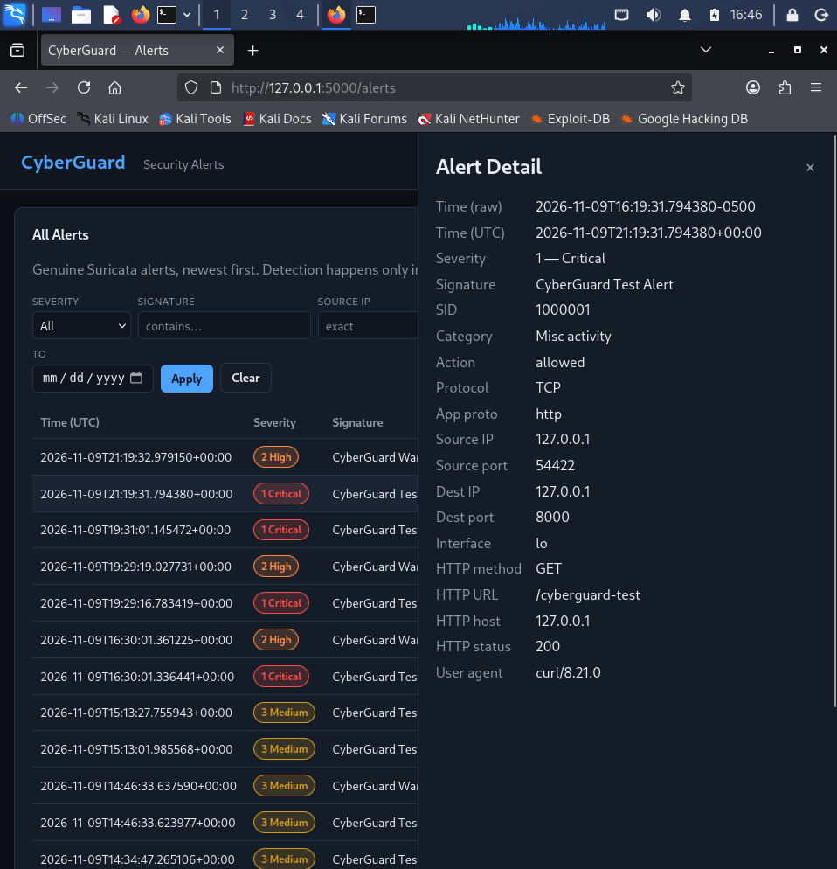
An alert in detail
• Click a row to open details.
• Source and destination IP and port.
• Protocol and HTTP fields.
• Severity and signature.
• All of it came from Suricata.
Notes:
When I click an alert, I see all its fields. The source, the destination, the URL, the time. My code did not create any of this. It only stored what Suricata wrote.

Slide 9
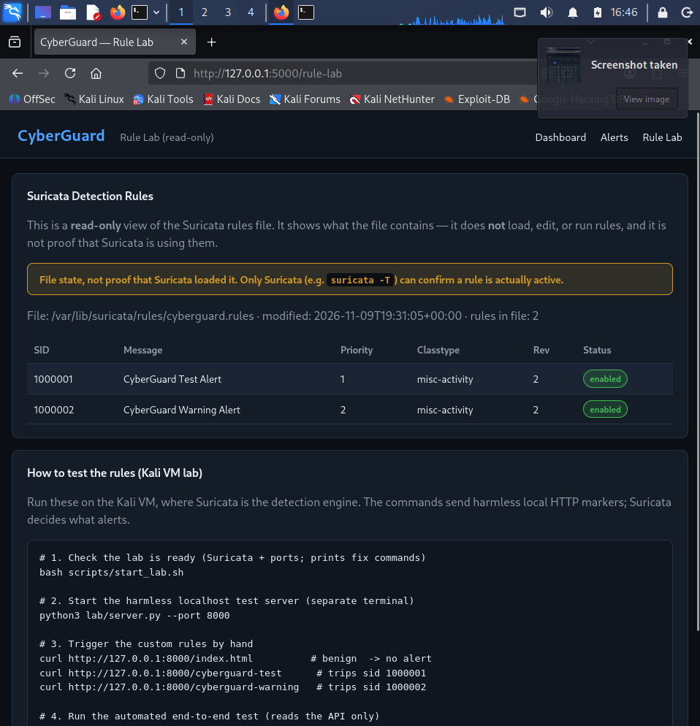
The two rules
• Rule 1000001: URL has /cyberguard-test.
• Priority 1 -> severity 1 (Critical).
• Rule 1000002: URL has /cyberguard-warning.
• Priority 2 -> severity 2 (High).
• Both match HTTP requests to a server.
Notes:
I wrote two simple rules. One fires on a test URL and is critical. One fires on a warning URL and is high. The priority in the rule sets the severity in the alert.

Slide 10
Live demo: detection
• Benign request -> no alert.
• /cyberguard-test -> SID 1000001.
• /cyberguard-warning -> SID 1000002.
• Alerts appear on the dashboard.
• Suricata did all the detection.
Notes:
Now a quick live demo. First a normal request: nothing happens. Then two test requests: two alerts appear. This is live, and Suricata found them.

Slide 11
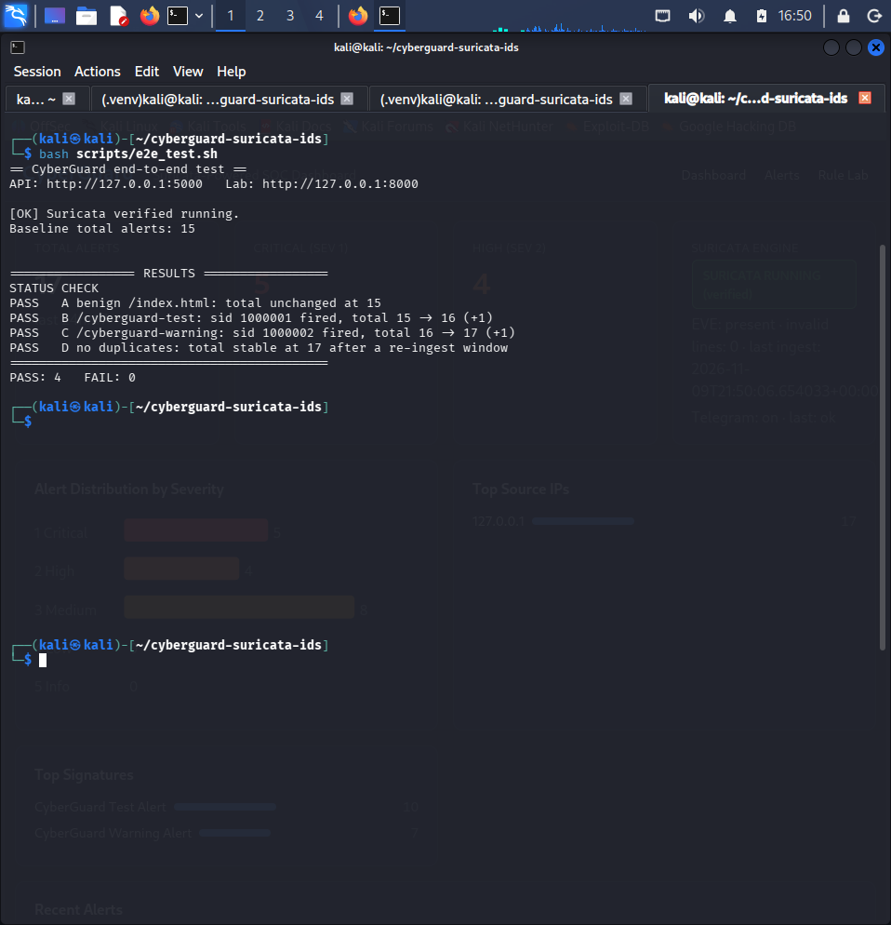
Automated end-to-end test
• One script sends real traffic.
• It checks the API after each step.
• PASS 4 / FAIL 0, exit 0.
• Benign no alert; two alerts; no duplicates.
• Repeatable proof the pipeline works.
Notes:
I also have a script that does this automatically. It sends traffic and checks the API. It shows four passes and zero fails. So the whole pipeline works end to end.

Slide 12
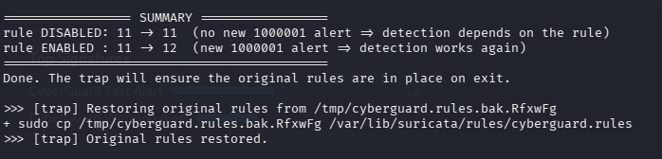
Proof: detection depends on the rule
• Turn off rule 1000001.
• Send the request -> no new alert.
• Turn the rule back on.
• Send again -> the alert returns.
• Python did not fake it.
Notes:
This is my strongest proof. I turn the rule off and the alert stops. I turn it back on and the alert comes back. So the detection is real and depends on Suricata.

Slide 13
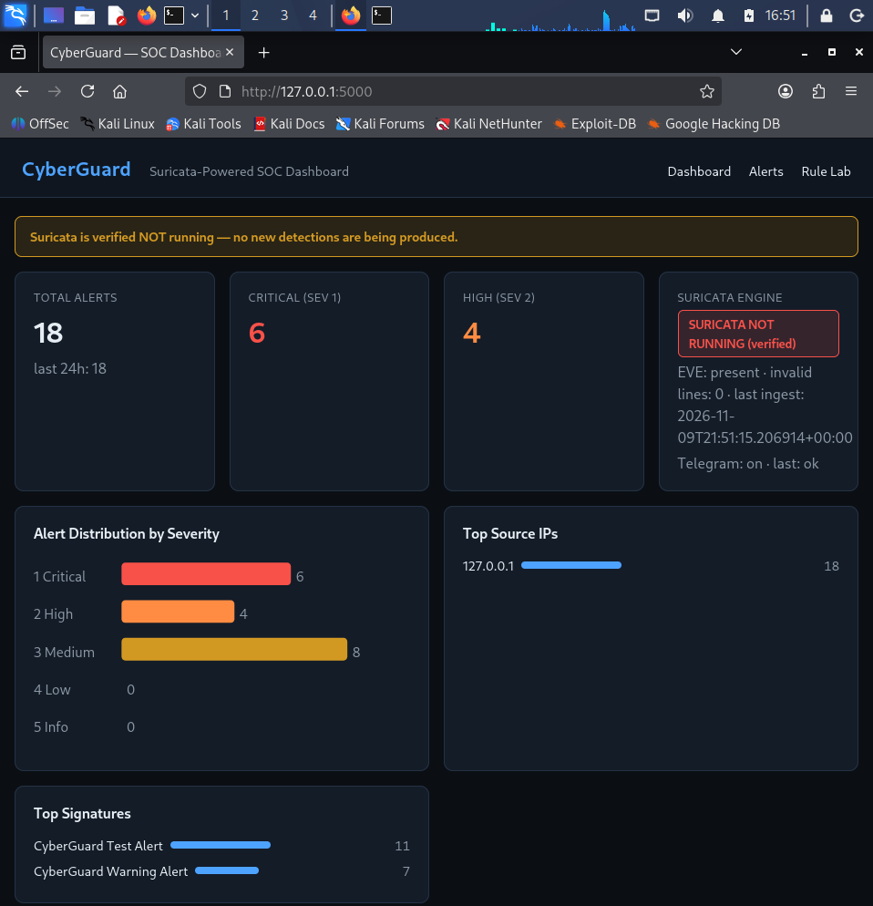
Honest status and safety
• "Running" only after a real check.
• Stop Suricata -> "NOT RUNNING".
• Stop backend -> "API unavailable".
• No commands run from the web app.
• Dashboard is XSS-safe.
Notes:
The app is honest. If the engine is down, it says so. If the backend is down, the browser shows that too. The web app cannot run commands, and it is safe from XSS.

Slide 14
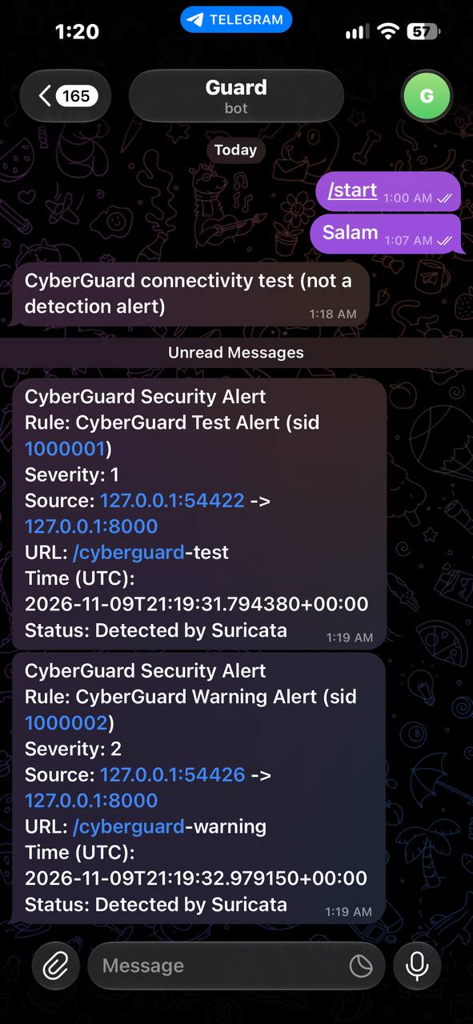
Optional Telegram alerts
• Off unless token and chat id are set.
• Sends a short plain-text message.
• Only new, serious alerts.
• No startup flood; rate limited.
• Token stays only in local .env.
Notes:
I added optional Telegram alerts. If I set a token, I get a message for each new serious alert. It is plain text, it never floods, and the token is never committed.

Slide 15
Limitations and future work
• Loopback only; two rules; IDS only.
• Rate-limit and revoke: unit-tested only.
• Dev server, no login (localhost only).
• Next: more rules, real interface, login.
• Next: Docker, suricata-update.
Notes:
The project has limits. It watches loopback, has two rules, and does not block. Next I would add more rules, a real interface, a login, and Docker. Thank you. I am happy to answer questions.

