Slide 1
SOFTWARE ENGINEERING PROJECT
WeatherBot
An AI-Style, Multi-Modal Conversational Weather Assistant
Live · Serverless · Zero-Configuration · Runs entirely in the browser
Live: https://khayamtariq.github.io/Weatherbot/

Slide 2
Project Overview
▸ What it is: A conversational weather assistant that runs entirely inside a web browser.
▸ How you ask: Natural-language text, voice, GPS location, or a tap on an interactive world map.
▸ What you get: Current conditions, a next-day outlook, or a 7-day forecast — in a friendly, optionally spoken reply.
▸ How it's built: A single self-contained HTML file — no back-end, no database, no build step, no API keys.
▸ Core idea: Every interaction is reduced to a location + a time intent, then handled by one reporting routine.
▸ Where it lives: Deployed publicly and available 24/7 on free static hosting.
WeatherBot • Software Engineering Project
02

Slide 3
Problem Statement
▸ Friction & configuration: Many weather tools need accounts, API keys, installs or paid tiers.
▸ Non-conversational UIs: Information is buried in cluttered dashboards instead of plain Q&A.
▸ Limited input flexibility: Few tools let you choose how to give a location — name, voice, GPS or map.
▸ Heavy deployment: Most apps need a server, database and build pipeline to host.
How can one self-contained web app deliver live, multi-modal weather through a natural conversation — with no back-end, credentials or installation — while staying responsive and always available?
WeatherBot • Software Engineering Project
03

Slide 4
Objectives
▸ Interpret plain-English weather questions and reply conversationally.
▸ Support four interchangeable input modes converging on one pipeline.
▸ Provide current, next-day and 7-day forecasts for any location.
▸ Use only free, public, key-less APIs over secure HTTPS.
▸ Build the whole product as a single, serverless HTML file.
▸ Deliver a responsive, accessible, polished interface.
▸ Handle network, permission and input errors gracefully.
▸ Deploy publicly for continuous 24/7 availability.
WeatherBot • Software Engineering Project
04

Slide 5
Key Features
Natural-language chat
Ask free-text questions and get conversational replies.
Voice interaction
Speak your question and hear the answer read aloud.
Geolocation
One tap reports the weather at your GPS position.
Interactive map
Pick any point on Earth to get its weather.
Three time horizons
Now, tomorrow, and a full 7-day forecast.
Rich formatting
Weather codes mapped to friendly text + emoji.
Responsive design
Glassmorphism UI adapts to phone and desktop.
Guided prompts
Quick-reply chips suggest common questions.
WeatherBot • Software Engineering Project
05

Slide 6
Technology Stack
Frontend
Browser APIs
Libraries & Data
Deployment
• HTML5 — structure
• CSS3 — glassmorphism UI
• JavaScript (ES6+) — logic
• Fetch — networking
• Geolocation — GPS
• Web Speech — voice I/O
• Leaflet — interactive map
• Open-Meteo — weather + geocoding
• BigDataCloud — reverse geocoding
• OpenStreetMap — tiles
• GitHub Pages — static host
• HTTPS — secure delivery
• Serverless — no back-end
WeatherBot • Software Engineering Project
06

Slide 7
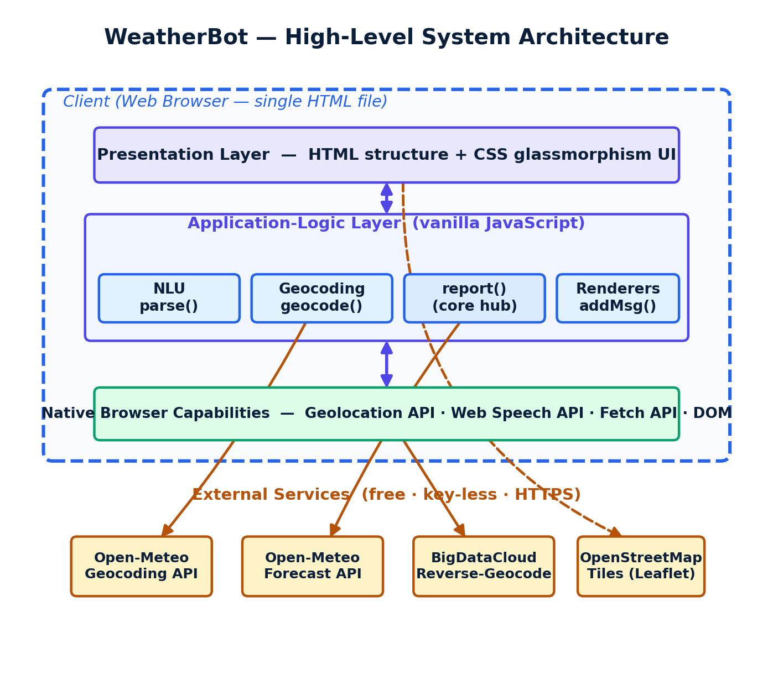
System Architecture
A single HTML file orchestrates four external services directly from the browser.
WeatherBot • Software Engineering Project
07

Slide 8
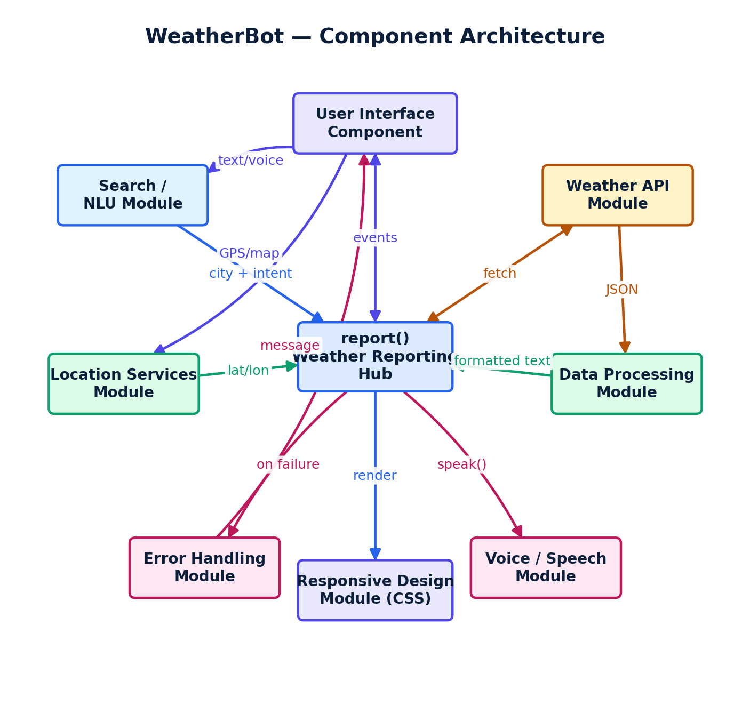
Component Architecture
Cohesive modules revolve around the central report() reporting hub.
WeatherBot • Software Engineering Project
08

Slide 9
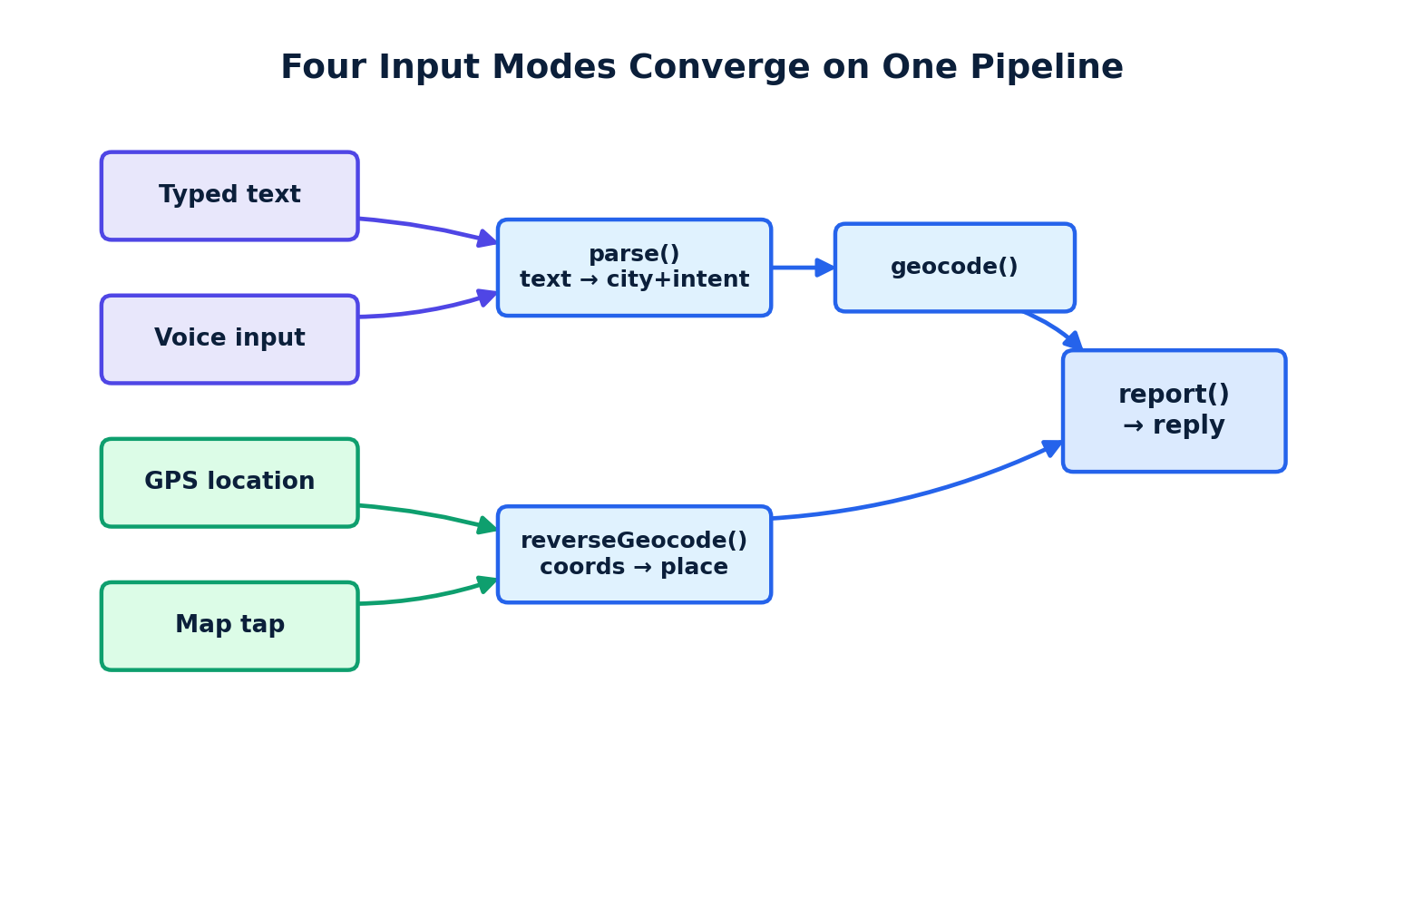
How It Works — Input Convergence
▸ Typed & voice input pass through parse() then geocode().
▸ GPS & map input are reverse-geocoded to a place name.
▸ All four modes produce a location object.
▸ report() fetches the forecast and renders the reply.
▸ Optional text-to-speech reads the answer aloud.
WeatherBot • Software Engineering Project
09

Slide 10
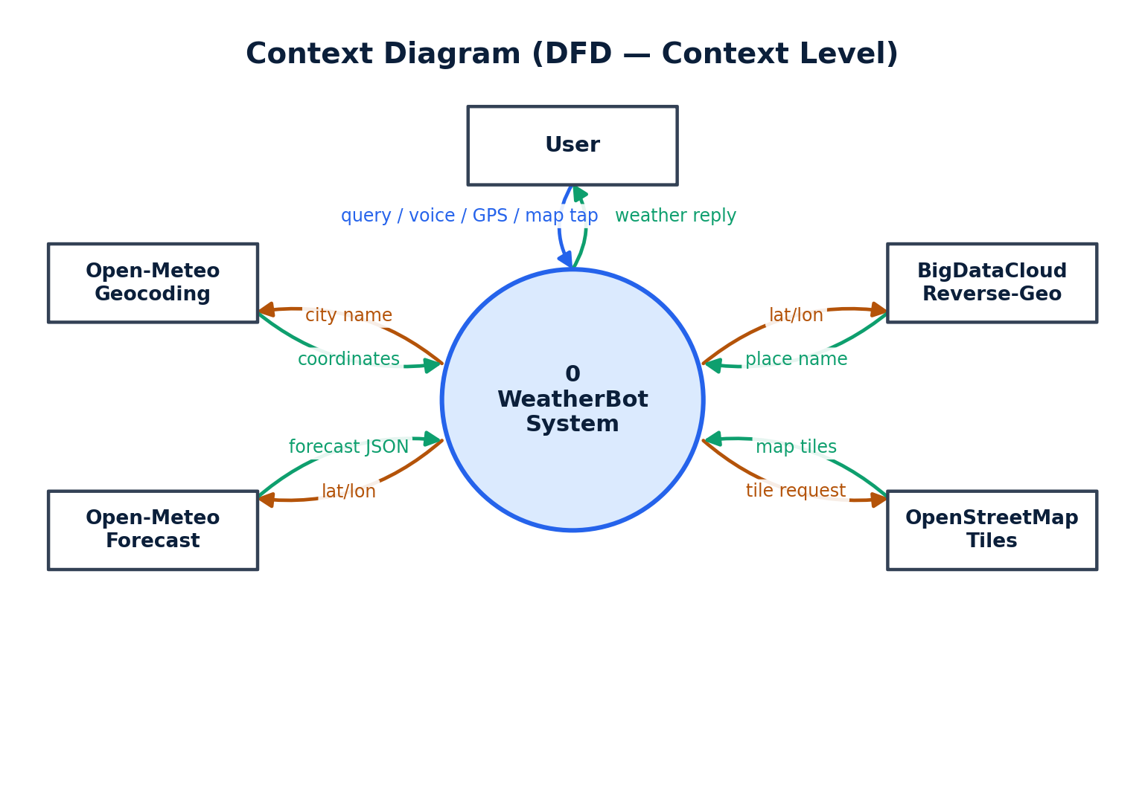
Data Flow — Context Diagram
WeatherBot as a single process exchanging data with the user and four services.
WeatherBot • Software Engineering Project
10

Slide 11
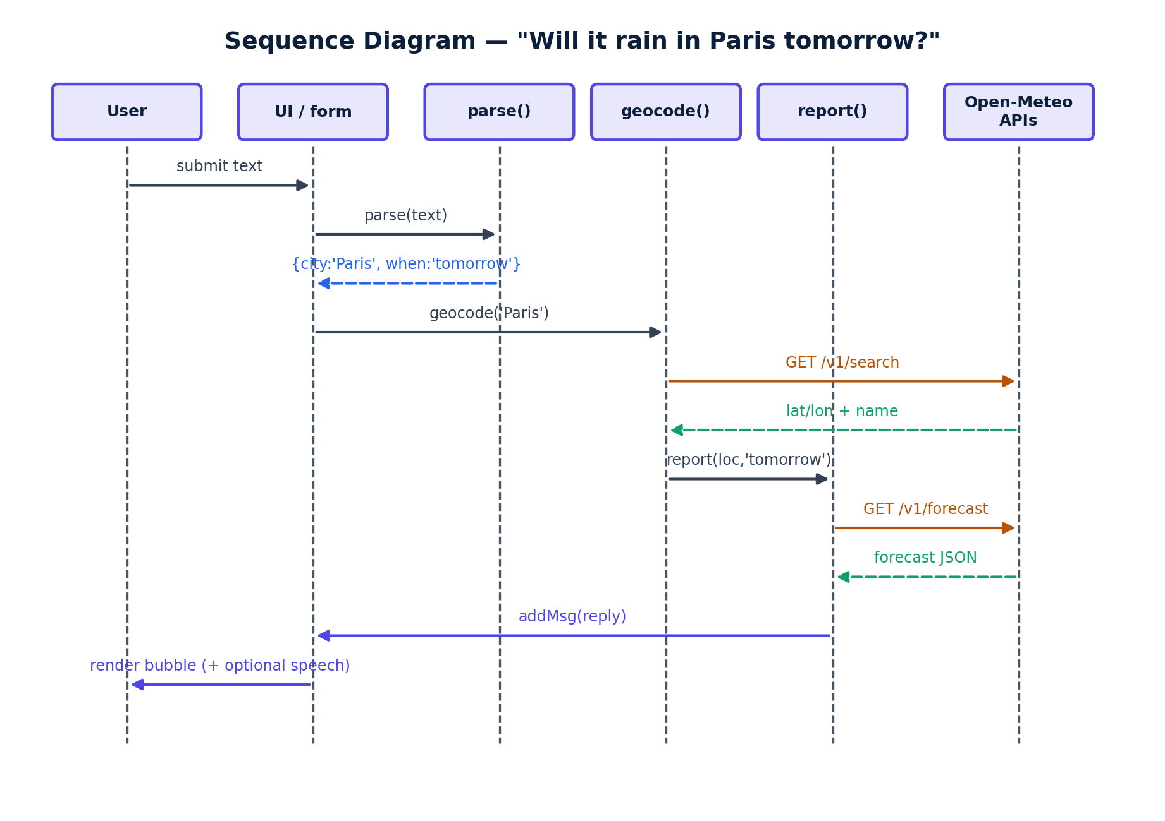
Request Flow — Sequence Diagram
End-to-end flow for the query “Will it rain in Paris tomorrow?”
WeatherBot • Software Engineering Project
11

Slide 12
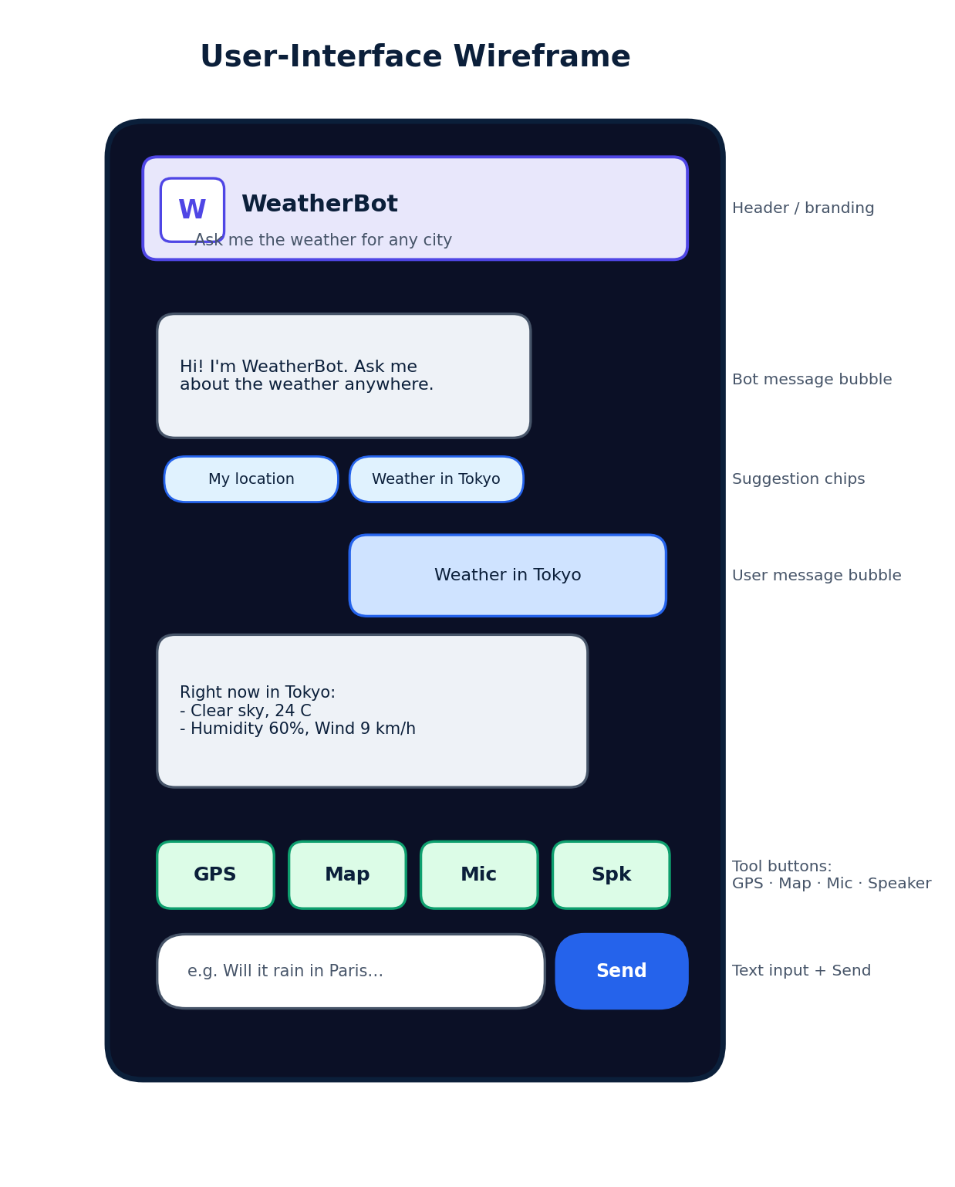
User Interface
▸ Frosted-glass chat panel over an animated backdrop.
▸ Distinct user vs. bot message bubbles.
▸ Tool row: GPS, map, microphone, speaker.
▸ Suggestion chips guide common questions.
▸ Fully responsive on phone and desktop.
WeatherBot • Software Engineering Project
12

Slide 13
Testing & Validation
Functional
Queries, time intents, chips, drill-down
Pass
User Interface
Animations, states, map, responsiveness
Pass
API Integration
Geocode, forecast, reverse-geocode, tiles
Pass
Input Validation
Empty, no-place, filler, misspelling
Pass
Error Handling
Network, permissions, unsupported features
Pass
Browser Compatibility
Chrome, Edge, Firefox, Safari, mobile
Pass*
* advanced voice features degrade gracefully where unsupported
WeatherBot • Software Engineering Project
13

Slide 14
Advantages
▸ Multi-modal: four interchangeable input methods in one interface.
▸ Zero-configuration: no back-end, database, keys or build step.
▸ Highly portable: a single shareable HTML file; runs anywhere.
▸ Fast: instant local logic; only data retrieval uses the network.
▸ Private & secure: no stored data; explicit in-browser consent; HTTPS.
▸ Always available: free static hosting gives continuous 24/7 uptime.
WeatherBot • Software Engineering Project
14

Slide 15
Limitations & Future Enhancements
Current Limitations
Future Enhancements
• Rule-based parser may miss unusual phrasings.
• One place matched per question.
• English-only parsing and voice.
• Requires internet for all live data.
• Voice support varies by browser.
• Stateless — no saved history.
• Multi-language parsing & speech.
• Hourly forecasts & severe-weather alerts.
• Offline caching of recent results.
• Unit selection (°C/°F, km/h vs mph).
• Compare multiple locations at once.
• Optional LLM for richer conversation.
• Installable Progressive Web App (PWA).
WeatherBot • Software Engineering Project
15

Slide 16
Deployment & Live Demo
▸ Hosting: GitHub Pages — static, HTTPS, continuous 24/7 availability.
▸ Access: Open the URL in any modern browser — no install or sign-up.
▸ Updates: Every push auto-deploys the latest version.
▸ Cost: Zero — no server, database or paid APIs.
https://khayamtariq.github.io/Weatherbot/
Scan-ready link — try it live during the demo.
WeatherBot • Software Engineering Project
16

Slide 17
Conclusion
▸ WeatherBot delivers a polished, multi-modal assistant using only standard browser tech and free public APIs.
▸ A single, uniform internal contract (location + time intent → one reporting routine) keeps it clean and extensible.
▸ Serverless and single-file: effortless to deploy and maintain, at zero hosting cost.
▸ Fully implemented, tested and publicly deployed — available 24/7.
Live: https://khayamtariq.github.io/Weatherbot/
WeatherBot • Software Engineering Project
17

Slide 18
Thank You
Questions & Discussion
https://khayamtariq.github.io/Weatherbot/

