Slide 1
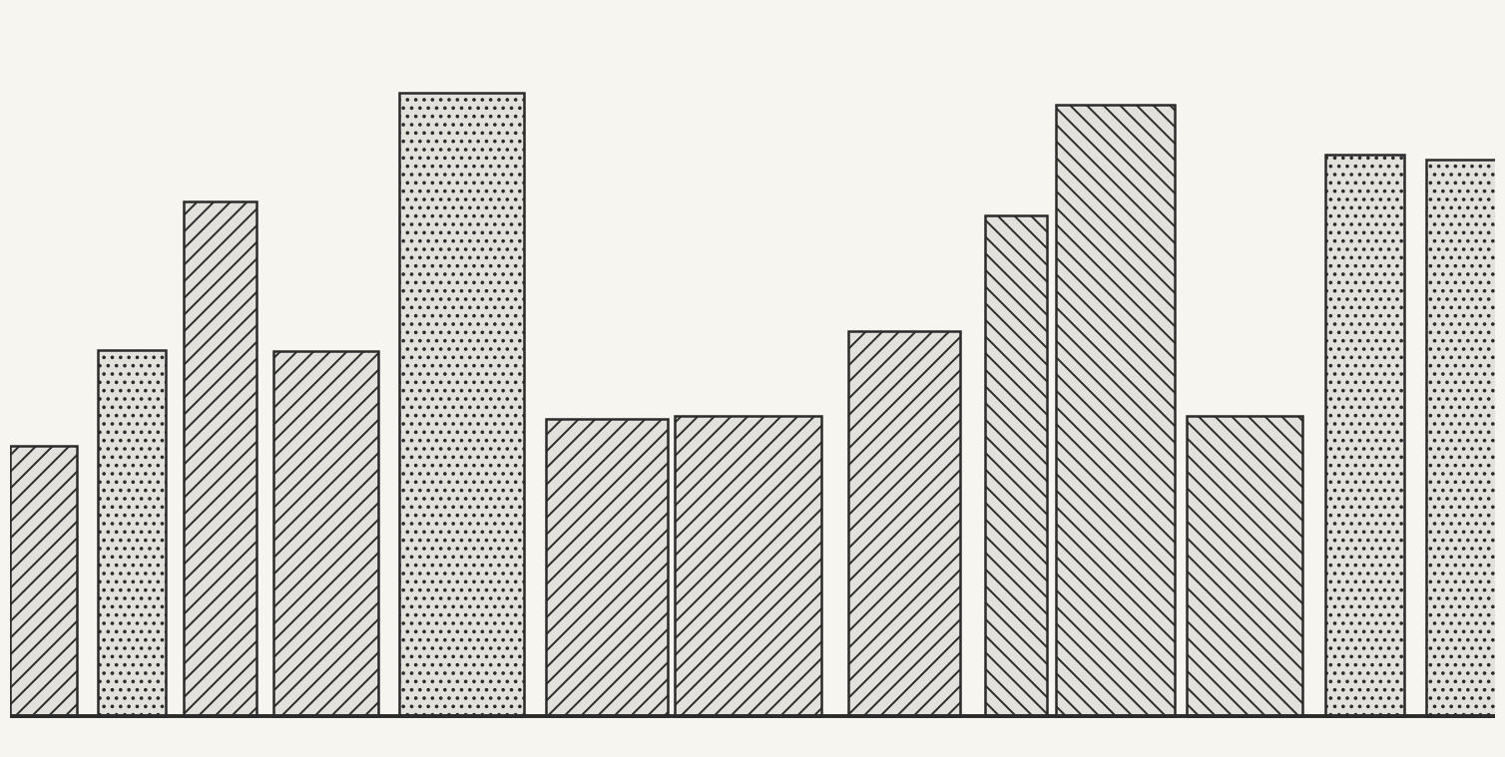
demo deck, invented numbers
SORTING BY DOMINANCE
— a short tour of NSGA-II —
Your Name
Your Institution
Month Year
— i —
— a short tour of NSGA-II —

Slide 2
PART I
THE PROBLEM
1.1 Two goals that disagree
1.2 Dominance
1.3 The Pareto front
— ii —
— a short tour of NSGA-II —

Slide 3
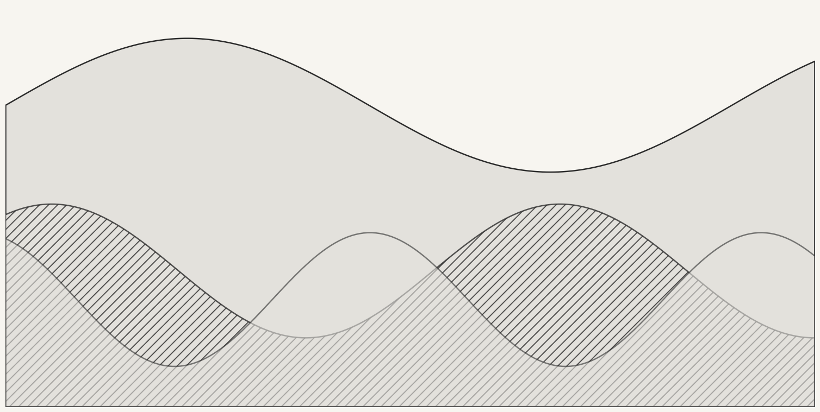
TWO GOALS THAT DISAGREE
— no single best answer —
TRADE-OFF
A cheaper design is usually a weaker one. When two goals pull in opposite directions, one solution cannot be best at both.
Multiobjective optimisation keeps the whole set of fair compromises instead of forcing one weighted score.
— placeholder illustration —
— iii —
— a short tour of NSGA-II —

Slide 4
DOMINANCE
— the only comparison NSGA-II needs —
— x dominates y when it is no worse everywhere and better somewhere (all goals minimised) —
Solutions that nothing dominates form the Pareto front.
— iv —
— a short tour of NSGA-II —

Slide 5
PART II
THE ALGORITHM
2.1 The loop
2.2 Three ingredients
2.3 A worked table
— v —
— a short tour of NSGA-II —

Slide 6
ONE GENERATION
— parents and children compete together —
I.
Pick parents by binary tournament.
II.
Make children with crossover and mutation.
III.
Merge parents and children into one pool.
IV.
Sort the pool into fronts by dominance.
V.
Fill the next population front by front.
VI.
Break the tie in the last front by crowding distance.
— vi —
— a short tour of NSGA-II —

Slide 7
THREE INGREDIENTS
— what makes it NSGA-II —
I · NON-DOMINATED SORTING
II · CROWDING DISTANCE
III · ELITISM
Rank every solution by the front it belongs to. Front one is the best.
Prefer solutions in sparse regions so the front stays spread out.
Parents compete with children, so a good solution is never lost.
Reference: Deb, Pratap, Agarwal and Meyarivan (2002), IEEE Transactions on Evolutionary Computation 6(2).
— vii —
— a short tour of NSGA-II —

Slide 8
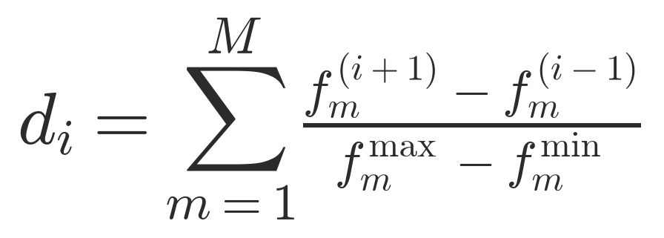
CROWDING DISTANCE
— how isolated is a solution —
— neighbours are taken after sorting the front by goal m; the two ends get infinite distance —
A larger value means fewer neighbours nearby, so the solution is kept.
— viii —
— a short tour of NSGA-II —

Slide 9
A WORKED TABLE
— four invented solutions, two goals to minimise —
SOLUTION
F1
F2
FRONT
CROWDING
A
1
9
1
inf
B
3
5
1
2.00
C
4
6
2
inf
D
7
2
1
inf
— ix —
— a short tour of NSGA-II —

Slide 10
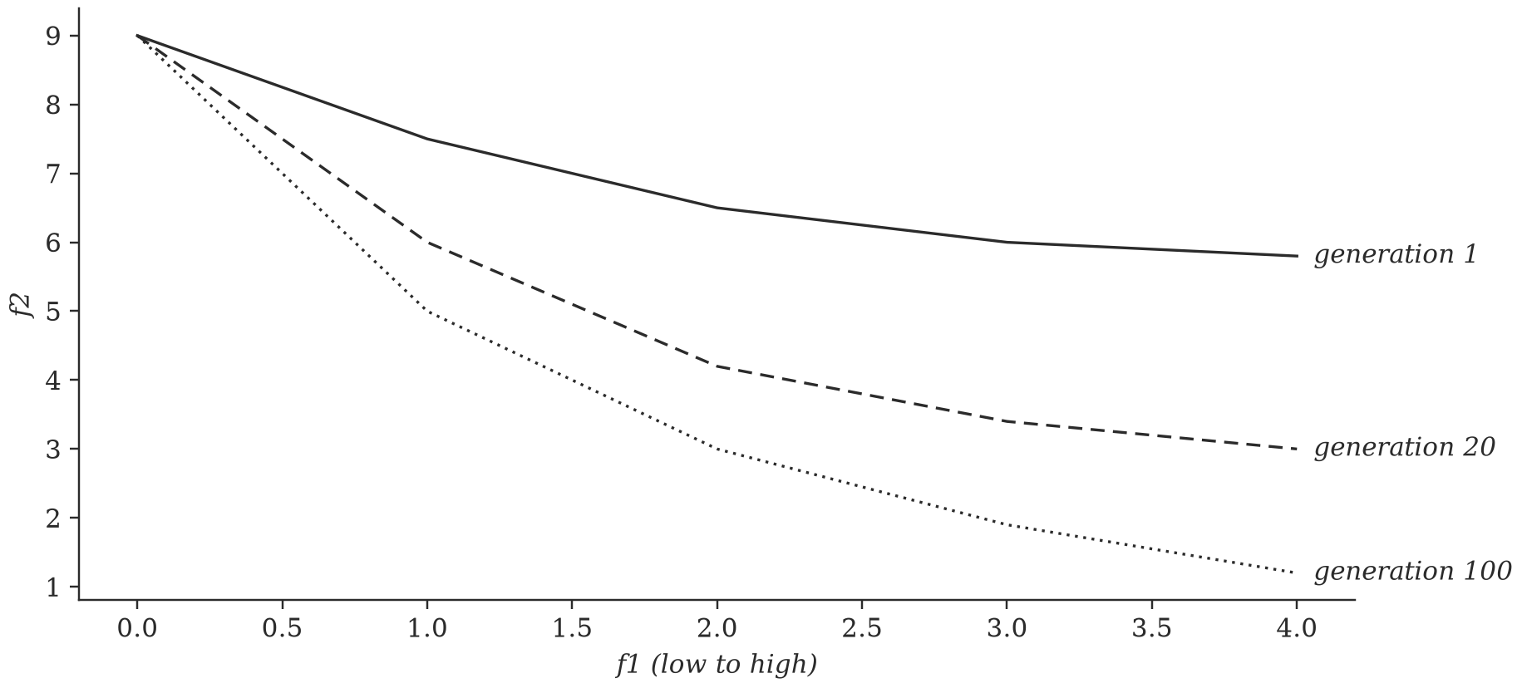
A FRONT CLOSING IN
— a sketch with invented values —
— invented values, only to show the idea —
With more generations the set of compromises moves toward the lower left and spreads along it.
— x —
— a short tour of NSGA-II —

Slide 11
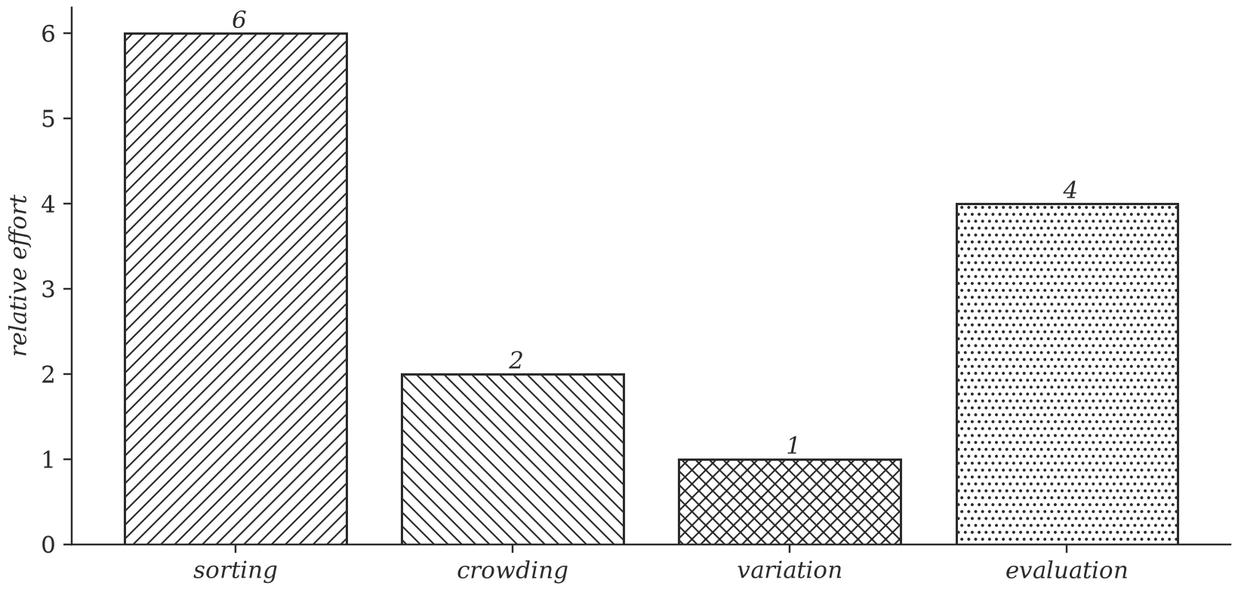
WHERE THE COST GOES
— sorting dominates the work —
— invented values, evaluation cost depends on the problem —
Non-dominated sorting costs on the order of M times N squared comparisons per generation (Deb et al., 2002).
— xi —
— a short tour of NSGA-II —

Slide 12
THANK YOU
— questions and corrections welcome —
Dominance orders the solutions, crowding keeps them spread out, and elitism keeps what works.
— Your Name —
— xii —
— a short tour of NSGA-II —

