Slide 1


Adama Science and Technology University
School of Electrical Engineering and Computing
Computer Science and Engineering
Advanced Distributed Systems
Critical Article review on
“A Genetic Algorithm For Process Scheduling in Distributed Operating Systems Considering Load Balancing”
Presented By:
Khalid Mohammed

Slide 2




outline

Slide 3

Introduction

Slide 4
about
Title
Authors
Type
Presented At
Presented Year
Cited By
A Genetic Algorithm For Process Scheduling in Distributed Operating Systems Considering Load Balancing
M. Nikravan and M. H. Kashani
Conference Paper
Proceedings 21st European Conference on Modelling and Simulation held in Prague, Czech Republic
August 2007
49 published journals

Slide 5
Abstract
The paper is mainly about a newly proposed method for process scheduling in distributed systems.
It presents and evaluates a new approach based on Genetic algorithms to solve the problem of scheduling in DS.
The paper describe and explains the performance evaluation of the proposed algorithm, which aims to achieve all characteristics of an optimal scheduling mechanism simultaneously.

Slide 6





summary

Slide 7

origin

Slide 8
Scheduling and load-balancing in DS
Scheduling mechanism in distributed systems is allocating processes to processors, so that minimal execution time and maximal processor utilization can be achieved in optimal communication cost.
Load-balancing is one of the crucial aspects of scheduling problem in DSs, which deals about fair distribution of load on processors.
Scheduling problem is an NP-complete problem which plays a significant role for overall performance of a distributed system.

Slide 9
GA-based algorithms
The most widely known evolutionary computation used as powerful search and optimization techniques.
One class of the probabilistic optimization algorithms in the heuristic techniques that have emerged as powerful tools to solve NP-problems.
These algorithms have five basic components:
Genotype(genetic encoding method representation of solutions)
Initial population of chromosomes
Fitness evaluation(rating) function and Selection
Genetic operators(Crossover and Mutation)
Parameters values of GA

Slide 10

Statement of the problem

Slide 11
Statement of the Problem
The problem of process scheduling is to assign for each process a processor so that total execution time and communication cost will be minimized, processors utilization and load balancing will be maximized.
But, most existing approaches tend to focus on achieving only one of these objectives.
The paper is mainly concerned about load balancing and distribution between overloaded and underloaded(idle) processors.

Slide 12
Proposed solution
The paper proposes to use Genetic Algorithm-based approach to solve the scheduling problem, the load balancing problem in particular, in distributed systems efficiently.
The paper tries to map the concept of the survival of the fittest into processes(analogous to chromosomes) execution order; fittest meaning less execution time, better load balance and processor utilization.

Slide 13
Problem Formulation
Model Descriptions:
Number of processors, number of processes, the execution time of each process on each processor, communication delay rate between processors, data transmission time between processors, data volume for each processes.
Definitions:
Definition of processor load, maximum life span of a process, processor utilization for each processors, queue-based process execution(FIFO) , number of acceptable processor queues(threshold of load measure or heaviness), light-threshold and heavy-threshold

Slide 14
Assumptions and Limitations
Assumptions
Distributed System is non-uniform and non-preemptive.
The subject of study is a deterministic model having more than one(different types) processors
Processor must finish current process execution before executing a new one(non-intervention of ongoing process execution)
The proposed mechanism is centralized and works without process migration.
Processor can only execute one process at a time
Process can not move to another processor during execution
Limitation
The proposed approach is not completely comparable with current existing techniques as they are concentrated on scheduling tasks with precedence constraints.

Slide 15

Objective of the article

Slide 16
Objective
The main objective of the proposed GA-based approach is to find an optimal scheduling mechanism that minimizes maximum life-span and communication cost, and maximizes average processor utilization and load-balance simultaneously.
It aims to achieve and optimize the multiple characteristics of an optimal scheduling mechanism at once.

Slide 17

methodology

Slide 18
methodology
The core approach to solve the problem is create a fair distribution of load on processors dynamically for optimal schedule in order to minimize total execution time and maximize processor utilization.
The paper uses Genetic-based approach to solve the dynamic scheduling problem in distributed systems.
The experimental analysis of the performance of the proposed GA-based algorithm is evaluated in a simulated environment.

Slide 19
methodology
The programming language used to implement the algorithm is C++ simulated on Pentium III 800, 256 MB RAM, IBM PC
Parameters used in the experiments are:
Population size, Mutation probability, Crossover probability, Number of processes, Number of processors, Number of generations
The default parameters were varied and the results collected from test runs were used to study the effects of changing these parameters.

Slide 20

findings

Slide 21
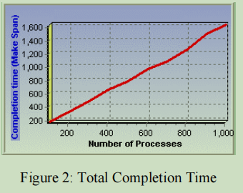
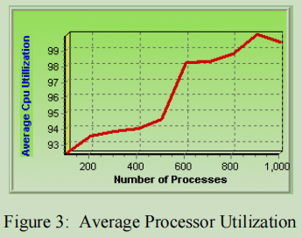
findings
Experimental results prove that the proposed algorithm tend to focus on all of the objectives simultaneously and optimize them.
The measurement of performance was based on three metrics:
Total Completion Time, Average Processor Utilization, and Cost of Communication
Changing the number of processes

Slide 22
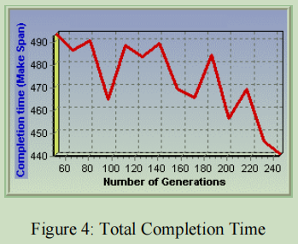
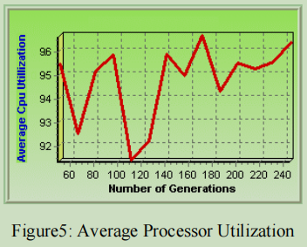
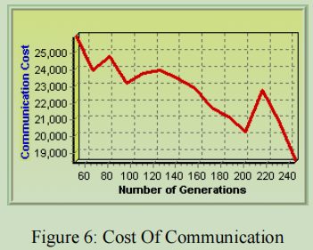
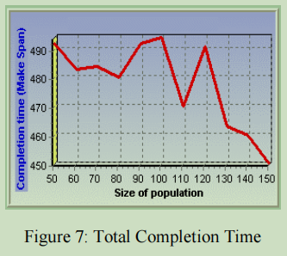
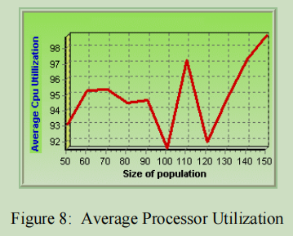
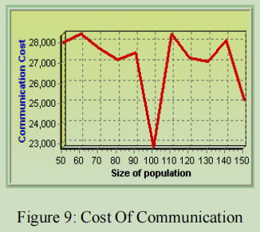
findings
Changing the number of generations: improves the quality of generated process assignment
Changing the size of population: increased number of the fitter chromosomes

Slide 23

critics

Slide 24
Critics: positive
The problem formulation, the conceptual framework of the solution, and the structure of the proposed algorithm was well explained.
Most existing approaches tend to focus on one of the objectives, while this approach aims to achieve and optimize all characteristics of best scheduling mechanism by considering multiple objectives simultaneously.
This article advocates the importance of approaching problems from new and different perspective.
The authors based their solution on very good and highly related works.

Slide 25
Critics: negative
It only considers the direct or inverse relation between parameters without proper careful consideration about the control parameters.
Some fluctuations in the experimental results are not explained at all.
The paper promises to evaluate the proposed algorithm in comparison with other similar algorithms, but failed to do so.
There are some grammatical and spelling errors in the paper which could result vague statements, leads inadequate understanding of the article.

Slide 26

conclusion

Slide 27
Conclusions
The results of the experiment justify the possibility to achieve all characteristics of an optimal scheduling mechanism simultaneously.
The outcome of the article also indicates the capacity of Genetic algorithms to solve the scheduling and other NP-complete problems.
Future research could be focused on the study and implementation of carefully calibrated values of the control parameters.
Additionally, the need for an optimal scheduling mechanism is still a wide research area to be explored and I advise u to do so.

Slide 28
References
Aggarwal, G., Motwani, R., Zhu, A.: The load rebalancing problem. Journal of Algorithms 60(1), 42–59 (2006)
Albers, S. (2013). Recent advances for a classical scheduling problem, In Automata, languages and processing, Lecture Notes in Computer Science (Vol. 7966, pp. 4–14). G.L.Park, “Performance Evaluation of a List Scheduling Algorithm In Distributed Memory Multiprocessor Systems”, International Journal of Future Generation Computer Systems 20, 2004, 249-256.
https://riot.ieor.berkeley.edu/Applications/Scheduling/index.html
https://en.wikipedia.org/wiki/Genetic_algorithm
https://www.sciencedirect.com/topics/engineering/genetic-algorithm

Slide 29
THANK YOU!

