Slide 1


Virtual Mouse using Hand Gestures using OpenCV
Presented by:
G.GOWTHAMI | (21491A4309)
M.GANESH | (21491A4344)
P.VIJAYA KRISHNA | (21491A4347)
SK.KHAZA | (21491A4358)
T.ABHI RAM REDDY | (22495A4301)
V.SIVA SATYA NARAYANA | (22495A4305)
Under the Guidance of
DR.M. Muthamizh Selvam
Assistant Professor
Department of Artificial Intelligence

Slide 2
Outline
ABSTRACT
INTRODUCTION
LITERATURE REVIEW
OBJECTIVE
EXISTING METHOD
PROPOSED METHOD
HARDWARE & SOFTWARE INVOLVED
ADVANTAGES AND APPLICATION
SYSTEM DESIGN (Architecture)
REFERENCES

Slide 3
Abstract
The Virtual Mouse is an innovative system designed to transform the way users interact with computers by replacing traditional input devices like the keyboard and mouse with intuitive hand gestures. Leveraging the power of computer vision and image processing, the system captures and interprets the movements of the hands and fingers through a camera, translating them into mouse actions such as cursor movement, clicking, and scrolling. This hands-free interface offers a more natural and ergonomic way of interacting with a computer, making it ideal for users who seek a modern, efficient alternative to conventional input methods. Additionally, it provides a significant advantage for individuals with physical disabilities, offering them an accessible means of interacting with technology without the need for complex or specialized hardware. The Virtual Mouse system eliminates the need for external hardware devices, making it a cost-effective and seamless solution for computer control. With real-time gesture recognition, the system ensures smooth and precise operation, enhancing the overall user experience and paving the way for more advanced forms of human-computer interaction in the future.

Slide 4
Introduction
The Virtual Mouse revolutionizes the way users interact with computers by eliminating the need for traditional input devices like a mouse or keyboard, relying instead on hand gestures for control.
Utilizing cutting-edge computer vision and image processing technologies, the system detects and interprets the movements of the hand and fingers captured by a camera, transforming these gestures into actions such as cursor movement, clicking, and scrolling.
This hands-free control method offers a more natural, intuitive, and ergonomic experience, reducing strain from repetitive motions commonly associated with traditional mouse and keyboard usage.
The Virtual Mouse is especially advantageous for individuals with physical disabilities, as it provides an alternative means of controlling a computer without the need for specialized equipment, making technology more accessible.
By removing the need for external input devices, the system presents a cost-effective solution that is easy to implement and doesn't require additional hardware, offering a streamlined approach to human-computer interaction.
Zeroth Review

Slide 5
Literature Survey
Ref. No | Title & Author | Technique Used | Pros | Cons
1 | “Virtual Control Using Hand -Tracking ”-Dhruv Rustagi, Gaurav Maindola. | MediaPipe, Gesture Recognition | Contactless Interaction, Enhanced Accessibility | Limited Accuracy and Precision
2 | “Hand Gesture Controlled Virtual Mouse Using Artificial Intelligence" – Kavitha, Janasruthi S | Hand Tracking, CNN and Voice Commands. | Improved User Experience , Improved Mobility | Accuracy and Precision Issues, Limited Functionality and Complexity
3 | “Virtual Mouse and Gesture Based Keyboard”-Gautami Yogesh Kakade, Abishek Koul, Shikhar Bhasin | Euclidean Distance, Hand Gesture Recognition. | Low-Cost and Minimal Hardware, Hands-Free Operation. | Environmental Limitations, Calibration Issues.
4 | “Augmented Virtual Mouse System with Enhanced Gesture Recognition”-Gopinadh Kotari, Keerthi Jangam | PyAutoGUI, Numpy | Convenient, Hygienic and Touchless | Hardware Dependency, Limited Gesture Set
5 | “Design and Implementation of an AI Virtual Mouse Using Hand Gesture Recognition”-Sharada Varalakshmi, Virinchi Sai, Chintagari Archana. | Coordinate Mapping, AutoPy. | Real-time Performance, Versatility. | Processing Power, Accuracy Challenges, User Learning Curve

Slide 6
Literature Survey
Ref. No | Title & Author | Technique Used | Pros | Cons
6 | “Virtual Mouse And Assistant: A Technological Revolution Of Artificial Intelligence”-Jagbeer Singh ,Yash Goel. | Integration with Voice Assistant, Pyttsx3 | Integration of Multiple Technologies, Adaptability and Customization | Potential for Inaccurate Recognition, Privacy Concerns.
7 | “Implementation of Hand Gesture Controlled Mouse Using Artificial Intelligence" – Piyush Pilare, Coral Mahato | Preprocessing, Masking Technique. | Cost-Effective, User-Friendly Interface | Processing Overhead, Limited Precision, Learning Curve.
8 | “Virtual Mouse Control Using Hand Gestures Recognition”-Abhilasha D, Vandana T D, Madhumitha R. | Real-time video processing , Hand Tip Detection, Deep Learning. | Hands-Free Interaction, Multi-functionality. | Computational Load, Environmental Limitations.
9 | “Virtual Mouse using Hand Gestures”-Roshnee Matlani, Shruti Mishra, Roshan Dadlani | Pynput, Mediapipe,CNN | Wide Application Potential, Improved Presentation Experience | Processing Overhead, Limited Gesture Set
10 | “VIRTUAL MOUSE USING HAND GESTURES ”-CN Sujatha, S.P.V Subbarao, P.Surajvarma. | Human-Computer Interaction (HCI), Object Detection and Image Processing. | No Hardware LimitationImproved Human-Computer Interaction. | Performance Dependence, Calibration Requirement

Slide 7
Motivation
The Virtual Mouse offers a groundbreaking way to interact with computers, eliminating the need for traditional input devices and replacing them with intuitive hand gestures. This system opens up new possibilities for how we interact with technology on a daily basis.
It provides an accessible and empowering solution for individuals with physical disabilities, allowing them to control a computer through hand gestures, without the need for specialized hardware. This can greatly improve their ability to engage with technology.
The hands-free nature of the Virtual Mouse reduces strain from repetitive movements associated with traditional input devices like a keyboard and mouse. This makes it a healthier, more ergonomic choice for users in the long run.
By utilizing computer vision and image processing, the system interprets hand movements into cursor actions, enabling a seamless and efficient user experience. This innovation marks a step forward in human-computer interaction.
The system is also cost-effective, as it eliminates the need for additional external hardware, making it a more affordable option for both individuals and organizations.
With the Virtual Mouse, users can enjoy a more natural and intuitive experience when using computers, while also benefiting from improved accessibility and reduced physical strain.
This project showcases the future potential of technology, where human-computer interaction is more seamless, inclusive, and adaptable, setting the stage for future advancements in the field.

Slide 8
Objectives
To develop a hands-free computer interaction system: The primary goal is to create a system that replaces traditional input devices like the mouse and keyboard with intuitive hand gestures, enabling users to control their computers through natural movements.
To enhance accessibility for individuals with physical disabilities: The project aims to provide an alternative, easy-to-use method of computer control for people with physical disabilities, making technology more inclusive and accessible.
To leverage computer vision and image processing technologies: The system will use advanced computer vision techniques to detect and interpret hand gestures in real time, translating them into mouse actions like moving the cursor, clicking, and scrolling.
To improve ergonomic and user-friendly design: By reducing the need for repetitive hand movements and offering a more ergonomic way of interacting with computers, the Virtual Mouse aims to minimize strain and discomfort for regular users.
To eliminate the need for external hardware devices: The system will work without requiring additional input devices, making it a cost-effective solution that is easy to implement without the need for specialized hardware.
To explore the future of human-computer interaction: The project seeks to lay the foundation for more advanced and natural ways of interacting with technology, contributing to the evolution of user interfaces in the future.

Slide 9
Existing Method
Leap Motion
The Leap Motion uses infrared sensors and computer vision to track 3D hand movements, offering precise gesture recognition. While it’s highly accurate, it requires external hardware, making it more expensive. Microsoft Kinect combines a depth sensor, RGB camera, and microphone to track full-body and hand movements. It is versatile but necessitates a dedicated device and can be costly.
Gesture Recognition with OpenCV
Gesture recognition with OpenCV leverages a webcam and computer vision techniques like contour detection and feature tracking to detect hand gestures and translate them into mouse actions. This solution is cost-effective but can be less accurate and is influenced by lighting conditions. AirMouse tracks hand movements through a camera, offering natural interaction, though its accuracy can be impacted by environmental factors.
HandWave
HandWave uses hand gestures such as waving or pointing to control the computer. It relies on OpenCV and machine learning for gesture detection, providing a simple user experience, but may lack accuracy in complex environments. Flex, developed by uSens, integrates infrared sensors and machine learning to track detailed hand and finger movements, offering high accuracy but requiring specialized sensors.

Slide 10
Finger Gesture Tracking with Machine Learning
Some systems use deep learning techniques to train models for recognizing finger movements in real-time. These systems can detect complex gestures with high accuracy but require substantial processing power and large datasets for training.
Wi-Fi Based Gesture Recognition
Some researchers are using Wi-Fi signals to track gestures. These systems analyze the disruption in Wi-Fi signals caused by body movement to interpret gestures. This method has the advantage of not needing cameras or infrared sensors, making it a less intrusive option.
Gesture Recognition with Accelerometers
Some systems use accelerometer-based sensors placed in gloves or bands to detect hand gestures. These devices translate movements into mouse actions by measuring changes in orientation or motion. While cost-effective, they may lack precision compared to vision-based methods.

Slide 11
Proposed Method
The system uses computer vision techniques to track and interpret hand gestures. A camera (usually a webcam or specialized camera) captures real-time images or video of the user's hand and fingers. These images are processed to detect the shape, position, and movement of the hand. The system uses image processing algorithms to distinguish between different gestures such as pointing, clicking, or scrolling
The proposed method relies on OpenCV (Open Source Computer Vision Library) for processing and interpreting hand gestures. Using techniques like contour detection and skin color segmentation, the system identifies the hand in the captured frames. It then analyzes the position and movement of fingers and hands to map those gestures to corresponding actions like cursor movement, click, and scroll.
Cursor Movement: The system detects the movement of the user's hand and translates it into corresponding cursor movement on the screen. For example, if the user moves their hand left or right, the cursor moves in the same direction. This creates a more natural and intuitive way of controlling the computer compared to a traditional mouse.
Clicking Mechanism: Clicking is implemented by recognizing specific gestures, such as forming a fist or extending a finger. When the system detects a specific gesture, it triggers a click action at the cursor’s current location, emulating a left-click or right-click.
Scrolling Mechanism: The scrolling action is achieved by interpreting vertical hand movements or specific finger gestures (like moving the fingers up or down). The system translates this into scrolling behavior within applications, allowing users to navigate web pages, documents, or apps by simply moving their hands.

Slide 12
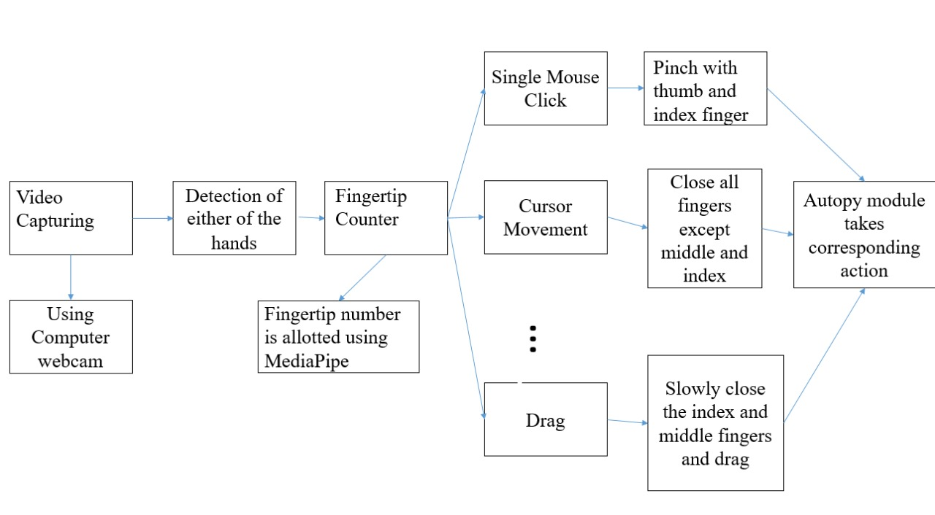
Block diagram

Slide 13
Explanation of Proposed Work
Hand Gesture Recognition: The system captures hand movements in real-time through a camera and processes the video feed to identify gestures. Image processing techniques like background subtraction, contour detection, and skin color segmentation are used to detect the hand and its movements.
Cursor Control: Once the hand is detected, its movement is translated into corresponding cursor movement on the screen. For example, moving the hand left or right will move the cursor in the same direction. This provides a simple and intuitive way to control the mouse cursor without needing a physical device.
Clicking: The system interprets specific gestures, such as forming a fist or extending a finger, as mouse clicks. By recognizing these gestures, the system simulates left-click or right-click actions, allowing users to interact with the operating system or applications as they would with a regular mouse.
Scrolling: Scrolling can be achieved by recognizing vertical hand movements or specific finger gestures. Moving the hand or fingers up or down will enable scrolling in a document, webpage, or application, mimicking the function of a traditional mouse wheel.
Cost-Effective and Accessible: Unlike systems that rely on specialized hardware (e.g., Leap Motion or Kinect), this system uses a standard webcam, making it more cost-effective and accessible for a wider range of users. This eliminates the need for extra hardware, making the solution more practical for everyday users, especially those with disabilities.

Slide 14
Explanation of Proposed Work
Real-Time Operation: The system processes hand movements in real-time, ensuring that gestures are recognized instantly and accurately. This enables smooth interaction with the computer without noticeable lag, making the system efficient and responsive.
Ergonomics and Comfort: The Virtual Mouse system aims to reduce strain caused by repetitive movements, such as wrist and hand motions, associated with traditional mouse and keyboard use. By offering a hands-free control method, it improves user comfort and makes computing more ergonomic.
Customization: The system is designed to be customizable, allowing users to define their own gestures for specific actions. This can enhance the system's flexibility and make it adaptable to various tasks or user preferences.
Integration with Existing Systems: The virtual mouse system can easily integrate with existing operating systems and software, allowing users to interact with their computers without the need for additional configuration or special software. It operates like a traditional mouse but with gestures, making it a seamless solution for controlling a computer.
Future Scalability: The system is designed to be scalable and adaptable. Future work could incorporate advanced techniques like machine learning to enhance gesture recognition accuracy or enable 3D gesture recognition, opening up possibilities for even more intuitive and complex human-computer interactions.

Slide 15
Hardware & Software Involved
Hardware Components
Camera (Webcam): The camera is the key hardware component used to capture real-time images or videos of the user's hand gestures. It tracks the movement of the user's hands and fingers, allowing the system to detect gestures and translate them into mouse actions like cursor movement, clicking, and scrolling. The camera's resolution and frame rate play a critical role in the accuracy and smoothness of hand tracking. A minimum resolution of 720p is recommended for clear image capture, but higher resolutions (such as 1080p) can improve accuracy.
Software Components
Programming Language (Python): The primary language used for development due to its simplicity and extensive libraries.
OpenCV: Used for real-time image processing and hand detection, enabling gesture recognition.
MediaPipe: A library for more accurate and efficient hand tracking and gesture recognition.
IDE: Visual Studio Code or PyCharm for writing and debugging the code.

Slide 16
Applications
Gesture-Based Sign Language Translation: The system could be used to interpret sign language gestures in real-time and convert them into text or voice commands, promoting inclusivity and improving communication between deaf and hearing individuals.
Smart Vehicle Control: In autonomous or smart vehicles, the Virtual Mouse can be used for touchless interaction with vehicle interfaces, allowing drivers or passengers to control navigation, entertainment, and climate settings without physical interaction with touchscreens or buttons.
Virtual Workspaces: In the growing field of remote work and virtual offices, the Virtual Mouse can be used to navigate virtual desktops and manage files and applications without relying on physical peripherals, offering a more immersive and efficient experience.
Human-Machine Interfaces (HMI) in Industrial Automation: The Virtual Mouse can be integrated into factory automation systems, where workers can control machines and monitor processes through gestures, improving efficiency and reducing the need for manual input devices.
Assistive Technology for Disabled Individuals: The Virtual Mouse provides a significant advantage to individuals with physical disabilities, allowing them to interact with computers and control devices using hand gestures, reducing reliance on specialized hardware and improving independence.

Slide 17
Advantages
Hands-Free Interaction: Provides an intuitive and ergonomic alternative to traditional input devices, reducing physical strain and making interactions more natural.
Accessibility: Enables individuals with physical disabilities to use computers effectively without requiring specialized equipment.
Cost-Effective: Eliminates the need for external hardware like a mouse or keyboard, reducing costs for users.
Hygienic and Safe: Ideal for environments requiring high hygiene standards, such as hospitals and laboratories, as it minimizes physical contact.
Ease of Use: Simple hand gestures make the system easy to learn and operate, enhancing user convenience.
Flexibility: Works across various devices and platforms, offering compatibility with different operating systems and applications.
Innovative Technology: Showcases the potential of computer vision and gesture recognition, paving the way for more advanced human-computer interaction systems.
Improved Efficiency: Reduces repetitive motion associated with traditional devices, improving workflow and productivity.
Versatility: Can be applied in diverse fields, including healthcare, industrial automation, gaming, and smart home systems.
Future-Oriented: Aligns with the trend toward touchless interfaces, promoting innovation in technology and user experience.

Slide 18
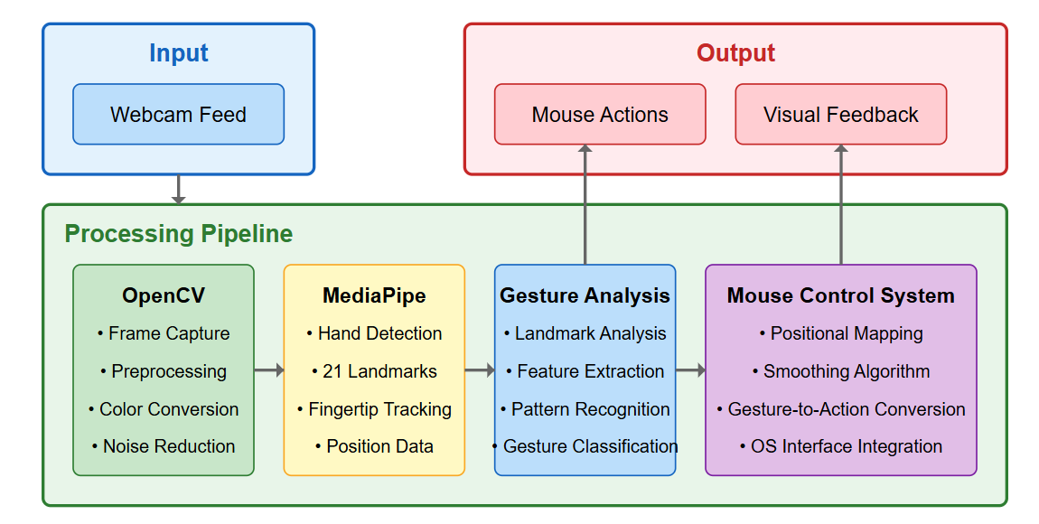
System Architecture
Fig.1. System Design
18

Slide 19
RESULT
The implementation of the Virtual Mouse using Hand Gestures with OpenCV and MediaPipe has demonstrated promising results, showcasing its effectiveness in providing a hands-free alternative to traditional input devices. With an impressive recognition accuracy of approximately 97%, the system successfully identified and executed various mouse operations, including cursor movement, left click, right click, double click, drag-and-drop, and scrolling gestures. The system's real-time responsiveness and precise tracking capabilities make it a viable solution for applications requiring seamless human-computer interaction.
The ability to recognize and interpret hand gestures under varying lighting conditions and backgrounds proved to be a significant advantage of the system. Tests conducted in different environments confirmed its robustness, with real-time tracking maintaining stability even in complex scenarios. The system’s speed and precision allowed for smooth and natural interaction, closely resembling conventional mouse usage. However, minor limitations were observed in cases where hand visibility was partially obstructed, leading to occasional misinterpretations in gesture execution. Overall, the integration of OpenCV and MediaPipe for virtual mouse control has significantly enhanced the feasibility of touchless interaction in modern computing. With its high accuracy and real-time processing capabilities, the system is well-suited for applications in accessibility solutions, gaming, interactive displays, and other hands-free computing environments.

Slide 20
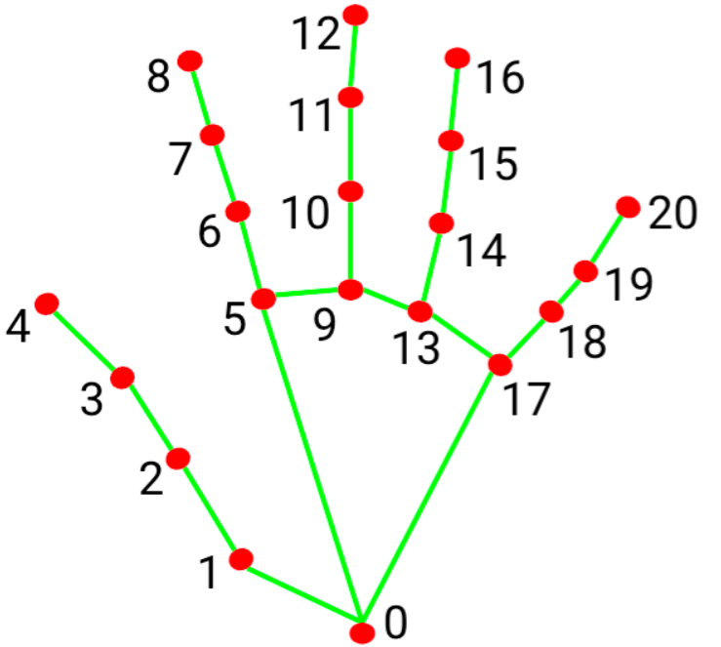
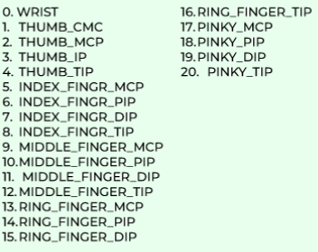
This landmark detection system plays a vital role in computer vision-based hand tracking, where real-time recognition of finger movements allows for gesture-based interactions. The structured identification of hand landmarks facilitates precise motion tracking, helping to map gestures into meaningful commands. With advancements in deep learning and computer vision, such systems are becoming more efficient, offering seamless user interaction with minimal hardware requirements.
Fig 2: Hand Landmark Detection and Keypoints Mapping

Slide 21
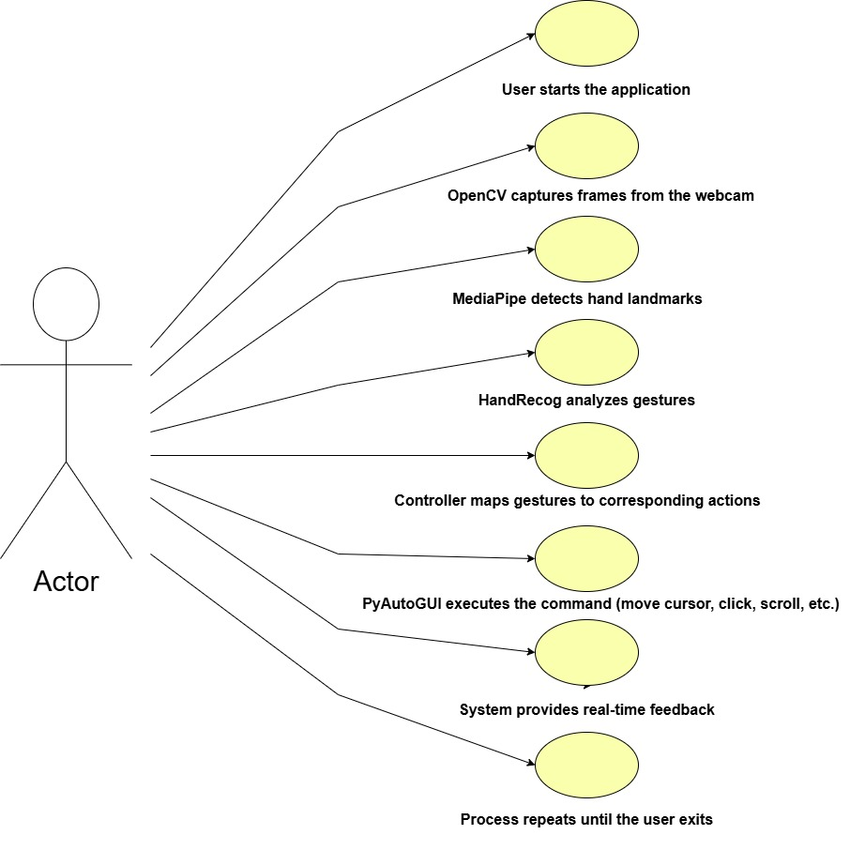
UML Diagram

Slide 22
S.NO | Gestures | Action Performed
1 | All fingers close except middle and index finger | To move cursor
2 | Index finger holding | Left Click
3 | Middle finger down | Right Click
4 | Palm | No movement
5 | All are closed except middle and index fingers are closing slowly | Drag & drop operations
6 | Touching thumb and index and others are open moving left and right | Brightness control
7 | Touching thumb and index and others are open moving up and down | Volume control
8 | Touching thumb and index and others are open | Scrolling operations
9 | All fingers close | Multiple selection
10 | Index Finger and Middle Finger Open (Close Together), Other Fingers Closed | Double Click
Table : Gestures and Actions

Slide 23
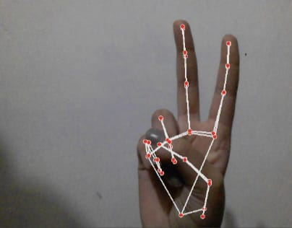
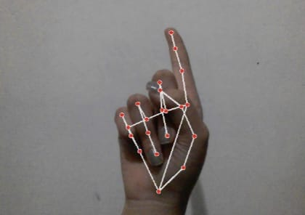
Fig 3: All fingers close except middle and index fingers
Fig 4: Index Finger Holding

Slide 24
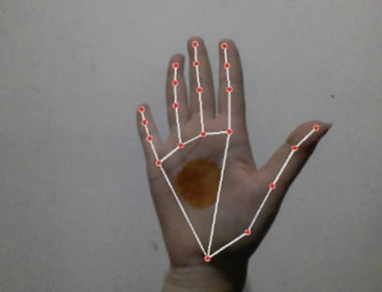
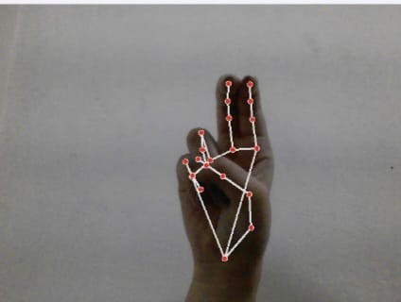
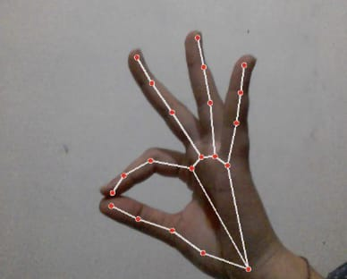
Fig 6: All are closed except middle
and index fingers are closing slowly
Fig 5: Palm
Fig 7: Pinch Mode

Slide 25
FUTURE SCOPE
The gesture-based virtual mouse system has the potential to revolutionize human-computer interaction by eliminating the need for traditional input devices like a mouse or touchpad. As technology continues to evolve, the system can be further enhanced in multiple ways to improve accuracy, usability, and adaptability across different domains.One of the key future improvements is advanced gesture recognition using deep learning. By integrating neural networks trained on diverse hand gestures, the system can detect a broader range of hand movements with higher accuracy. This would allow users to perform complex and customized gestures for more intuitive controls.The system can be expanded to multi-hand gesture support, enabling dual-hand interactions for multi-touch functionalities such as pinch-to-zoom, 3D object manipulation, and multi-finger scrolling. This enhancement will be highly beneficial for applications in graphic design, 3D modeling, and gaming.Integration with Augmented Reality (AR) and Virtual Reality (VR) will allow natural hand movements to be used for interacting with virtual environments, making the system a seamless tool for immersive experiences in education, gaming, and remote collaboration. Another promising advancement is AI-powered gesture learning, where the system adapts to individual users' unique hand movements over time, improving personalized interactions.

Slide 26
CONCLUSION
The gesture-based virtual mouse system is an innovative approach to human-computer interaction, offering a touchless, intuitive, and efficient alternative to traditional input devices like a mouse or touchpad. This system leverages computer vision, hand tracking, and real-time gesture recognition to control various system functions, making it an accessible and futuristic solution for digital interactions.By integrating MediaPipe for hand landmark detection, OpenCV for image processing, and PyAutoGUI for executing system commands, this system successfully captures hand gestures in real-time and translates them into meaningful actions. The ability to move the cursor, click, scroll, adjust volume and brightness, lock the screen, and control media playback enhances user convenience, creating a natural and immersive computing experience. One of the key advantages of this system is its contactless nature, which makes it a hygienic alternative to conventional input devices, particularly in public spaces, hospitals, offices, and shared workstations where physical contact with surfaces should be minimized. Additionally, it offers enhanced accessibility for users with motor disabilities, enabling them to interact with computers through simple hand gestures.

Slide 27
References
Dhruv Rustagi, Gaurav Maindola, Harshit Jain, Bhanu Gakhar and Gunjan Chugh. Virtual Control Using Hand – Tracking. International Journal for Modern Trends in Science and Technology 2022, 8 pp. 26-31. https://doi.org/10.46501/IJMTST0801005
Kavitha, R., Janasruthi, S. U., Lokitha, S., & Tharani, G. (2023). Hand gesture controlled virtual mouse using artificial intelligence. International Journal of Advanced Research in Computer Science and Engineering, 9(2), 19380–19395.
Phursule, R. N., Kakade, G. Y., Koul, A., & Bhasin, S. (2023). Virtual Mouse and Gesture Based Keyboard. Proceedings of the 7th International Conference on Computing, Communication, Control, and Automation (ICCUBEA), Pimpri Chinchwad College of Engineering, Pune, India, August 18-19, 2023, 979-8-3503-0426-8/23. https://doi.org/10.1109/ICCUBEA58933.2023.10392123
Kotari, G. (2024b). Augmented Virtual Mouse System with Enhanced Gesture Recognition. INTERANTIONAL JOURNAL OF SCIENTIFIC RESEARCH IN ENGINEERING AND MANAGEMENT, 08(04), 1–5. https://doi.org/10.55041/ijsrem31709
Varalakshmi, M. S., Sai, A. V., Archana, C., & Fatima, A. (2024). Design and Implementation of an AI Virtual Mouse Using Hand Gesture Recognition. Scope, 14(1), 312–320. https://www.scope-journal.com

Slide 28
References
Singh, J., Goel, Y., Jain, S., & Yadav, S. (2022). Virtual mouse and assistant: A technological revolution of artificial intelligence. Journal of Pharmaceutical Negative Results, 13(Special Issue 10), 3013–3022. https://doi.org/10.47750/pnr.2022.13.S10.362
Pilare, P., Mahato, C., Khergade, C., Agrawal, S., and Thakre, P. (2022). Implementation of hand gesture controlled mouse using artificial intelligence. 3C Tecnología. Glosas de innovación aplicadas a la pyme, 11(2),71-79. https://doi.org/10.17993/3ctecno.2022.v11n2e42.71-79
D. Abhilasha, T. D. Vandana, R. Madhumitha, and D. Supriya, "Virtual Mouse Control Using Hand Gesture Recognition," International Advanced Research Journal in Science, Engineering and Technology, vol. 9, no. 7, pp. 126-130, July 2022, doi: 10.17148/IARJSET.2022.9722.
R. Matlani, S. Mishra, R. Dadlani, A. Tewari, and S. Dumbre, "Virtual Mouse using Hand Gestures," 2021 International Conference on Technological Advancements and Innovations (ICTAI), 2021, pp. 340-345, doi: 10.1109/ICTAI53825.2021.9673251.
Sujatha, C. N., Subbarao, S. P. V., Preetham, P., Surajvarma, P., & Upendra, Y. (2022). Virtual mouse using hand gestures. International Journal of Creative Research Thoughts (IJCRT), 10(6), 704-712. https://www.ijcrt.org/papers/IJCRT2206826.pdf

Slide 29
THANK YOU

