Slide 1

Customer Queue
Group Members: Yuri Khechoyan, Vikram hegde

Slide 2

Business Model
Customer: Customers $ Employees & customers of different industries
Solution: Design a Queue System. The customer will be able add themselves to the queue by entering their full name, mobile number [Reason for Visit/Party Size]. This will help with the efficiency of aiding customers & employees
Benefits: Customer Queue will:
Improve efficiency with aiding customers
Let Employees & customers know who is next in line for assistance
Give customers a more interactive experience

Slide 3
System Requirements
Make sure ALL REQUIRED credentials are entered
When customer is removed from queue, everyone after them moves up in the queue (x-1)

Slide 4
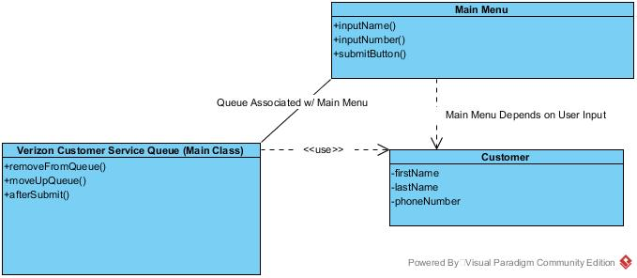
High Level Design

Slide 5
Schedule
Serial # | Priority | Story Title | Est. Story Pts. | Actual Story Pts. | Implemented by | Status
1 | 1 | Login Screen | 3 | 4 | Yuri & Vikram | Completed
2 | 1 | Name Input | 1 | 1 | Yuri & Vikram | Completed
3 | 1 | Phone # Input | 1 | 1 | Yuri & Vikram | Completed
4 | 2 | Submit Button | 2 | 4 | Vikram & Yuri | Completed
5 | 2 | After Submit (tablet) | 4 | 4 | Vikram & Yuri | Completed
6 | 2 | Remove from Queue | 3 | 5 | Vikram & Yuri | Completed
7 | 2 | Moving up in Queue | 3 | 5 | Vikram & Yuri | Completed

Slide 6
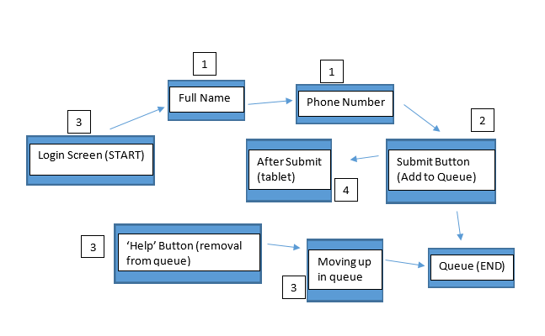
Schedule (cont.)

Slide 7
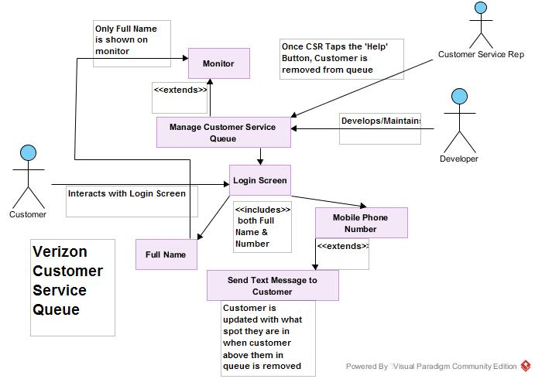
User Requirements

Slide 8
DEMO ILLUSTRATION
Programming Environment: IntelliJ IDEA
Steps:
Add Full Name
Add Phone Number
Receive SMS Text Message
Add Customer to Queue
Remove User from Queue

Slide 9

Challenges Faced
Complete & Identical translation of program from GUI to Web Model
Minor issue: Twilio code did not initialize when inside the same method with Spring Framework Initialization
Gradle build longer than needed

Slide 10

Known Issues
Program will only work if establishment has Internet connection

Slide 11

Future Work
Implementing Payment System for every customer registered through system
Establishment will pay Developers or Company ~ $2-$4 for every customer registered
Ex. 1: 300 visitors/customers @ $2 = $600/day from 1 establishment
Ex. 2: 300 visitors/customers @ $4 = $1,200/day from 1 establishment

Slide 12
Questions?

