Slide 1

John McQuaide, Jessie Wilkins, Steven Olsen, Yuri Khechoyan

Slide 2

Background: Why Qu· eu· ed exists?
Benefits:
Improve efficiency (B2B) with aiding customers
Let CSRs & customers know who is next in line for assistance
Give customers a more interactive experience
Allow Business to Significantly Cut Costs
No maintenance
No stolen equipment

Slide 3

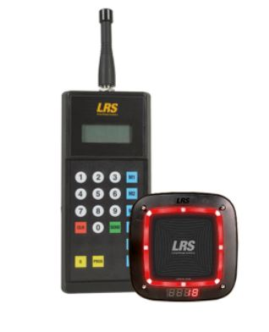
Putting things in Perspective
Qu· eu· ed | Cost | Traditional Queue System | Cost
 | $0.0075 |  | ~ $100/pager
Maintenance Stolen | N/A |  | ~ $500-$1000 /transmitter
-- | -- | Maintenance/Fix Additional Pagers Stolen | $$$$

Slide 4
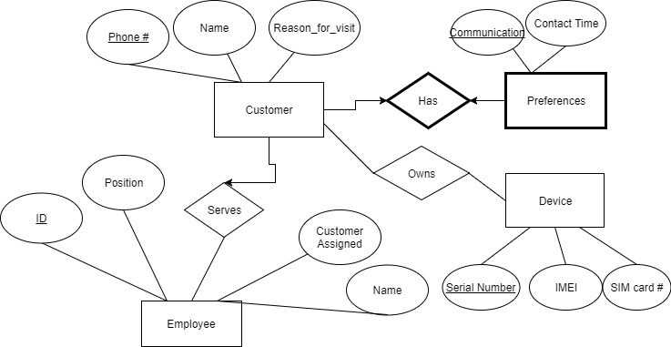
ERD

Slide 5
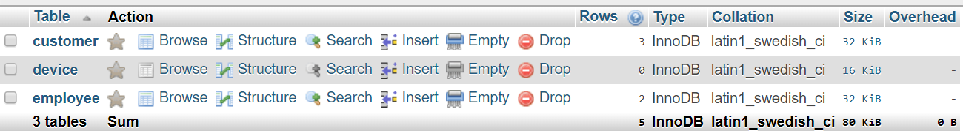
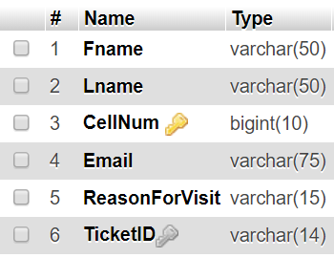
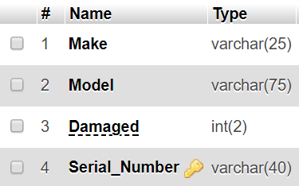
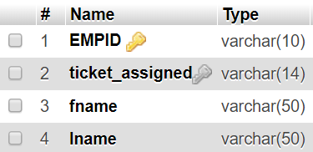
Table Implementation

Slide 6
Normal Forms
employee(EMPID,TicketID,fname,lname)
2NF
Candidate keys: EMPID, TicketID
Functional dependency (EMPID->fname,lname)
Functional dependency (TicketID->EMPID)
device(Make,Model,Damaged,Serial_Number, Ticket_ID)
BCNF
Candidate keys: Serial_Number
Functional dependency device(Serial_Number ->Make, Model, Damaged, Ticket_ID)
customer(Fname,Lname,CellNum,Email,NotifyFreq,ReasonForVisit,TicketID,Preference)
BCNF
Candidate keys: CellNum
Functional dependency (CellNum ->Fname, Lname, Email, NotifyFreq, ReasonForVisit, TicketID, Preference)

Slide 7
Possible Users
Restaurants
Telecommunication Retailers (AT&T, Verizon, T-Mobile, etc.)
Cafes (Bread Co., etc.)

Slide 8
Importance of Database

Slide 9
Webpages + Queries

Slide 10
Selecting specific Customer from Database:
SELECT Fname, Lname,CellNum,Email, ReasonForVisit, TicketID FROM customer;

Slide 11
Selecting the number of tickets that an employee has assigned themselves to (how many customers are they interacting with):
SELECT COUNT(EMPID), ticket_assigned FROM employee GROUP BYticket_assigned;

Slide 12
Retrieving which employee assisted which customer based on specific ticketID :
SELECT c.CellNum, c.TicketID, e.EMPID FROM customer c,employee e WHERE c.TicketID=e.ticket_assigned AND e.EMPID >(SELECT EMPID FROM employee WHERE ticket_assigned ='A123456789');

Slide 13
Retrieving the average amount of customers an employee assists:
SELECT EMPID, AVG(ticket_assigned) FROM employee GROUP BYEMPID

Slide 14
Retrieving the amount of times a customer comes in and gets assisted by employee based on the amount of ticketIDs the that are associated with a customer’s cell number:
SELECT CellNum, COUNT (TicketID) FROM customer GROUP BY CellNum

