Slide 1
Welcome to ANU Presentation
Hassan
Khedr
Amr

Slide 2
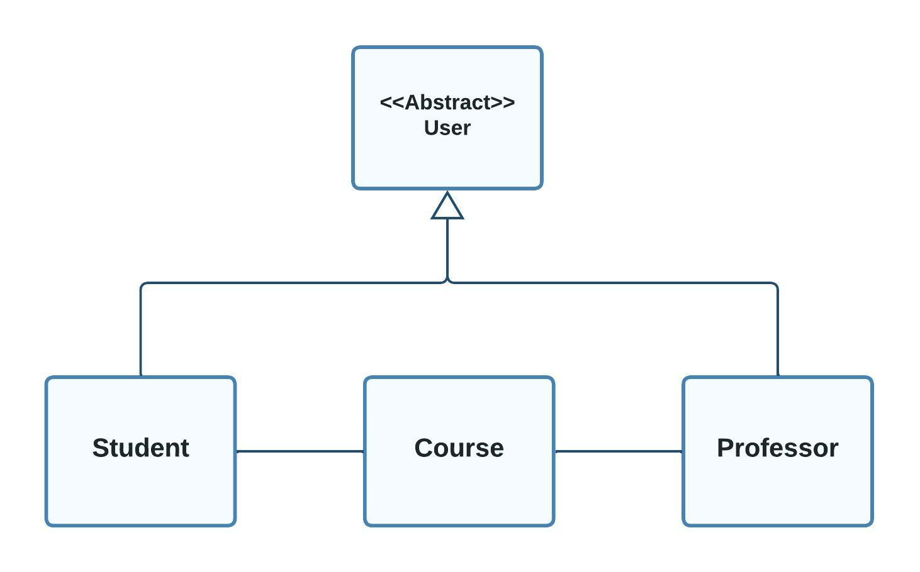

Slide 3
What this program do
The program helps Professors & Student to automat all University tasks
Manage courses | ADD | Delete
Update courses | Update courses for both Professors and students
Help professor to manage student courses | Show all students activities
Help students to sign in courses And register | signin and register courses
Connect professors and students | Can control all students make and direct them
Editable system | System flexible

Slide 4
Table of Classes
01
02
03
04
Profooser
Student
User
Course

Slide 5
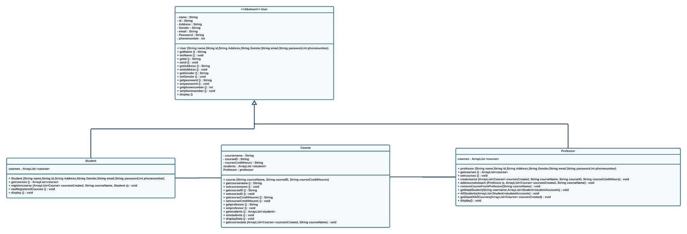

Slide 6
01
User
User class a class that have all professors and students attributes and all properties

Slide 7
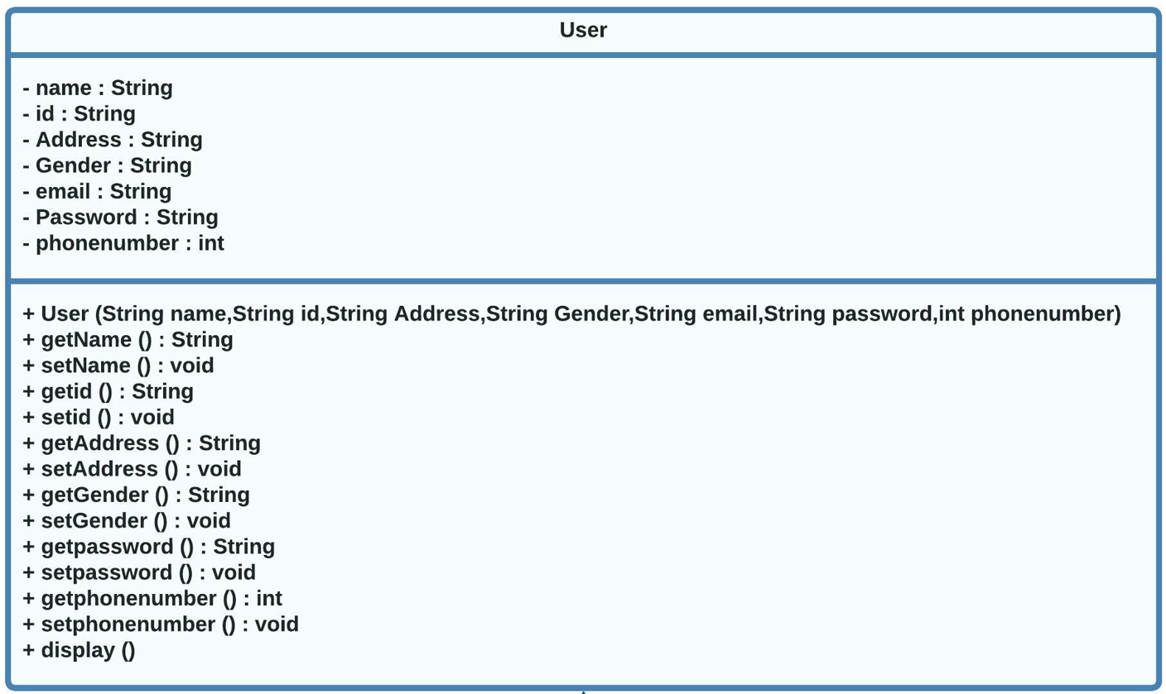
User

Slide 8

02
Student
Student class is a class that have all students options and properties that help them to use the program as easy as possible

Slide 9
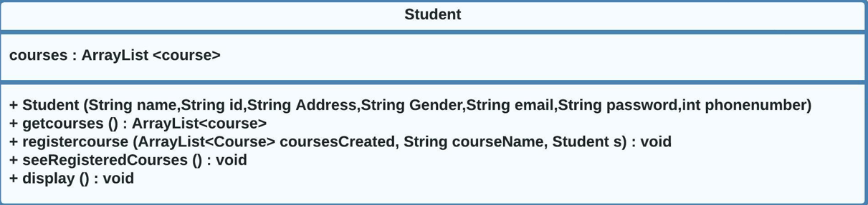

Slide 10
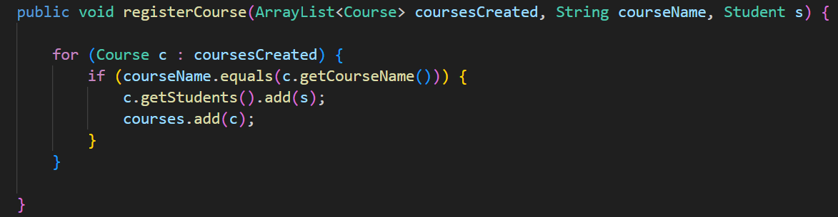
Register course

Slide 11
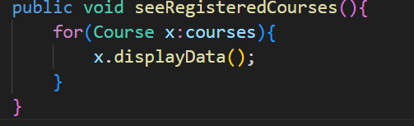
see Registered Courses

Slide 12
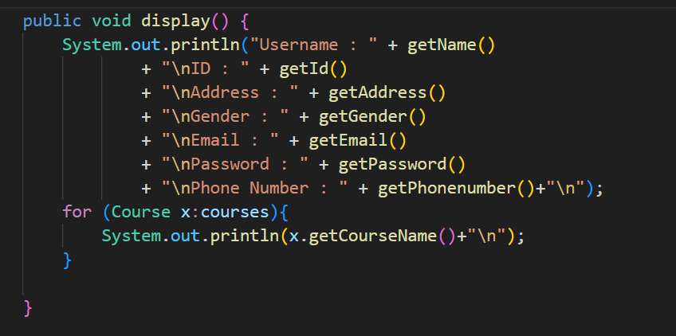
Display professor or student

Slide 13
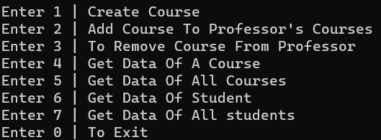
03
Professor
Professor class is a class that have all Professors options and properties that help them to use the program as easy as possible

Slide 14
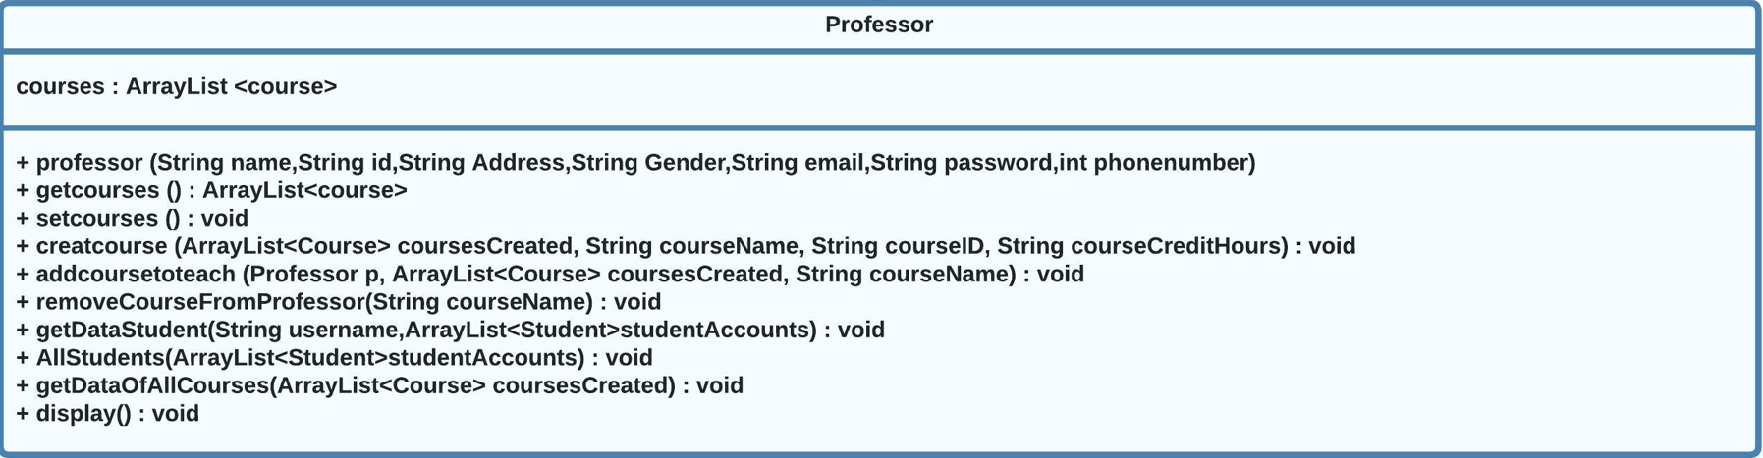

Slide 15
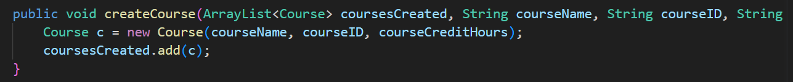
Create new course

Slide 16
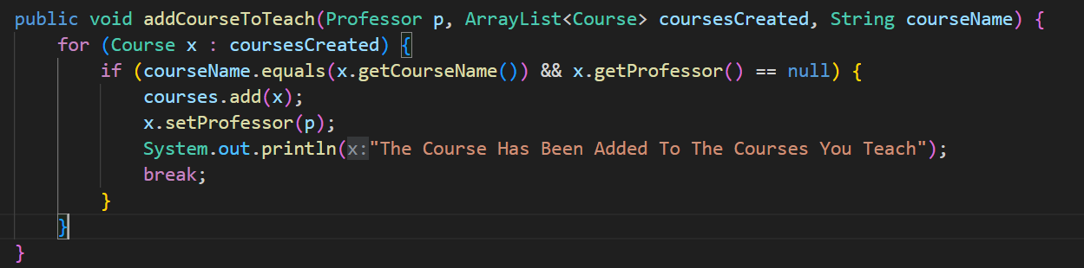
Add course to professor

Slide 17
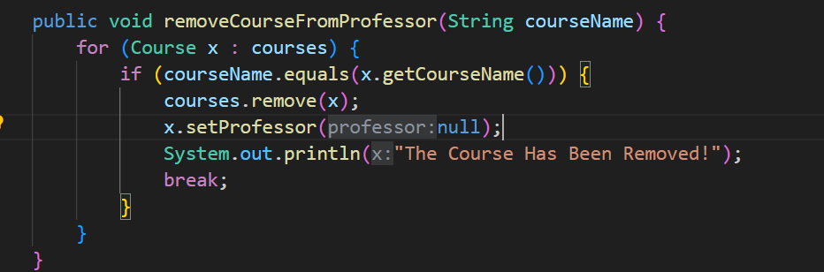
Remove course from professor

Slide 18
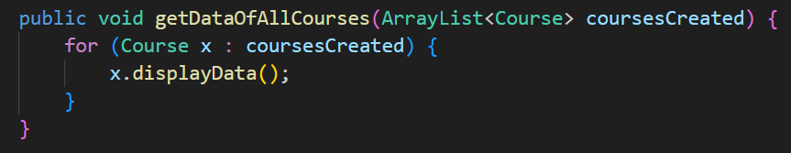
Get data of all courses

Slide 19
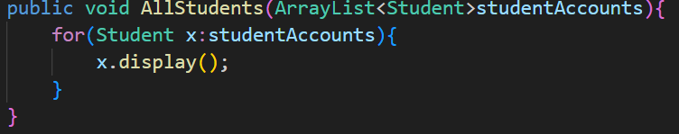
View all students courses

Slide 20
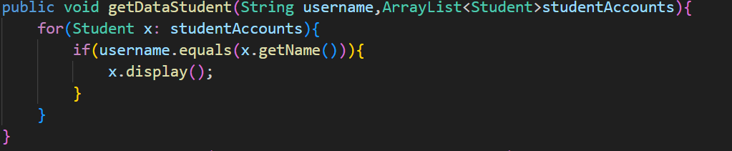
Get data of specific student

Slide 21
04
Course
A class have all courses functions and properties and control all courses from professors or students

Slide 22
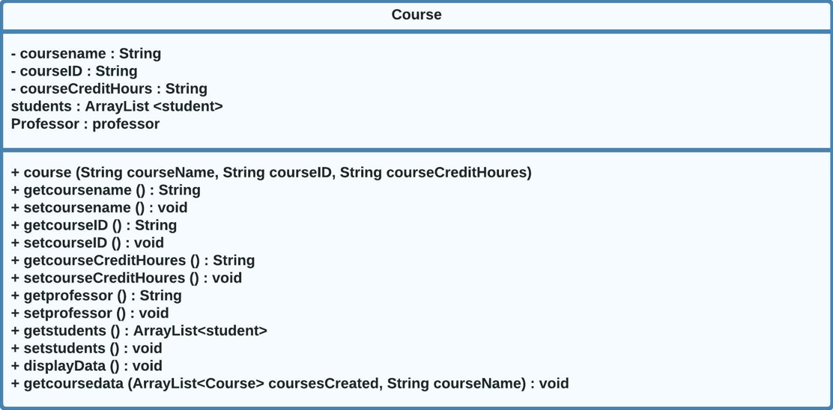

Slide 23
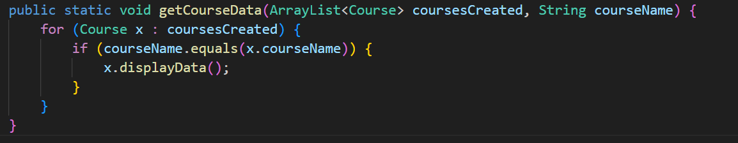
Get course data

Slide 25
Future Release
01
02
03
Three-step practical exercise for a computer workshop for beginners
Mouse handling
Web browsing
File management

Slide 26
Question and answer
What is your Questions
And What is your Feedback

Slide 27
Thanks!
Do you have any questions?
Please keep this slide for attribution

