Slide 1



Term Deposit Prediction
A Data-Driven Approach for Al-Vive Banking
This presentation outlines a machine learning solution that enables targeted marketing for term deposit subscriptions, significantly reducing customer acquisition costs while increasing success rates. We'll explore key customer insights, model development strategy, and actionable recommendations.
By Khee Ern

Slide 2



About Me
Wong Khee Ern
"A ship is safe in harbor, but that's not what ships are for.“
My journey so far…
Graduated in 2016 from NTU with:
Degree in Engineering Science (EEE)
Masters in Technology
Professional Experience:
2017: Electrical Engineer at Keppel
2018: Intrapreneur at Keppel
2019: Project Manager at Synapxe
2023: Algorithmic Trader at Grasshopper
2025: Budding ML Engineer (AIAP Applicant)
When I am not coding…
I'm an enthusiastic golfer, avid travel planner, home automation hobbyist, and beginner cook.
Party Story: Got chased by elephants in Khao Yai, Thailand. If I can survive charging elephants, no other problems are too big!
Why ML?
I'm passionate about solving business problems through technology and data-driven insights. ML represents the perfect intersection of systematic problem-solving, strategic thinking, and hands-on engineering.

Slide 3
Executive Summary
An ML-driven customer targeting solution can greatly drive down customer cost per acquisition.
65%
Fewer Calls Needed
With ML-driven targeting, the marketing team can make 65% fewer calls
2x
Success rate
The model doubles the conversion rate from 11.3% to 22.6%
7x
Increase in subscription likelihood
If previously contacted by marketing team
ML Model Performance Impact
Approach | Calls Made | Subscriptions | Success Rate | Resource Usage
Without Model | 40,000 (100%) | 4,510 | 11.3% | 100%
With Model | 14,000 (35%) | 3,157 | 22.6% | 35%
Difference | -26,000 calls | -1,353 subs | +11.3% | -65%

Slide 4
EDA - Methodology
I adopted a systematic and iterative approach to analyze the data for subsequent model performance improvements
Initial dataset exploration
Data overview: Explore shape, features, target variable and missing values
Techniques employed:
Mean, std dev, percentile etc.
Frequency distribution, cardinality
Missing values analysis
Outlier detection / visualization
Thorough analysis for
first model run
Univariate feature analysis and target correlation through statistics, visualizations and effect size assessment
Techniques employed:
Numerical features: Mann-Whitney U test, Cohen's D for statistical significance and effect size
Crosstab, Chi-square, Cramer's V for categorical variables
Data deep dive to improve model performance
Bivariate/multivariate analysis and target correlation to detect multicollinearity and gather insights for feature engineering
Techniques employed:
3D heatmaps for correlation
Feature engineering with domain knowledge
Feature importances

Slide 5




EDA – Key Data Insights
Data Challenges
Large class imbalance (only 10% subscribers)
Missing values in personal and housing loan categories
Highly imbalanced credit default data
Unknown values in multiple features
Temporal patterns for client ID
Pipeline design solutions
Implemented F2 scoring with recall emphasis
Used algorithms with built-in class imbalance handling
Stratified train-test split
Created binary features for missing financial data
Preserved unknown values in categorical features
Drop Client ID to preserve model integrity over predictive power improvement
Actionable Data Insights
Previous campaign contact increases subscription likelihood by 7x
Optimal recontact window within 14 days of previous contact
Diminishing returns with repeated contacts
Students <30 and retirees >60 are high value segments
Cellular outperforms traditional telephone
Weak predictors: Education, marital status; financial data needs improvement

Slide 6



EDA – Business Insights and data improvements
Actionable Business Intelligence Today, Enhanced Insights Tomorrow
Business Insights
High class imbalance signifies low campaign efficiency, indicating need to understand why conversion rates are historically low.
Prioritize gathering financial and credit history as they are likely to be significant predictors of subscription behavior.
Reduce resources on multiple calls and keep hot leads hot with quick follow-up.
Marketing needs active follow-up lists and should continue nurturing even failed conversions in previous campaigns
Campaign strategy should target younger and older clients while investigating why middle-aged customers have low subscription rates
Enhanced Data sources
Quick wins
Fill gaps in financial data through internal systems integration or credit agencies.
Campaign History data
Previous campaign outcome, Contact day and time
Macroeconomic data
Interest rates, treasury bills, inflation data
Comprehensive enhancements
Temporal features
Bonus seasons, holidays, campaign duration
Customer profiling
Account tenure, lifetime value, spending habits, multi-channel engagements
1
2
3
4
5

Slide 7
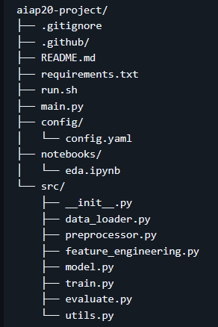
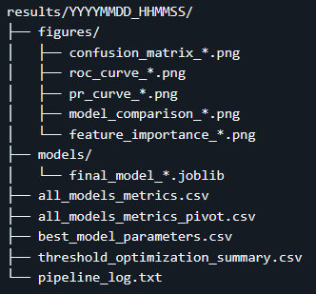
ML Pipeline Architecture
The pipeline was designed with modularity and reproducibility as key principles, enabling rapid iteration while maintaining good code quality standards.
Directory Structure
Key Components and Execution Flow
Utilities: Enable easy debugging and directory management to save logs and results
Configuration Management: Enable configurability to facilitate easy experimentation.
Preprocessing: Ensure data quality and prevent data leakages
Feature Engineering: For advanced feature interactions.
Sklearn pipeline creation: Dynamic feature preprocessing treatment based on selected features, and automated preprocessing pipeline construction based on selected models.
Model Training: Implementation of nested cross-validation for unbiased selection of optimal hyperparameters and train model on it.
Evaluation: Allow ease of evaluation with proper recording and visualization techniques
Results Directory

Slide 8
Engineered Features
Engineered features were created based on a mixture of domain knowledge and effect sizes
✨ Feature Name | 🎯 Key Purpose | 🧩 Input Components
F2-Optimized Ultimate Profile | Create tiered approach capturing 85-99% of positives with conversion rates from 5-90% | Any previous contact + age 50+ OR professional education
Age_Weighted_Engagement | Maximize capture of high-converting age groups | Age Group + Previous Contact + Engagement Depth
Engagement_Depth_Score | Capture nuanced engagement history beyond binary Yes/No | Previous Contact + Contact Frequency + Last Response
Senior_Priority_Index | Aggressive inclusion of 60+ prospects | Age Group + Any Positive Signal + Contact Method
Permissive_Campaign_Score | Allow more attempts before giving up | Campaign Calls + Previous Contact + Age
Age_Multiplier_Score | Weight older prospects more heavily | Age + Previous Contact + Credit + Education

Slide 9
Model Selection
🤖 Model | ✅ Pros | ⚠️ Cons | 🔧 Mitigation measures
Logistic Regression | High interpretability Well-calibrated probabilities Fast training and inference Reliable baseline | Not as effective in handling imbalanced datasets | Use comprehensive GridSearchCV to create good baseline for evaluation of other models
Balanced Random Forest | Undersamples majority class during tree creation Captures non-linear patterns Handles mixed data types Provides feature importance Robust to outliers | Computationally expensive, longest training time. May limit bank's ability to extend outreach to many potential clients | Reduce number of estimators Implement parallel processing (n_jobs) Use feature selection to reduce dimensionality
XGBoost | Built-in regularization prevents overfitting Gradient boosting corrects previous errors | Requires careful parameter tuning to optimize performance and prevent overfitting | Grid search with cross-validation Early stopping Conservative learning rate Monitor validation metrics
Final ensemble | Combines strengths of multiple model Reduces overfitting risk Improves stability Soft voting for probability calibration | Dynamic model selection means that different pipeline runs might results in different ensembles, making reproducing results challenging | Use multiple evaluation metrics when selecting models. Implement diversity constraints to ensure different model types are included. Create a fixed random seed for selection process to ensure reproducibility. Track and version ensemble components for each production deployment.

Slide 10
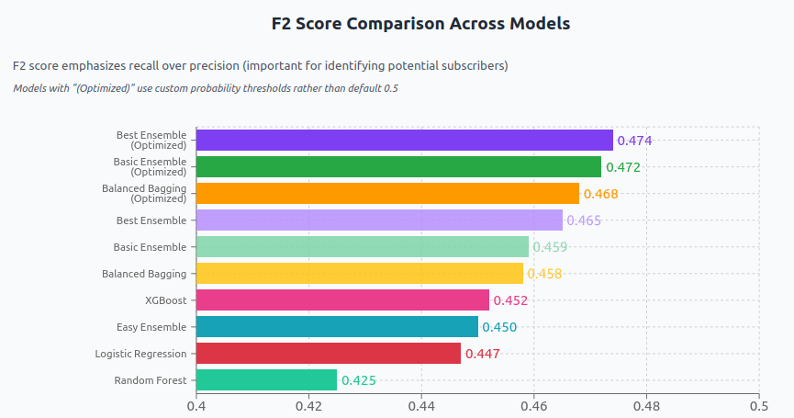
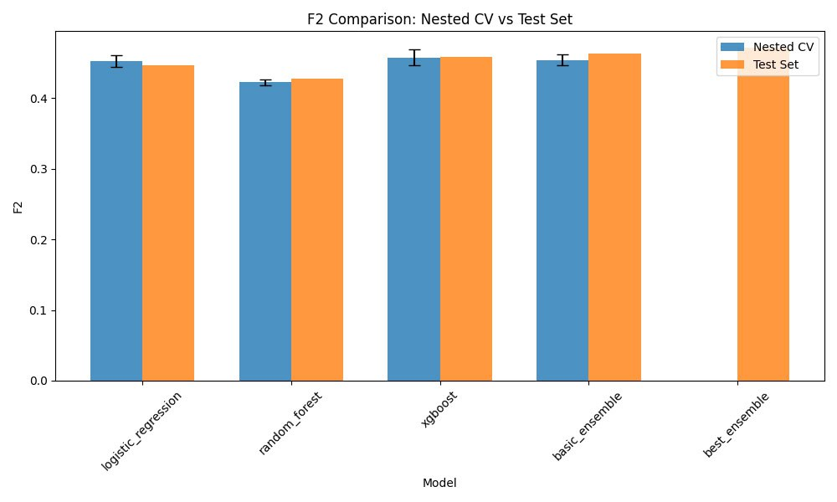
Model Prediction Performance
It is more important to identify as many potential customers as possible (high recall) even if it means including some customers who ultimately won't subscribe (lower precision).
Best ensemble (optimized)
High Recall 0.82
Identifies 4 out of 5 potential term deposit subscribers for marketing team to contact
Lower Precision 0.18
Trade-off: ~1 in 5 chance that identified potential customers will convert to subscribers
Models are generalizing well from cross-validation to the test set, with small and acceptable variance.
A F2-score of 0.42-0.48 shows medium bias, which is still acceptable given class imbalanced data.

Slide 11
Future Model Improvements
Enhanced Data Sources
Fill gaps in financial data through internal systems integration or credit agencies. Incorporate interest rates, treasury bills, bonus seasons, previous campaign outcomes, and customer spending habits for more precise targeting.
Better Feature Engineering
More systematic, iterative approach to improve model predictive performance through feature engineering and selection
Log to keep track of engineered features
Use permutation importance and SHAP to understand why and how
Make keep/discard decision based on performance + interpretability with backward selection
More Rigorous Coding
Improve on coding best practices to ensure code readability, easier maintenance and upgrade, and improved performance.
Write preprocessing validation tests to ensure data quality and check for leakages
Business Metric Optimization
Shift from statistical to profit-based metrics, optimizing for term deposit value, campaign costs, and lifetime customer value rather than pure classification performance.

