Slide 1

Term Deposit Prediction
A Data-Driven Approach for Al-Vive Banking
AIAP® Batch 20 Applicant | Wong Khee Ern
01
About
Me
02
Executive
Summary
03
Key Data
Insights
04
Data Enhancements
05
Model Performance
06
Business Impact
07
Feature Importance
08
Future Improvements

Slide 2
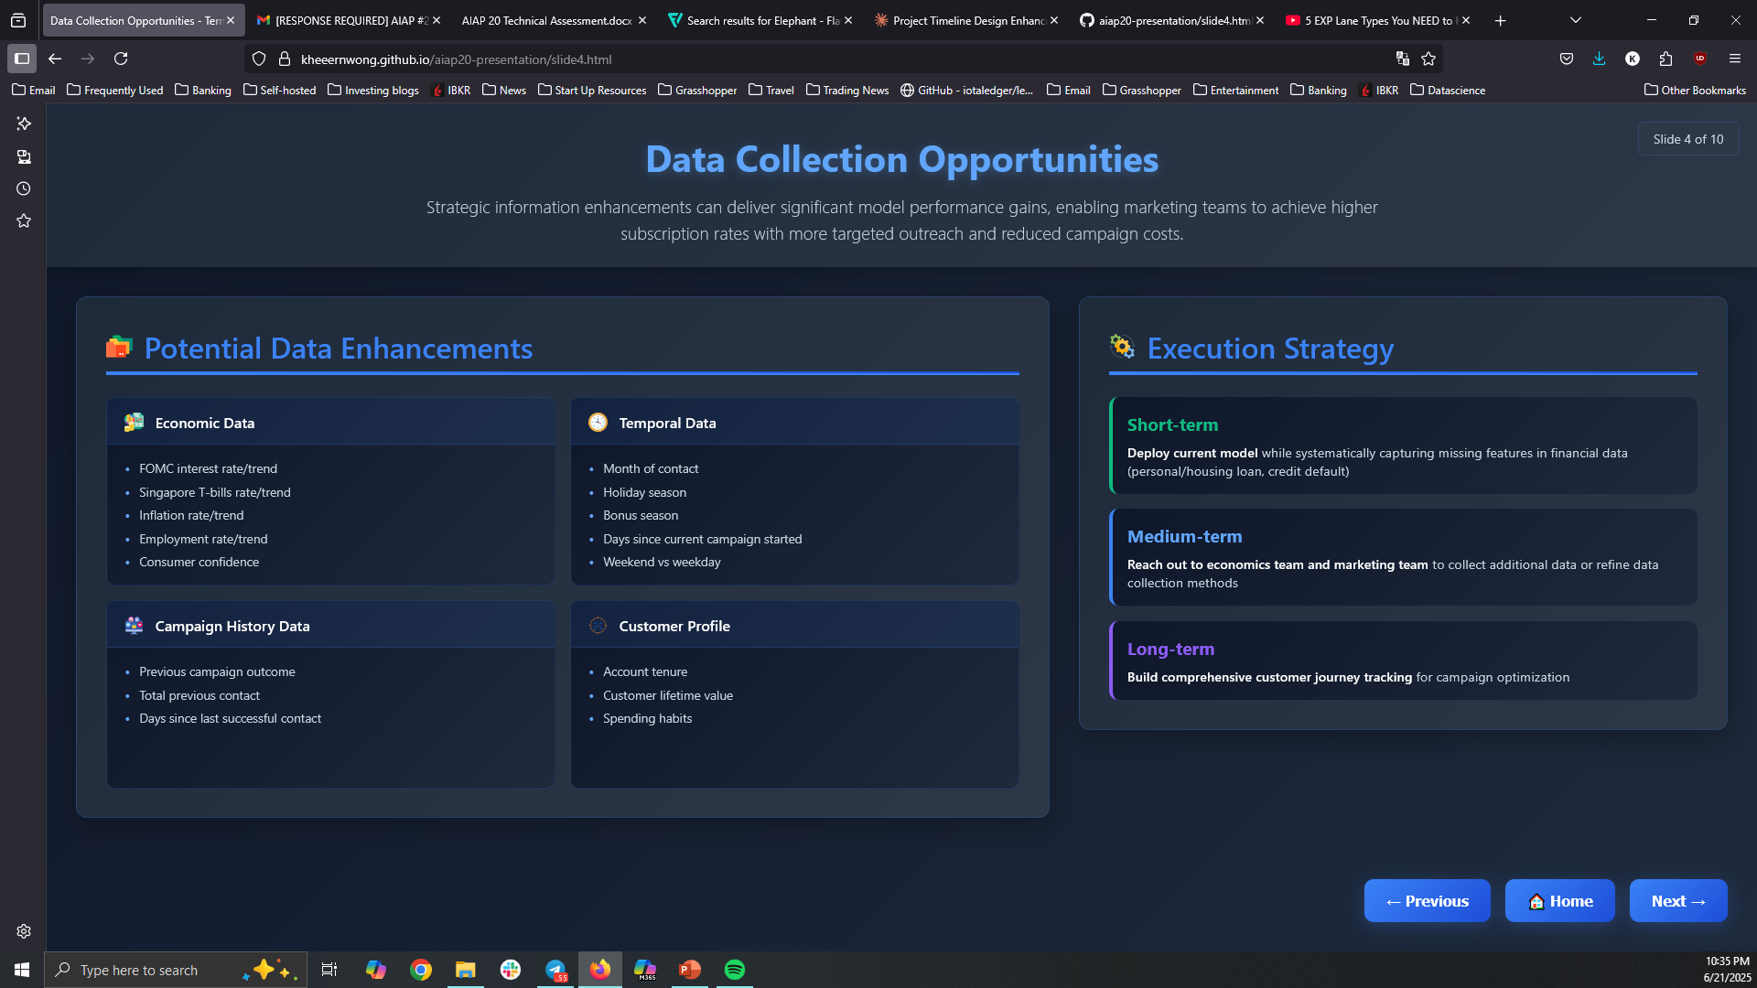












Wong Khee Ern
“A ship is safe in harbor, but that's not what ships are for.”
My journey so far…
When I am not coding…
Graduated in 2016 from NTU with:
Degree in Engineering Science (EEE)
Masters in Technology
Enthusiastic golfer
Avid Travel Planner
Home Automation
Hobbyist
Beginner Cook
Funny Story
Got chased by elephants in Khao Yai, Thailand. If I can survive charging elephants, no other problems are too big
2017
Electrical
Engineer
Keppel
2018
Intrapreneur
Keppel
2019
Project
Manager
Synapxe
2023
Algorithmic
Trader
Grasshopper
2025
Budding ML
Engineer
AIAP Applicant
Why ML?
I'm passionate about solving business problems through technology and data-driven insights. ML represents the perfect intersection of systematic problem-solving, strategic thinking, and hands-on engineering.
What to expect in this presentation?
We'll dive deep into data insights and architecture solutions while maintaining strategic business perspective. We will also explore future model enhancements along with a practical execution strategy.

Slide 3
Executive Summary
An ML-driven customer targeting solution can greatly drive down customer cost per acquisition.
Key EDA insights shows high potential subscribers for quick wins.
Key Takeaways
Key Insights
Significant reduction in cost per acquisition with ML-driven customer targeting. The model essentially allows marketing team to make 65% lesser calls with double the success rate.
  Quick Actionable Insights on EDA
  Previous campaign contact increases subscription likelihood by 7x
  Optimal recontact window within 14 days of previous contact
  Contact frequency: Diminishing returns with repeated contacts
  High-value segments: Students <30 and retirees >60
  Channel preference: Cellular outperforms traditional telephone
  Weak predictors: Education, marital status; financial data needs improvement
ML Model Performance Impact
Approach | Calls Made | Subscriptions | Success Rate | Resource Usage
Without Model | 40000 (100%) | 4510 | 11.3% | 100%
With Model | 14,000 (35%) | 3,157 | 22.6% | 35%
Difference | -26,000 calls | -1353 subs | +11.3% | -65%
  Key Modeling Decisions
  Designed to handle large class imbalance (only 10% subscribers)
    F2-scoring focuses on performance of minority subscribers with an emphasis on identifying as much potential customers as possible
    Use of models that have in-built class imbalance handling
    Stratify train-test split
  Client ID presented our most significant modeling decision: choosing model integrity over apparent predictive power
This can free up resources for marketing team to
Further customize marketing campaigns to different customer profiles
Explore different channels of engagement (e.g., social media, mobile apps, branch)
Improve on client financial data collection
Future Enhancements to improve model performance
Fill in missing financial data
Financial data should have a high correlation with subscription rates which can be obtained from internal teams or credit agencies
Enhanced Data Sources
These data have strong impact on subscriber rates
Interest rates, short term treasury bills, bonus seasons, previous campaign outcomes, customer spending habits
Metrics Optimization
Shift from statistical to profit-based metrics, optimizing for term deposit value and campaign costs

Slide 4
ML Pipeline Architecture
ML pipeline was designed with rapid experimentation, easy debugging and comprehensive evaluation in mind
Core Capabilities
Configuration-driven architecture for rapid experimentation
Nested CV with multi-seed validation for robust, unbiased evaluation
Automated feature engineering with intelligent preprocessing
Multi-algorithm support including ensemble methods
Production Features
Comprehensive logging and monitoring
Automated threshold optimization
Comprehensive visualization suite for stakeholder reporting
Single file orchestrator
Setup
Configuration, logging, and
environment initialization
📋 Configuration
YAML-based configuration management
📁 Directory Management
Automated results, models, and figures directories
Timestamped run organization
📝 Logging System
• Comprehensive logging to file and console
Data Preprocessing
Loading, cleaning, and feature engineering pipeline
📥 Data Loading
SQLite database connection with automatic download
🧹 Data Cleaning
Outliers, negative values, missing data handling
⚙️ Feature Engineering
Suffix-based features: _cat, _bin, _num
Model Development
Algorithm selection, tuning, and
cross-validation
🏭 Model Factory
Automatic feature type detection and preprocessing for pipeline transformers
🎯 Algorithms
Logistic Regression, Random Forest, XGBoost
Ensemble methods with soft voting
🔄 Nested Cross-Validation with GridSearchCV
Evaluation
Performance metrics, model
comparison, and deployment
📊 Performance Metrics
• F2 Score (optimized for recall), MCC
• Average Precision Recall Cruve
🔍 Model Selection
• CV vs Test performance comparison
• Threshold optimization for F2 score
💾 Output Generation
• Serialized models, evaluation reports
• Performance visualizations, feature analysis

Slide 5
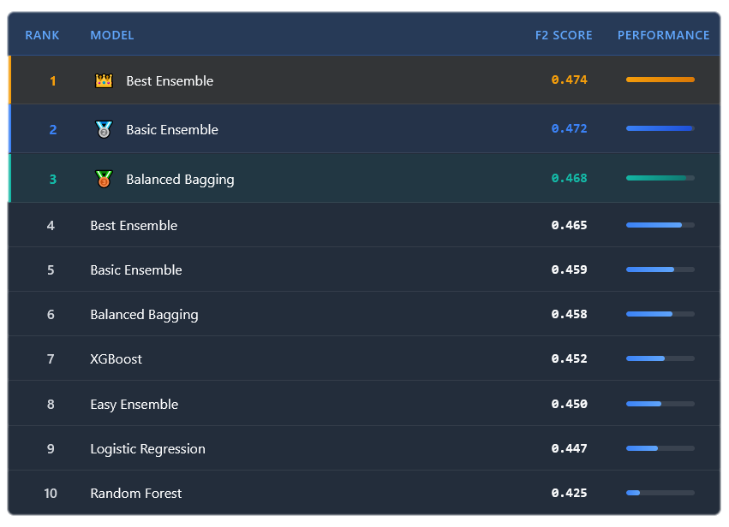

Model Performance
Best Ensemble Model shows acceptable performance, the target is to hit F2-Score 0.8, and get higher precision scores.
Model Performance (F2-score)
Performance Analysis
0.474
F2 Score (Primary Metric)
Prioritizes recall over precision - optimal threshold at 0.46 brings
meaningful improvement for identifying potential subscribers
High Recall 0.82
Identifies 4 out of 5 potential term deposit subscribers for marketing team to contact
Lower Precision 0.18
Trade-off: Only 1 out of 5 chance that identified potential customers will convert to subscribers
MCC 0.21
Shows genuine predictive power beyond random chance - reasonable performance considering dataset's class imbalance and missing data
F1 Score 0.29
Balanced precision-recall metric confirms model's solid overall performance despite missing financial data

Slide 6

Model Enhancement Roadmap
A phased approach to systematically improve model performance with actionable steps.
Strategic Implementation Timeline
Short Term (0-3 months)
Medium-term (3-12 months)
Long-term (12+ months)
Strategy
Deploy current model (MLOps)
Systematically capture “low-hanging” data with the help of marketing team.
Strategy
Reach out to economics team and to collect additional data
Optimize model architecture to cope with larger amounts of data
Strategy
Build comprehensive customer journey tracking for campaign optimization and advanced predictive analytics
Cross functional team collaborations (DevOps, DataOps, MLOps, Security)
Priority Data Collection
Enhanced Data Sources
Missing Financial Data
Personal loan • housing loan • credit default
Additional Temporal Features
Holiday seasons • Bonus periods • Campaign duration
Advanced customer analytics
Macroeconomic data
FOMC rates • Singapore T-bills • Inflation • Employment • Consumer confidence
In-depth Customer Profiling
Account tenure • Customer lifetime value • Spending habits • Multi-channel engagements
Campaign History
Previous outcomes Success • Contact day and time

