Slide 1
نبض
Nabz
نبض
Urdu-first, voice-first AI health triage
Powered by Alibaba Qwen · Built for 240 million Pakistanis
Alibaba Cloud AI Hackathon Pakistan 2026
Submissions close 4 September 2026 · Team Nabz
Notes:
Opening line: Nabz means "pulse" in Urdu. In the next ten minutes I will show you why an Urdu-first, voice-first health triage is the only kind that reaches 240 million Pakistanis — and why Alibaba Qwen is the only stack that makes it possible.

Slide 2
02 · THE PROBLEM
A country of 240 million cannot triage in English.
1 : 1,300
~90
~40%
~120 M
Doctor-to-patient ratio, Pakistan
Mental-health professionals for 240 M people (WHO)
Adult literacy in written English
Smartphones — mostly low-cost Android
English-only, keyboard-first health AI misses the caregiver in the kitchen, the labourer at 11pm, the college student in crisis at 3am — every real user.
①
Primary earner
②
Night-shift caregiver
③
Student in crisis
Won't queue at a clinic for a day of wages.
Woman triaging fever in a child at 11pm.
Mental-health emergency at 3am, no one to call.
Nabz · Alibaba Cloud AI Hackathon 2026
1 / 16
Notes:
All three personas are voice-native and two of three have limited written English. All three own phones. Voice + Urdu is not a nice-to-have — it is the only path to the user.

Slide 3
03 · THE SOLUTION
Speak your symptoms. Nabz talks back — in your language.
1
Tap and speak
10:12 Nabz ●●●●● 89%
Urdu, Roman Urdu, English, or any mix — one voice note.
آج آپ کی طبیعت کیسی ہے؟
2
Get a structured triage
Tell me how you're feeling — I'm here to help.
Likely cause · red flags · urgency · concrete next steps.
3
Hear it read back
🎙
Urdu voice narration — no reading, no typing needed.
4
Escalate or hand off
1122 for emergency · doctor-handoff link with one tap.
بولیے
مجھے بخار اور سر درد ہے
کھانسی اور گلے میں درد
پیٹ میں درد ہو رہا ہے
Nabz · Alibaba Cloud AI Hackathon 2026
2 / 16
Notes:
Zero-typing path works end to end. The screen on the right is the actual guest chat page from Nabz v2.3.0 — this is not a mockup.

Slide 4
04 · WHY NABZ, WHY NOW
Qwen changed what a health assistant for Pakistan can hear.
Before Qwen
With Qwen (Nabz)
English only — patient translates in their head
Qwen3.7-plus reads Urdu, Roman Urdu, English natively
Meaning lost, red flags missed
No MT hop, no meaning loss
Keyboard-first UI
Voice-first via Qwen3.5-Omni STT + TTS
Excludes low-literate and elderly users
Zero-typing path, works for everyone
MT hop (Urdu → English → LLM → English → Urdu)
One-shot: audio-in, structured triage-out
Latency + hallucinations at each step
Sub-second UX; under one cent per turn
Single provider = single point of failure
OpenAI as budget-capped fallback
One quota blip takes the demo down
Two providers, one demo that never dies
Nabz · Alibaba Cloud AI Hackathon 2026
3 / 16
Notes:
Explain that Qwen3.5-Omni is not just "another STT" — it is the first model that handles the mixed Urdu/English code-switching real Pakistanis actually use.

Slide 5
05 · PRODUCT OVERVIEW
One product, three user modes — all built.
Capability
Guest
Registered
Doctor
Voice + text triage (Urdu/English)
●
●
● view
Emergency (1122) escalation
●
●
—
Mental-health first-response
●
●
● view
Prescription / lab-report OCR
●
●
●
DailyMed drug-label lookup
●
●
●
Nearby hospital / pharmacy
●
●
—
TTS Urdu read-out
●
●
●
Persistent history
session
●
one session
Family Vault — multi-profile
—
●
—
AI budget cap
$0.30/guest
$0.50/account
inherited
Every ● in this table is shipped in v2.3.0 — the APK and the live Render backend.
Nabz · Alibaba Cloud AI Hackathon 2026
4 / 16
Notes:
Family Vault is the differentiator vs. every consumer health chatbot. One account, many profiles — spouse, child, parent — each with isolated history.

Slide 6
06 · LIVE DEMO
What we'll show in ninety seconds.
0:00
Open app on phone
Nabz launcher · APK v2.3.0 · icon = Nabz pulse mark
0:10
Speak Urdu symptom
"مجھے بخار اور سر درد ہے" — one voice tap
0:25
Watch triage render
Symptoms · red flags · urgency · plan · citations — bilingual
0:45
Hit TTS
Qwen Urdu voice reads the plan back — hands-free
1:00
Trigger emergency phrase
Deterministic detector fires 1122 banner BEFORE the LLM
1:20
Switch family profile
Same session, isolated child profile — no history bleed
Nabz · Alibaba Cloud AI Hackathon 2026
5 / 16
Notes:
Do not skip the emergency-detector step. It is the single strongest safety story we have.

Slide 7
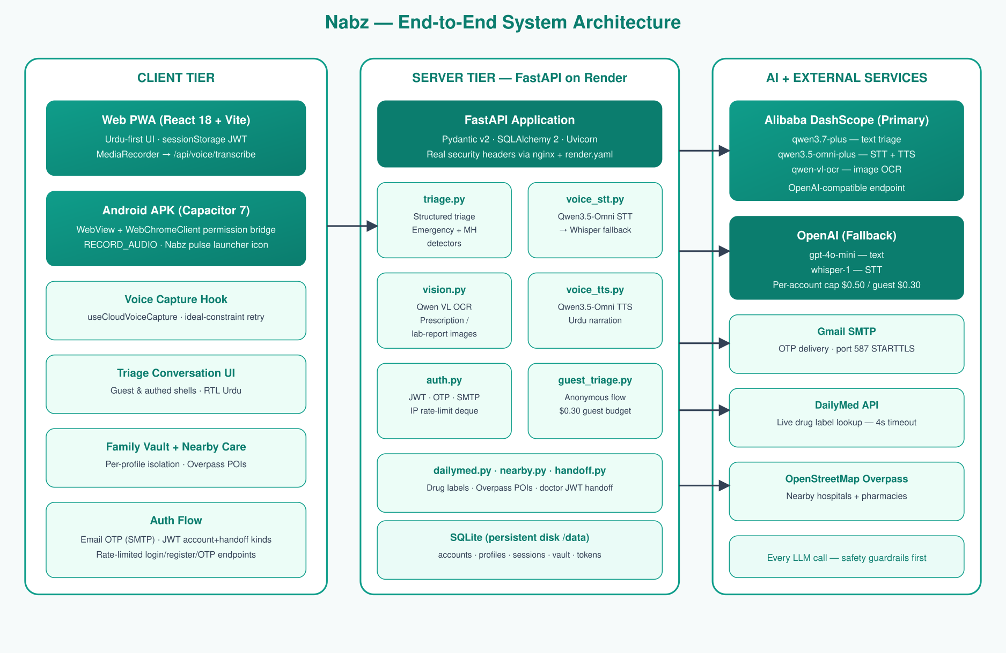
07 · SYSTEM ARCHITECTURE
Three tiers. Two providers. One code path.
Nabz · Alibaba Cloud AI Hackathon 2026
6 / 16
Notes:
Highlight: client tier ships as both PWA and Capacitor APK from the same React bundle. Server tier is FastAPI + SQLite on Render — one persistent-disk service. AI tier: Qwen primary, OpenAI fallback, Overpass + DailyMed as third-party enrichment.

Slide 8
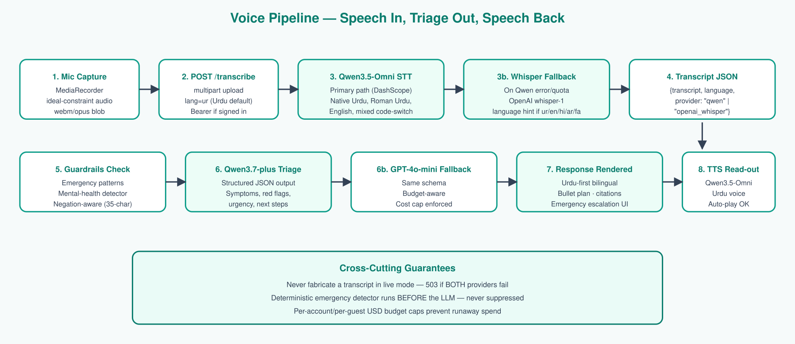
08 · VOICE PIPELINE
Speech in, structured triage out, speech back.
Never fabricate
Emergency first
Budget capped
Both STT providers dead → 503, never a made-up transcript
Deterministic detector runs BEFORE the LLM
Per-account $0.50 / per-guest $0.30 — server-enforced
Nabz · Alibaba Cloud AI Hackathon 2026
7 / 16
Notes:
The Whisper fallback saved us during pre-demo when the Qwen free-tier STT quota exhausted. Provider is returned in the response so we can see which path served each request.

Slide 9
09 · TECHNOLOGY STACK
Every choice is boring — on purpose.
◆
Frontend
■
Backend
• React 18 + Vite 6
• FastAPI + Pydantic v2
• Capacitor 7 (APK)
• SQLAlchemy 2 + SQLite
• MediaRecorder API
• PyJWT (two token kinds)
• Session-scoped JWT
• IP-deque rate limit
●
AI Models
▲
Ops & Infra
• Qwen3.7-plus (text)
• Render (web + api + disk)
• Qwen3.5-Omni-plus (STT/TTS)
• Gmail SMTP for OTP
• Qwen-VL / qwen-vl-ocr
• DailyMed (drugs) · Overpass (POIs)
• gpt-4o-mini + whisper-1 fallback
• Real CSP via nginx + render.yaml
Nabz · Alibaba Cloud AI Hackathon 2026
8 / 16
Notes:
Boring on purpose. No exotic databases, no custom framework. Judges love this because it means we spent our time on the product, not on plumbing.

Slide 10
10 · AI LAYER & COST
Under one US cent per triage. Capped, not estimated.
Role
Primary
Fallback
Cost lever
Text triage
qwen3.7-plus
gpt-4o-mini
≤ NABZ_AI_MAX_OUTPUT_TOKENS
Speech-to-text
qwen3.5-omni-plus
whisper-1
≤ 15 MB audio, ~2 min
Text-to-speech
qwen3.5-omni-plus
— (silent skip)
Skipped if user muted
Image OCR
qwen3.7-plus (VL)
qwen-vl-ocr
45s timeout
$0.50
$0.30
Hard USD cap · per registered account · server-enforced
Per anonymous guest session · no login required
Nabz · Alibaba Cloud AI Hackathon 2026
9 / 16
Notes:
The client cannot raise these caps. Any request that would overshoot is served by the cheaper fallback or refused with a graceful message.

Slide 11
11 · SAFETY GUARDRAILS
Safety is in the code, not in a prompt.
Emergency detector
Fires when: Cardiac · stroke · obstetric · poisoning · trauma
Action: Return 1122 banner + safe text · SKIP the LLM
Mental-health (immediate)
Fires when: Suicidal / self-harm phrases · negation-aware (35-char window)
Action: Warm response + helpline · SKIP the LLM
Mental-health (distress)
Fires when: Softer distress cues
Action: Steer LLM prompt toward supportive tone
"میں خودکشی نہیں کروں گا" ← the negation window prevents this from firing.
Nabz · Alibaba Cloud AI Hackathon 2026
10 / 16
Notes:
These layers run BEFORE the LLM sees the text. Nothing a patient — or an attacker — can type will bypass them. That is the single strongest answer to any safety question a judge will ask.

Slide 12
12 · SECURITY
Twelve controls. All in production.
🔒
TLS everywhere
🛡
Real CSP header
🚫
X-Frame-Options: DENY
Render-managed cert · Capacitor cleartext:false
nginx + render.yaml (meta tag was inert)
Click-jacking prevention
🎛
Permissions-Policy
🔑
Two JWT kinds
⏱
Per-IP rate limit
geolocation, mic, camera restricted to self
account vs handoff · kind-checked server-side
429 auth_rate_limit on burst attempts
🔐
bcrypt passwords
📧
Hashed one-shot OTP
🗂
Per-profile isolation
Via passlib · Argon2id migration planned
Expires in minutes
Vault under per-profile dir · 403 on cross-read
🌐
CORS allow-list
💰
Server-side USD caps
🧠
Prompt-injection safe
No wildcard in prod
Client cannot raise them
Deterministic detectors first
Nabz · Alibaba Cloud AI Hackathon 2026
11 / 16
Notes:
If asked about credential rotation: all four secrets shared during pre-demo debugging (JWT, SMTP, OpenAI, DashScope) are on the post-demo rotation checklist.

Slide 13
13 · TRACTION
Not a slide-only prototype — a shipped product.
v2.3.0
4
11
Signed Android APK
APK release iterations
SQA cases passed
versionCode 5 · installed on Xiaomi & Realme test devices
v2.0 → v2.3 · each closed a real reported bug
Guest · registered · vault · nearby · TTS · zoom · dark-mode · rate-limit
6
2
~3s
Viewport widths verified
STT providers wired
OTP email round-trip
360 / 375 / 393 / 768 / 1440 / 1920 — zero horizontal scroll
Qwen primary · Whisper fallback · tested with primary killed
Gmail SMTP · verified end-to-end in production
Nabz · Alibaba Cloud AI Hackathon 2026
12 / 16
Notes:
Emphasise: every one of these numbers is verifiable — the APK is here, the Render URL is live, the git history shows the fixes.

Slide 14
14 · ROADMAP
Where Nabz goes after the hackathon.
Now — v2.3
Q4 2026
H1 2027
H2 2027+
Voice-first triage
WhatsApp OTP via Twilio Verify
Doctor panel — verified physicians
Regional expansion (Bangla, Pashto)
Family Vault
Postgres migration
Booking + telehealth handoff
Wearable + BP-cuff intake
Emergency + MH guardrails
Refresh-token rotation
Formal medical safety review
Insurance-partner API
APK + PWA
Redis-backed rate limit
iOS build via Capacitor
On-device Qwen for offline mode
Nabz · Alibaba Cloud AI Hackathon 2026
13 / 16
Notes:
If asked "what after the hackathon" — WhatsApp OTP is the single highest-leverage next step for Pakistan (SMS deliverability is unreliable, but WhatsApp is universal).

Slide 15
15 · WHAT WE NEED
To go from demo to district clinic.
Three concrete asks
①
Alibaba Cloud credits
Bootstrap a public pilot in one Karachi clinic — a few hundred users, six-week feedback loop.
②
Introductions to a Pakistani physician panel
Formal review of the safety-detector patterns — Urdu clinical vocabulary is nuanced.
③
A partner hospital
Wire the doctor-handoff into one real workflow so we can measure "time to triage → time to care".
Team
Kheem Parkash Dharmani · Machine Learning Engineer
dharmanikheem@gmail.com · +92 336 3182779
Full end-to-end build — architecture, model choice, safety layer, UI, APK, deployment.
Nabz · Alibaba Cloud AI Hackathon 2026
14 / 16
Notes:
Do not ask for money on this slide. Ask for what unlocks the pilot — credits, physicians, one hospital.

Slide 16
نبض
Thank you.
Nabz — a pulse of care, in the language patients actually speak.
Live:
https://nabz-web.onrender.com
API:
https://nabz-api.onrender.com
Questions?
Nabz · Alibaba Cloud AI Hackathon 2026
15 / 16
Notes:
Leave this slide on the screen for Q&A. Do NOT keep clicking — silence is fine.

