Slide 1

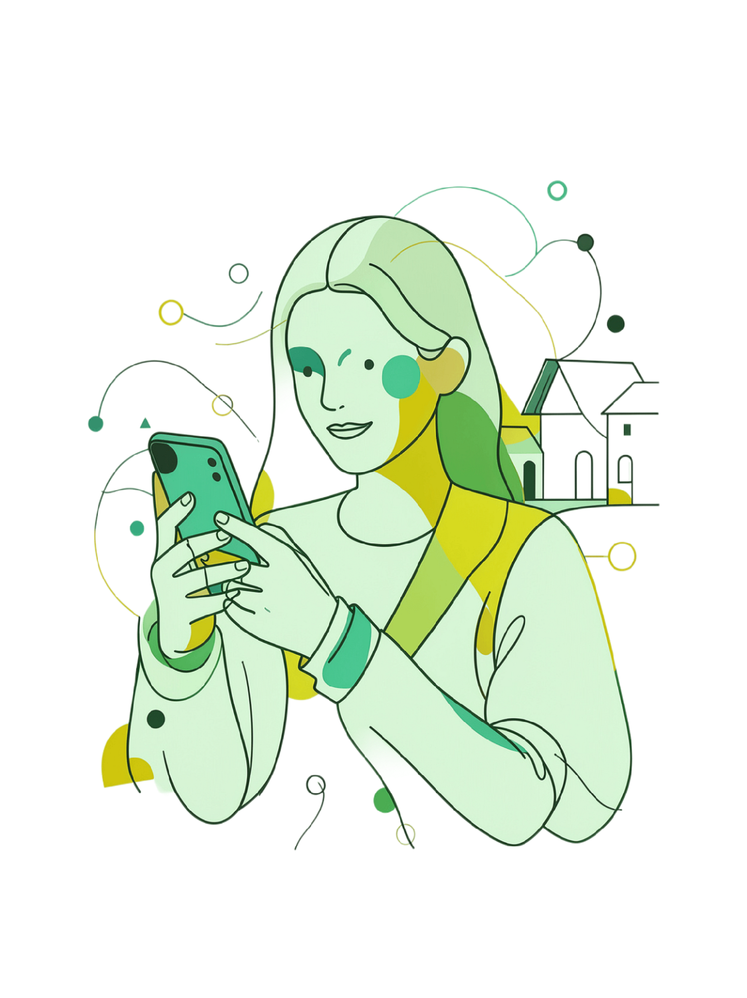
NabzAIنبض
Your voice, your health
آپ کی آواز، آپ کی صحت
Nabz is a voice-first, Urdu-first AI health companion.
Alibaba Cloud AI Hackathon Pakistan 2026

Slide 2
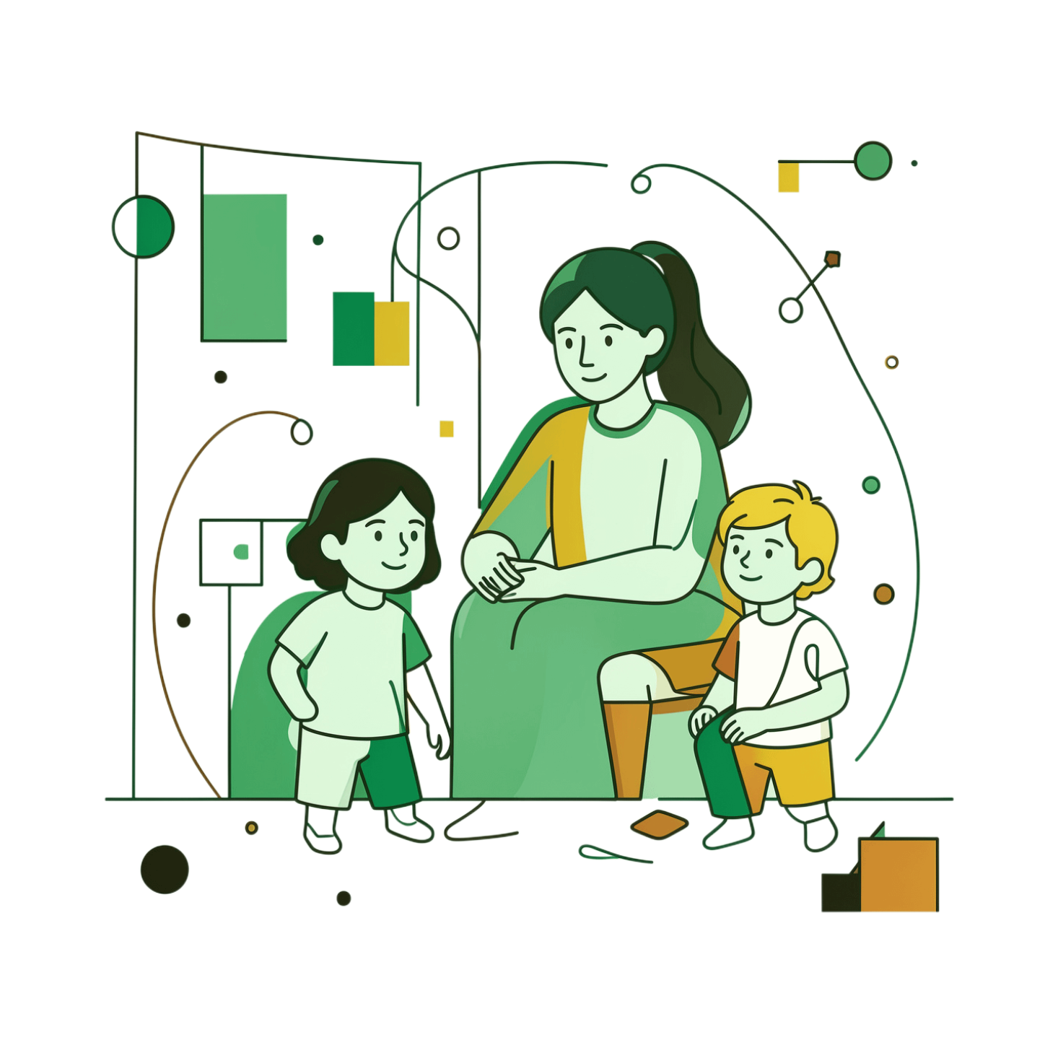

MEET OUR USER
Meet Amna
Amna, 35 — mother of 3 in rural Punjab. Speaks only Urdu and local Punjabi. No formal education. Cannot read English or navigate digital health apps.
"What if it's serious and I miss it? What if I waste money on a doctor for nothing?"
When her children fall ill, Amna waits 6+ hours to see a doctor 40km away or ignores symptoms and hopes they pass. She has been managing this for 15 years.
Amna represents 220 million Pakistanis — low-literacy, Urdu-speaking, locked out of digital health because every app assumes she reads English.

Slide 3
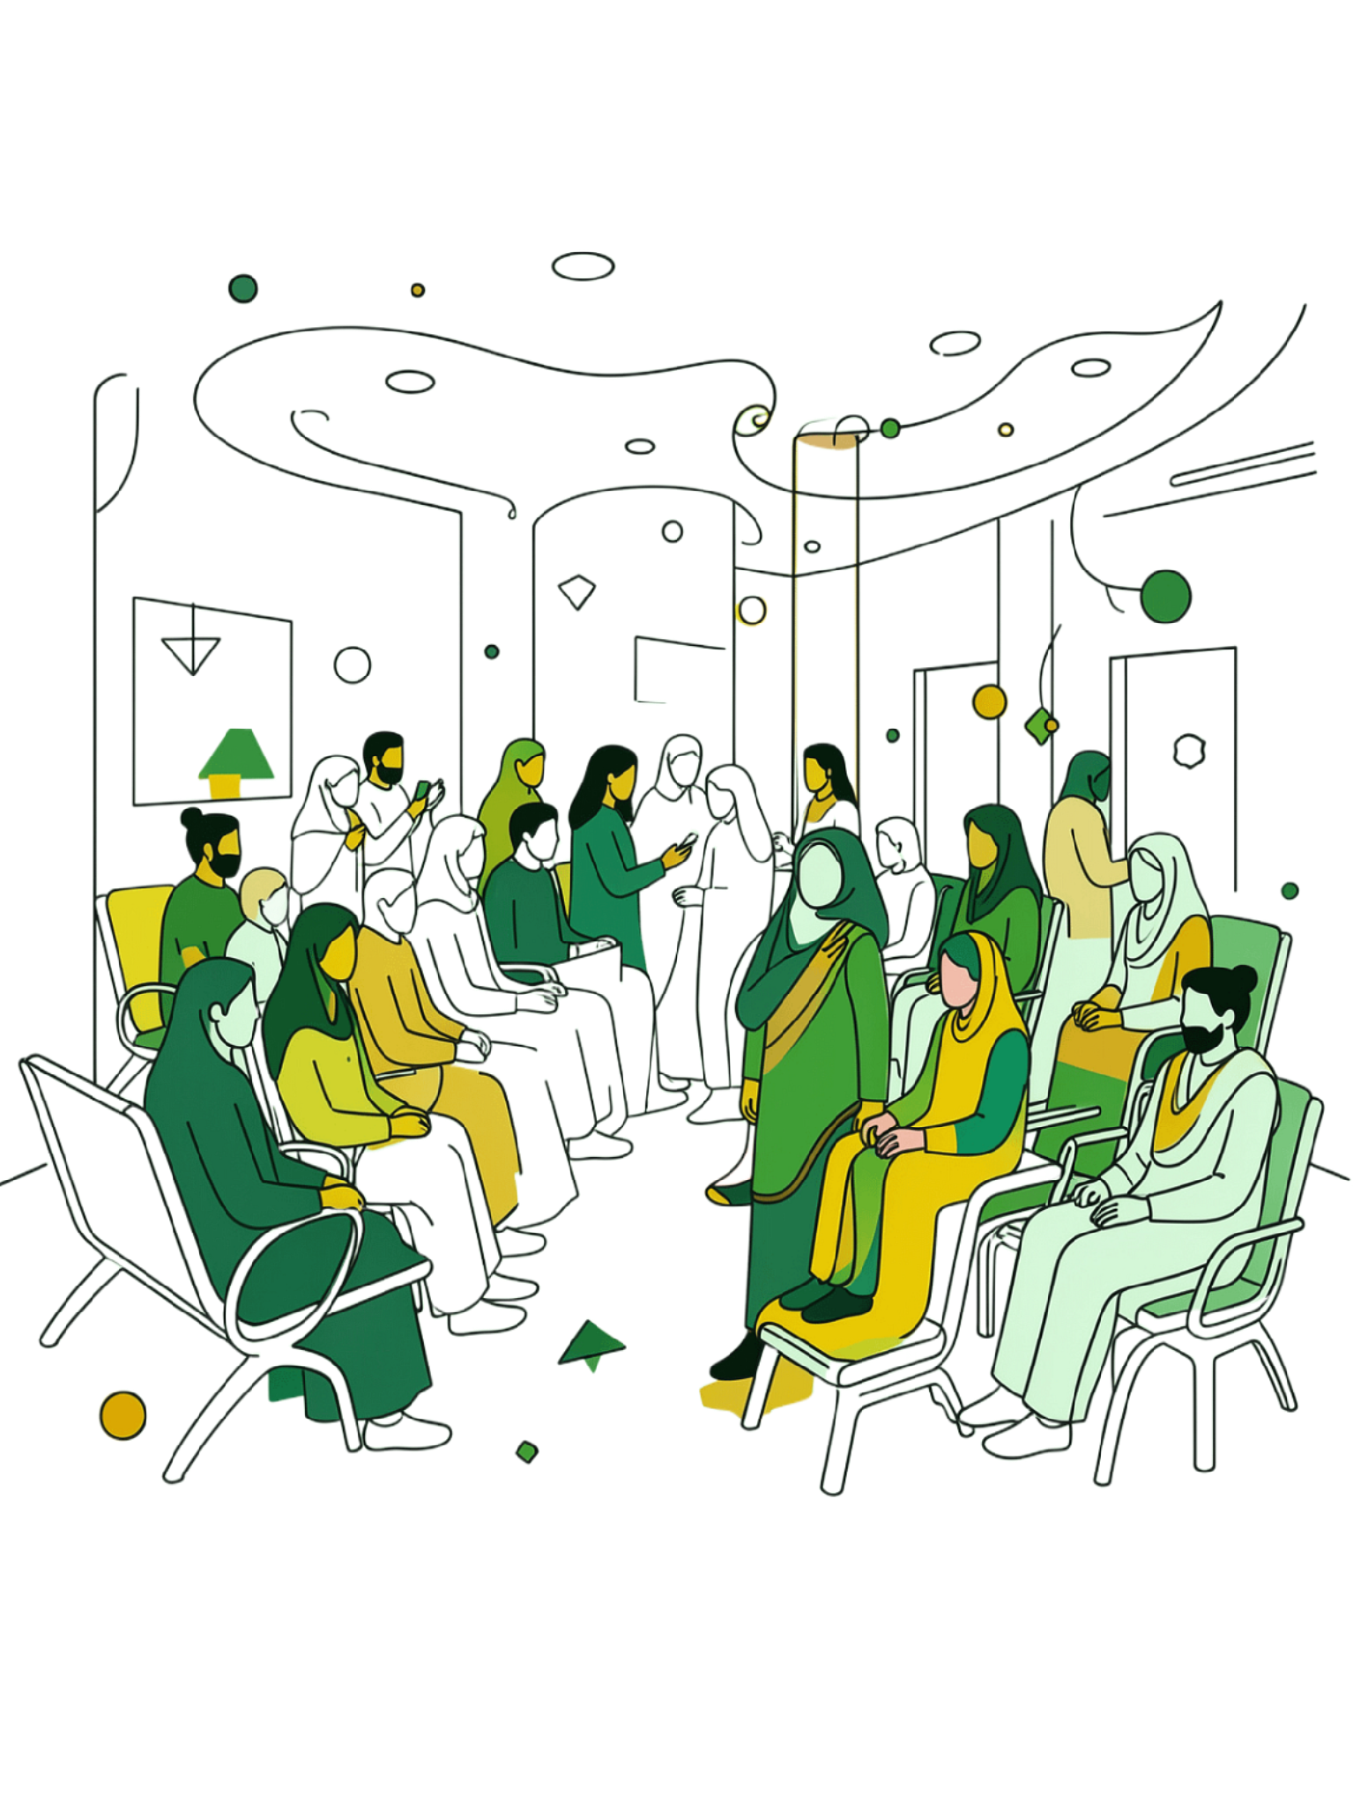
The Problem: Healthcare Access Crisis
1 Doctor per 1,000 People
Pakistan's ratio vs. 2.8 in India and 4.3 in the UK. Primary care is structurally out of reach.
Unreachable Care
₨500–2,000 per visit. 40+ km distance. 6+ hour waits. For millions, it simply isn't an option.
Dangerous Delay
Red-flag symptoms get ignored. Emergency rooms flood with minor cases. No safe first step exists.
Apps That Exclude
Every existing health app is built for English speakers—erasing the low-literacy, Urdu-speaking majority.

Slide 4
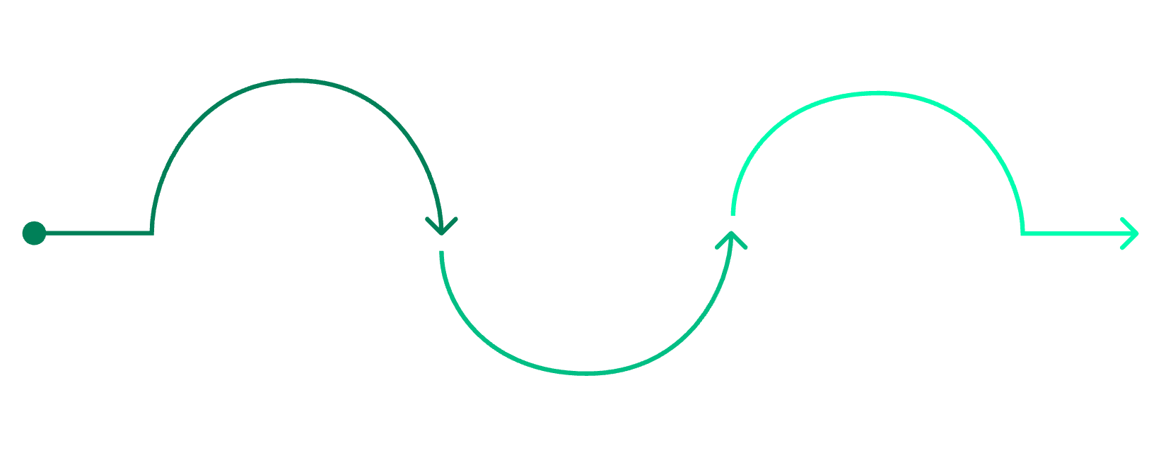

Solution: Nabz Voice-First Triage
Speak in Urdu
AI Triage Questions
Get Recommendation
Voice or text input, Urdu supported
3–4 GP-depth clinical prompts
Color-coded: Emergency/Doctor/Home
🎙️ Accessible
🛡️ Safe
🧠 Smart
📋 Actionable
Voice input, Urdu language — no reading, no typing, no English required.
Triage only — never diagnoses or prescribes. Red flags escalate instantly.
GP-depth clinical questions, WHO/FDA medication safety catalog, and family profiles.
Doctor handoff with SBAR summary + QR code ready for the clinician.

Slide 5
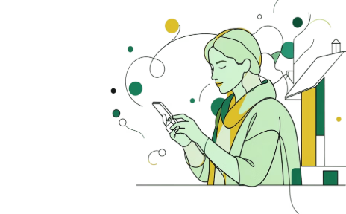
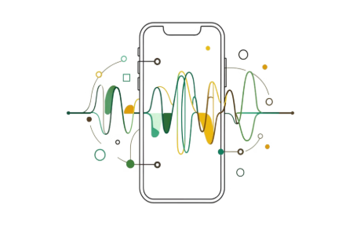
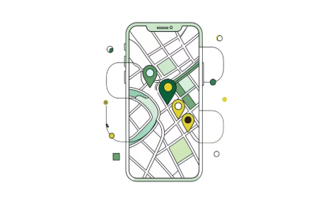
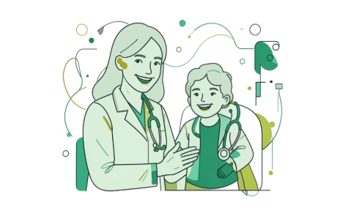
User Experience: Amna's Journey
1 — Discovery
2 — Triage
3 — Recommendation
4 — Impact
Amna's neighbor shares Nabz via WhatsApp. No signup needed — guest mode. She speaks naturally: "میرے بیٹے کو بخار ہے" (my son has fever).
AI asks 4 smart questions by voice: fever level, cough, rash, breathing difficulty. Live analysis shows findings and confidence in real time.
Amna saves ₨500, avoids the ER, gets her son to the right care at the right time — and signs up to add her whole family.
🟠 "See a doctor within 24 hours." Plain-Urdu advice spoken aloud: "بخار کم کرنے کے لیے ٹائلنول دیں". Nearby clinics appear on map.

Slide 6
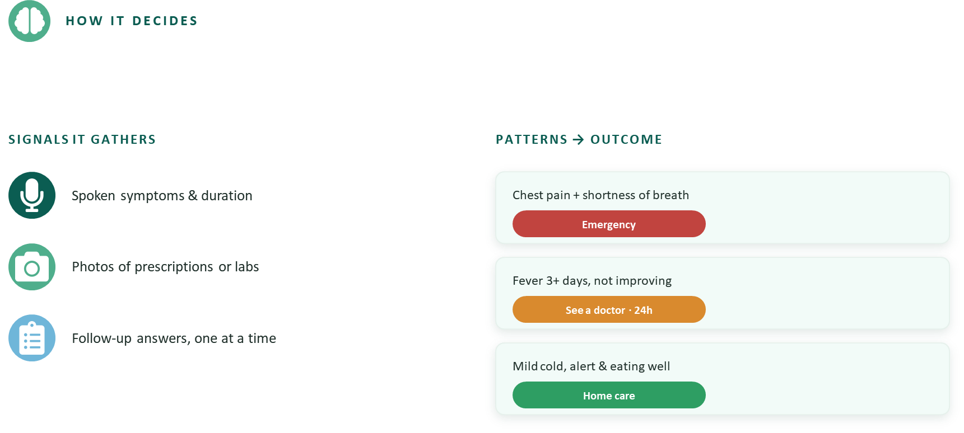

Slide 7
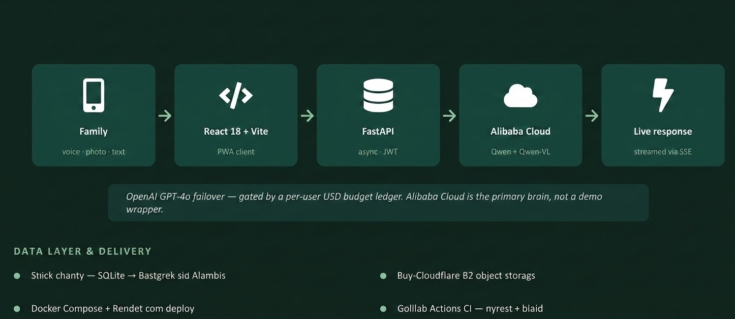
Flow +Tech

Slide 8
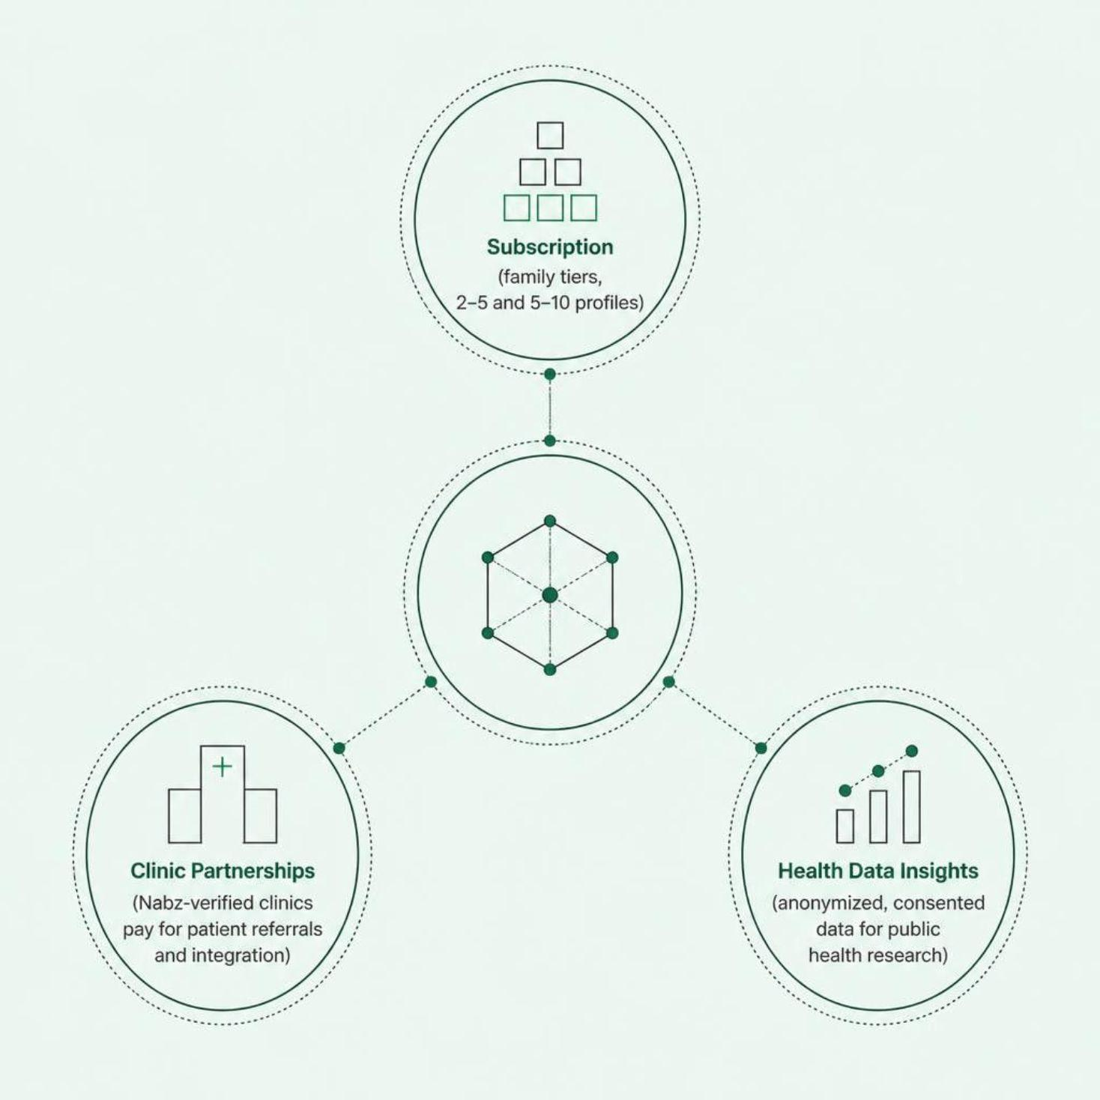
Business Model: Freemium + Family Tiers
🆓 Free Tier
💳 Paid — ₨299/month
Single patient profile · Unlimited triage sessions · Basic home-care advice in Urdu
2+ family profiles · Priority doctor handoff · Prescription history · Medication reminders
Family plan tiers scale from 2–5 profiles to 5–10 profiles to serve extended households.

Slide 9
Milestones: 4-Month Roadmap
Month 1
1
Beta Launch
100 users in Lahore · Voice UX feedback · Urdu accuracy · Triage logic validation
2
Month 2
Scale & Integrate
Full Qwen API integration · 500 users across Lahore, Karachi, Islamabad · Family profiles live
Month 3
3
Document Intelligence
Qwen-VL for lab reports & prescriptions · 5 clinic partnerships · 2,000 users
4
Month 4
Production Launch
Full compliance · Paid membership · 5,000+ users · National scale preparation

Slide 10
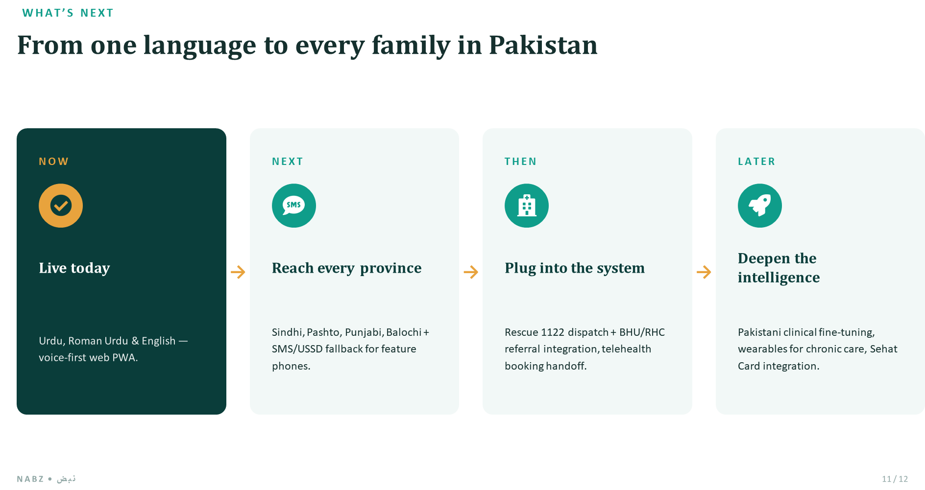

Slide 11
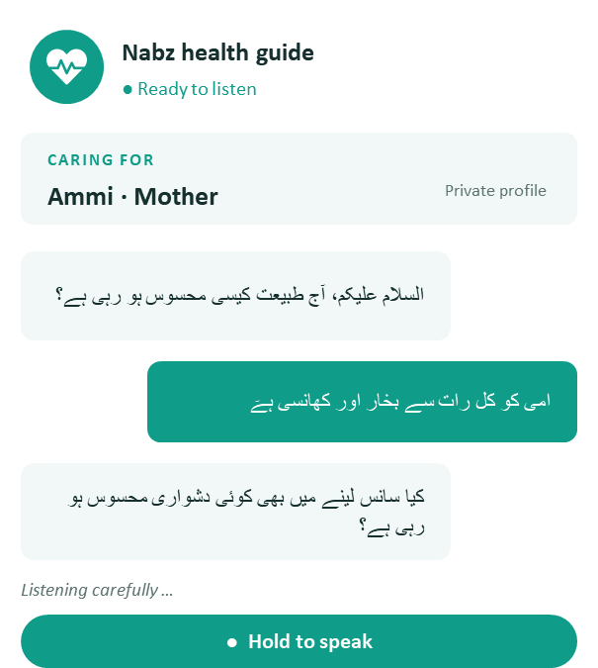

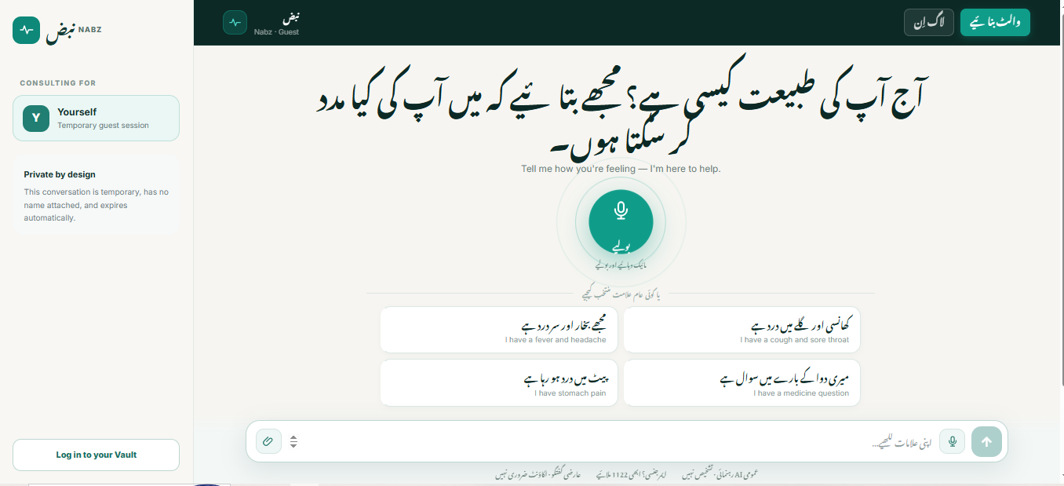
Demo: Live triage walkthrough.

Slide 12

Team: Builders Behind Nabz
Kheem Darmani
Faiza Ali
Senior ML Engineer
Full-stack AI/ML expertise. Built core triage logic, Qwen integration, and safety guardrails.
AI Instructor
Clinical domain knowledge, prompt engineering, Urdu NLP fine-tuning, and safety compliance.
Muhammad Hassan
Data Scientist
Backend architecture (FastAPI, SQLAlchemy), data pipelines, analytics, and deployment.

Slide 13

اپ کی آواز، اپ کی صحت
Your Voice. Your Health.
Healthcare in your language, when you need it most.
Join us in making primary care accessible to 220 million Pakistanis.
Nabz Team — Alibaba Cloud AI Hackathon Pakistan 2026

