Slide 1

Excel Analytics Platform
Transform your spreadsheets into stunning visualizations with AI-powered intelligence and effortless data analysis.

Slide 2

The Challenge
Data Analysis Remains Complex and Time-Consuming
Business professionals and data analysts spend countless hours wrestling with Excel data, manually creating charts, and struggling to extract meaningful insights from their spreadsheets.
Traditional methods require extensive technical knowledge, multiple software tools, and significant time investment to transform raw data into actionable visualizations.

Slide 3
Common Pain Points in Data Visualization
Limited Accessibility
Time Inefficiency
Complex tools require specialized training and technical expertise that most users don't possess, creating barriers to effective data analysis.
Manual chart creation and data manipulation consumes hours that could be spent on strategic analysis and decision-making.
Fragmented Workflow
No Historical Tracking
Switching between multiple applications disrupts productivity and increases error risk, slowing down the entire analysis process.
Previous analyses are lost or scattered across different files with no centralized history, making it impossible to track insights over time.

Slide 4

Effortless File Upload and Management
Universal Excel Support
Upload any Excel file format (.xls or .xlsx) with a simple drag-and-drop interface. Our platform automatically processes your data, identifying column headers and data types to prepare for instant analysis.
Files are securely stored in the cloud with automatic backup, ensuring your data is always accessible and protected. Support for files up to 100MB means even your largest spreadsheets are handled effortlessly.

Slide 5
Interactive 2D and 3D Visualization
Dynamic 2D Charts
Advanced 3D Graphics
Custom Axis Selection
Create stunning bar charts, line graphs, scatter plots, and pie charts with customizable colors, labels, and legends that bring your data to life.
Explore your data from every angle with interactive 3D visualizations that reveal hidden patterns and relationships in your datasets.
Simply select any column headers as X and Y axes, choose your preferred chart type, and generate professional graphs instantly with zero coding required.

Slide 6
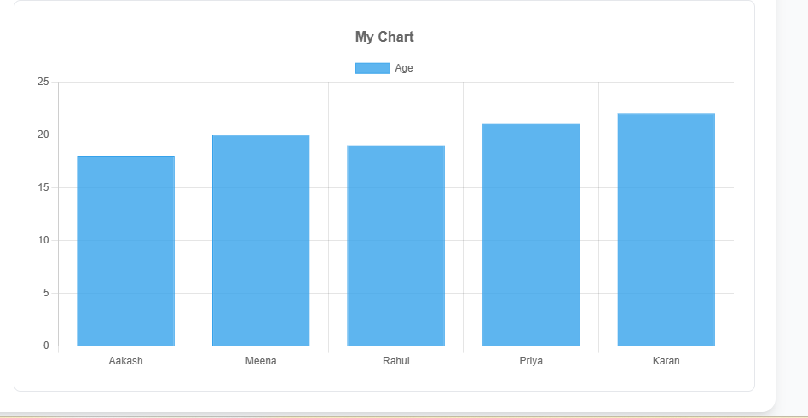
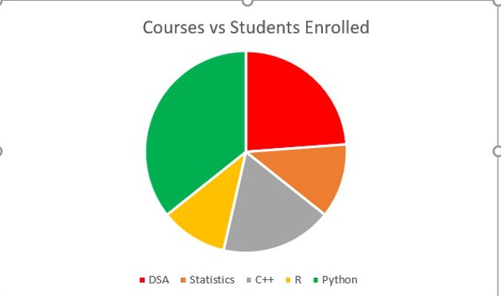
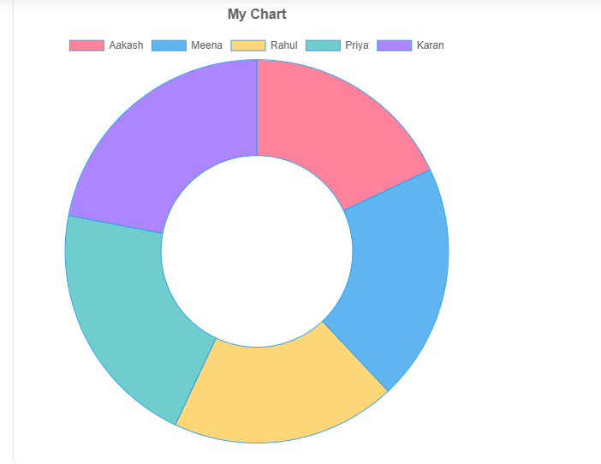
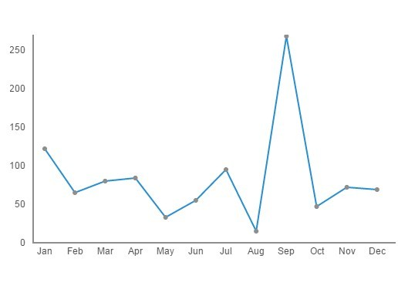
Types of Graph
Bar Graph
Pie Chart
Doughnut Chart
Line Graph

Slide 7




Smart Features That Save Time
Intelligent Chart Recommendations
One-Click Downloads
Our system analyzes your data structure and suggests the most effective visualization types for your specific dataset, eliminating guesswork and ensuring optimal presentation.
Export your charts in multiple formats (PNG, JPG, SVG, PDF) with high resolution, ready for presentations, reports, or publications without any additional formatting.
Real-Time Customization
Collaborative Sharing
Share interactive charts with team members via secure links, enabling collaborative analysis without complex file transfers or version control issues.
Adjust colors, fonts, axis labels, and chart styles in real-time with instant preview, ensuring every visualization matches your brand standards perfectly.

Slide 8



Comprehensive Dashboard and User Management
Personal History Tracking
Admin Control Panel
Enterprise Security
Every upload and analysis is automatically saved to your personal dashboard, creating a searchable archive of all your work with timestamps and notes for easy reference.
Administrators can manage users, monitor data usage, set permissions, and generate usage reports across the entire organization from a centralized interface.
Role-based access controls, encrypted data storage, and comprehensive audit logs ensure your sensitive data remains secure and compliant with industry standards.

Slide 9
Transform Your Data Analysis Today
10x
100%
∞
Faster Analysis
Cloud Accessible
Unlimited History
Reduce time from data to insights by eliminating manual chart creation and streamlining your workflow.
Access your analyses anywhere, anytime from any device with seamless cloud synchronization.
Never lose track of previous analyses with complete historical records and searchable archives.

Slide 10


Team Members
Name:-Khemchand Prajapat
Name:-Renuka Joshi
Email id:-khemchand730030@gmail.com
Email id:-renukajoshi1064@gmail.com

Slide 11
Thank You!!

