Slide 1

Introduction to Bash
Ian Miell
@ianmiell

Slide 2
Introduction
About me
Contact:
Twitter: @ianmiell
Email: ian.miell@gmail.com

Slide 3
Bash and Me
Used throughout career
Never learned formally
Stumbled around, lots of mistakes
Slowly learned concepts and key points
Wrote a book

Slide 4
This Course
Live Walkthroughs
Encourage you to follow - ‘Hard Way’ Method
Exercises
Polls / yes/no ‘temperature checks’
Group chat
Materials:
https://github.com/ianmiell/introduction-to-bash

Slide 5
Pre-Requisites
Familiar with command line
Bash version 4+
$ echo $SHELL
$ bash --version
<4 is still ok
Basic shell utilities (eg grep, cat, ls)
Any editor (I use vim)

Slide 6
Target Audiences
No knowledge assumed
Advanced questions outside the course please
‘Hardly/never used bash’
Coverage of 90% of bash features
‘Used bash casually for a while’
Refresher on some topics, learn some new things
‘Used bash for years, but never studied’
A-ha moments

Slide 7
Why This Course?
Bash is everywhere
Shells are everywhere
Work with it every day
Taken for granted that it’s known
Studying it pays massive dividends
Gateway to deeper OS concepts

Slide 8
Bash is under-served
Man page is hard to follow if you don’t know the jargon
One-liners are easy to find but concepts give you real power
Guides that assume knowledge you may not have

Slide 9
Ever been confused by…?
Diffference between ‘[‘ and ‘[[‘
Globs vs regexes
Single vs double quotes
Difference between `` and $()
What a subshell is

Slide 10
Recently I’ve used bash to…
Fix a Terraform script
Robustly apply changes in a cloud-init VM script
Automate the renaming of files with spaces in my backup folders
Setup environments at work

Slide 11
Poll - Experience
Never used bash
Used bash for <2 years
Used bash for >2 years
Used bash for >5 years
Studied bash seriously

Slide 12
Structure of Course
Part I – Bash Basics
Part II – Further Bash Basics
Part III - Scripting
Part IV - Advanced

Slide 13
Discussion
What do you want to achieve in bash?
Any specific goals?
What have you been frustrated by with bash?

Slide 14
Part I – Bash Basics
1.1 Bash background
1.2 Variables
1.3 Globs
1.4 Pipes and Redirects

Slide 15
1.1 What is Bash?
What is a shell?
A program takes input from a terminal
Translates input into:
System calls
Calls to other programs
Computation within the bash program
Bash excels at ‘gluing’ other commands together

Slide 16
Other shells
sh
ash
ksh
tcsh
tclsh

Slide 17
Walkthrough
Run tcsh from bash

Slide 18
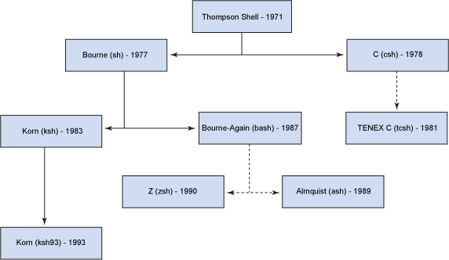
History of Shells

Slide 19
Bash in the Market
Most popular shell
Lots of competition:
zsh will be default on mac
fish is also popular
Very rarely, you find servers that don’t have bash on still

Slide 20
1.2 Variables
Basic variables
Quoting variables
‘env’ and ‘export’
Simple arrays

Slide 21
Walkthrough - Basic Variables
Assignment
De-referencing

Slide 22
Walkthrough – Variables and Quotes
Why Quote?
Space separation
Double quotes and variables
Single quotes and variables

Slide 23
Walkthrough – Shell Variables
What are Shell Variables?
Readonly variables
Exporting variables
Ouptutting exported and shell variables

Slide 24
Walkthrough - Arrays
Zero-indexed
Curly braces required
All variables are arrays!
declare -a

Slide 25
Recap - Variables
$ dereferences
Variables in double quotes are interpreted, single quotes not
Exported variables are passed to programs run within the shell
Env shows exported variables, compgen -v shows all variables

Slide 26
1.3 Globbing
What does ‘*’ mean?
Differences to regular expressions
Not familiar with regexes?

Slide 27
Activity – Basic globbing
ls *
Shell interpretation
Globbing and quoting

Slide 28
Activity – Other Glob Characters
Character classes
Dots and dotfiles
.* vs *
?
Special directories

Slide 29
Activity – Difference to Regexps
Renaming a set of files
‘.*’ is not the same as ‘*’!
Extended globbing available in bash (not covered)

Slide 30
Recap - Globs
What a glob is
What a dotfile is
Special directory files
Globs, regexps and dots

Slide 31
Exercise I

Slide 32
1.4 Pipes and Redirects
Basic redirects
Basic pipes
File descriptors
Special files
Standard out vs standard error

Slide 33
Walkthrough – Basic Pipes and Redirects
The ‘>’ operator
Simple pipe

Slide 34
Walkthrough – Standard out / error
Errors and pipes
‘Channels’
File descriptors
0 – standard input
1 – standard output
2 – standard error

Slide 35
Walkthrough – Standard out / error
‘n>’ notation
2>&1
Ordering is important
Bash parses left to right

Slide 36
Walkthrough – Pipes vs Redirects
Pipes ‘eat’ standard output from a command
Pipes ‘output’ standard input to another command
Redirects send a channel of output to a file
The ‘<’ operator
The ‘>>’ operator

Slide 37
Recap – Pipes vs Redirects
The main 3 file descriptors
‘>’ vs ‘>>’
n> and standard error
2>&1 and ordering

Slide 38
Part I Recap
Globs
vs regexps
Variables, arrays
Pipes and redirects
File descriptors

Slide 39
Exercise II

Slide 40
Break

Slide 41
Part II – Further Bash Basics
2.1 Functions
2.2 Tests
2.3 Loops
2.4 Exit Codes
2.5 Process Substitution
2.6 Command Substitution

Slide 42
Discussion
Is bash a programming language?
What is a programming language?
Why has bash lasted so long?

Slide 43
2.1 Functions in Bash
Four types of command:
Function
Alias
Program
Builtin

Slide 44
Walkthrough - Basic Functions
Declaring a function
Function arguments
Variable scope
Local variables

Slide 45
Walkthrough - Builtins
cd is a builtin
Builtins can also be programs
‘builtin’ is a builtin!
Functions and builtins
unset -f
declare -f / -F

Slide 46
Walkthrough - Programs
‘which’

Slide 47
Walkthrough - Aliases
‘alias’
‘unalias’
The ‘type’ builtin

Slide 48
2.2 Tests
Bash tests
Different ways of writing tests
Logical operators
Binary and unary operators
‘if’ statements

Slide 49
Walkthrough – Basic Tests
Tests and exit codes
Comparing values
What is ‘[‘?

Slide 50
Walkthrough – Logical Operators
‘!’ means ‘NOT’
‘||’ means ‘OR’
‘&&’ means ‘AND’
‘(...)’ evaluates first
‘-a’ vs ‘&&’

Slide 51
Walkthrough – The ‘[[‘ Operator
Why do both exist?
Confused?

Slide 52
Walkthrough – Unary and Binary Operators
‘-z’
‘-a’
‘-d’
Types in bash

Slide 53
Walkthrough – if Statements
Basic ‘if’ statements
Bare ‘if’ statements

Slide 54
Recap - Tests
Tests in bash
‘[‘ vs ‘[[‘
Unary vs Binary operators
Types in bash (limited)

Slide 55
2.3 Loops
‘C’-style for loops
‘for’ loops over items ‘in’ lists
‘while’ and ‘until’ loops
‘case’ statements

Slide 56
Walkthrough – Loops
C-style - ‘((‘
Different variable referencing
‘for f in $()’
Beware!
‘while’ and ‘until’
Infinite loop form with ‘break’

Slide 57
Walkthrough – Loops
‘case’ statements
‘esac’, ;; and *)
Command line options

Slide 58
Recap – Loops
Two types of for loop
while and until
case statements
command line options

Slide 59
2.4 Exit Codes
What an Exit Code is
How to set one
Conventions
Other ‘special’ parameters

Slide 60
Walkthrough – Exit Codes
The ‘$?’ variable
‘0’ or ‘not 0’
Exit codes and tests

Slide 61
Standard Exit Codes
0 – OK
1 – General Error
2 – Misuse of shell builtin
126 – Cannot execute
127 – No file found matching command
128 – Invalid exit value
(128 + n) – Process killed with signal ‘n’
(Signals covered in Part IV)

Slide 62
Walkthrough – Exit Codes
Exit codes used differently by different apps
eg grep
The ‘exit’ builtin
The ‘return’ builtin

Slide 63
Walkthrough – Special Parameters
Special parameters == special variables
$?
$$
man bash

Slide 64
Recap – Exit Codes
Standard exit codes
Exit code usage (eg grep)
Setting exit codes
‘return’ing from functions
Special parameters

Slide 65
Exercise III

Slide 66
2.5 Process Substitution
The ‘<()’ operator
Substitution of file arguments

Slide 67
Walkthrough – Process Subsitution
The ‘<()’ operator
Substitution of file arguments

Slide 68
2.6 Command Substitution
The ‘$()’ operator

Slide 69
Walkthrough – Command Substitution
The ‘$()’ operator
$() vs ``
Nesting

Slide 70
Discussion / Recap – Part II
Bash more as programming language:
Functions
Tests / ifs
Loops
Return/Exit codes
Process and command substitution
$() vs ``

Slide 71
Break

Slide 72
Part III - Scripting
Scripts and Startup
The ‘set’ Command
Debugging in bash
Subshells
IFS

Slide 73
3.1 Scripts and Startup
What shell scripts are
What happens on bash startup
This has cost me many hours!

Slide 74
Walkthrough – Shell Startup
The ‘shebang’ - ‘#!’
What happens on bash startup
Running an executable file
Making a file executable

Slide 75
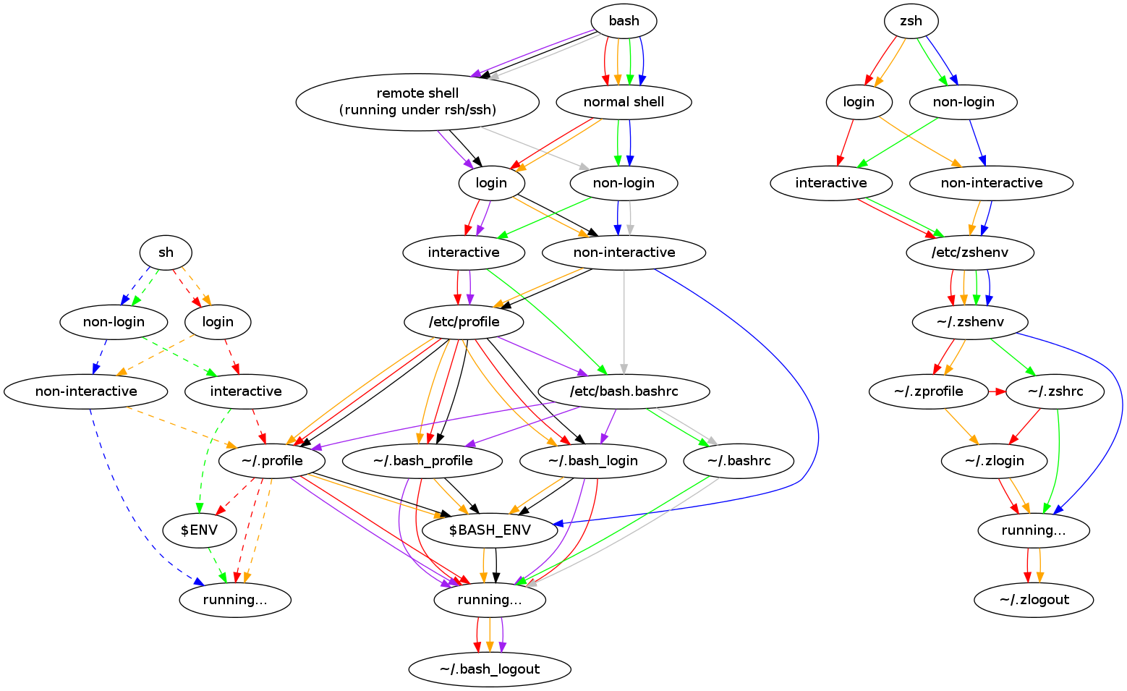
Walkthrough – Startup Explained

Slide 76
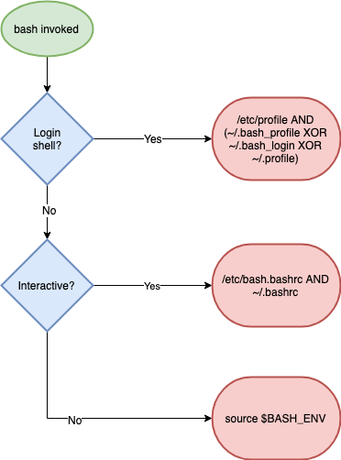
Walkthrough – Startup Explained (simpler)

Slide 77
Walkthrough - sourcing
The ‘source’ builtin
‘source’ vs ‘./’
The ‘sh’ suffix
Debugging with ‘env -i’

Slide 78
Recap - Scripts and Startup
What shell scripts are
How complex bash startup can be
Keep diagram handy!

Slide 79
3.2 The ‘set’ builtin
Setting options in bash
What POSIX is
Most useful options:
nounset
xtrace
errexit
pipefail
‘set’ vs ‘shopt’

Slide 80
Walkthrough – Running ‘set’
‘set’
POSIX
set POSIX off
+ is off – is on (this IS confusing)
‘set’ vs ‘env’

Slide 81
Walkthrough – ‘set’ Options
errexit
xtrace
nounset
flags vs -o name
pipefail
‘set’ vs ‘shopt’

Slide 82
Recap - ‘set’
Options: + off, - on
POSIX
Most common options
shopt and set

Slide 83
3.3 Debugging bash
‘set’ flags already covered
Syntax checking
Profiling bash and ‘PS4’
Shellcheck

Slide 84
Walkthrough – bash Arguments
bash -n
bash -v
bash -x
bash -x and PS4
shellcheck my bashrc

Slide 85
Exercise IV

Slide 86
3.4 Subshells
What is a subshell?
How to create a subshell
Why they are useful
() vs {}

Slide 87
Walkthrough - subshells
A simple subshell
Subshells and variable scope
Subshells and redirection
() or {}?
Subshells and working directory

Slide 88
3.5 Internal Field Separator
aka IFS
Why it’s important
How to use it

Slide 89
Walkthrough – Spaces in Filenames
‘for’ looping over files
The IFS shell variable
The $’’ construct

Slide 90
Walkthrough – Spaces in Filenames
Setting IFS
The ‘find’ command and ‘xargs’
find, xargs and the null byte separator

Slide 91
Exercise V

Slide 92
Part III – Discussion / Recap
Shell Startup
Practical bash usage
Shell options
Shell debugging
IFS

Slide 93
Break

Slide 94
Part IV – Advanced Bash
Traps
String manipulation
Autocomplete
Walkthrough a ‘real’ script

Slide 95
4.1 Jobs and Traps
Background jobs
Traps and signals
The ‘kill’ command
The ‘wait’ builtin
Trapping signals
Process groups

Slide 96
Standard Exit Codes
0 – OK
1 – General Error
2 – Misuse of shell builtin
126 – Cannot execute
127 – No file found matching command
128 – Invalid exit value
(128 + n) – Process killed with signal ‘n’
(Signals covered in Part IV)

Slide 97
Exercise VI

Slide 98
4.2 String Manipulation
Why use bash for this?
Quicker
No dependencies
Editing/examining strings in bash
Avoiding common quoting problems

Slide 99
Walkthrough – String Manipulation
Get string length
${#VAR}
String slicing
${VAR:2}
${VAR:2:3}
String editing
${VAR/234/432}
${VAR//234/432}

Slide 100
Walkthrough – Advanced Strings
Requires 4.x+
${VAR,}
${VAR,,}
${VAR^}
${VAR^^}

Slide 101
Walkthrough – Quoting Hell
Quotes in quotes
Changing quotes mid-line

Slide 102
4.3 – Autocomplete
How autocomplete works
The ‘shift’ command
Writing your own autocompletes

Slide 103
Walkthrough – A Simple Program
myecho
‘shift’
Colours
‘$@’

Slide 104
Walkthrough – Autocomplete Script
myechocomplete
Sourcing
Advanced autocompletion
Write your own!

Slide 105
Discussion – cheapci script
https://github.com/ianmiell/cheapci

Slide 106
Wrapup
Feedback welcome
Thanks!
Any questions:
@ianmiell
ian.miell@gmail.com

Slide 107
Wrapup
https://github.com/ianmiell/introduction-to-bash
https://github.com/ianmiell/cheapci

Slide 108
Introduction to Bash
Ian Miell
@ianmiell

