Slide 1

Introduction to Bash
Ian Miell
@ianmiell

Slide 2
Introduction
About me
Contact:
Twitter: @ianmiell
Email: ian.miell@gmail.com

Slide 3
Bash and Me
Used throughout career
Never learned formally
Stumbled around, lots of mistakes
Slowly learned concepts and key points
Wrote a book

Slide 4
This Course
Live Walkthroughs
Encourage you to follow - ‘Hard Way’ Method
Exercises
Polls / yes/no ‘temperature checks’
Group chat
Materials:
https://github.com/ianmiell/introduction-to-bash

Slide 5
Bash and Me
Used throughout career
Never learned formally
Stumbled around, lots of mistakes
Slowly learned concepts and key points
Wrote a book

Slide 6
Pre-Requisites
Familiar with command line
Bash version 4+
$ echo $SHELL
$ bash --version
<4 is still ok
Basic shell utilities (eg grep, cat, ls)
Any editor (I use vim)

Slide 7
Target Audiences
No knowledge assumed
Advanced questions outside the course please
‘Hardly/never used bash’
Coverage of 90% of bash features
‘Used bash casually for a while’
Refresher on some topics, learn some new things
‘Used bash for years, but never studied’
A-ha moments

Slide 8
Why This Course?
Bash is everywhere
Shells are everwhere
Work with it every day
Taken for granted that it’s known
Studying it pays massive dividends
Gateway to deeper OS concepts

Slide 9
Bash is under-served
Man page is hard to follow if you don’t know the jargon
One-liners are easy to find but concepts give you real power
Guides that assume knowledge you may not have

Slide 10
Ever been confused by…?
Diffference between ‘[‘ and ‘[[‘
Globs vs regexes
Single vs double quotes
Difference between `` and $()
What a subshell is

Slide 11
Recently I’ve used bash to…
Fix a Terraform script
Robustly apply changes in a cloud-init VM script
Automate the renaming of files with spaces in my backup folders
Setup environments at work

Slide 12
Poll - Experience
Never used bash
Used bash for <2 years
Used bash for >2 years
Used bash for >5 years
Studied bash seriously

Slide 13
Structure of Course
Part I – Bash Basics
Part II – Further Bash Basics
Part III - Scripting
Part IV - Advanced

Slide 14
Discussion
What do you want to achieve in bash?
Any specific goals?
What have you been frustrated by with bash?

Slide 15
Part I – Bash Basics
1.1 Bash background
1.2 Variables
1.3 Globs
1.4 Pipes and Redirects

Slide 16
1.1 What is Bash?
What is a shell?
A program takes input from a terminal
Translates input into:
System calls
Calls to other programs
Computation within the bash program
Bash excels at ‘gluing’ other commands together

Slide 17
Other shells
sh
ash
ksh
tcsh
tclsh

Slide 18
Walkthrough
Run tcsh from bash

Slide 19
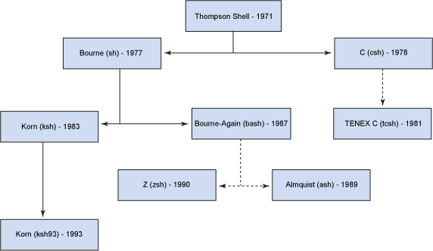
History of Shells

Slide 20
Bash in the Market
Most popular shell
Lots of competition:
zsh will be default on mac
fish is also popular
Very rarely, you find servers that don’t have bash on still

Slide 21
1.2 Variables
Basic variables
Quoting variables
‘env’ and ‘export’
Simple arrays

Slide 22
Walkthrough - Basic Variables
Assignment
Dereferencing

Slide 23
Walkthrough – Variables and Quotes
Why Quote?
Space separation
Double quotes and variables
Single quotes and variables

Slide 24
Walkthrough – Shell Variables
Why Quote?
Space separation
Double quotes and variables
Single quotes and variables

Slide 25
Walkthrough – Shell Variables
What are Shell Variables?
Readonly variables
Exporting variables
Ouptutting exported and shell variables

Slide 26
Walkthrough - Arrays
Zero-indexed
Curly braces required
All variables are arrays!
declare -a

Slide 27
Recap - Variables
$ dereferences
Variables in double quotes are interpreted, single quotes not
Exported variables are passed to programs run within the shell
Env shows exported variables, compgen -v shows all variables

Slide 28
1.3 Globbing
What does ‘*’ mean?
Differences to regular expressions
Not familiar with regexes?

Slide 29
Activity – Basic globbing
ls *
Shell interpretation
Globbing and quoting

Slide 30
Activity – Other Glob Characters
Character classes
Dots and dotfiles
.* vs *
?
Special directories

Slide 31
Activity – Difference to Regexps
Renaming a set of files
‘.*’ is not the same as ‘*’!
Extended globbing available in bash (not covered)

Slide 32
Recap - Globs
What a glob is
What a dotfile is
Special directory files
Globs, regexps and dots

Slide 33
Exercise I

Slide 34
1.4 Pipes and Redirects
Basic redirects
Basic pipes
File descriptors
Special files
Standard out vs standard error

Slide 35
Walkthrough – Basic Pipes and Redirects
The ‘>’ operator
Simple pipe

Slide 36
Walkthrough – Standard out / error
Errors and pipes
‘Channels’
File descriptors
0 – standard input
1 – standard output
2 – standard error

Slide 37
Walkthrough – Standard out / error
‘n>’ notation
2>&1
Ordering is important
Bash parses left to right

Slide 38
Walkthrough – Pipes vs Redirects
Pipes ‘eat’ standard output from a command
Pipes ‘output’ standard input to another command
Redirects send a channel of output to a file
The ‘<’ operator
The ‘>>’ operator

Slide 39
Recap – Pipes vs Redirects
The main 3 file descriptors
‘>’ vs ‘>>’
n> and standard error
2>&1 and ordering

Slide 40
Part I Recap
Globs
vs regexps
Variables, arrays
Pipes and redirects
File descriptors

Slide 41
Exercise II

Slide 42
Break

Slide 43
Part II – Further Bash Basics
2.1 Functions
2.2 Tests
2.3 Loops
2.4 Exit Codes
2.5 Process Substitution
2.6 Command Substitution

Slide 44
Discussion
Is bash a programming language?
What is a programming language?
Why has bash lasted so long?

Slide 45
2.1 Functions in Bash
Four types of command:
Function
Alias
Program
Builtin

Slide 46
Walkthrough - Basic Functions
Declaring a function
Function arguments
Variable scope
Local variables

Slide 47
Walkthrough - Builtins
cd is a builtin
Builtins can also be programs
‘builtin’ is a builtin!
Functions and builtins
unset -f
declare -f / -F

Slide 48
Walkthrough - Programs
‘which’

Slide 49
Walkthrough - Aliases
‘alias’
‘unalias’
The ‘type’ builtin

Slide 50
2.2 Tests
Bash tests
Different ways of writing tests
Logical operators
Binary and unary operators
‘if’ statements

Slide 51
Walkthrough – Basic Tests
Tests and exit codes
Comparing values
What is ‘[‘?

Slide 52
Walkthrough – Logical Operators
‘!’ means ‘NOT’
‘||’ means ‘OR’
‘&&’ means ‘AND’
‘(...)’ evaluates first
‘-a’ vs ‘&&’

Slide 53
Walkthrough – The ‘[[‘ Operator
Why do both exist?
Confused?

Slide 54
Walkthrough – Unary and Binary Operators
‘-z’
‘-a’
‘-d’
Types in bash

Slide 55
Walkthrough – if Statements
Basic ‘if’ statements
Bare ‘if’ statements

Slide 56
Recap - Tests
Tests in bash
‘[‘ vs ‘[[‘
Unary vs Binary operators
Types in bash (limited)

Slide 57
2.3 Loops
‘C’-style for loops
‘for’ loops over items ‘in’ lists
‘while’ and ‘until’ loops
‘case’ statements

Slide 58
Walkthrough – Loops
C-style - ‘((‘
Different variable referencing
‘for f in $()’
Beware!
‘while’ and ‘until’
Infinite loop form with ‘break’

Slide 59
Walkthrough – Loops
‘case’ statements
‘esac’, ;; and *)
Command line options

Slide 60
Recap – Loops
Two types of for loop
while and until
case statements
command line options

Slide 61
2.4 Exit Codes
What an Exit Code is
How to set one
Conventions
Other ‘special’ parameters

Slide 62
Walkthrough – Exit Codes
The ‘$?’ variable
‘0’ or ‘not 0’
Exit codes and tests

Slide 63
Standard Exit Codes
0 – OK
1 – General Error
2 – Misuse of shell builtin
126 – Cannot execute
127 – No file found matching command
128 – Invalid exit value
(128 + n) – Process killed with signal ‘n’
(Signals covered in Part IV)

Slide 64
Walkthrough – Exit Codes
Exit codes used differently by different apps
eg grep
The ‘exit’ builtin
The ‘return’ builtin

Slide 65
Walkthrough – Special Parameters
Special parameters == special variables
$?
$$
man bash

Slide 66
Recap – Exit Codes
Standard exit codes
Exit code usage (eg grep)
Setting exit codes
‘return’ing from functions
Special parameters

Slide 67
Exercise III

Slide 68
2.5 Process Substitution
The ‘<()’ operator
Substitution of file arguments

Slide 69
Walkthrough – Process Subsitution
The ‘<()’ operator
Substitution of file arguments

Slide 70
2.6 Command Substitution
The ‘$()’ operator

Slide 71
Walkthrough – Command Substitution
The ‘$()’ operator
$() vs ``
Nesting

Slide 72
Discussion / Recap – Part II
Bash more as programming language:
Functions
Tests / ifs
Loops
Return/Exit codes
Process and command substitution
$() vs ``

Slide 73
Break

Slide 74
Part III - Scripting
Scripts and Startup
The ‘set’ Command
Debugging in bash
Subshells
IFS

Slide 75
3.1 Scripts and Startup
What shell scripts are
What happens on bash startup
This has cost me many hours!

Slide 76
Walkthrough – Shell Startup
The ‘shebang’ - ‘#!’
What happens on bash startup
Running an executable file
Making a file executable

Slide 77
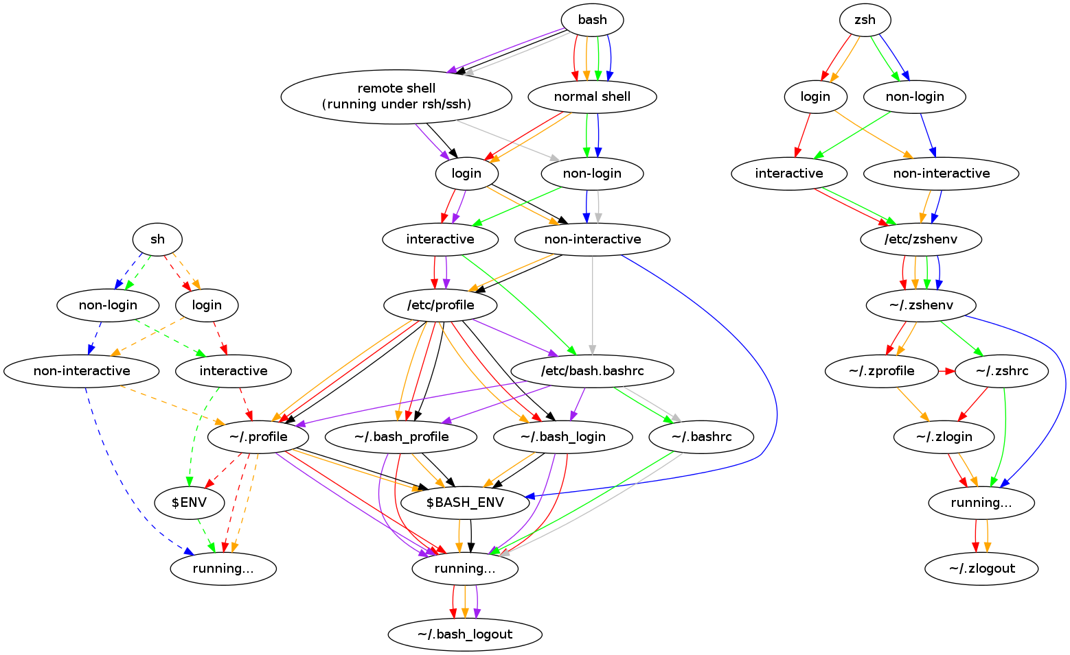
Walkthrough – Startup Explained

Slide 78
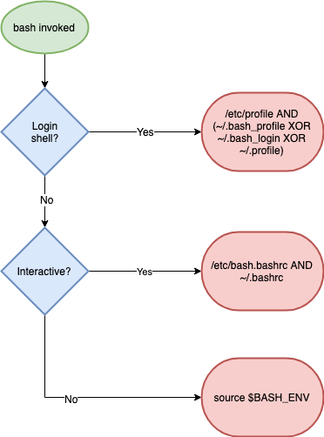
Walkthrough – Startup Explained (simpler)

Slide 79
Walkthrough - sourcing
The ‘source’ builtin
‘source’ vs ‘./’
The ‘sh’ suffix
Debugging with ‘env -i’

Slide 80
Recap - Scripts and Startup
What shell scripts are
What happens on bash startup
This has cost me many hours!

Slide 81
3.2 The ‘set’ builtin
Setting options in bash
What POSIX is
Most useful options:
nounset
xtrace
errexit
pipefail
‘set’ vs ‘shopt’

Slide 82
3.2 The ‘set’ builtin
Setting options in bash
What POSIX is
Most useful options:
nounset
xtrace
errexit
pipefail
‘set’ vs ‘shopt’

Slide 83
Walkthrough – Running ‘set’
‘set’
POSIX
set POSIX off
+ is off – is on (this IS confusing)
‘set’ vs ‘env’

Slide 84
Walkthrough – ‘set’ Options
errexit
xtrace
nounset
flags vs -o name
pipefail
‘set’ vs ‘shopt’

Slide 85
Recap - ‘set’
Options: + off, - on
POSIX
Most common options
shopt and set

Slide 86
3.3 Debugging bash
‘set’ flags already covered
Syntax checking
Profiling bash and ‘PS4’
Shellcheck

Slide 87
Walkthrough – bash Arguments
bash -n
bash -v
bash -x
bash -x and PS4
shellcheck my bashrc

Slide 88
Exercise IV

Slide 89
3.4 Subshells
What is a subshell?
How to create a subshell
Why they are useful
() vs {}

Slide 90
Walkthrough - subshells
A simple subshell
Subshells and variable scope
Subshells and redirection
() or {}?
Subshells and working directory

Slide 91
3.5 Internal Field Separator
aka IFS
Why it’s important
How to use it

Slide 92
Walkthrough – Spaces in Filenames
‘for’ looping over files
The IFS shell variable
The $’’ construct

Slide 93
Walkthrough – Spaces in Filenames
Setting IFS
The ‘find’ command and ‘xargs’
find, xargs and the null byte separator

Slide 94
Exercise V

Slide 95
Part III – Discussion / Recap
Shell Startup
Practical bash usage
Shell options
Shell debugging
IFS

Slide 96
Break

Slide 97
Part IV – Advanced Bash
Traps
String manipulation
Autocomplete
Walkthrough a ‘real’ script

Slide 98
4.1 Traps
Traps and signals
The ‘kill’ command
The ‘wait’ builtin
Trapping signals
Process groups

Slide 99
Exercise VI

Slide 100
4.2 String Manipulation
Why use bash for this?
Quicker
No dependencies
Editing/examining strings in bash
Avoiding common quoting problems

Slide 101
Walkthrough – String Manipulation
Get string length
${#VAR}
String slicing
${VAR:2}
${VAR:2:3}
String editing
${VAR/234/432}
${VAR//234/432}

Slide 102
Walkthrough – Advanced Strings
Requires 4.x+
${VAR,}
${VAR,,}
${VAR^}
${VAR^^}

Slide 103
Walkthrough – Quoting Hell
Quotes in quotes
Changing quotes mid-line

Slide 104
4.3 – Autocomplete
How autocomplete works
The ‘shift’ command
Writing your own autocompletes

Slide 105
Walkthrough – A Simple Program
myecho
‘shift’
Colours
‘$@’

Slide 106
Walkthrough – Autocomplete Script
myechocomplete
Sourcing
Advanced autocompletion
Write your own!

Slide 107
Discussion – cheapci script
https://github.com/ianmiell/cheapci

Slide 108
Wrapup
Feedback welcome
Thanks!
Any questions:
@ianmiell
ian.miell@gmail.com

Slide 109
Wrapup
https://github.com/ianmiell/cheapci

Slide 110
Introduction to Bash
Ian Miell
@ianmiell

