Slide 1

Slide 1
Case Study: Comparison of Regression Models in Predicting Medical Insurance Costs
By: Khethiwe Dlamini

Slide 2
Steps and Tools
Exploratory Data Analysis in Python using ydata profiling
1
Exploratory Data Analysis using scatter plots in Python
2
Predictive modelling and comparison of key metrics in Python
3
Discussion
4

Slide 3
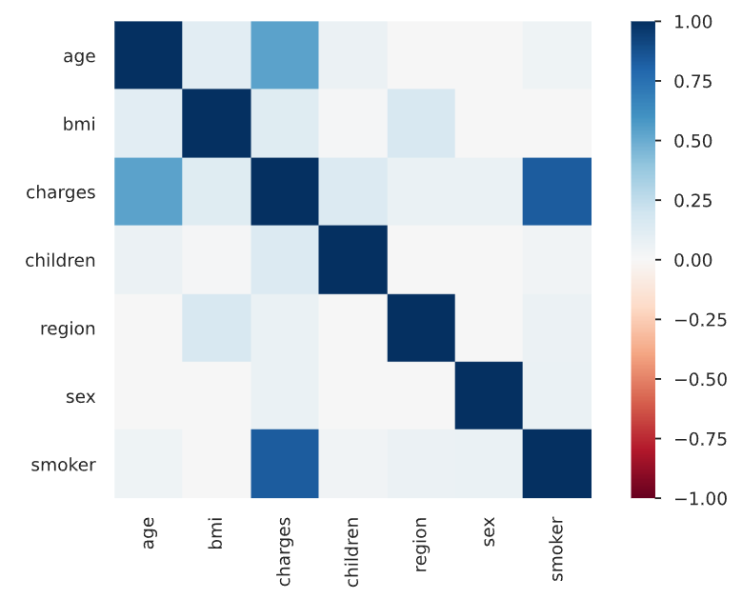
Slide 6
EDA in python using ydata profiling
3
Dataset statistics
Heatmap of Correlations
Number of Variables | 7
No. of Observation | 1338
Missing Values | 0
Variables | Age, Sex, BMI, Number of Children, Smoker Status, Region, Charges
Variable Types | 4 Numeric 2 Categorical 1 Boolean
All predictor variables are positively correlated with charges
Strongest positive correlation between medical charges and smoker status (0.832), followed by age (0.534), no. of children (0.133) and BMI (0.119)
Complete output from the ydata profiling can be accessed here

Slide 4
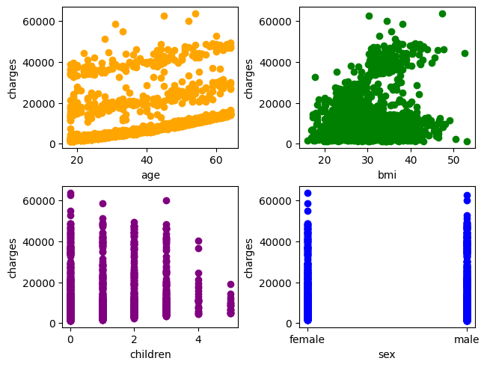
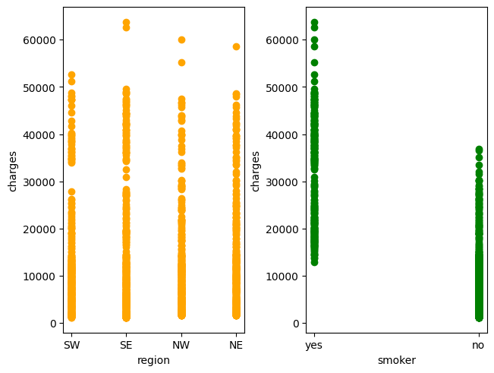
Slide 6
Scatter plot Analysis in python
4
Plots for the age, BMI, number of children, and sex of policyholder
Plots for region and smoker status of policyholder
Slightly linear relationships between charges and age as well as BMI, but with a lot of noise
No significant patterns for sex and region, charges seem to decrease with increasing number of children
Smokers generally have higher medical insurance charges than non-smokers
Full code can be accessed here

Slide 5
Slide 6
Predictive modelling and comparison of key metrics in Python
5
 | Training |  | Testing
 | RMSE (Train) | R² (Train) | RMSE | R²
Linear Regression | 6105.5510 | 74.17 | 5796.3207 | 78.36
Ridge Regression | 6105.6127 | 74.17 | 5798.3071 | 78.34
Lasso Regression | 6105.5534 | 74.17 | 5797.0984 | 78.35
Random Forest | 1872.4694 | 97.57 | 4621.3033 | 86.24
Gradient Boosting | 3804.2402 | 89.97 | 4329.3581 | 87.93
XGBoost | 850.6283 | 99.50 | 4761.0498 | 85.40
Machine learning models outperform linear and penalised linear models across all metrics
Significant drop in predictive performance for Random Forest and XGBoost on the test dataset, suggesting overfitting
Gradient Boosting performs the best on the test dataset and has the lowest drop in predictive power for ML models
Full code can be accessed here

Slide 6
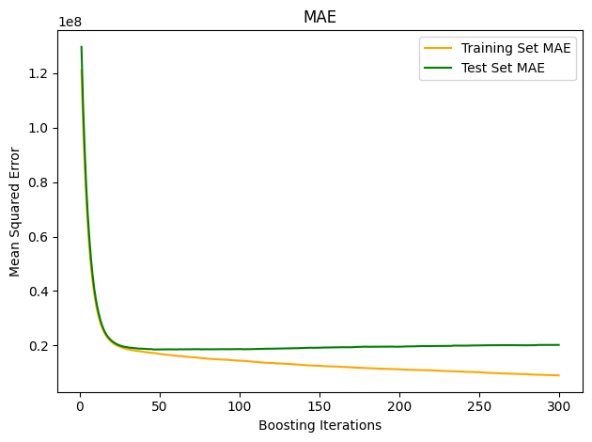
Slide 6
Predictive modelling – Gradient Boosting
6
Increasing the number of boosting iterations beyond the default (100) does not minimise the mean squared error further for predictions on the test set
Through trial and error, the parameters that minimised the root mean squared error and maximised the coefficient of determination (R²):
N estimators: 300,
Max depth: 3,
Min samples split: 2
Learning rate: 0.1
The resulting R² (88.04) is not much higher than the previous R² (87.93).
Full code can be accessed here

Slide 7
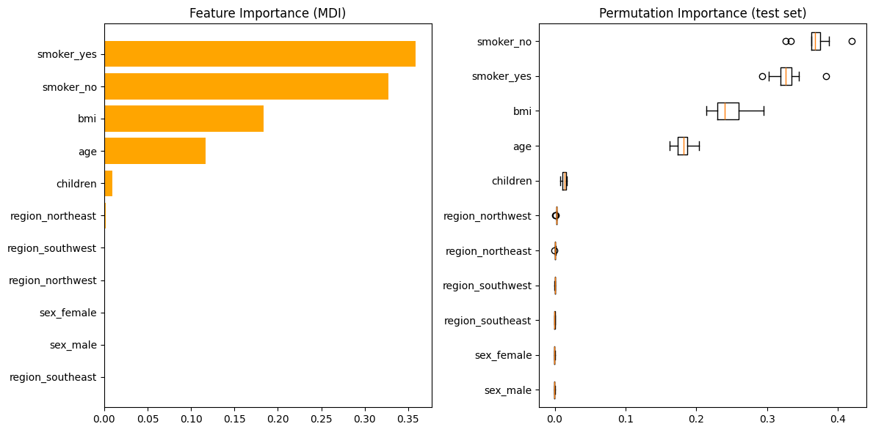
Slide 6
Predictive modelling – Gradient Boosting
7
Smoker status, BMI, age, and number of children are the strongest descriptive features in the model
Region and sex of the policyholder have less predictive power
Full code can be accessed here

Slide 8
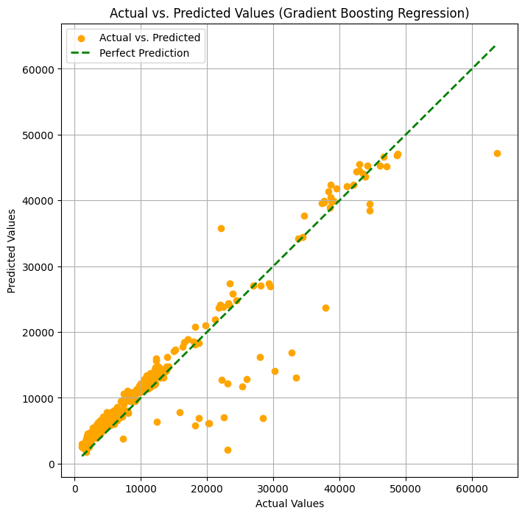
Slide 6
Discussion
8
Exploratory data analysis revealed that all independent variables are positively correlated with medical insurance charges with smoker status showing the strongest correlation
The three ML models considered outperformed the linear and penalised linear regression models, producing the lowest RMSE values and the highest R² values
Gradient Boosting performed the best on the test dataset and has the lowest drop in predictive power compared to Random Forest and XGBoost
Hyperparameter tuning only slightly improved the predictive power of the Gradient boosting model
Smoker status, BMI, age, and number of children were the strongest descriptive features in the model while region and sex of the policyholder were the weakest descriptive features
Full code can be accessed here

Slide 9
Slide 6
References
9
Klymentiev, R. (2018). Health Care Cost Prediction w/ Linear Regression. [online] Kaggle.com. Available at: https://www.kaggle.com/code/ruslankl/health-care-cost-prediction-w-linear-regression/report
scikit-learn. (n.d.). Gradient Boosting regression. [online] Available at: https://scikit-learn.org/stable/auto_examples/ensemble/plot_gradient_boosting_regression.html.
Thongpeth, W., Lim, A., Wongpairin, A., Thongpeth, T. and Chaimontree, S. (2021). Comparison of linear, penalized linear and machine learning models predicting hospital visit costs from chronic disease in Thailand. Informatics in Medicine Unlocked, [online] 26, p.100769. doi:https://doi.org/10.1016/j.imu.2021.100769.
Verma, N. (2023). Gradient Boosting Regression Implementation in Python for Predictive Modeling. [online] Medium. Available at: https://medium.com/@nandiniverma78988/gradient-boosting-regression-implementation-in-python-for-predictive-modeling-437e4ece8c9e.

Slide 10

Slide 10
THANK YOU!

