Slide 1

PSM1/PTA 1
Project Based

Slide 2
Chapter 1
1.1 Introduction
1.2 Problem Statement
1.3 Objective
1.4 Scope
1.5 Thesis Organization

Slide 3
Chapter 2
2.1 Introduction
2.2 Existing System 1
2.2 Existing System 2
2.3 Existing System 3
    Description of the system
    How you do Requirement elicitation (eg: observation, interview, previous document)
    Flow chart / activity diagram for that systems (work analysis)
Notes:
Existing

Slide 4
Chapter 3
3.1 Introduction
3.2 Software Process
  Why choose this software process
  Gantt Chart
3.3 Project Requirement
3.4 Proposed Design
3.5 Data Design
3.6 Proof of Concepts
3.7 Testing Plan

Slide 5
Chapter 3
Section | OOAD | SSAD
3.3 Project Requirement | Use Case Use Case Description Sequence Diagram | Context Diagram DFD Level 0 …n Flow chart
3.4 Proposed Design | General architecture Package diagram Class with relationships (class name ONLY without attribute and method) | Package structural Dialog Diagram GUI
3.5 Data Design | ERD Database design (PK, FK)/ Data Model / Input data and Output Data Json Tree for no SQL DB | ERD Database design (PK, FK)/ Data Model Json Tree for no SQL DB
3.6 Proof of Concept | Package Structure in implementation API use Framework Environment setup | Package Structure in implementation API use Framework Environment setup
3.7 Testing Plan / Validation Plan | UAT / survey / usability testing (user feedback) Test case / Survey question Decide Quality Characteristics (ISO/IEC 9126) to achieve by designing software testing using suitable metrics and tools.

Slide 6
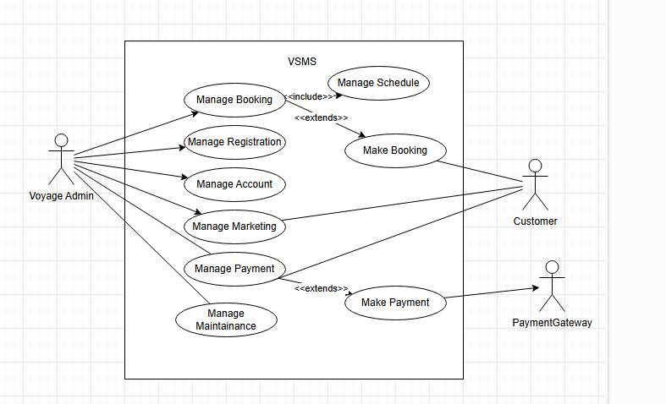
Example 3.3.1 OOAD – Use Case Diagram

Slide 7
Example 3.3.3 OOAD – Use Case Description
Use Case Name
Brief Description
Actor
Pre-Conditions
Basic Flow
Post Conditions
Constraints

Slide 8
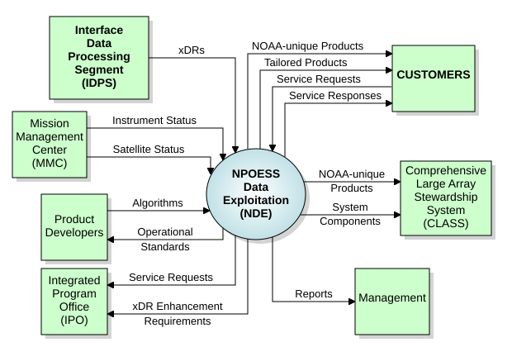
Example 3.3.2 SSAD – ContextDiagram

Slide 9
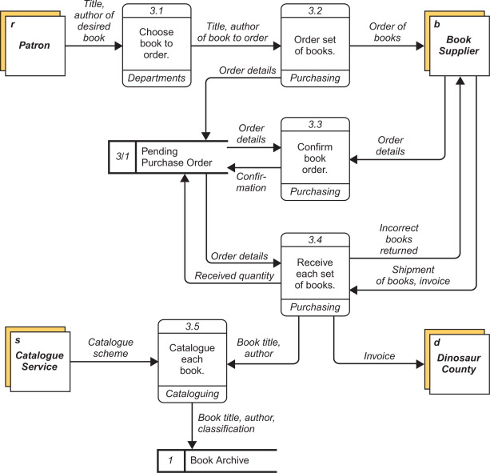
Example 3.3.2 SSAD – DFD

Slide 10
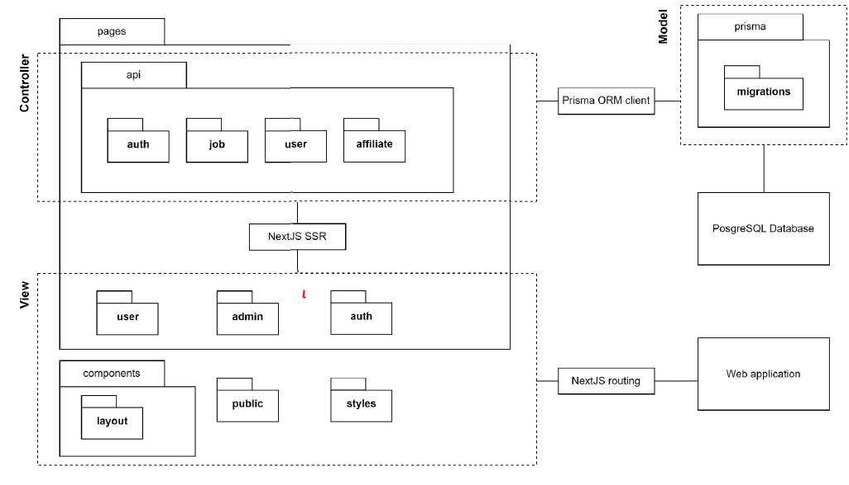
Example 3.4.1 Propose Design
Project Based: Package Structure ( High level View) in Implementation + API+ Middleware or Library Use

Slide 11
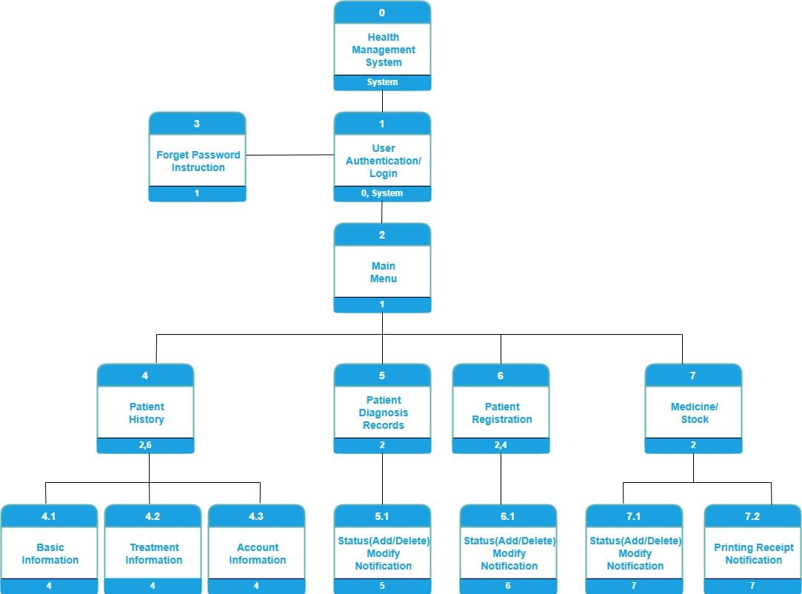
Example 3.4.2 SSAD Dialogue Diagram

Slide 12
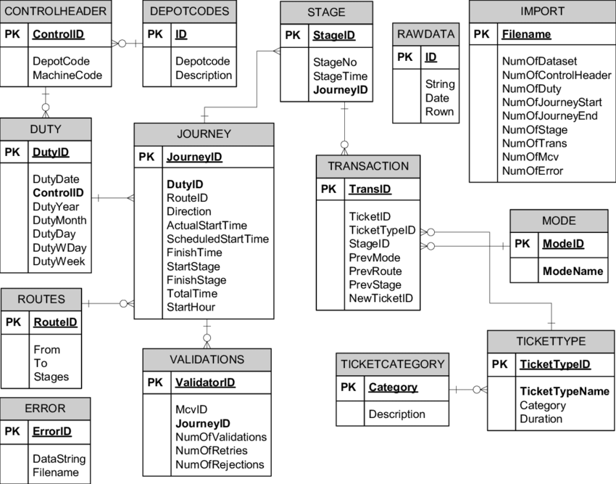
Example 3.5.1 ERD

Slide 13
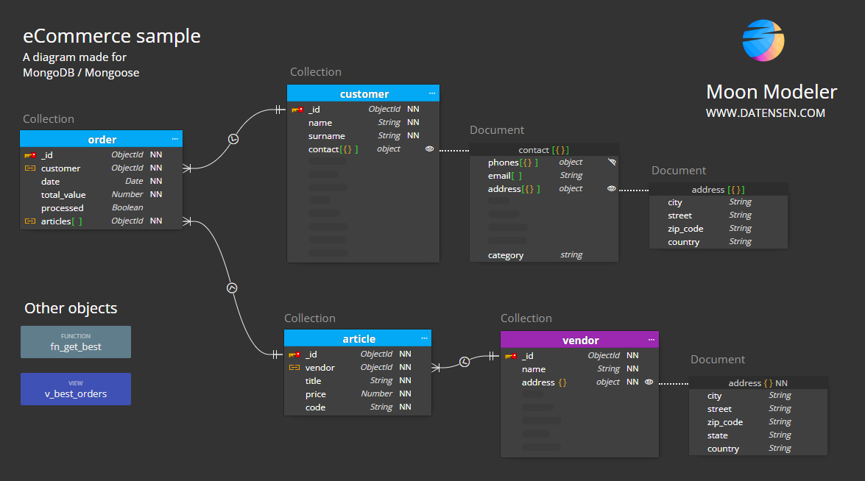
Example 3.5.2 JSON Tree

Slide 14
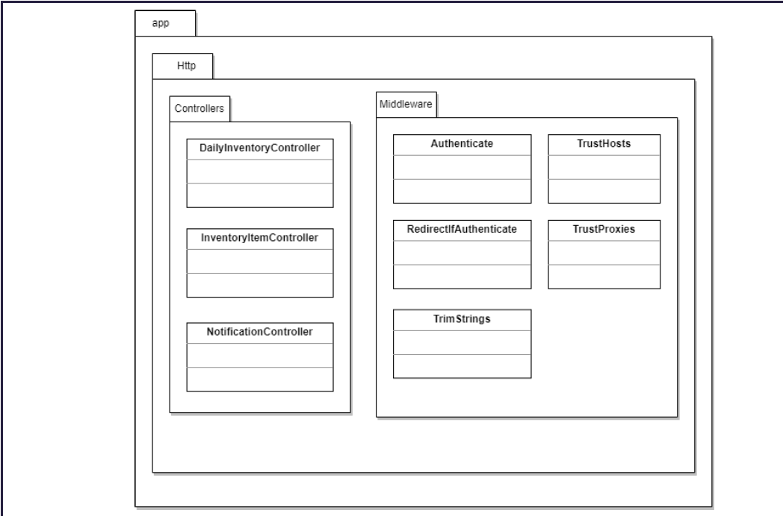
Example 3.6 Proof of Concept
Sub package Struture

Slide 15
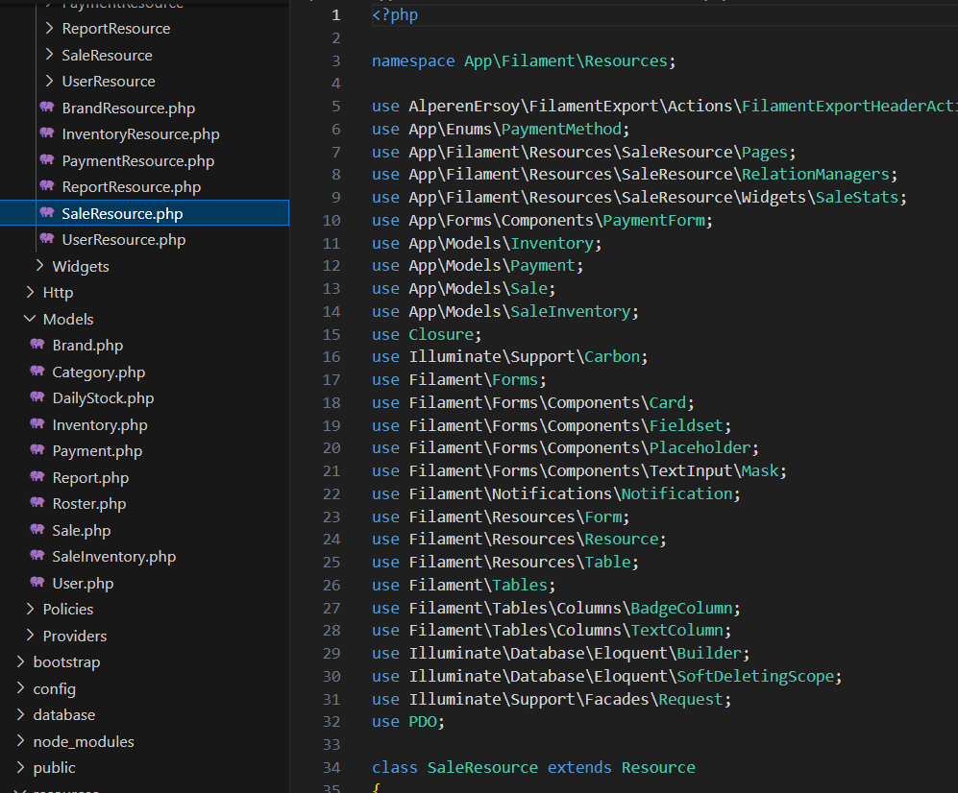
Example 3.6 Proof of Concept
Example of Implementation

Slide 16
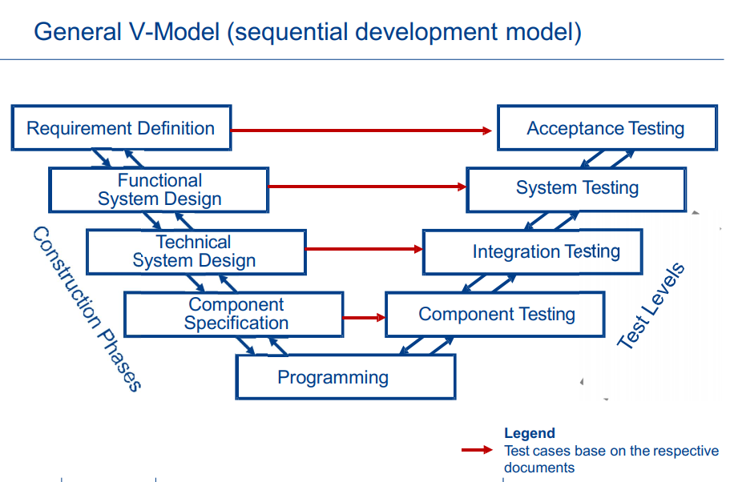
Example 3.7 Testing Plan

Slide 17
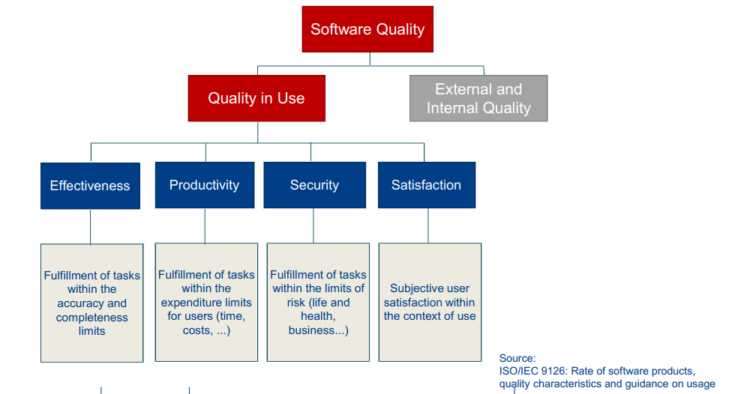
Example 3.7 Testing Plan

Slide 18
Example 3.7.1 Testing Strategy for Functional Requirements
Testing based on requirements
Business process-based testing
Use Case Testing

Slide 19
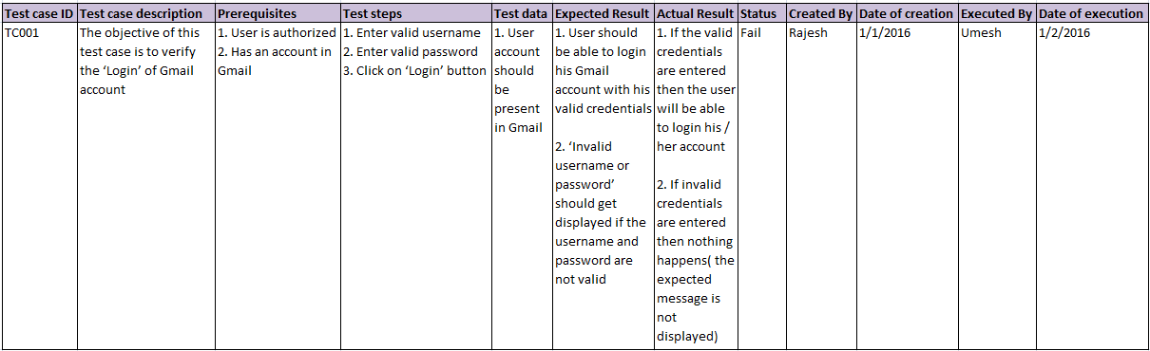
Test Case – SE student

Slide 20
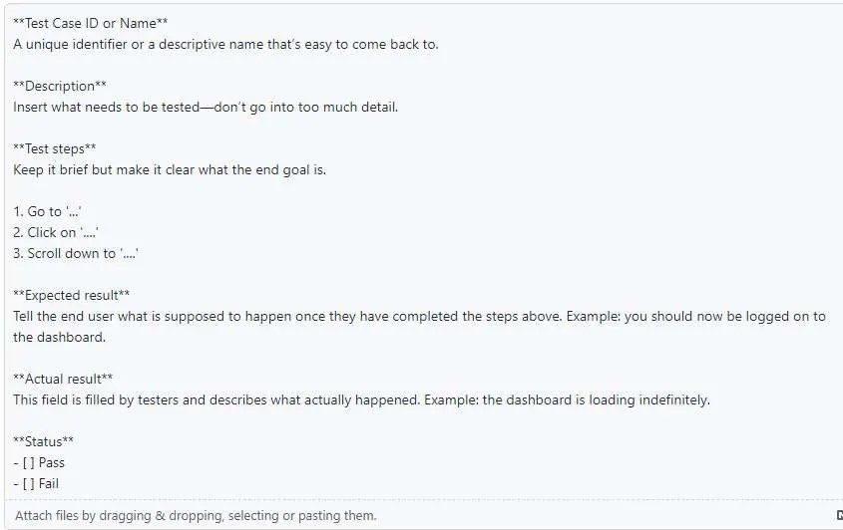
UAT Method

Slide 21
Test Result
Test Case ID | Test Case Description | Result | Remarks

Slide 22
Example 3.7 Testing Strategy for Survey
Survey testing is an important part of the survey development process to provide guide to
1. Adequacy of the sampling frame
2. Variability of the target population about the survey subject
3. Expected non-response rate and the effectiveness of measures aimed at reducing non-response
4. Suitability of the data collection method, including testing of various methods to determine the most suitable
5. Adequacy of the questionnaire, including testing of alternative versions to determine the most effective
6. Effectiveness of interviewer training and the adequacy of survey instructions
7. Answer categories to be used for pre-coded questions
8. Likely cost and duration of parts of the survey and the survey as a whole
9. Organisation of the survey.

Slide 23
Example 3.7.2 Testing Strategy for Survey
Testing based on a questionnaire
Expert Interview
Field testing with expert

Slide 24
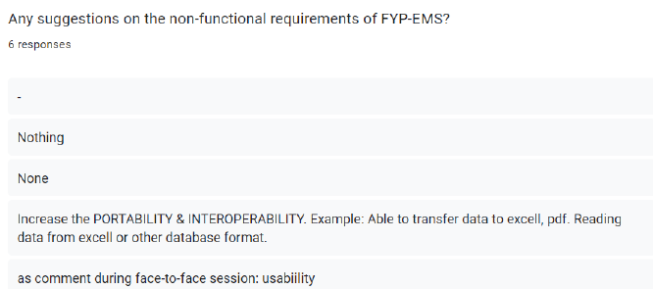
Survey Question Example

Slide 25
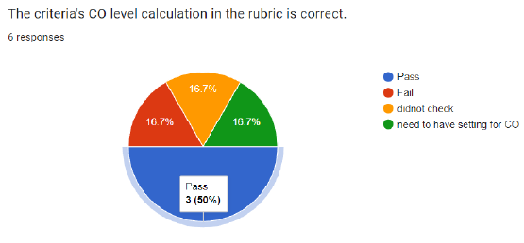
Survey Result Example

Slide 26
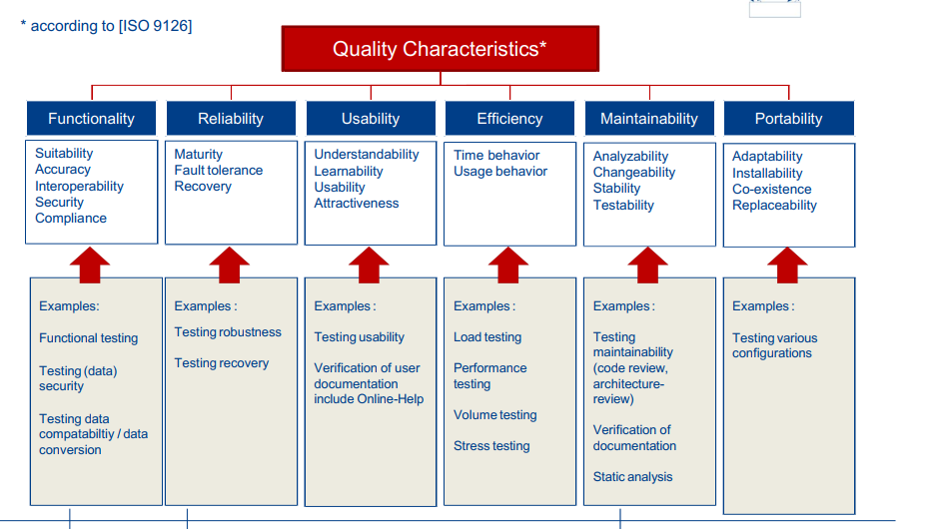
Example 3.7 Testing Strategy for Non-Functional Requirements

Slide 27

Thank You

