Slide 1
Simulation 4D
Simulate the different construction phases over time

Slide 2
Main Features
Task Scheduling
Save & Load Schedule
Modify Schedule
Assign objects to schedule
Gantt Chart Overview
4D Simulation
From the schedule, animate the objects to simulate construction
Different animation styles

Slide 3
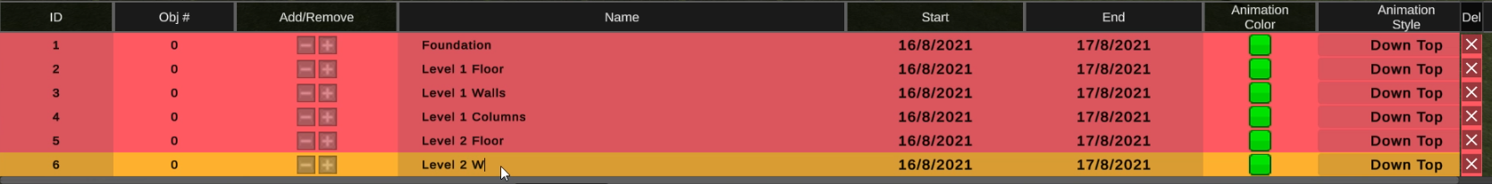
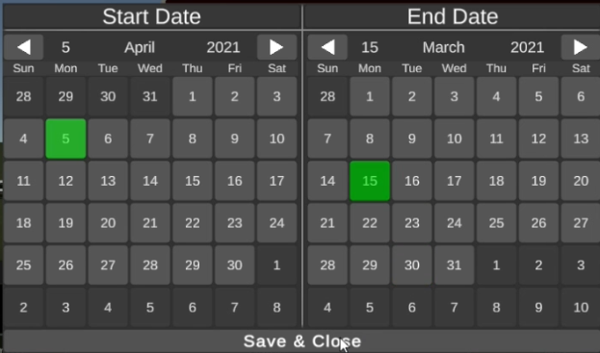
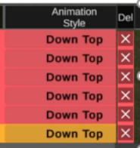
Task Scheduling Example
Schedule
Assign/Unassign Object
Change Start/End Date
Change Animation Style

Slide 4
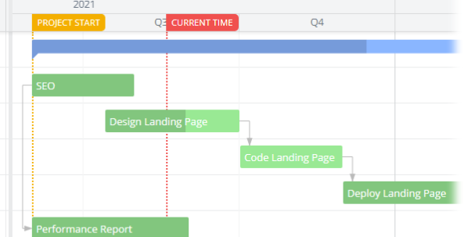
Schedule Issues
Task Dependency
How complex?
Applies to Gantt chart
Loading time
Schedule also checks and assign models reference
Model objects Count * Schedule Rows
Allow object to be assign to multiple task?
Allow Construction + Deconstruction?
Checking for object unique assignment is expensive
Potential animation clash in Simulation

Slide 5
4D Simulation Issues
Animation Style
Procedural Animation, start/stop anytime
Cast down animation (positional change) in order
Large Model Rendering
Adds to the issue with loading schedule loading times

Slide 6
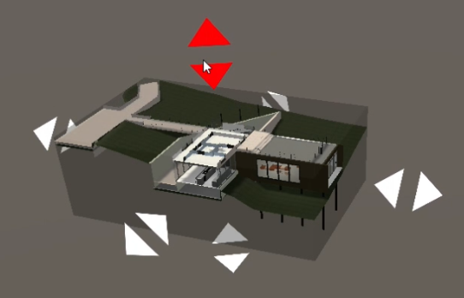
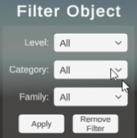
Secondary Features
To help with Task Scheduling
Section Box (Cross-section view)
Object Filtering (by Category,Type,Level)
Hide Assigned Objects
Section Box
Filter Object Window

Slide 7
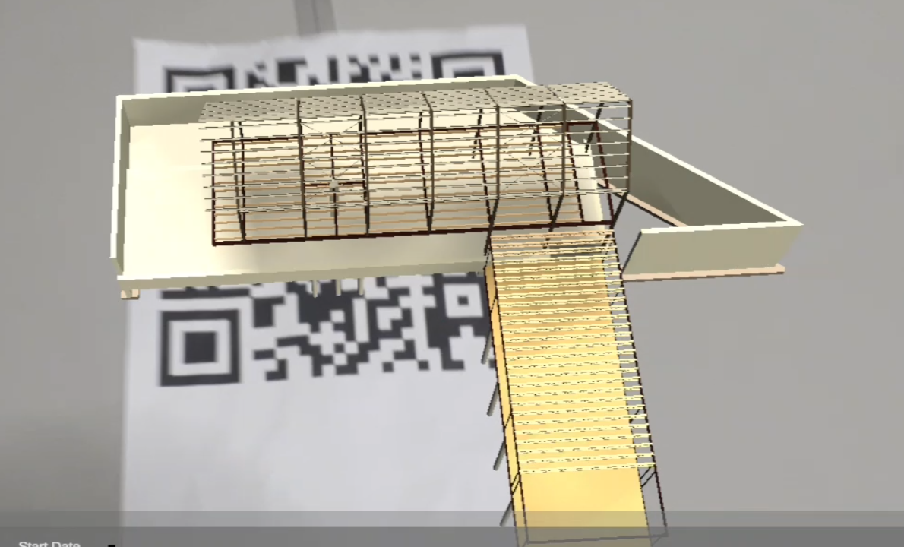
Secondary Features
To Showcase/Display work
Video Recording (save as mp3)
Mobile support + AR Support

Slide 8
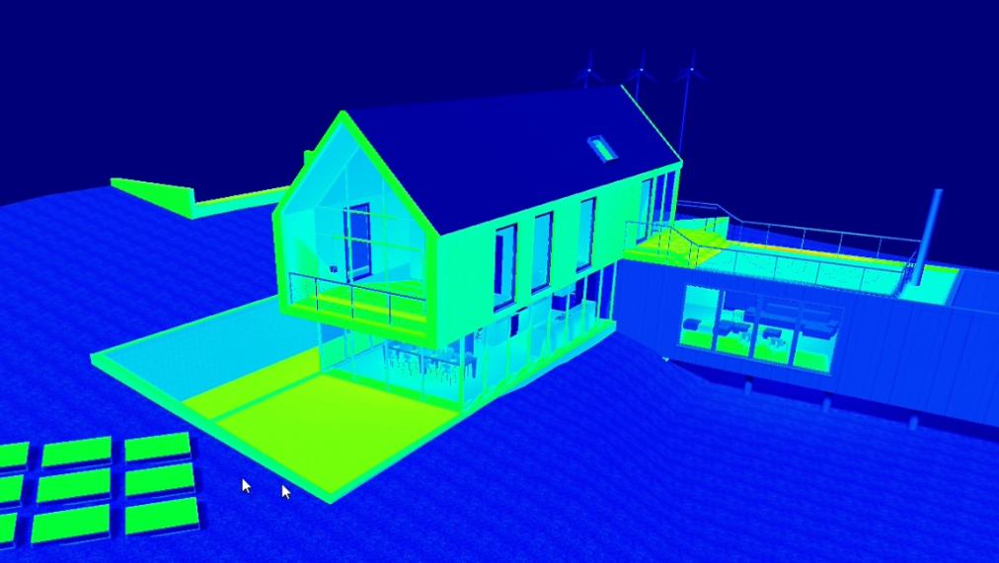
Extra Features
Live/Cloud Sync
Sync Models and Schedules
Analysis
Solar Analysis
Shows heatmap textured on the model
Wind Analysis
Shows windflow vectors of how wind flows though the model

