Slide 1
IoTSD Presentation
Done by L2 Khilfi 201945D

Slide 2

Arduino 7 Segment Display Clock Without RTC
Items given : 3 buttons and 2 LEDs
Features, Multi-functional. Able to change modes with button.
Mode change using Switch Case function

Slide 3
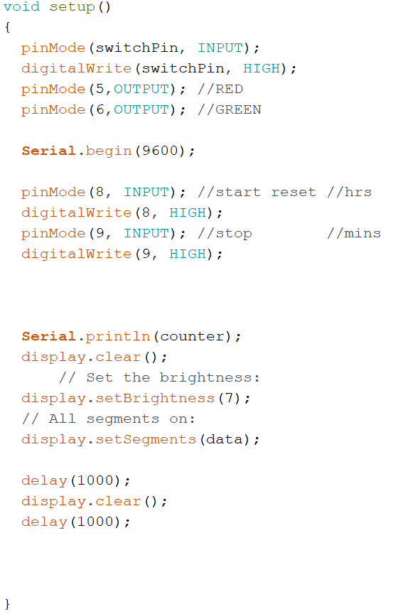
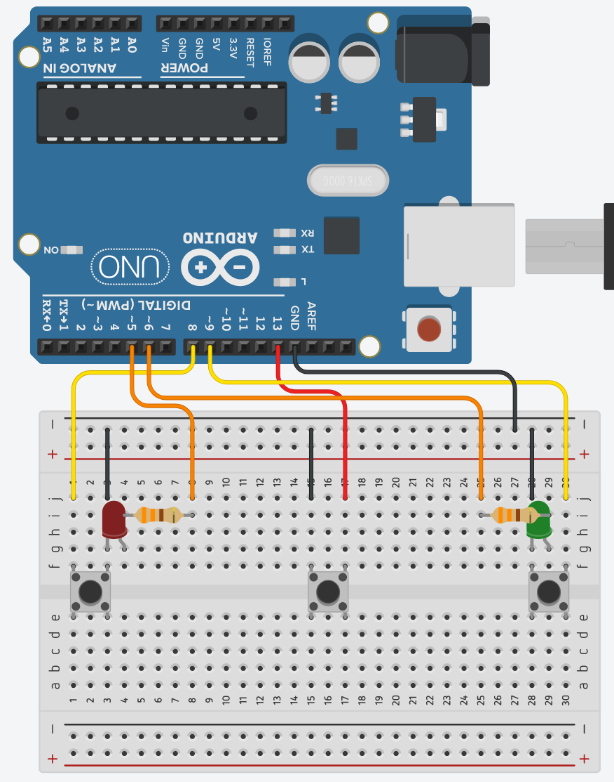
Schematics
Mode button is 13
Action button is 8 & 9
7 segment display is directly connected to Arduino
By default, when no buttons are pressed, 8 9 and 13 will be high.
Ground voltage will be applied to the button if the button is pressed

Slide 4
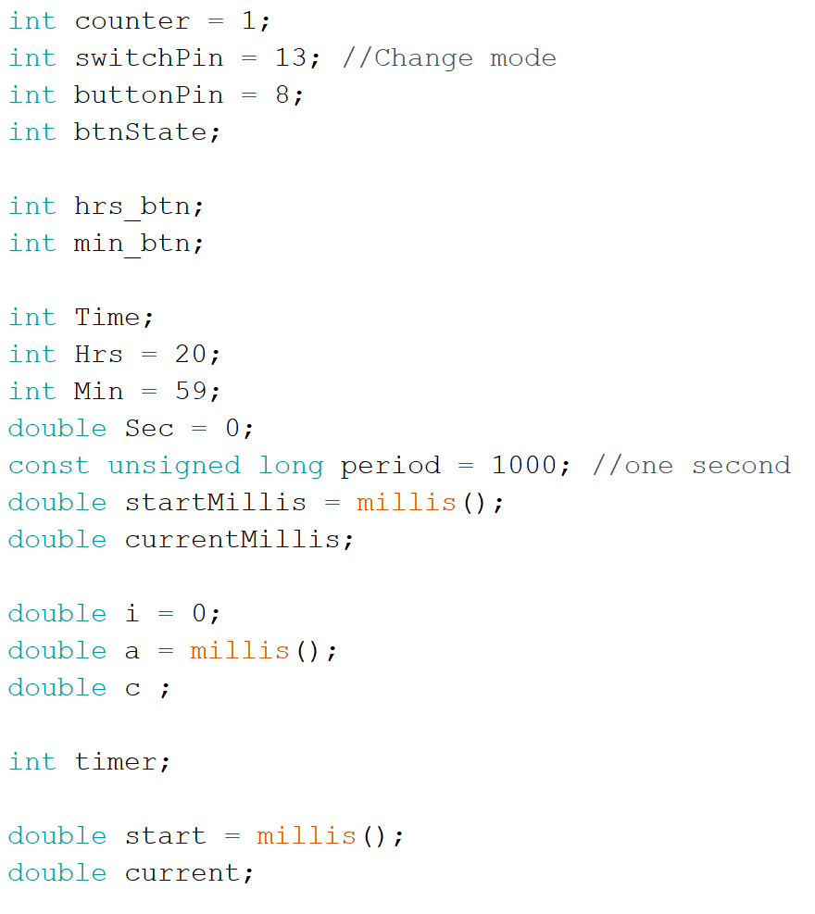
Declarations and Definitions

Slide 5
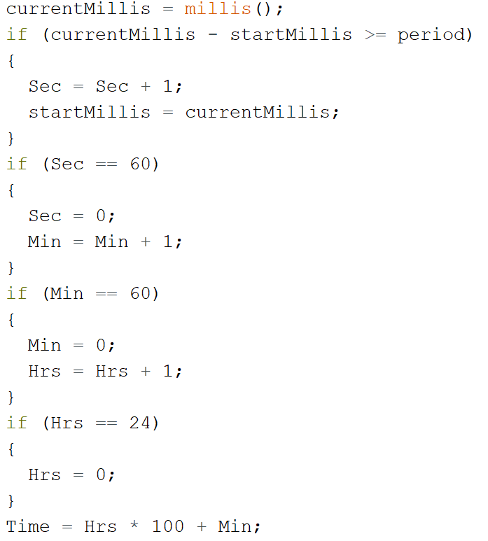
The clock
Period is 1000ms (1s)
Sec + 1 only if its more than 1s
The clock runs in the “background”. It is not in the switch case

Slide 6
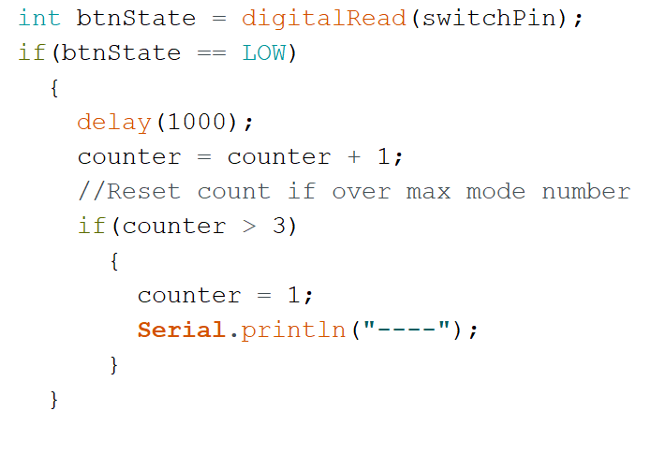
The Switch Case for buttons
By default all the buttons are on. Thus the if statement (change mode) will occur only when the button is pressed
If its pressed. The counter will +1 and will reset to 1 again if it exceeds 3
The cases are from the counter “switch(counter)”

Slide 7
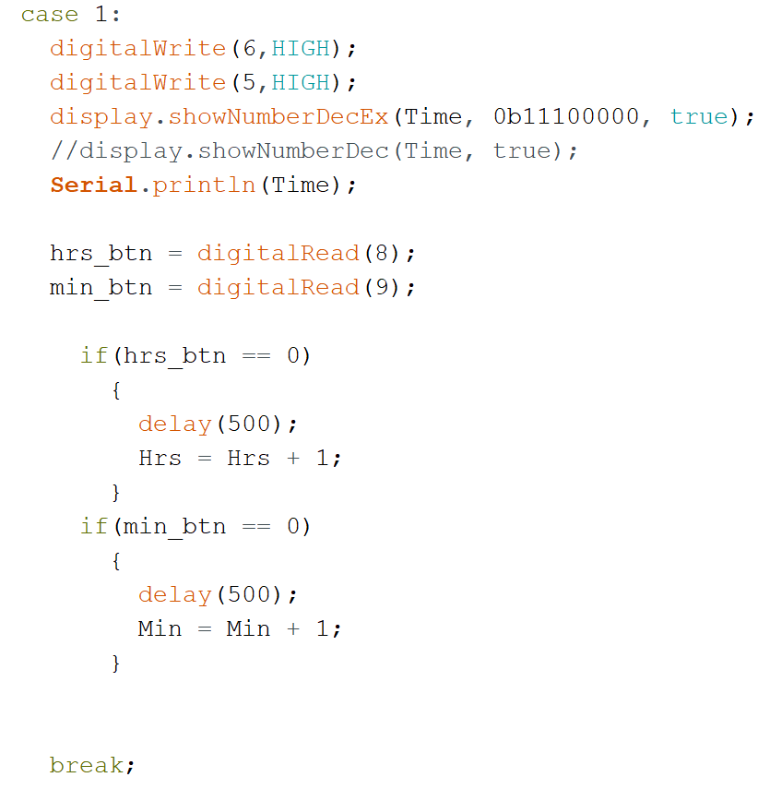
Case 1: Setting time on the clock
In case 1, hrs int will +1 only when the button is pressed
Same could be said for mins button.
RED and GREEN led will light up

Slide 8
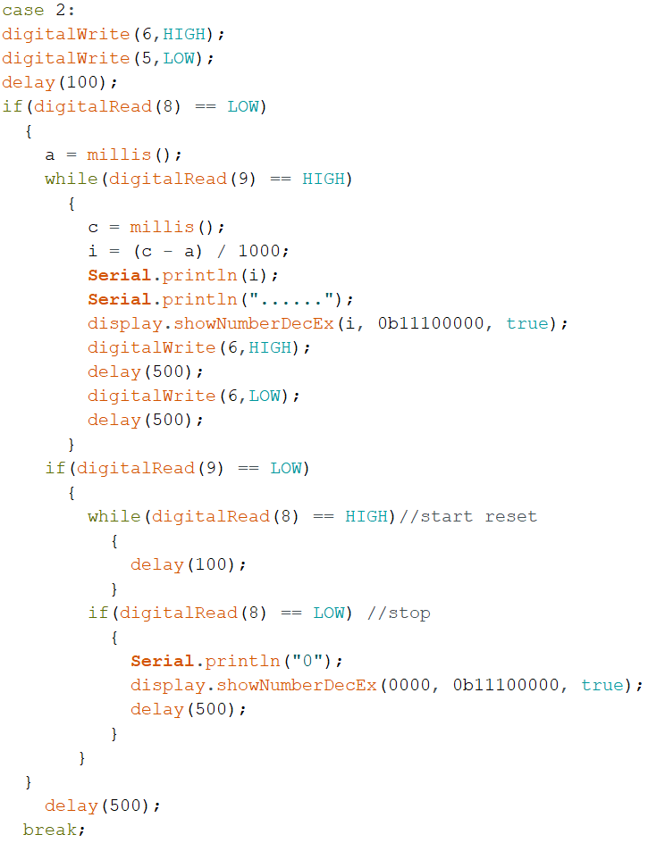
Case 2: Stopwatch Timer
The while loop will trigger only when the button is pressed.
The while loop will continue running after the user let go as the default of the pin is HIGH. It will stop when pressed again. Triggering another while loop
The while loop will do nothing until its pressed again to reset. I will be 0 everytime as its declared globally as 0
ONLY Green LED light up and will BLINK when stopwatch is running

Slide 9
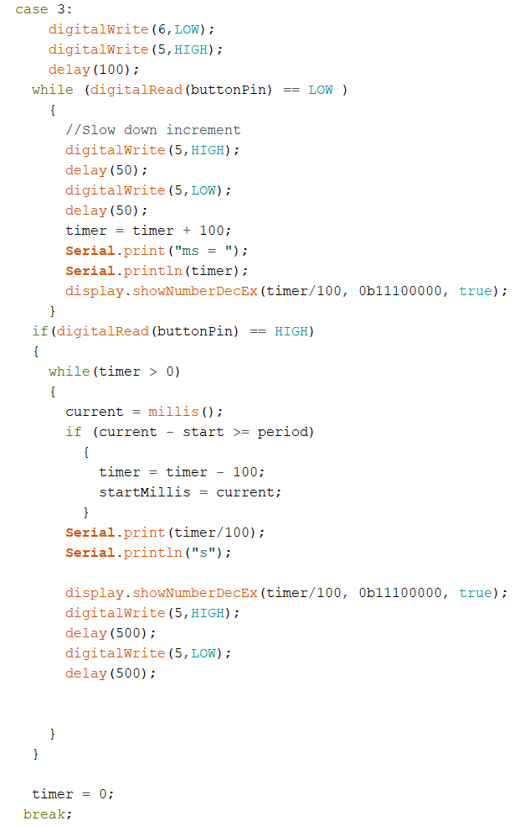
Case 3: Countdown Timer
Timer will record how many ms the user hold and will divide the time by 100 as countdown starter
Example hold for 1000ms = 10s countdown
Countdown will begin when button pin is HIGH (user let go after holding)
ONLY Red LED light up and will BLINK when being held and during countdown

Slide 10
Extras
More modes as its theoretically possible to just add more cases.
Alternatively the ability to detect how long the user holds can open up to other modes in modes
Example if user hold 100ms {something2}
Else if user hold 500ms{something2}
So on and so forth

Slide 11
End of presentation

