Slide 1
Considerations from the last meeting with Mr. Aris (7 March)
User’s point of contact with the system- handphone
Notification – WhatsApp
Automatic watering, but also prefer to have manual control via phone
Prefer the design to be mobile
Prefer not to depend fully on electricity & want rechargeable design
Same PH for all stages (6.5 to 7)
Different moisture is required for different stages
Based on the water & PH level, not timing
REQ GP1
System & software
REQ GP2
Physical design
REQ GP3
Logics

Slide 2
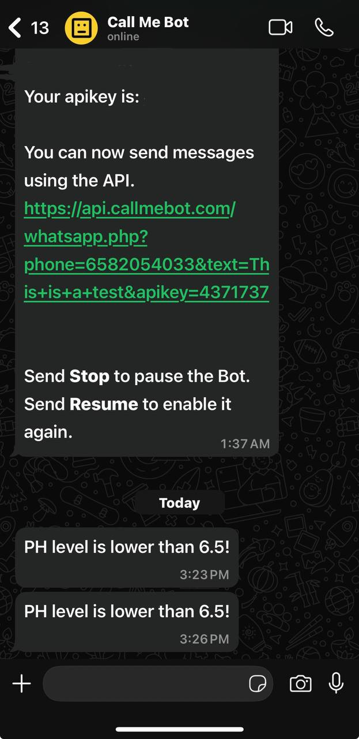
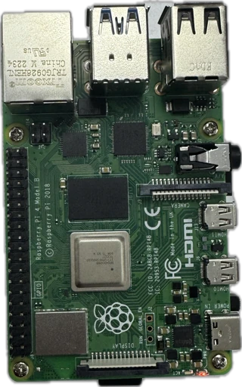


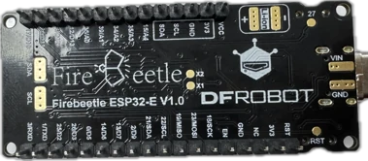
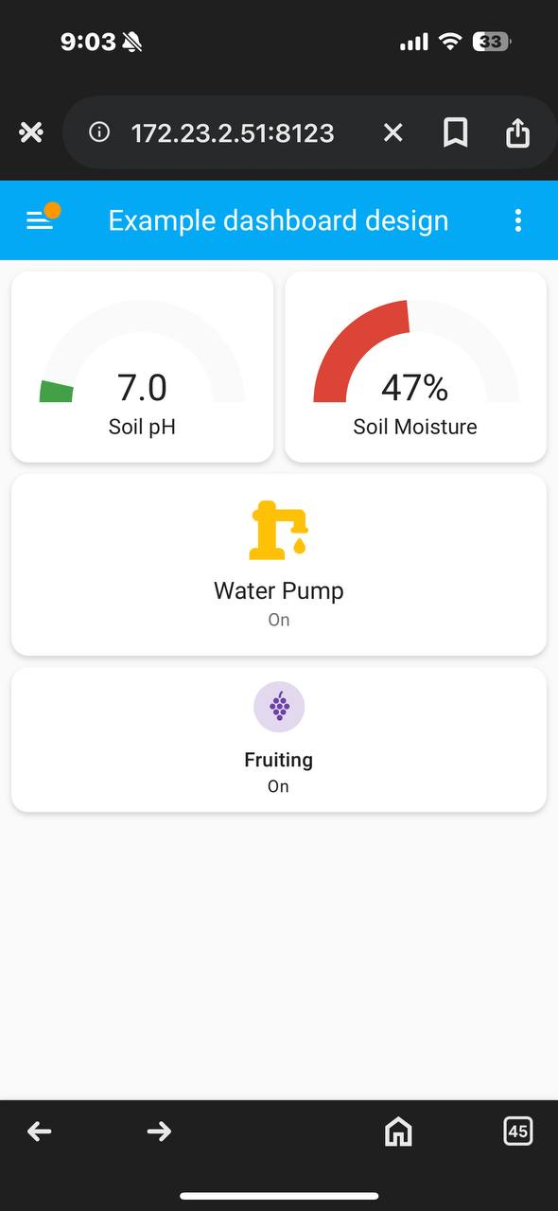
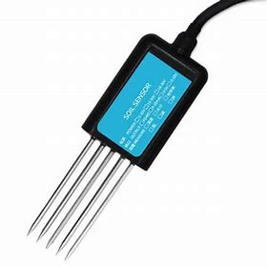
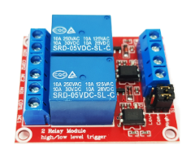

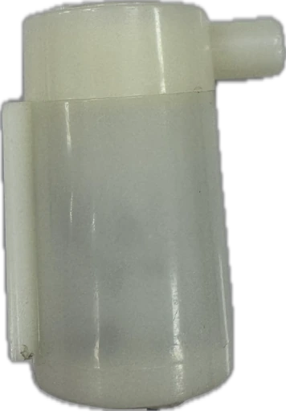
System design
Server: Raspberry Pi
Node-red
(will handle all logics)
Call me bot WhatsApp API
MQTT
MQTT client
MQTT
The system monitors sensor data via the microcontroller and sends it to a Raspberry Pi using MQTT.
Mode-red handles automation and alerts.
Home Assistant lets the user view and control the system.
Notifications are sent through WhatsApp.
Home Assistant (for user interface)
Benefit in future expansion
Can control many microcontrollers with one Raspberry Pi
Notes:
browser

Slide 3
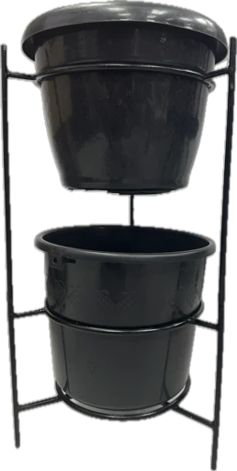
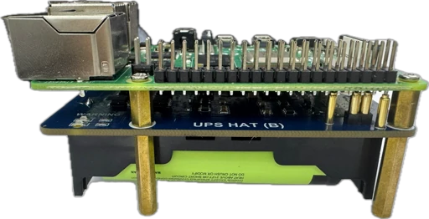
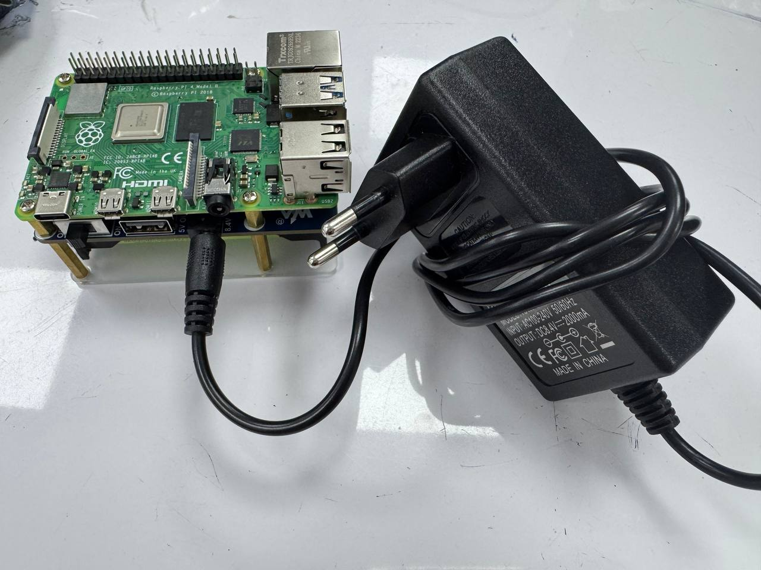
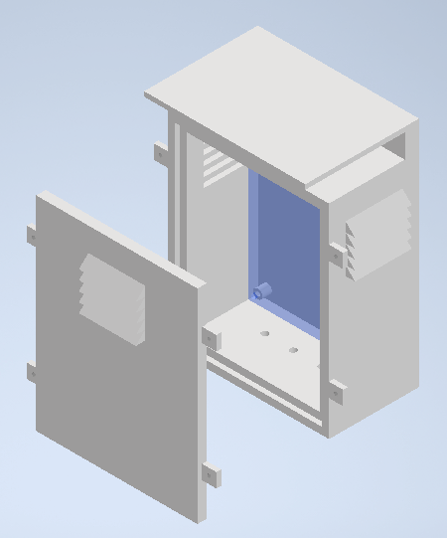
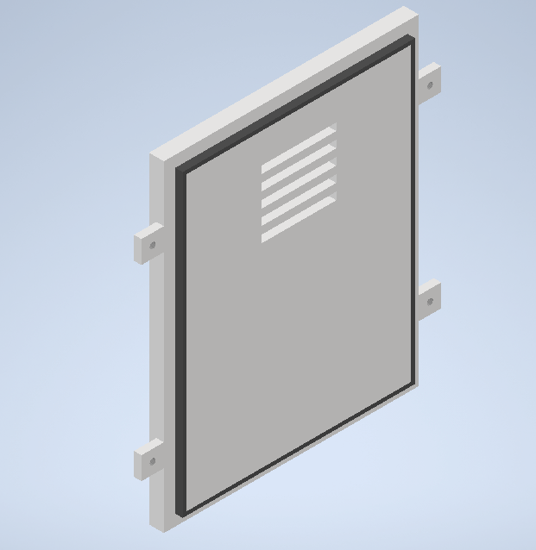
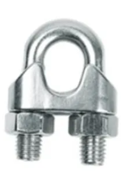
Power source & casing design
Power source: Rechargeable battery
Detachable case initial design
Charger
Roof: protect from direct sunlight
Raspberry Pi
Louvre holes: prevent hot air trapped inside
Control box
Rubber: reduce the risk of water coming in
Battery
Support Raspberry Pi to run on battery
Cons: only lasts around 7 hours
U-type clamp:
make holes at the back of the case and screw it around the stand
Cons: risk of water entering due to louvre holes

Slide 4
Key logics inside Node-Red
Sensor will check PH and moisture level every 1minutes
If pH or moisture level is lower than the specified limit, Note-Red will send a notification to the user
If the moisture level is low, Node-Red will automatically do the process beside
The user will have access to switch from the Home Assistant dashboard from the browser via mobile phone
Switch to choose plant life stages. The logic inside Node-Red will be changed based on this
Switch to control the water pump turn on/off
Moisture level < min limit
No
Turn off the pump
Yes
Turn on the pump for 3 minutes

Slide 5
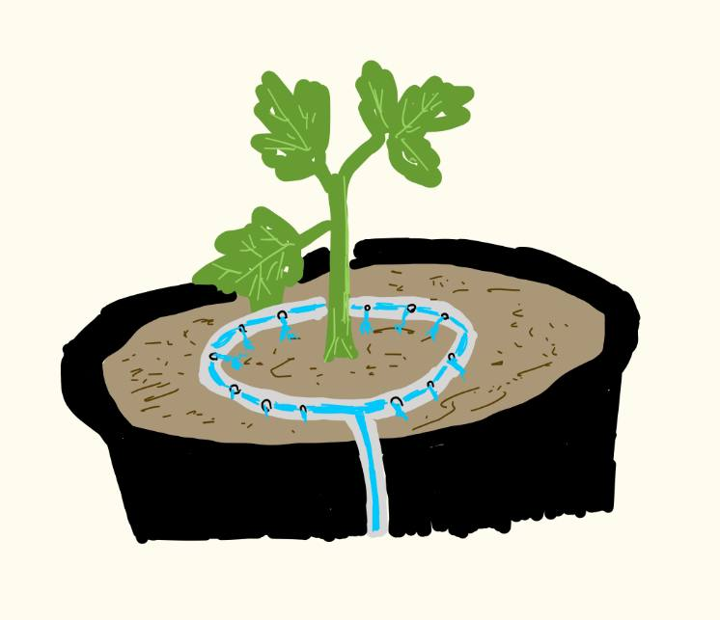
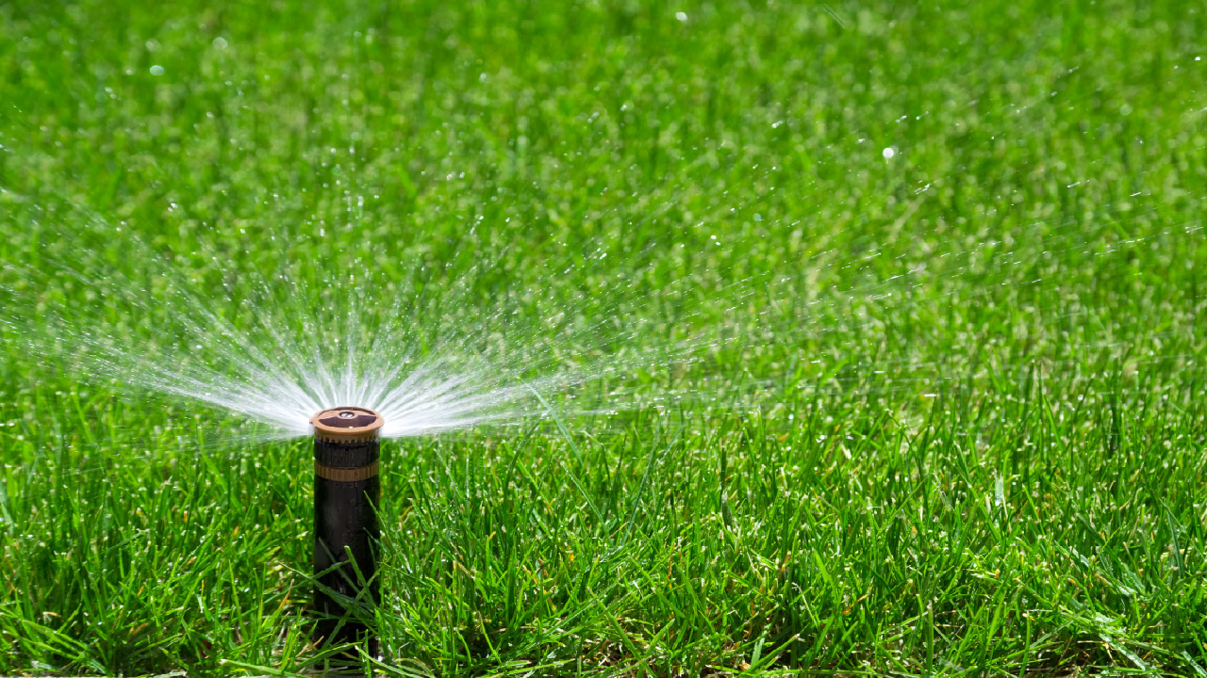
Ensuring even water distribution
1.Circular drip ring
Make a ring with a soft tube
Poke small holes evenly spaced around the ring
Put the ring around the plant
Connect the ring with water pipe
Small holes along the tube
Soft tube
Water pipe from the pump
2.Sprinkler
Pros: covers wide areas easily
Cons: not water-efficient, won’t work well with low water pressure

