Slide 1


Feature Extraction from Children’s Speech for Gender Classification
12th National Conference
on Science and Engineering 2019
Presented By:
Ma Khin Aye Chan
NCSE2019-CEIT002
27th -28th ,June

Slide 2
Outlines of Presentation
Introduction
Problem Statement
Theoretical Background
Proposed System Design
Experimental Results
Conclusion
References

Slide 3
Introduction
Nowadays classification of gender is one of the most important processes in speech processing.
Speech processing is the study of speech signals and the processing methods of signals.
Many applications based on speech processing such as speaker identification, smart human computer interaction, biometrics social robots, audio or video content indexing, health related communications. etc., use gender classification.
Automatic gender classification from speech is a basic and important phase in speech recognition.

Slide 4
Problem Statement
Gender identiﬁcation of children is difﬁcult than adults, it is confusing to identify whether the speaking child is male or female.
Due to underdeveloped vocal tract and thin vocal folds in both male and female child, there is no signiﬁcant difference in their acoustic-phonetic properties.

Slide 5
Theoretical Background
Feature Extraction
The extraction of the relevant and important information from the speech signals of the human voice is an important task to produce a latter recognition performance.
The most widely used features for speech recognition are the acoustic features namely MFCC.
MFCC is the most nearest to the actual human auditory speech perception.

Slide 6
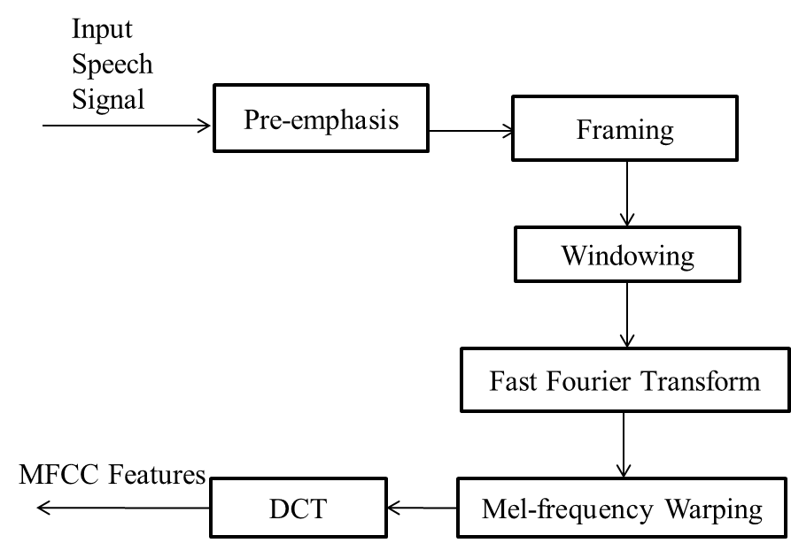
Theoretical Background (Cont’d)
Figure. 1 shows the detail process of MFCC feature extraction from speech.
Fig. 1: Step by Step Process of MFCC

Slide 7
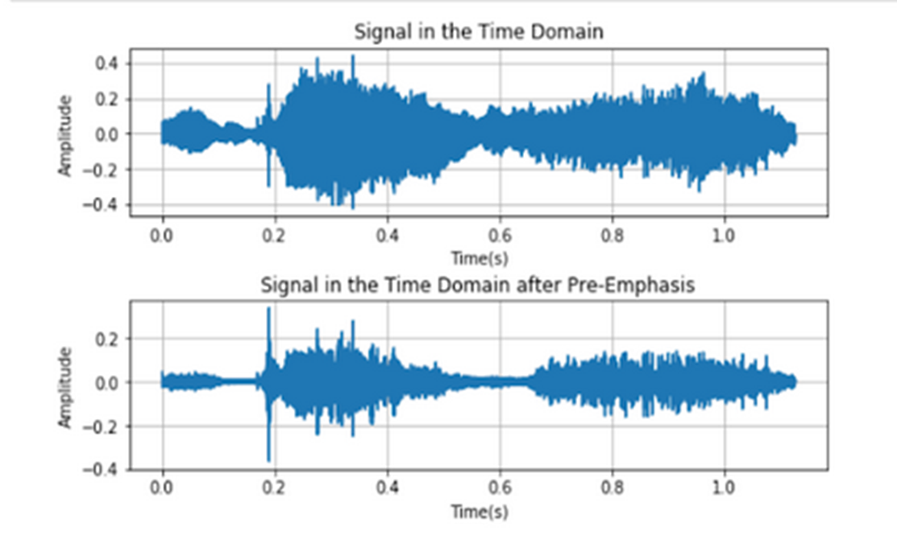
Theoretical Background (Cont’d)
Step1: Pre-emphasis
A high pass filter is applied on the signal and this filter increases the energy of higher frequency signal and decreases the energy of lower frequency signal and obtains a much evenly distributed spectrum.
Fig. 2: Original Signal Vs Pre-emphasis Signal

Slide 8
Theoretical Background (Cont’d)
Step2: Framing
Framing is the process of blocking the speech signal into short portion of n samples known as frames in the time domain.
These frames are generally selected as 20-30 milliseconds, and frame step is about 10-15 milliseconds along the signal.

Slide 9

Theoretical Background (Cont’d)
Step 3: Windowing
Each individual frame is multiplied with a window function to minimize signal discontinuities at the beginning and at the end of each frame .
This step makes the end of each frame connects smoothly with the beginning of the next.
MFCC uses hamming window and the equation is as follows:
Where: n = number of samples in each frame
Y(n) = Output Signal
x(n) = Input Signal
W(n) = Hamming window
$$Y\left(n\right)=x\left(n\right). W(n)$$

Slide 10
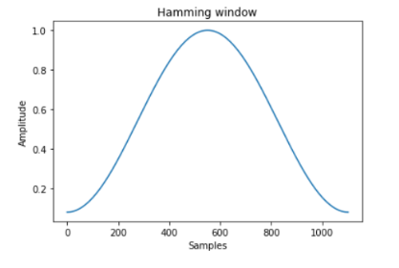

Theoretical Background (Cont’d)
A Hamming window has the following form:
where: 0 ≤ n ≤ N−1, N = the window length
$W\left(n\right)=0.54−0.46\cos{(\frac{2πn}{N−1}}$)
Fig. 3: Hamming Window with 1000 samples

Slide 11
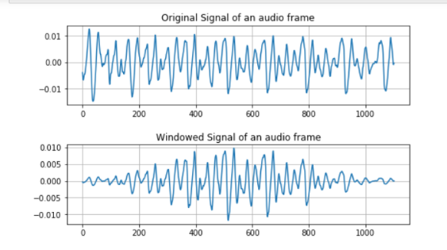
Theoretical Background (Cont’d)
Fig. 4: Windowing of an Audio Frame

Slide 12

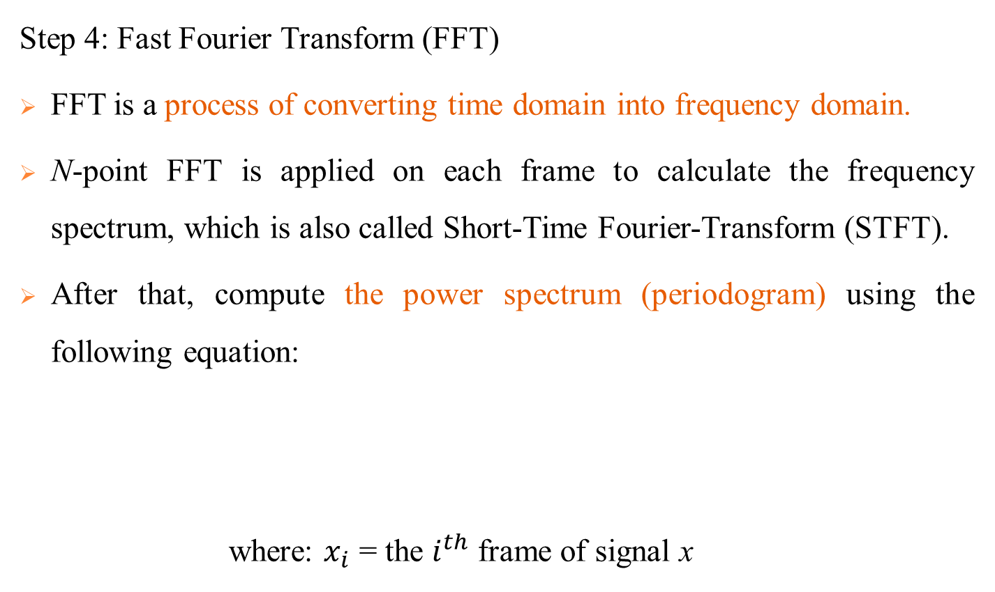
Theoretical Background (Cont’d)
Step 4: Fast Fourier Transform (FFT)
FFT is a process of converting time domain into frequency domain.
N-point FFT is applied on each frame to calculate the frequency spectrum, which is also called Short-Time Fourier-Transform (STFT).
After that, compute the power spectrum (periodogram) using the following equation:
where: $x_{i}$ = the $i^{th}$ frame of signal x
$$P=\frac{{|FFT\left(x_{i}\right)|}^{2}}{N}$$

Slide 13
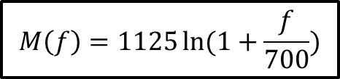
Theoretical Background (Cont’d)
Step 5: Mel-frequency Warping
The main process in this step is to convert the frequency spectrum to Mel spectrum.
The Mel scale relates perceived frequency, or pitch, of a pure tone to its actual measured frequency.
The Mel-frequency is defined as:
At this stage, mel filterbank energies is obtained by multiplying power spectrum of the signal with mel filter bank.
Take the log of each of the energies and get log filterbank energies.
$$M\left(f\right)=1125\ln{(1+\frac{f}{700})}$$

Slide 14
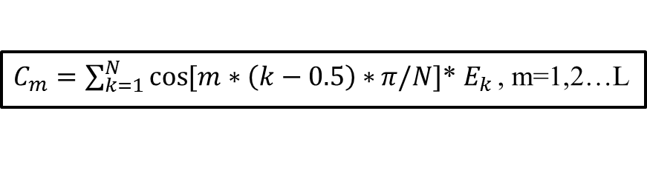
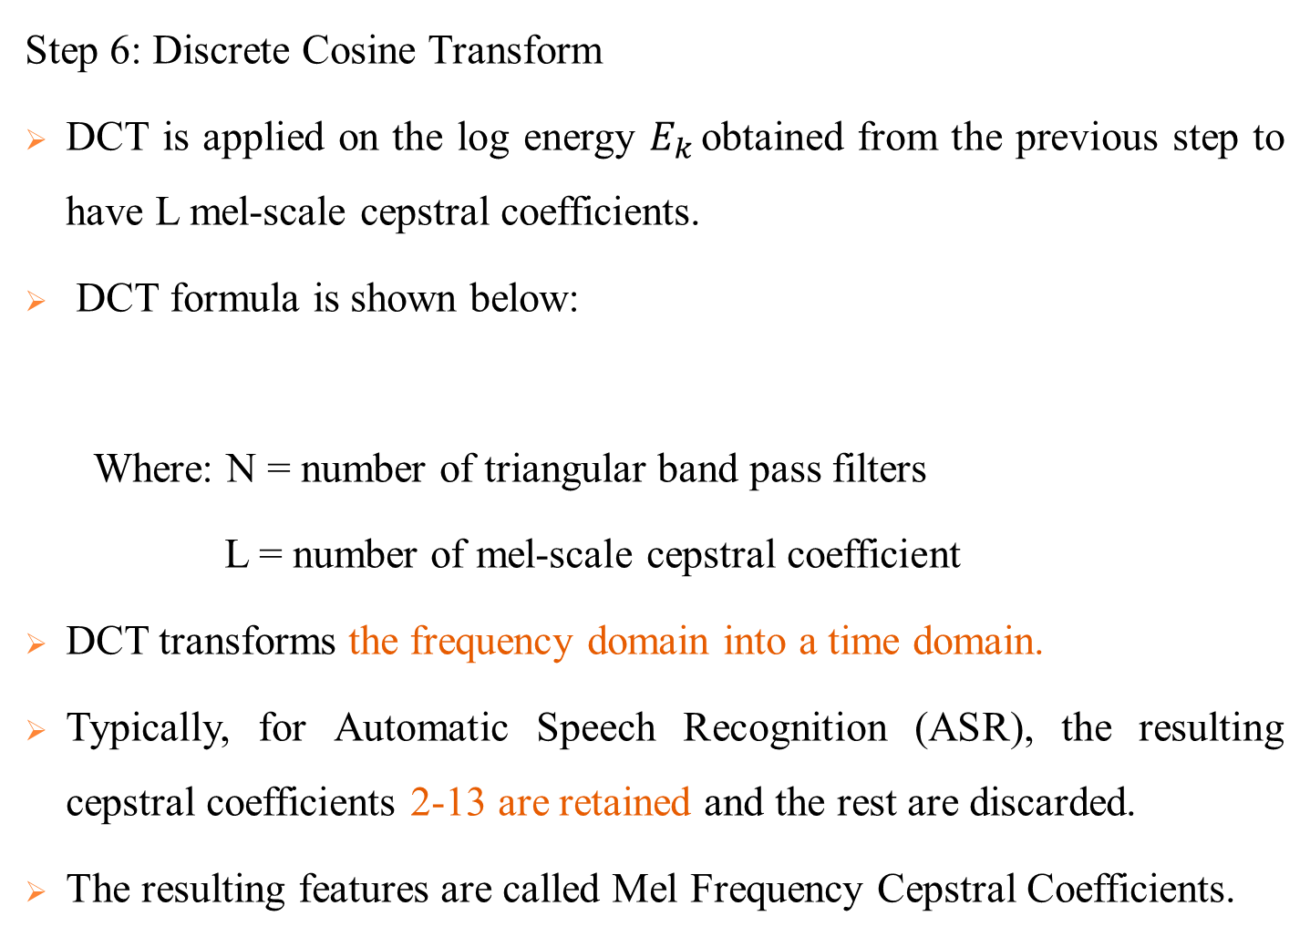
Theoretical Background (Cont’d)
Step 6: Discrete Cosine Transform
DCT is applied on the log energy $E_{k }$obtained from the previous step to have L mel-scale cepstral coefficients.
DCT formula is shown below:
Where: N = number of triangular band pass filters
L = number of mel-scale cepstral coefficient
DCT transforms the frequency domain into a time domain.
Typically, for Automatic Speech Recognition (ASR), the resulting cepstral coefficients 2-13 are retained and the rest are discarded.
The resulting features are called Mel Frequency Cepstral Coefficients.
$C_{m}=\sum_{k=1}^{N}{\cos{[m∗\left(k−0.5\right)∗}π/N]}$* $E_{k }$, m=1,2…L

Slide 15
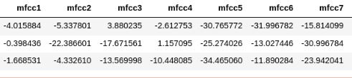
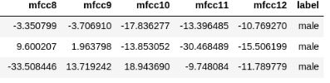
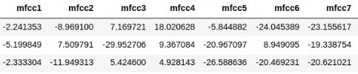
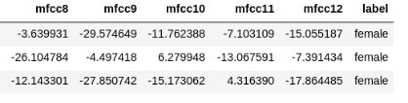
Theoretical Background (Cont’d)
Extracted features points which were collected in the CSV file can be seen in the figure 5.
Fig. 5: Features Extracted from MFCC

Slide 16
Theoretical Background (Cont’d)
Classification
Classification is establishing a mathematical model that separates into male and female based on the features of children’s speech.
There are different kinds of classification algorithms: Logistic Regression, Support Vector Machine, Decision Tree, Random Forest etc.
In this system, Random Forest Classifier is used to get the good classification result.

Slide 17
Theoretical Background (Cont’d)
Random Forest Classifier
Random Forest is a supervised learning algorithm.
It is an ensemble of Decision Trees, most of the time trained with the “bagging” method.
The general idea of the bagging method is that a combination of learning models increases the overall result.
To say it in simple words: Random forest builds multiple decision trees and merges them together to get a more accurate and stable prediction.

Slide 18

Theoretical Background (Cont’d)
Fig. 6: Prediction Model of Random Forest Classifier

Slide 19
Proposed System Design
The system has three main processing stages.
The first stage is preprocessing the speech signal.
The second stage involves feature extraction by MFCC algorithm .
In the last stage, extracted features are evaluated using RF classifier to predict children’s gender.

Slide 20
Proposed System Design (Cont’d)
Start
Children Speech
(6 to 11 age range)
Preprocessing
Feature Extraction
(MFCCs)
Classification
(Random Forest)
Predicted Output
(Male/Female)
End
Fig. 7: System Flow Diagram

Slide 21
Proposed System Design (Cont’d)
Data Collection
For training and testing dataset, 600 audio files from children of KG to Grade V (age range 6 to 11 years) are collected.
A boy and a girl for each year are selected and asked to speak 5 Myanmar sentences repeatedly about 10 times.
Record their voice in quiet classrooms using SONY Digital Stereo High Definition recorder.
File Type | .wav format
Duration | 2 or 3 second
Numbers of Channel | Mono (1 Channel)
Sampling Frequency | 44.1 kHz
Number of Bits | 16 bits
Table 1: Recording Specification

Slide 22
Proposed System Design(Cont’d)
Preprocessing
Only voiced region of speech contains most of the gender related information.
So silence and unvoiced regions are removed from the speech signals.
Noise reduction from these voice clips is done with using ACID pro voice editing software.

Slide 23
Experimental Results
Separating data into training and testing sets is an important part of evaluating classification models.
Classification model is built on the training set and check the accuracy of the model by using it on the testing set.
Currently the system uses 480 audio records are used as training dataset and 120 records are used for testing.

Slide 24
Experimental Results (Cont’d)
Training set classification rate is 99% and testing set classification rate is 88%.
Table 2 is a confusion matrix which shows the number of correct and incorrect predictions made by the classification model compared to the actual outcomes (target value) in the data.
Actual Group | Predicted Group
 | Male | Female
Male | 44 (TP) | 10 (FN)
Female | 4 (FP) | 62(TN)
Table 2. Confusion Matrix After Evaluating RF Classifier

Slide 25
Experimental Results (Cont’d)
True Positive (TP) : The true label of the given instance is positive, and the classifier also predicts it as a positive.
True Negative (TN) : The true label is negative, and the classifier also predicts a negative.
False Positive (FP) : The true label is negative, but the classifier incorrectly predicts it as positive.
False Negative (FN) : The true label is positive, but the classifier incorrectly predicts it as negative.

Slide 26
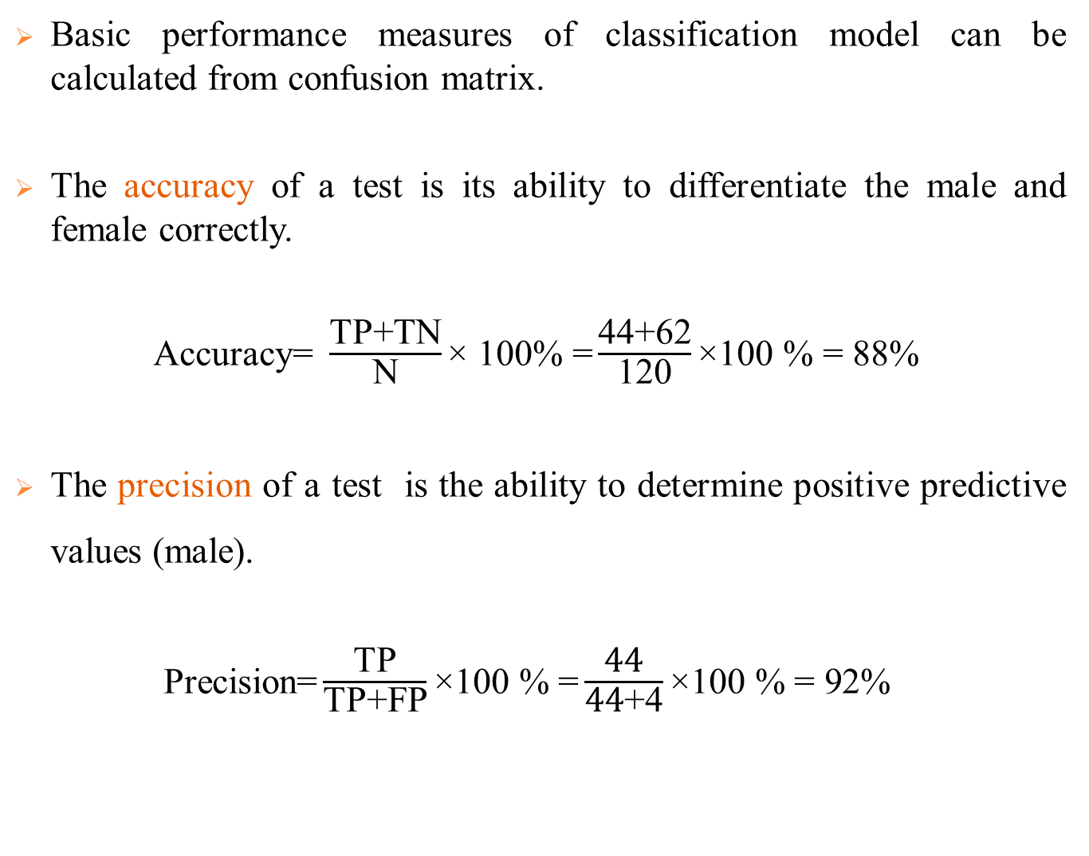
Experimental Results (Cont’d)
Basic performance measures of classification model can be calculated from confusion matrix.
The accuracy of a test is its ability to differentiate the male and female correctly.
$\text{Accuracy}\text{= }\frac{\text{TP}\text{+}\text{TN}}{\text{N}}\text{× 100\% =}\frac{\text{44}\text{+}\text{62}}{\text{120}}\text{×100 \% = }\text{88}\text{\% }$
The precision of a test is the ability to determine positive predictive values (male).
Precision$\text{=}\frac{\text{TP}}{\text{TP}\text{+}\text{FP}}\text{×100 \% =}\frac{\text{44}}{\text{44}\text{+}\text{4}}\text{×100 \% = }\text{92}\text{\% }$

Slide 27
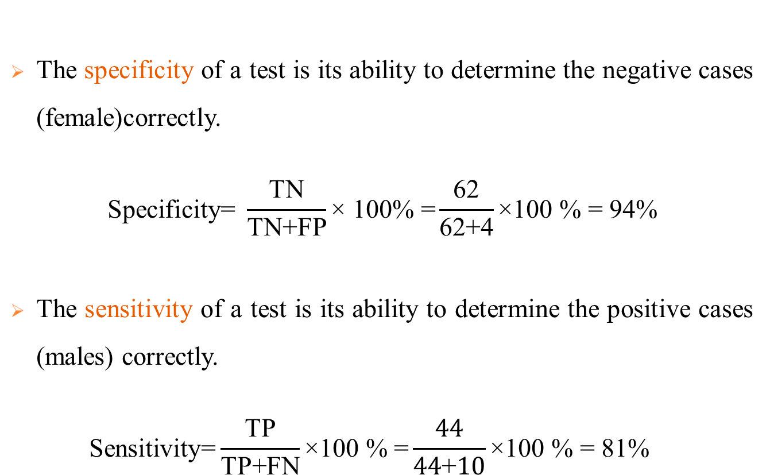
Experimental Results (Cont’d)
The specificity of a test is its ability to determine the negative cases (female)correctly.
$$\text{Specificity}\text{= }\frac{\text{TN}}{\text{TN}\text{+}\text{FP}}\text{× 100\% =}\frac{\text{62}}{\text{62+4}}\text{×100 \% = 94\%}$$
The sensitivity of a test is its ability to determine the positive cases (males) correctly.
$$\text{Sensitivity}\text{=}\frac{\text{TP}}{\text{TP}\text{+}\text{FN}}\text{×100 \% =}\frac{\text{44}}{\text{44}\text{+}\text{10}}\text{×100 \% = 81\% }$$

Slide 28
Conclusion
The gender classification system by using Random Forest (RF) classifier based on MFCC features is implemented by applying Python programming language and the experimental results has been analyzed.
There are many challenges in this system because of different speakers, speaking styles and sound pitches.
The analysis of the results shows that the performance of the proposed system is good, as the accuracy achieved is 88% .
Therefore, it can be extended to the another researchers and can also be tested by using different features and other classification techniques.

Slide 29
References
Parwinder Pal Singh, Pushpa Rani, “An Approach to Extract Feature using MFCC,” OSR Journal of Engineering (IOSRJEN), vol. 04, Issue 08, Auguest, 2014.
Pravin Bhaskar Ramteke , Amulya A. Dixit , Sujata Supanekar , Nagraj V. Dharwadkar , and Shashidhar G. Koolagudi , “ Gender Identiﬁcation From Children’s Speech ”, Published in: Proceedings of 2018 Eleventh International Conference on Contemporary Computing (IC3), 2-4 August, 2018, Noida, India.
S. I. Levitan, T. Mishra, and S. Bangalore, “Automatic identiﬁcation of gender from speech,” in Proceeding of Speech Prosody, 2016.

Slide 30
Thank you for your attention!!!

