Slide 1

YANGON TECHNOLOGICAL UNIVERSITY
DEPARTMENT OF COMPUTER ENGINEERING AND INFORMATION TECHNOLOGY
Development of Children Gender Classification System Using Speech
(Second Seminar)
Presented By
Ma Khin Aye Chan
M.E CEIT -2
Supervised By
Dr. Su Su Maung
July 17, 2019

Slide 2
Outlines
Objectives
Introduction
System Design
Methodology
Experimental Results
Conclusion
References

Slide 3
Objectives
To study the algorithms of feature extraction (MFCC) and classification (RF)
To understand the speech recognition operations in details
To implement a gender classifier that can automatically predict the gender of the speaker

Slide 4
Introduction
Gender classification is to determine a person’s gender, e.g., male or female, based on his or her biometric cues.
There are a number of biometrics which may be used to classify gender such as the face, eyes, fingerprint and hand shape, speech etc.
This system aims at analyzing speech signals to predict the gender of the speaker.

Slide 5
System Design
Start
Figure 1
Children Speech
(6 to 11 age range)
Preprocessing
Feature Extraction
(MFCCs)
Predicted Output
(Male/Female)
Classification
(Random Forest)
End

Slide 6
Methodology
Feature Extraction using MFCC Algorithm
Mel-frequency Cepstral Coefﬁcients (MFCCs)
In sound processing, the mel-frequency cepstrum (MFC) is a representation of the short-term power spectrum of a sound.
The power spectrum describes the distribution of power into frequency components composing that signal.
MFCCs are coefficients that collectively make up an MFC.

Slide 7
Methodology (Cont’d)
Input Speech Signal
Pre-emphasis
Framing
Windowing
Fast Fourier Transform
MFCC Features
DCT
Mel-frequency Warping
Figure 2: Steps for Computing MFCCs

Slide 8
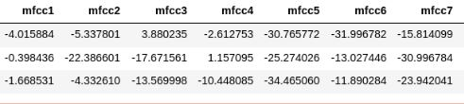
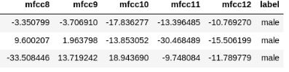
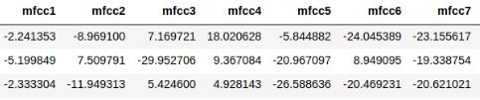
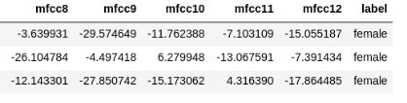
Methodology (Cont’d)
Extracted features points which were collected in the CSV file can be seen in the figure 3.
Fig. 2: Features Extracted from MFCC
Figure 3

Slide 9
Methodology (Cont’d)
Classification
Classification is establishing a mathematical model that separates into male and female based on the features of children’s speech.
There are different kinds of classification algorithms: Logistic Regression, Support Vector Machine, Decision Tree, Random Forest etc.
In this system, Random Forest Classifier is used to get the good classification result.

Slide 10
Methodology (Cont’d)
Random Forest Classifier
Random Forest is a supervised learning algorithm.
It is an ensemble of Decision Trees, most of the time trained with the “bagging” method.
The general idea of the bagging method is that a combination of learning models increases the overall result.
To say it in simple words: Random forest builds multiple decision trees and merges them together to get a more accurate and stable prediction.

Slide 11

Methodology (Cont’d)
Figure 4: Prediction Model of Random Forest Classifier

Slide 12
Experimental Results
Separating data into training and testing sets is an important part of evaluating classification models.
Classification model is built on the training set and check the accuracy of the model by using it on the testing set.
In this system voice dataset contains 600 audio records (300 for each gender).
Two testing is done to estimate the skill of the model: k-fold cross validation method and simple train test split.

Slide 13
Experimental Results (Cont’d)
k-Fold Cross-Validation
The general procedure is as follows:
Shuffle the dataset randomly.
Split the dataset into k groups
For each unique group:
Take the group as a hold out or test data set
Take the remaining groups as a training data set
Fit a model on the training set and evaluate it on the test set
Retain the evaluation score and discard the model
Summarize the skill of the model using the sample of model evaluation scores

Slide 14
Experimental Results (Cont’d)
Classifier | Random Forest
10-fold Cross Validation Score | 87%
 | 83%
 | 83%
 | 80%
 | 83%
 | 93%
 | 85%
 | 83%
 | 85%
 | 80%
Average | 84%
Table 1. Cross Validation Score

Slide 15
Experimental Results (Cont’d)
Simple Train Test Split
480 audio records are used as training dataset and 120 records are used for testing.
Training set classification rate is 99% and testing set classification rate is 84%.
Table 2 is a confusion matrix which shows the number of correct and incorrect predictions made by the classification model compared to the actual outcomes (target value) in the data.
Table 2. Confusion Matrix After Evaluating RF Classifier
Actual Group | Predicted Group
 | Male | Female
Male | 53 (TP) | 11 (FN)
Female | 8 (FP) | 48(TN)

Slide 16
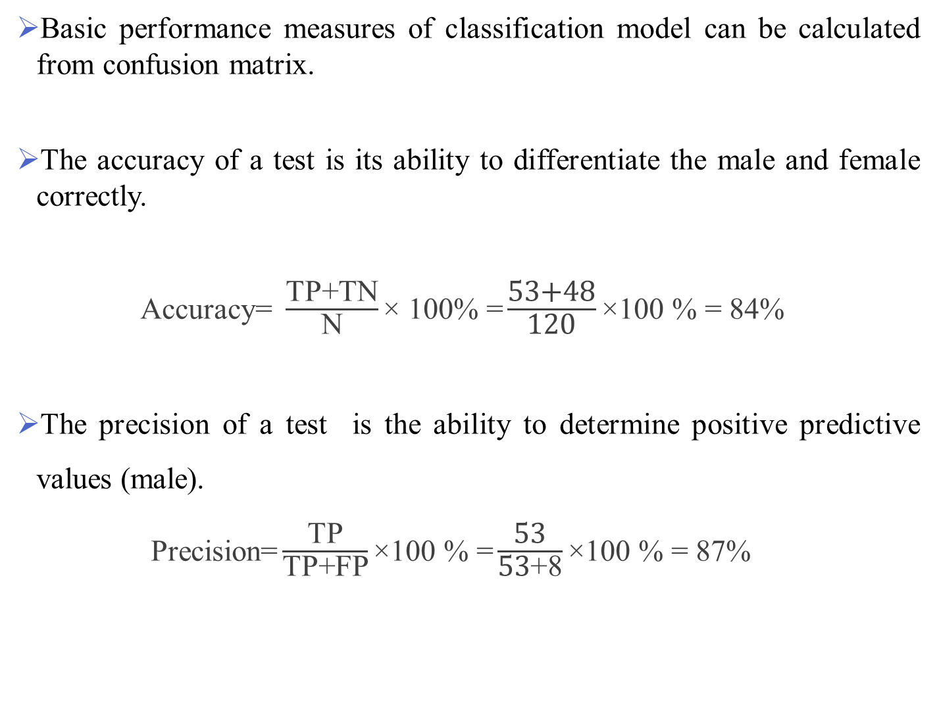
Experimental Results (Cont’d)
Basic performance measures of classification model can be calculated from confusion matrix.
The accuracy of a test is its ability to differentiate the male and female correctly.
$\text{Accuracy}\text{= }\frac{\text{TP}\text{+}\text{TN}}{\text{N}}\text{× 100\% =}\frac{\text{53+48}}{\text{12}\text{0}}\text{×100 \% = }\text{84}\text{\% }$
The precision of a test is the ability to determine positive predictive values (male).
Precision$\text{=}\frac{\text{TP}}{\text{TP}\text{+}\text{FP}}\text{×100 \% =}\frac{\text{53}}{\text{53}\text{+}\text{8}}\text{×100 \% = }\text{87}\text{\% }$

Slide 17
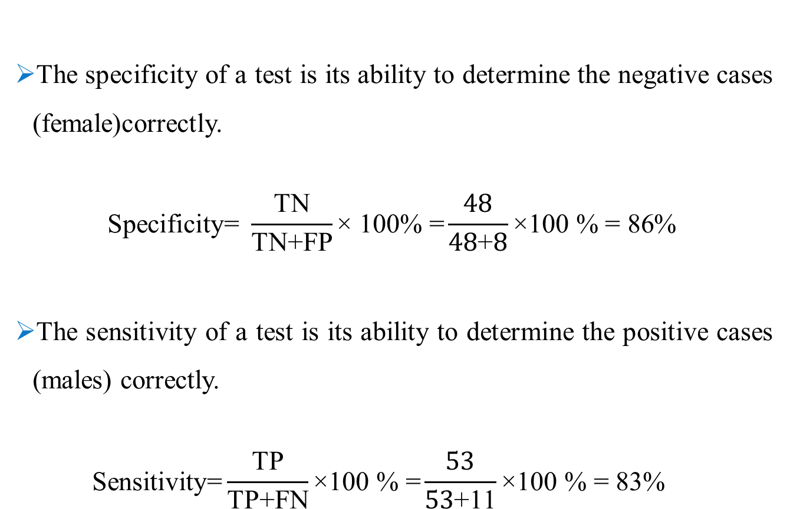
Experimental Results (Cont’d)
The specificity of a test is its ability to determine the negative cases (female)correctly.
$$\text{Specificity}\text{= }\frac{\text{TN}}{\text{TN}\text{+}\text{FP}}\text{× 100\% =}\frac{48}{\text{48}\text{+}8}\text{×100 \% = }\text{86}\text{\%}$$
The sensitivity of a test is its ability to determine the positive cases (males) correctly.
$$\text{Sensitivity}\text{=}\frac{\text{TP}}{\text{TP}\text{+}\text{FN}}\text{×100 \% =}\frac{\text{53}}{\text{53}\text{+}\text{11}}\text{×100 \% = }\text{83}\text{\% }$$

Slide 18
Conclusion
The gender classification system by using Random Forest (RF) classifier based on MFCC features is implemented by applying Python programming language and the experimental results has been analyzed.
There are many challenges in this system because of different speakers, speaking styles and sound pitches.
The analysis of the results shows that the performance of the proposed system is good, as the average accuracy achieved is 84% .
Therefore, it can be extended to the another researchers and can also be tested by using different features and other classification techniques.

Slide 19
References
Pravin Bhaskar Ramteke , Amulya A. Dixit , Sujata Supanekar , Nagraj V. Dharwadkar , and Shashidhar G. Koolagudi , “ Gender Identiﬁcation From Children’s Speech ”, Published in: Proceedings of 2018 Eleventh International Conference on Contemporary Computing (IC3), 2-4 August, 2018, Noida, India.
A Raahul, R Sapthagiri, K Pankaj and V Vijayarajan, “Voice based gender classification using machine learning” ,Published in: IOP Conf. Series: Materials Science and Engineering, 14th ICSET-2017.
https://machinelearningmastery.com/k-fold-cross-validation/

Slide 20
Thank you for your attention!!!

