Slide 1
YANGON TECHNOLOGICAL UNIVERSITY DEPARTMENT OF COMPUTER ENGINEERING AND INFORMATION TECHNOLOGY
Gender Classification with Deep Convolutional Neural Network
Presented By
Ma Khin Aye Chan
M.E CEIT -2
Supervised By
Dr. Su Su Maung
December 5, 2018

Slide 2
Outlines
Introduction
Related Works
Proposed System Overview
Research Methodology
Expected Outcomes
References

Slide 3
Introduction
Gender classification is to determine a person’s gender, e.g., male or female, based on his or her biometric cues.
There are a number of biometrics which may be used to classify gender such as the face, eyes, fingerprint and hand shape, etc.
Applications of face gender recognition range from human-computer interaction systems, content based image search, video surveillance and others.
Face gender classiﬁcation is a challenging problem since face images may vary in pose, lighting, expression and other factors.

Slide 4
Related Works
No. | Title | Methodology | Advantages | Disadvantages
1. | Gender Classification based on Fusion of Facial Components Features | Face detection by Viola Jones algorithm. Feature extraction by Local Binary Pattern . Dimensionality reduction by Principal Component Analysis (PCA) and Linear discriminant analysis (LDA). Classification by artificial neural network with back propagation. | Fusion improves classification rates more than single feature. | Feature extraction technique requires enhancement in forehead detection and cropping as hair is cropped out too. The mouth has the lowest individual accuracy rate, especially males having beards.

Slide 5
Related Works (cont.)
No. | Title | Methodology | Advantages | Future Work
2. | A Robust Approach for Gender Recognition using Deep Learning | Convolutional Neural Network - Convolution layers - Max pooling - Non linear function, ReLu, or rectified linear unit - Fully connected layer with softmax layer | Achieve a good amount of accuracy i.e. 98.5 percent on 2500 images. | Extend the use of CNNs to recognition of other biometric traits like fingerprint, iris, palm etc.

Slide 6
Proposed System Overview
Input Image
Face Detection
CNN
Feature Extraction/Classification
Male/ Female

Slide 7
Research Methodology
Convolutional Neural Network
a class of deep, feed-forward artificial neural networks in deep learning
most commonly applied to classification and recognition of images or digital signals
CNN can do feature learning, feature extraction and classification.

Slide 8
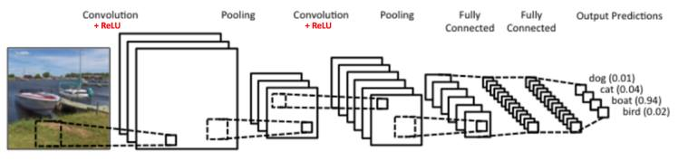
Figure.1
1. Convolution Layer
extract features from input image
input matrix is filtered with kernel ( convolution matrix)
kernel size may be 3×3,5×5,7×7, etc.
values in kernel are random, usually range 0 to 1 or -1 to 1

Slide 9
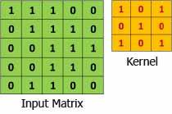
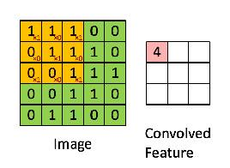
Figure.2
Figure.3
Stride: The number of pixels shifts over the input matrix
When the stride is 1, the filter is moved to 1 pixel at a time When the stride is 2, the filter is moved to 2 pixels at a time
Zero-padding : the process of symmetrically adding zeroes to the input matrix.
allows the size of the input matrix is adjusted to meet the required kernel size.

Slide 10
2. Rectified Linear Unit (ReLU)
non-linear operation
Negative numbers resulted from convolved matrix are replaced with zeros.
After convolution operation and ReLU, the output matrix is called feature map.
3. Pooling Layer
dimensional reduction to improve processing speed and remove unwanted noise features
max pooling, average pooling, summation pooling, etc.

Slide 11
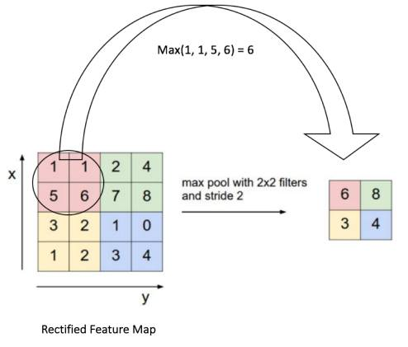
Figure.4
Stride and slide window size are the same.

Slide 12
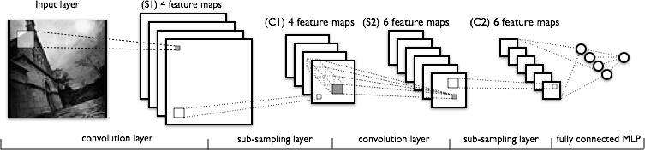
4. Fully Connected Layer (FC)
To make the same feature maps in fully connected layers with target vector size ( number of class labels)
Use non-linearity activation function, mostly use softmax function including Multi-layer Perceptron (MLP) classifiers
Figure. 5

Slide 13
Expected Outcomes
To get classification results at a high accuracy rate

Slide 14
References
Mayibongwe Bayana, Serestina Viriri , “Gender Classification based on Fusion of Facial Components Features ”, Published in: 2018 Conference on Information Communications Technology and Society (ICTAS)
Shefali Arora, M.P.S Bhatia , “A Robust Approach for Gender Recognition using Deep Learning ”, Published in: 2018 9th International Conference on Computing, Communication and Networking Technologies (ICCCNT).
https://blog.xrds.acm.org/2016/06/convolutional-neural-networks-cnns-illustrated-explanation/

Slide 15


